Slide 1
M3U8(1)
朝阳区线上课堂·高一年级英语
必修（三）Unit 8 Lesson3（1）
北京市和平街第一中学 陈倩冉

Slide 2
学习目标
能够通过阅读，获取 “白色单车”的事实性信息，如背景条件、发展过程以及影响；
能够口头介绍“白色单车” 的发展过程；
能够认识到绿色出行的意义和面临的挑战，认识到事物的发展必然会经历挫折，人们要直面问题、坚持不懈地努力。

Slide 3
学法指导
1.阅读时，关注事物的发展过程：起源、发展和结果；
2.能够使用可视化图表，梳理事物的发展过程。

Slide 4
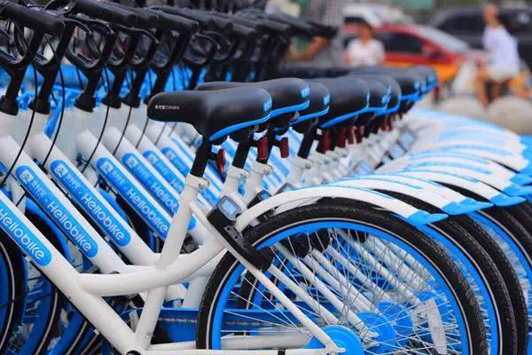
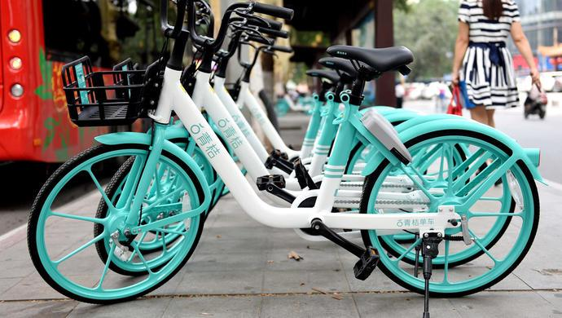
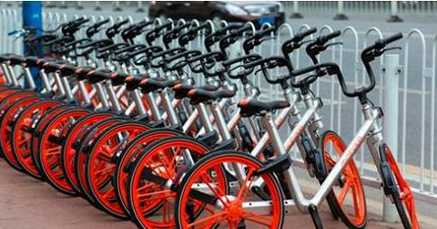
Shared bikes
Have you ever used shared bikes?
Why do you use shared bikes?
Advantages
Convenient
Saving energy
Reducing pollution
Providing public transport
Making “the last-mile distance” easy

Slide 5
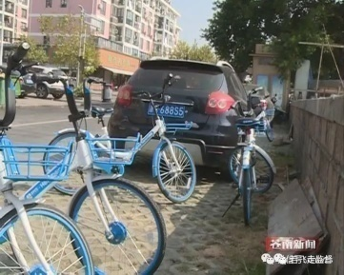
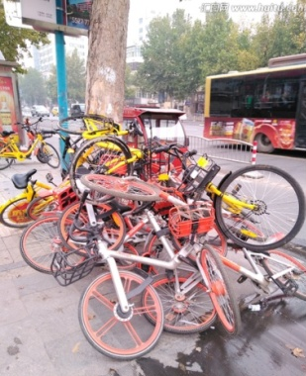
Shared bikes
Is there any disadvantage of shared bikes?
Disadvantages
Causing parking problems
Causing accidents on the road

Slide 6
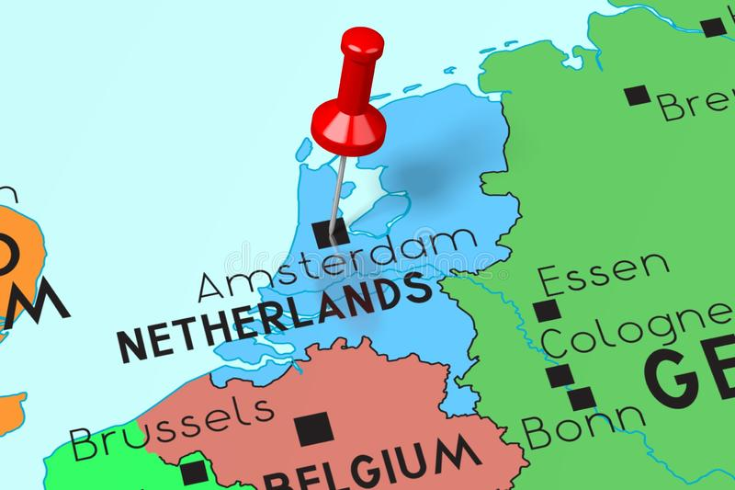
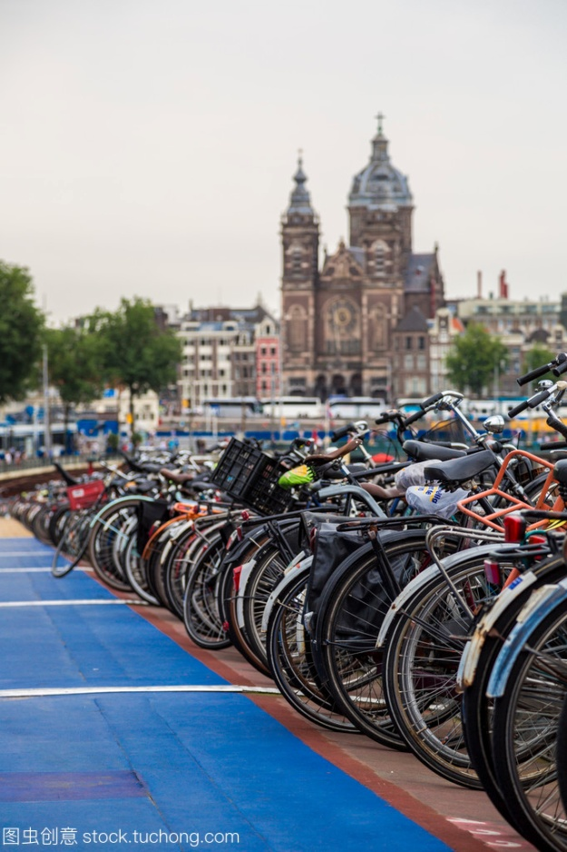
Do you know in which city the idea of the first shared bikes was born?
Amsterdam
“the City of Bicycles”.

Slide 7
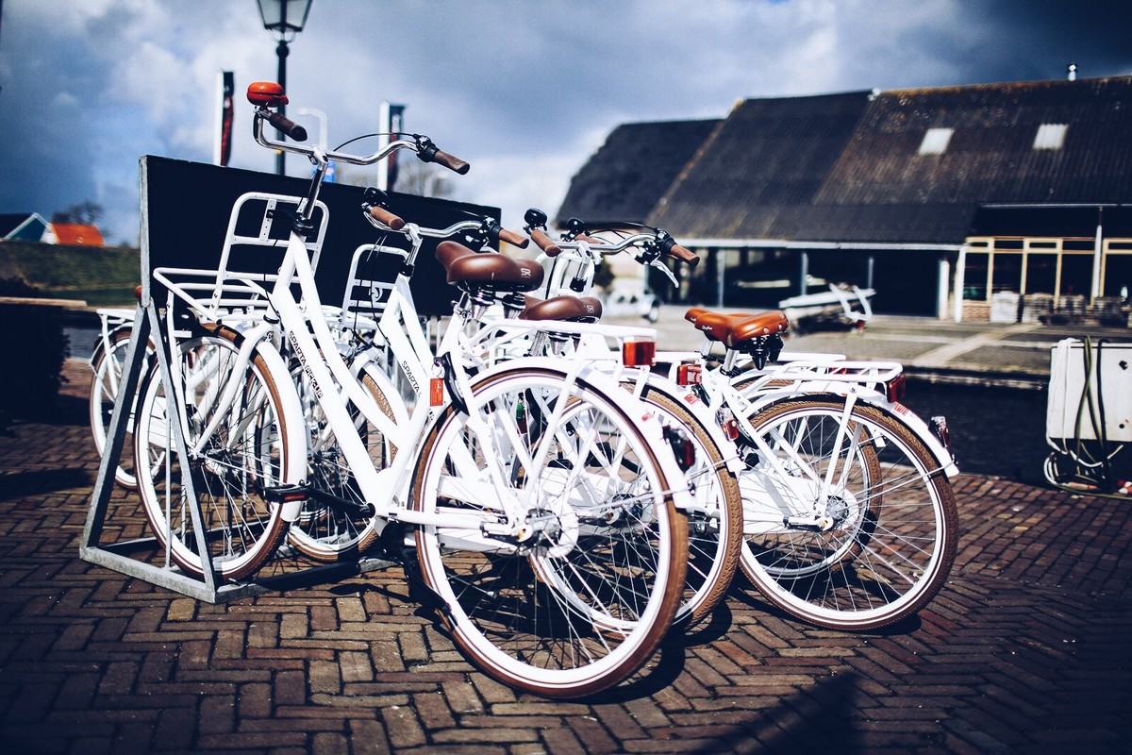
Lesson 3 White Bikes on the Road

Slide 8
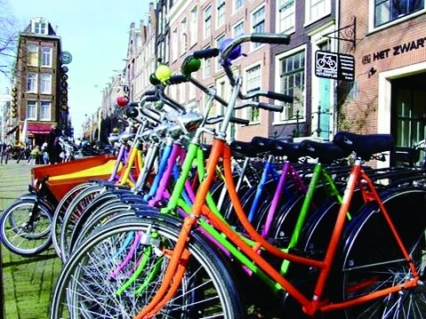
“White Bikes” on the Road
Reading
Amsterdam is called “the City of Bicycles”.
Why is Amsterdam a good city for cycling?
Read the first paragraph and take notes about the reasons.

Slide 9
Amsterdam
——“the City of Bicycles”
It is flat
38% of all trips are made by bike
…plenty of places for bicycle parking and ..bicycle paths in most streets

Slide 10
Skill builder
Understanding Development of events （P37）
The starting point
When and where the events developed
What problems developed and what the consequences

Slide 11
Development
Reading
Please read the rest of the passage to find out about the development of the “White Bikes”.
When did the idea of “white bikes” start?
In the 1960s
When did the “white bikes” return?
In 1999
What is the situation now?
(Para. 4,5,6) It’s successful in Amsterdam and has pedalled its way around the world.

Slide 12
Development
Reading
Start (in the 1960s)
1. Who put forward the idea and why? What did they do?
2. What happened to it soon after?
Return ( in 1999)
3. What is the difference between the “white bikes” and the 1960s and of the 1999?
Now
4. What effects have “white bikes” had on Amsterdam?
5. Why has the idea spread to other parts of the world in recent years?
6. What about the shared bikes in China?

Slide 13
Development
Reading
Start (in the 1960s)
1. Who put forward the idea and why? What did they do?
A group of cycling fans.
They want to help to save energy, reduce pollution and provide free public transport.
They painted hundreds of bicycles white and placed them in many areas around Amsterdam for people to use.
2. What happened to it soon after?
The white bikes all disappeared—thieves stolen them all in a matter of weeks.
Para.2

Slide 14
Development
Reading
Return ( in 1999)
3. What is the difference between the “white bikes” of the 1960s and of the 1999?
The “white bikes” of the 1960s were painted white while the bikes of 1999 were painted in bright colors.
The bikes of 1999 had a computer tracking system to record their every move.
To use a bike in 1960s, you just took them, used them and left them in the place where you finished your journey. To use a bike of 1999, you had to put in a special card and parked them at special parking places near your destination and left them there.
Para.3

Slide 15
Development
Reading
Now
4. What effects have “white bikes” had on Amsterdam?
People can now enjoy clean air and easy transport in central Amsterdam.
5. What effects have “white bikes” had on the world?
The idea of “white bikes” has pedalled its way around the world and there has been a global increase in bike-sharing.
(The idea has spread to other parts of the world.)
6. What about the shared bikes in China?
More and more cities in China have shared bikes. There are problems but people are trying to solve them.
Para.4,5,6

Slide 16
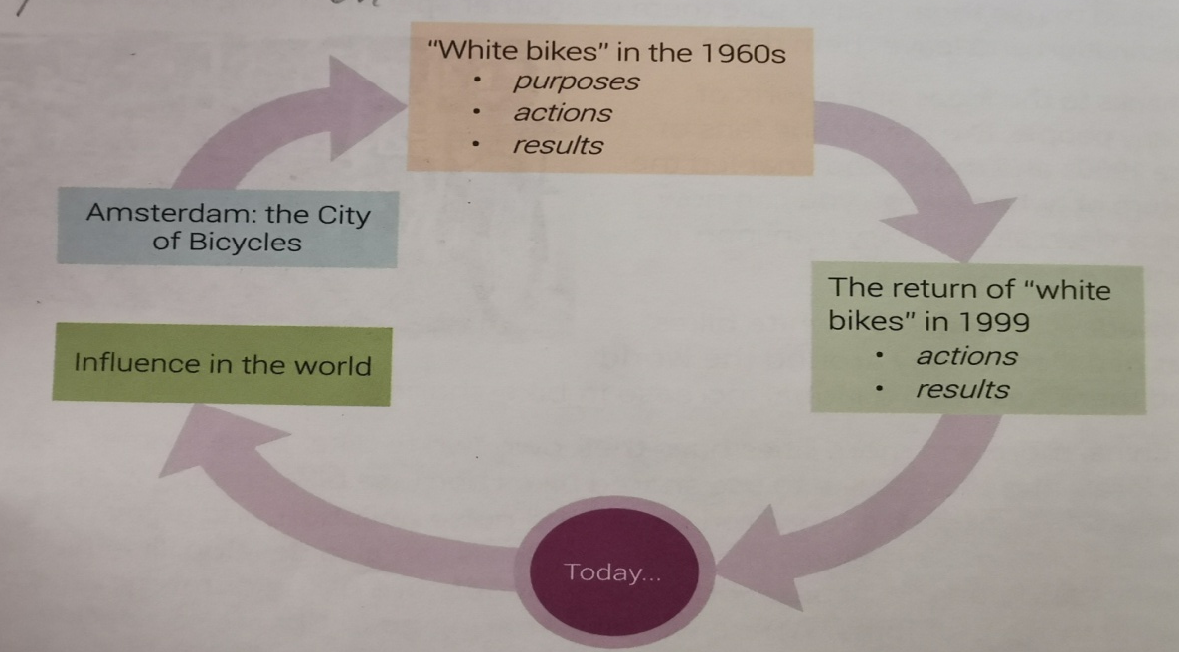
Suppose you are giving a presentation about “white bikes” in Amsterdam to the audience . Please try to introduce it with the help of the flow chart. (P38)
Oral Presentation

Slide 17
Voice your opinion
What does the title “ ‘White Bikes’ on the Road” mean?
“White bikes” on the road refers to “white bikes” being used to ride around the streets of a city.
Apart from the literal meaning, the title can also mean that the effort to implement “White bikes” projects takes time and it’s still on the way. There’re still aspects that need to be improved.

Slide 18
Voice your opinion
2. From the development of bike-sharing in Amsterdam and in China, what can you learn?
There will always be difficulties in the road. What we need to do is to face them and try our best to fix them. Never give up and we will make it.

Slide 19
Homework
Choose one.
1. Make a survey on shared-bikes in China. And draw a flow chart of its development.
2. Make a survey on carpooling in China. You can draw a flow chart of its development.

Slide 20
谢谢您的观看
北京市朝阳区教育研究中心 制作

