Slide 1
M3U8(1)
朝阳区线上课堂·高一年级英语
必修（三）Unit 8 Writing Workshop
A Survey Report（1）
北京市和平街第一中学 胡月秋

Slide 2
Learning Objectives:
To read and understand a survey report
To identify the main idea of each paragraph and label it correctly
To read and understand graphs

Slide 3
Unit 8 Green Living
Writing Workshop
- A Survey Report
environmental protection

Slide 4
1. Get ready for writing
What should be included in a survey report
on environmental protection?

Slide 5
Factors

Slide 6
Factors
when/where/who
facts/data
purpose
problems
solution/suggestions

Slide 7
1. Get ready for writing
A clear purpose
Proper quantity expressions
Proper graphs
A good conclusion
A logical organization

Slide 8
A Survey Report
Actions Taken by City Residents to Help
Protect the Environment

Slide 9
2. Read for Idea
Read the survey and answer the questions.
1) Who conducted the survey?
2) When and where was the survey conducted?
3) How many people took part in the survey?
4) What’s the purpose of the survey?
5) What questions are asked?
6) What are the findings?
Notes:
电压表是测量电压的仪表，又称伏特表。其外形见图，指针在标尺左端置零。标尺上有两种刻度，分别是0~3 V，0~15 V。调零器在读数窗正下方，使用电压表测量前应先调零。
接线柱分别标有“—”、“3”、“15”标记，其中“—”接线柱为公共端。 3和15是正接线柱，测量时选择其一。

Slide 10
2. Read for Idea
Read the survey and answer the questions
Who conducted the survey?
City officials
2) When and where was the survey conducted?
Last August at Summer Fun Festival
Notes:
电压表是测量电压的仪表，又称伏特表。其外形见图，指针在标尺左端置零。标尺上有两种刻度，分别是0~3 V，0~15 V。调零器在读数窗正下方，使用电压表测量前应先调零。
接线柱分别标有“—”、“3”、“15”标记，其中“—”接线柱为公共端。 3和15是正接线柱，测量时选择其一。

Slide 11
2. Read for Idea
Read the survey and answer the questions
3) How many people took part in the survey?
About 500 residents
(496 city residents, 15 years of age and older)
4) What’s the purpose of the survey?
To find out people’s attitudes to protecting the environment and what actions they had taken.
Notes:
电压表是测量电压的仪表，又称伏特表。其外形见图，指针在标尺左端置零。标尺上有两种刻度，分别是0~3 V，0~15 V。调零器在读数窗正下方，使用电压表测量前应先调零。
接线柱分别标有“—”、“3”、“15”标记，其中“—”接线柱为公共端。 3和15是正接线柱，测量时选择其一。

Slide 12
2. Read for Idea
Read the survey and answer the questions
5) What questions are asked?
Is it necessary to help protect the environment?
What activities have you done?
Notes:
此处设计意图为获取文本信息和文本特点。

Slide 13
2. Read for Idea
Read the survey and answer the questions
6) What are the findings?
As the pie graph shows, ……
From the bar chart, we can see……
Notes:
电压表是测量电压的仪表，又称伏特表。其外形见图，指针在标尺左端置零。标尺上有两种刻度，分别是0~3 V，0~15 V。调零器在读数窗正下方，使用电压表测量前应先调零。
接线柱分别标有“—”、“3”、“15”标记，其中“—”接线柱为公共端。 3和15是正接线柱，测量时选择其一。

Slide 14
3. Read for Structure
Read the survey again and label each paragraph of the report with different headings.
( )
Introduction
( )
Conclusion
1
4
( )
Negative findings
( )
Positive findings
3
2
Notes:
电压表是测量电压的仪表，又称伏特表。其外形见图，指针在标尺左端置零。标尺上有两种刻度，分别是0~3 V，0~15 V。调零器在读数窗正下方，使用电压表测量前应先调零。
接线柱分别标有“—”、“3”、“15”标记，其中“—”接线柱为公共端。 3和15是正接线柱，测量时选择其一。

Slide 15
3. Read for Structure
Finish the following chart
Topics | Details
introduction
positive findings
negative findings
conclusion
Notes:
电压表是测量电压的仪表，又称伏特表。其外形见图，指针在标尺左端置零。标尺上有两种刻度，分别是0~3 V，0~15 V。调零器在读数窗正下方，使用电压表测量前应先调零。
接线柱分别标有“—”、“3”、“15”标记，其中“—”接线柱为公共端。 3和15是正接线柱，测量时选择其一。

Slide 16
3. Read for Structure
Finish the following chart
Topics | Details
introduction | purpose, when, who, where…
positive findings | examples, figures, percentage
negative findings | examples, figures, percentage
conclusion | summary, suggestions
Notes:
电压表是测量电压的仪表，又称伏特表。其外形见图，指针在标尺左端置零。标尺上有两种刻度，分别是0~3 V，0~15 V。调零器在读数窗正下方，使用电压表测量前应先调零。
接线柱分别标有“—”、“3”、“15”标记，其中“—”接线柱为公共端。 3和15是正接线柱，测量时选择其一。

Slide 17
4. Read for Language
Read the survey and finish Ex. 4 on page 41. Underline the quantity expressions in the survey report
Notes:
电压表是测量电压的仪表，又称伏特表。其外形见图，指针在标尺左端置零。标尺上有两种刻度，分别是0~3 V，0~15 V。调零器在读数窗正下方，使用电压表测量前应先调零。
接线柱分别标有“—”、“3”、“15”标记，其中“—”接线柱为公共端。 3和15是正接线柱，测量时选择其一。

Slide 18
4. Read for Language
Read the survey and finish Ex. 4 on page 41. Underline the quantity expressions in the survey report
Sentence Builder:
Quantity Expressions
as high as / almost all
about / around
most of / more than / the majority of
just under / just over
not as many / very few
Notes:
电压表是测量电压的仪表，又称伏特表。其外形见图，指针在标尺左端置零。标尺上有两种刻度，分别是0~3 V，0~15 V。调零器在读数窗正下方，使用电压表测量前应先调零。
接线柱分别标有“—”、“3”、“15”标记，其中“—”接线柱为公共端。 3和15是正接线柱，测量时选择其一。

Slide 19
4. Read for Language
Think and Answer
1.Why does the author use quantity expressions?
Notes:
电压表是测量电压的仪表，又称伏特表。其外形见图，指针在标尺左端置零。标尺上有两种刻度，分别是0~3 V，0~15 V。调零器在读数窗正下方，使用电压表测量前应先调零。
接线柱分别标有“—”、“3”、“15”标记，其中“—”接线柱为公共端。 3和15是正接线柱，测量时选择其一。

Slide 20
4. Read for Language
Think and Answer
1.Why does the author use quantity expressions?
precise persusive objective
2.Please give more quantity expressions.
Notes:
电压表是测量电压的仪表，又称伏特表。其外形见图，指针在标尺左端置零。标尺上有两种刻度，分别是0~3 V，0~15 V。调零器在读数窗正下方，使用电压表测量前应先调零。
接线柱分别标有“—”、“3”、“15”标记，其中“—”接线柱为公共端。 3和15是正接线柱，测量时选择其一。

Slide 21
survey report
factors
when/where/who
facts/data
purpose
problems
solution/suggestions
structure
introduction
positive findings
negative findings
conclusion
language
quantity expressions

Slide 22
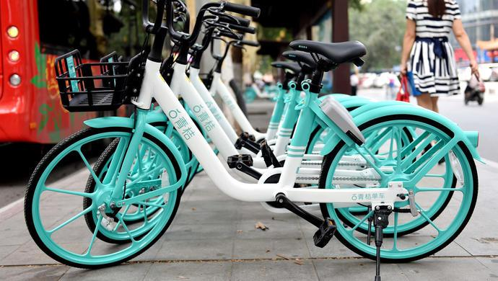
Homework
Make a survey on shared-bikes in China.
Have you ever used shared bikes?
Why do you use shared bikes?
Is there any disadvantage of shared bikes?

Slide 23
谢谢您的观看
北京市朝阳区教育研究中心 制作

