Slide 1
M3U8(1)
朝阳区线上课堂·高一年级英语
必修（三）Unit 8 Writing Workshop
A Survey Report（2）
北京市和平街第一中学 胡月秋

Slide 2
Learning Objectives:
To use expressions relating to quantity
To write a survey report
To conduct peer assessment

Slide 3
survey report
factors
when/where/who
facts/data
purpose
problems
solution/suggestions
structure
introduction
positive findings
negative findings
conclusion
language
quantity expressions

Slide 4
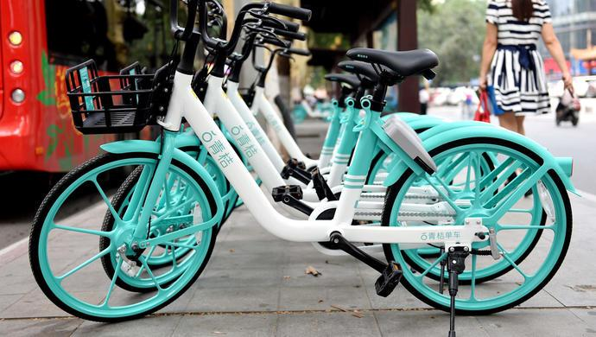
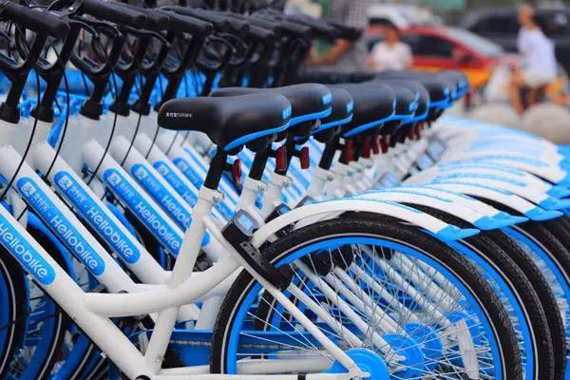
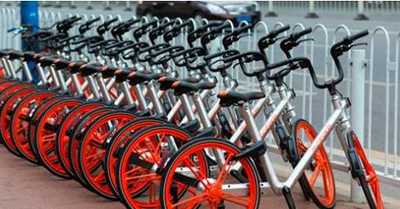
Describe Graphs
Do you use shared bikes?
Notes:
教师要关注追问。 How often do you use shared

Slide 5
Describe Graphs
Describe graphs based on Activities 3 and 4, and the data below. Please use proper quantity expressions.
Notes:
电压表是测量电压的仪表，又称伏特表。其外形见图，指针在标尺左端置零。标尺上有两种刻度，分别是0~3 V，0~15 V。调零器在读数窗正下方，使用电压表测量前应先调零。
接线柱分别标有“—”、“3”、“15”标记，其中“—”接线柱为公共端。 3和15是正接线柱，测量时选择其一。

Slide 6
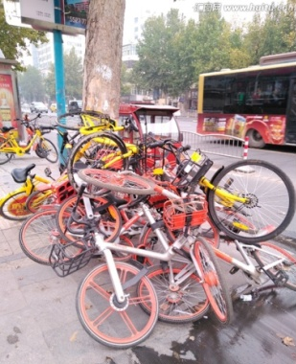
compose your writing
A Survey Report on Shared Bikes
Last week, on campus,
200 senior students, ……
Notes:
教师要关注追问。

Slide 7
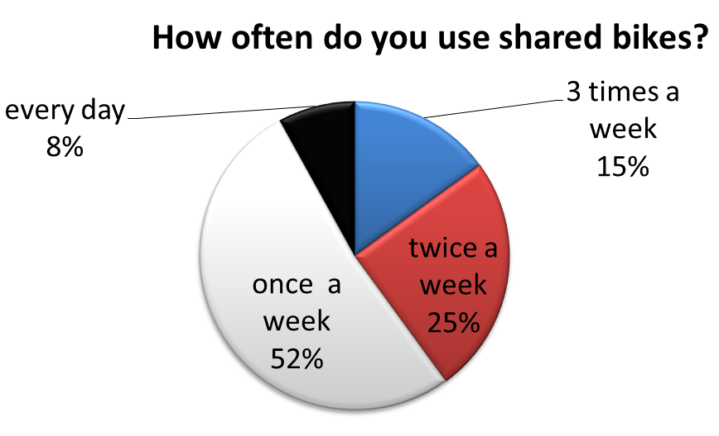
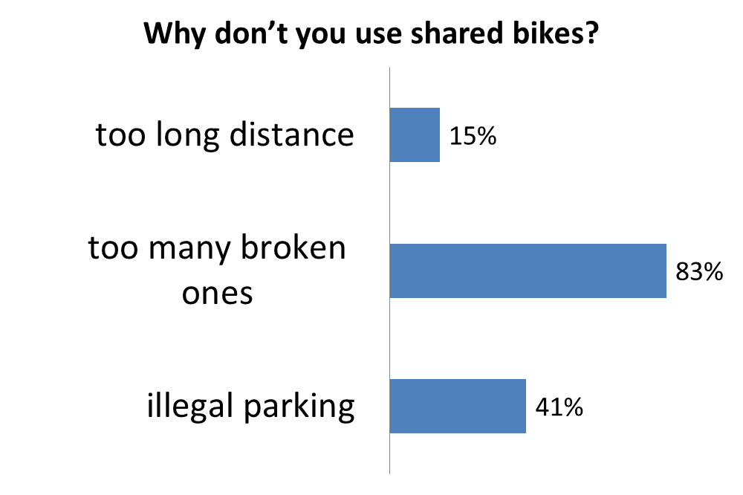
Writing：two more graphs
Notes:
教师要关注追问。

Slide 8
Write a survey report based on the data below.
Notes:
电压表是测量电压的仪表，又称伏特表。其外形见图，指针在标尺左端置零。标尺上有两种刻度，分别是0~3 V，0~15 V。调零器在读数窗正下方，使用电压表测量前应先调零。
接线柱分别标有“—”、“3”、“15”标记，其中“—”接线柱为公共端。 3和15是正接线柱，测量时选择其一。

Slide 9
Notes:
个人活动，

Slide 10
survey report
factors
when/where/who
facts/data
purpose
problems
solution/suggestions
structure
introduction
positive findings
negative findings
conclusion
language
quantity expressions

Slide 11
Write a survey report based on the data below.
Notes:
电压表是测量电压的仪表，又称伏特表。其外形见图，指针在标尺左端置零。标尺上有两种刻度，分别是0~3 V，0~15 V。调零器在读数窗正下方，使用电压表测量前应先调零。
接线柱分别标有“—”、“3”、“15”标记，其中“—”接线柱为公共端。 3和15是正接线柱，测量时选择其一。

Slide 12
Evaluation
A clear purpose
Proper quantity expressions
Proper graphs
A good conclusion
A logical organization

Slide 13
student’s version
A survey report on shared bikes
Last month,200 students on campus were interviewed to figure out people’s attitude on shared bikes and the reasons for like or dislike shared bikes.The followings are the results.
As you can see from the first pie diagram,more than two thirds of those who took part in the survey said they use shared bikes. Simultaneously,more than half of them can keep the usage of the shared bike once a week.Among the four reasons listed for the like of the shared bikes,as high as 96% of the participants used shared bikes because of its convenience.However, not as many used shared bikes because it can reduce pollution.
Meanwhile,we can tell from the second pie chart that very few people use shared bikes every day.And there is still 30% of people who don’t use shared bikes.The two main reasons for not using shared bikes showed on the diagram are too many broken ones(83%) and not safe(71%) respectively.
In conclusion,It seems that shared bikes are already very popular among people.Most of the people gained advantages from its convenience and cheapness.However， along with its rapid development， bicycle-sharing system also brings some problems， including random parking，vandalism etc.The public should raise their awareness of using shared bike reasonably.

Slide 14
Evaluation
A clear purpose
Proper quantity expressions
Proper graphs
A good conclusion
A logical organization

Slide 15
Homework
Polish your survey report on shared bikes.
Notes:
教师要关注追问。

Slide 16
谢谢您的观看
北京市朝阳区教育研究中心 制作

