Slide 1
朝阳区线上课堂·高一年级英语
必修三 Unit8“绿色生活” Lesson2 Greening the Desert (1)
北京市和平街第一中学 王丽君

Slide 2
Learning objectives
1. 根据图片预测演讲的内容;
2. 借助笔记,获取易解放种树的事实性信息(如种树的起因、遇到的困难和解决方式等）；
3. 理解易解放为环境保护做出的贡献,思考生命的意义。

Slide 3
Guidance on learning
在听的过程中，不仅要听关键词获取关于人物故事的细节性信息，还要注意听表示时间和逻辑的词汇，掌握大意，从而更好地了解人物身上发生的故事；学习如何快速做笔记，理清结构，能够依据所记内容进行转述。

Slide 4
desert 沙漠
desertification沙漠化

Slide 5
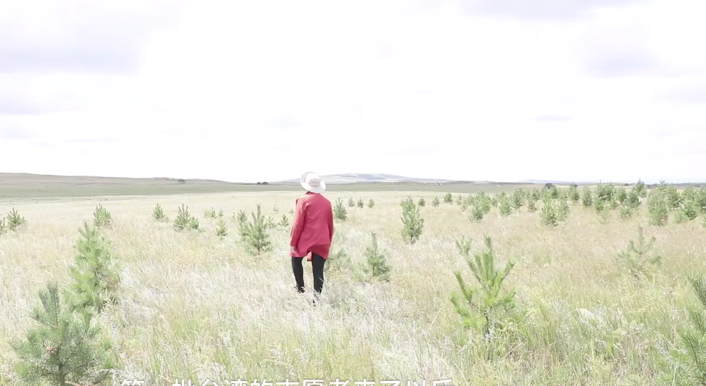
Lesson 2
Greening the desert

Slide 6
Greeting the desert(1)
What is the event about?
a public speaking event on environmental protection
What do you think the presenter is going to talk about?
Yi Jiefang and a non-profit organization
What does NPO stand for?
non-profit organization

Slide 7
Match words with their definitions

Slide 8
Listen to part 1 and summarize the general idea.
What terrible thing happened to Yi Jiefang?
How did she feel?
Why did she create NPO-Greenlife?
Because of her son’s death, she felt so sad that life seemed meaningless to her, but she decided to make her son’s dream , planting trees in northern China, come true and created NPO-Greenlife.

Slide 9
2. Listen to part 2 and summarize the general idea.
What were the early days like for Green-life?
How did it end?
The early days of NPO-Greenlife were not easy. But the difficulty didn’t prevent her and now the trees have a survival rate of 85%.

Slide 10
Listen to part 2 again, take notes and retell
Discourse markers | Details
The early days | Yi Jiefang went to____________________________________ Yi Jiefang proposed the local government to ____________________________
However | The first trees____________________________
Although | There seemed _______________________________________
Now | The trees_____________________________________

Slide 11
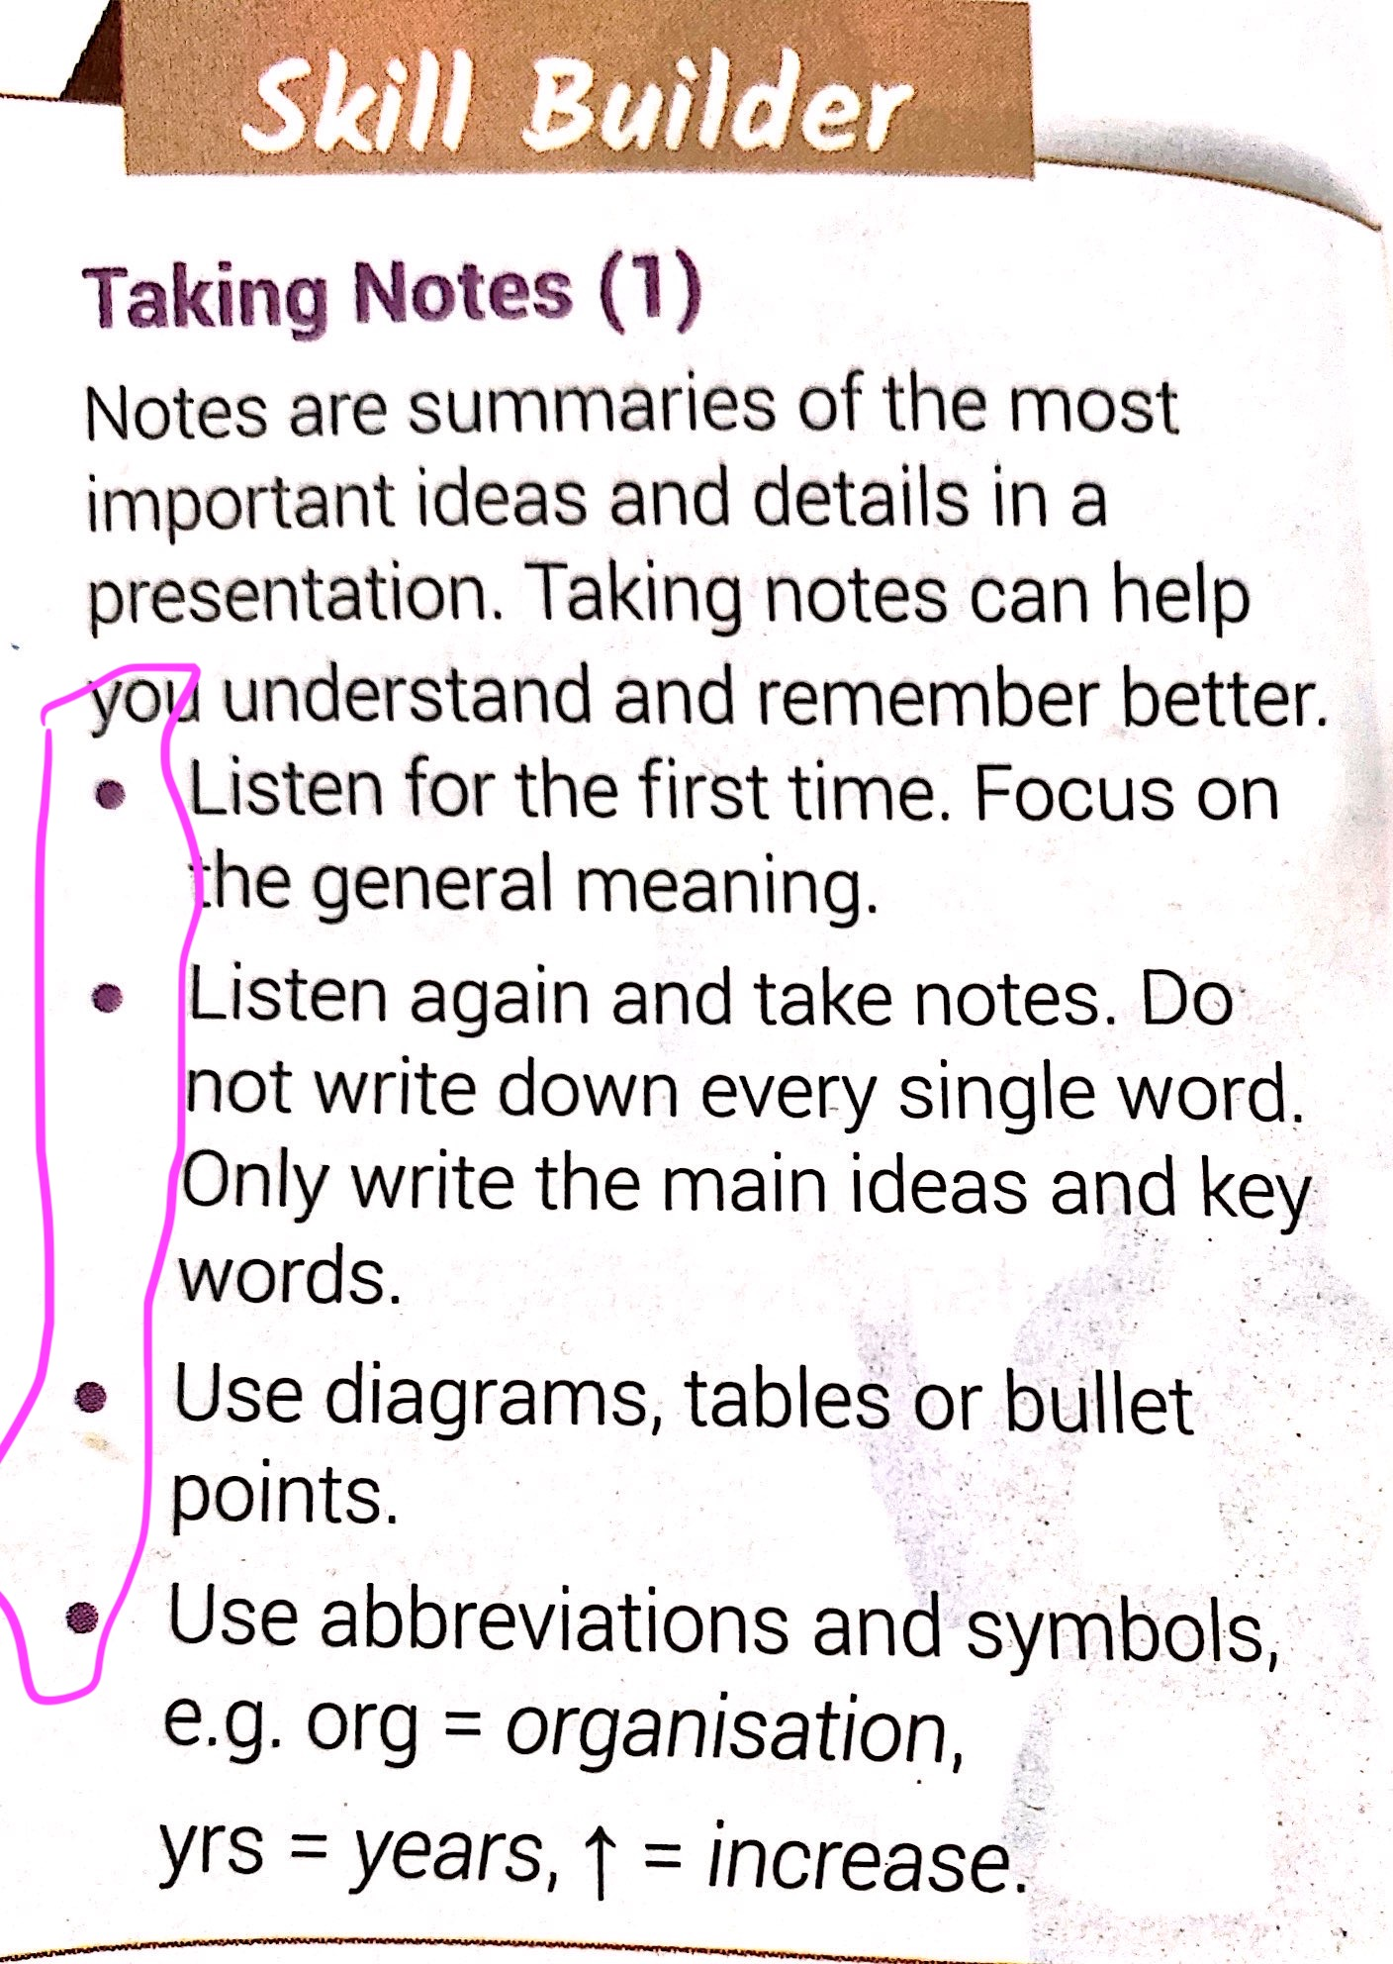
Note-taking skills
Skill Builder
Discourse markers
help us get the structure
The early days, however, although, now
Notes
help with understanding and retelling
Only write down key words（Do not …every single word ):
Use diagrams, table or bullet points
Abbreviations and symbols:
eg. org=organization
yrs=years
=increase
%=percent

Slide 12
Listen to part 2 again, take notes and retell
Discourse markers | Details
The early days | Yi Jiefang went to____________________________________ Yi Jiefang proposed the local government to ____________________________
However | The first trees____________________________
Although | There seemed _______________________________________
Now | The trees_____________________________________
the desert of IM and saw vast areas of dry land with little agriculture.
plant one million trees over ten years
were blown away due to little experience
a slim chance for the trees to survive, but they did’t give up
have a survival rate of 85%

Slide 13
Listen to part 3 and complete the quotes written on the headstone of Yi Jiefang’s son. Then read the quotes aloud.
“You are _______. ________ or _______, you served a purpose. ___________, you stood proud against winds and sandstorms; _________, your brightness gave ______________ to others.”
“Let life prosper _____________; let _______________ last forever _____________.”
a tree
alive
fallen
alive
fallen
light and warmth
in greenness
greenness
in life
Explain the meaning of the quotes in your own words.
What inspiration do the quotes have for us?

Slide 14
Listen to part 3 and complete the quotes written on the headstone of Yi Jiefang’s son. Then read the quotes aloud.
A possible version
It tells us to live a meaningful life, breaking through the ego ,overcoming personal gains and losses and struggling for the well-being of all mankind. Besides, we should have a harmonious relationship with nature and self.

Slide 15
谢谢您的观看
北京市朝阳区教育研究中心 制作

