Slide 1
必修三 Unit8“绿色生活” Lesson1 Roots & Shoots (2)
朝阳区线上课堂·高一年级英语
北京市和平街第一中学 陶曲萍

Slide 2
【学习目标】
1. 用主题汇报的形式介绍“根与芽”组织；
2. 梳理说明文的文本结构，找出并赏析说明文的写作特点和语言特点。
3. 能够运用所学语言进行模拟演讲，号召为了环境保护每个人都行动起来。
Notes:
学习目标：希望大家通过本节课的学习，能够。。。。

Slide 3
【学法指导】
通过更深入了解文章写作技巧，有助于理解人与自然的主题意义。
结合上下文，运用自身知识储备和逻辑推理，学会运用本文写作技巧模拟演讲。

Slide 4
Lesson 1 Roots & Shoots (2)

Slide 5
Recall and practice
Make a presentation introducing Roots & Shoots.
When and why it was established
The meaning of its name
The contribution it makes to society
…

Slide 6
Read and Explore
Scan the text. Focus on the techniques the writer used.
What techniques did the writer use to make her view logical and convincing?
quotations, examples, colloquial style, repetitions
Ordinary language used by common people in everyday life which can convey the writer’s message more clearly.

Slide 7
Read and Explore
Every individual matters. Every individual has a role to play. Every individual makes a difference.(Para.4)
Quotations:
It is by acting together, in this exciting way, that we can involve thousands—millions—of people, and this is what is going to change the world.

Slide 8
Read and Explore
Examples
…say you leave the tap running while you brush your teeth, leave a light burning when you go out or you drop a piece of litter and can’t be bothered to pick it up. (Para.1)

Slide 9
Read and Explore
Colloquial style
You know that all those things are wrong, but so what? (Para.1)
You get to choose: do you want to use your life to make the world a better place for people, animals and the environment? (Para.4)

Slide 10
Read and Explore
Repetitions
…How can it matter if I leave one little tap running, one little light on, or a little piece of litter on the road? (Para.1)
…Millions of gallons of water would be wasted; millions of lights would be left on; millions of pieces of litter would be dropped. (Para.1)
…
parallel structures

Slide 11
Read and Explore
The writer uses the parallel structures to create a strong effect on readers so that they understand the writer’s point better and reflect on their own behavior deeply as well.
The text uses many parallel structures with the same pattern of words and sentences. Does it help your understanding of the text if key phrases are repeated? How do you feel reading repeated words/phrases?
Para.1:
How can it matter if I leave one little tap running,
one little…
Para.1:
Millions of gallons of water would be wasted; millions of…
Para4:
Do you think you help to make the world a better place when you make a sad person smile, when you make…
Para4:
One cheered-up person, one happy dog, one flowering plant, and you.
Para4:
Every individual matters. Every individual has
a role to play. Every individual…
Para4:
Do you want to use your life to make the world a better place? Do you want to make…

Slide 12
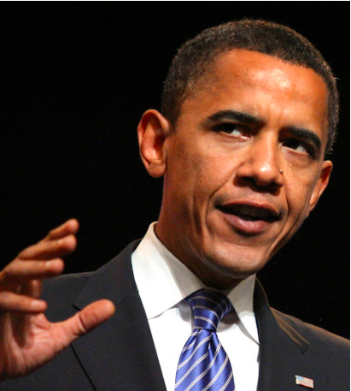
Former U.S. president Obama used a lot of writing techniques， especially parallel structures in his speech to create a strong effect on listeners, conveying his point more clearly and more effectively. More importantly, hearing the speech, the students would reflect on their own behaviors deeply and collect courage and passion to take action.
Examples
Colloquial style
Repetitions
Speech 1
Speech 2

Slide 13
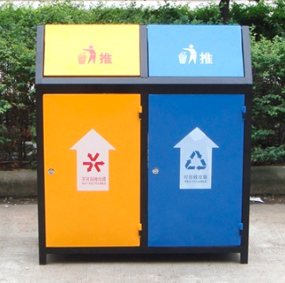
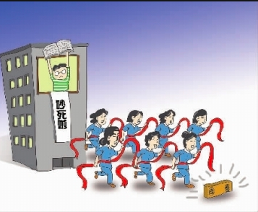
Project
How can you help out your community?
From the perspective of a community of a shared future, do you want to make your community better? Please write a short speech, using at least one of the techniques above, to persuade the neighbors into actions.

Slide 14
Square dance: Let the good be good
Possible version
As a convenient, cheap and healthy way of exercise for older citizens, even for all citizens from young to old, square dance has been spreading wildly in recent years. It’s so convenient that people need no professional equipment or special places. You just come and dance.
But is square dance always popular and loved by all? I’m afraid not.
When the young want to sleep late on weekend morning, they will be woken up by the thunderous sound of square dancing. When the students want to read on weekday night, they will be forced to wish that they were deaf because of the deafening sound of square dancing.
So how can this convenient and healthy way of exercise be hated?
I believe the unlimited volume of music, the unlimited time of dancing, and the unlimited places to choose are the reasons.
They turn up the volume to deafening level; they dance from weekday evening to weekend morning; they dance in the places just near the apartment buildings.
Please, please dance in a suitable volume that will not hurt the ears, in the right time that is not when people need a quiet environment and in the proper places that are away from the apartment buildings.
Please, square dancers. Let’s make our community a better and more peaceful place.
Let the good be good.

Slide 15
Homework
Complete and polish your speech to persuade neighbors into actions.

Slide 16
谢谢您的观看
北京市朝阳区教育研究中心 制作

