Slide 1
必修三 Unit8“绿色生活” Lesson1 Roots & Shoots (1)
朝阳区线上课堂·高一年级英语
北京市和平街第一中学 陶曲萍

Slide 2
Lesson 1 Roots & Shoots (1)

Slide 3
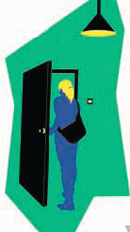
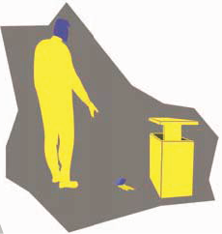
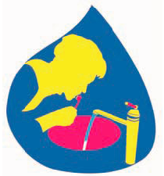
Activate and share:
Leave the tap running while you brush your teeth.
Leave a light on when you go out.
Drop a piece of litter and can’t be bothered to pick it up.

Slide 4
Activity 1
Read paragraph 1 and answer the questions below:
What is “Just-me-ism”?
Why is it a problem?
Any suggestions for solving the problem?
1.“Just-me-ism” is a way of thinking that focuses on caring just oneself and ignores the environment, animals and the community.
2.There will be nobody to care and look after the environment.

Slide 5
Activity 1
Read paragraph 1 and answer the questions below:
3. Any suggestions for solving the problem?
3. A solution would be to make them understand that even the smallest action can change the world, so they should take actions whenever possible for the environment, animals and their community. For example, they should turn the tap off when brushing their teeth, turn the light off when they leave a room and pick up even little pieces of litter they dropped on the road.

Slide 6
Activity 2
Read the rest of the text and complete the table about Roots & Shoots.
Roots & Shoots | The time of its establishment
 | The founder
 | The purpose
 | The meaning of its name

Slide 7
Activity 2
Read the rest of the text and complete the table.
Roots & Shoots | The time of its establishment
 | The founder
 | The purpose
The early 1990s
Dr. Jane Goodall
To educate young people, from pre-schoolers to university students, so they can help to build a future that is secure and live together in peace with nature.

Slide 8
Activity 2
Read and complete the table.
Roots & Shoots | The meaning of its name
Roots move slowly under the ground to make a firm foundation and shoots seem small and weak, but they can break open brick walls to reach the light.

Slide 9
Activity 3
Read the text again and answer the questions below:
What contribution does Roots & Shoots make to society?
What makes Dr. Jane Goodall think Roots & Shoots can help solve the problem of “Just-me-ism”?
What is your explanation for the two quotes from
Dr. Jane Goodall?

Slide 10
Activity 3
Read the text again and answer the questions below:
What contribution does Roots & Shoots make to society?
What makes Dr. Jane Goodall think Roots & Shoots can help solve the problem of “Just-me-ism”?
It inspires young people to build a future that is secure and to live together in peace with nature.
It is the belief that every individual matters. It encourages individuals to play a part in making the world a better place instead of just thinking about themselves.

Slide 11
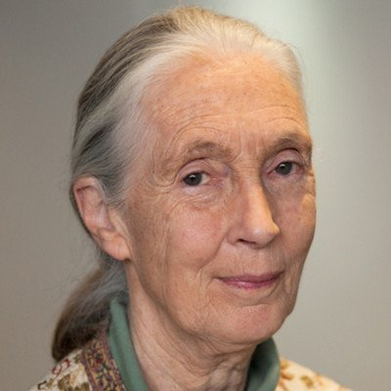
Activity 3
Every individual matters. Every individual has a role to play. Every individual makes a difference.(Para.4)
3. What is your explanation for the two quotes from Dr. Jane Goodall?
It is by acting together, in this exciting way, that we can involve thousands—millions—of people, and this is what is going to change the world.

Slide 12
Activity 3
3. What is your explanation for the two quotes from Dr. Jane Goodall?
Dr. Jane Goodall’s quotes mean that changing the role is an individual act, because there are millions of people who can make a difference if they all act on their own.
Why does the author use the two quotes in paragraph 4?

Slide 13
Purpose of each paragraph:
Roots & Shoots
Just-me-ism and its effect
Can you suggest another title for the text?
Roots & Shoots and its purpose
Make a Difference
Turn the Light Off
Education Saves the Environment
Every individual matters
…
Meaning of its name
Appealing

Slide 14
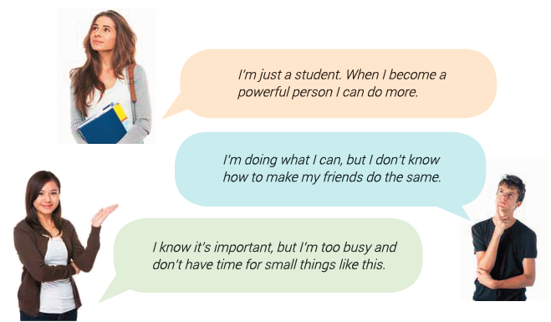
Express Yourself
Activity 4
You are a volunteer of Roots & Shoots. Use what you have learnt to persuade one of the following people.

Slide 15
Express Yourself
Activity 4
Possible version:
Students are just like shoots, which seem small and weak, but they can break open brick walls to reach light. Hundreds of thousands of shoots can solve the problem, change the world and make it a better place to live in. So trust yourself, take action now and influence people around you. Every individual matters. You will make a big difference.

Slide 16
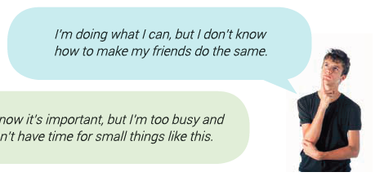
Express Yourself
Activity 4
Possible version:
It’s wonderful that you are doing what you can and are willing to make your friends do the same. Why not share with your friends what you are doing and ask them to join you? You can make a big difference, starting from your friends, to your neighborhood, and to our shared planet. Just as what Dr. Jane Goodall said, ”It is by acting together, in this exciting way, that we can involve thousands-millions-of people, and this is what is going to change the world.”

Slide 17
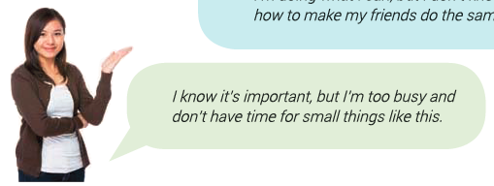
Express Yourself
Activity 4
Possible version:
Yes, it is a small thing with one little tap running, one little light on or a little piece of litter on the road. But there are thousands of millions of students like you and me on this planet. If we just leave the small things alone, then millions of gallons of water would be wasted; millions of lights would be left on; millions of pieces of litter would be dropped, which would be very harmful. So there are no small things. We need to spare some time and take action right now. Let’s just start from you and me.

Slide 18
Homework:
1. Suppose ou are invited to make a brief introduction of Roots & Shoots to students in Hongxing Middle School. Please prepare a presentation.
2. Visit http://www.rootsandshoots.org and learn more about
Roots & Shoots.

Slide 19
谢谢您的观看
北京市朝阳区教育研究中心 制作

