Slide 1
必修（三）Unit 8 词汇学习（2）
朝阳区线上课堂·高一年级英语
汇文中学朝阳垂杨柳分校 赵娜

Slide 2
学习目标：
1.在主题语境中理解词义，辨别词性。
2.借助上下文辨析下列词shoot, firm, contented, proposal, region, involve, can’t be bothered, occur, slim，track 的词义及用法。
3.运用所学词汇看图写句子。
学法指导：
关注上下文语境，分析词义，词性。
关注一词多义，旧词新义。

Slide 3
1. To inspire young people to take action for the environment, animals and their community, Roots & Shoots was established.(P31)
shoot n. 1. the part of a plant that comes up above ground 芽， 苗
2.an occasion of taking photos/making a film
(照片，电影）的拍摄
on the shoot
在拍摄现场
shoot v. shot shot
朝。。。射击
1). We spent the afternoon shooting at the pigeons on the roof.
2). The striker shot at goal but missed.
3). Jack shot an anxious look at his mother.
4).The lawyer shot a series of rapid questions at Henry.
朝。。。进球
shoot a look/ glance at
急促提问

Slide 4
2. You drop a piece of litter and can't be bothered to pick it up.(P31)
have no energy/ interest to do 懒得做
bother n.
give sb. any bother 麻烦某人
bother v.
1). I'm too busy to bother about fixing it now.
我太忙了，现在没空修理。
2). You know it really bothered me that he'd forgotten my birthday.
他把我的生日都忘记了，这让我觉得没劲儿。
to make the effort to do
something费心 ,尽力做
to make sb. feel slightly worried

Slide 5
3. The organization is called Roots & Shoots because roots move slowly and are the ground to make a firm foundation.(P31)
firm n. a small business /company 小型公司，商号
adj. hard, not soft 硬的
strong and in control 强有力，坚定的
v. make sth. harder or more definitely 使变坚硬；明确
1).A country needs firm leadership in fighting against the plague.
一个国家需要强有力的领导去击退这场传染病。
2.)We’re hoping to firm up the deal later this month.
我们希望这个月就把这笔买卖确定下来。

Slide 6
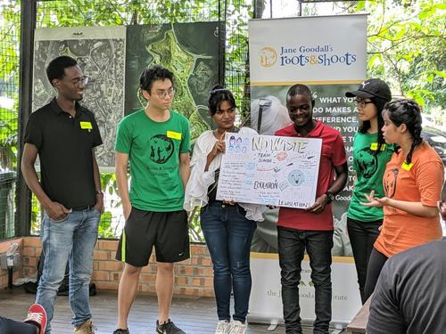
4.Therefore, Roots & Shoots hopes to involve millions of young people in building a secure future so that we can live in peace with nature.(P32)
involve… in
be involved in
允许某人参与;
卷入，牵扯进
1). Try to involve as many children in the game.
尽量让多的孩子参与游戏。
2). I’m afraid your son’s been involved in an accident.
恐怕你儿子牵扯在一次事故当中。

Slide 7
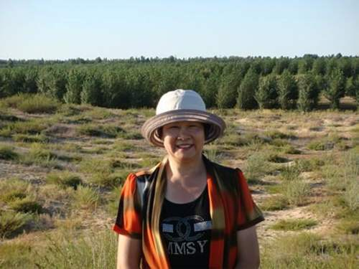
5.Ms Yi had a contented life until a terrible event occurred which changed her life. (106)
contented adj.
happy and satisfied because your life is good
(not before noun)
content adj
满意的，满足的
be content to do/with
满意于
content n. 容纳的东西，内容，目录，含量

Slide 8
1). The box had fallen over, and some of the contents had spilled out.
盒子倒了，里面的一些东西散落出来。
2). The fat content of cheese is high.
奶酪的脂肪含量很高。
3). She is content with his job at the moment.
他目前很满足自己的工作。
4). A fat and contented black hat is lying in the sun.
一只肥胖而心满意足的黑猫正躺在阳光下晒太阳。

Slide 9
occur vi. [formal] to happen
6.Ms Yi had a contented life until a terrible event occurred which changed her life. (106)
occur occurred, occurred
It (never) occurs to sb. that
（主意或想法）突然浮现于
脑中/从未想到
Didn’t it occur to you that your husband might be late?
你当时没想到你丈夫也许会晚到吗？

Slide 10
发生 | 使用场合 | 事件特点 | 过去式，过去分词
occur | 【rather formal】非常正式 | things not planned 非计划中的事情的发生 | occurred occurred
happen | 书面，口语皆可但口语中用的较多 | things not planned 非计划中的事情(尤指碰巧意外事情)发生 | happened happened
take place | 书面，口语皆可 | sth. that is planned/ arranged 有计划有安排的事情 | took place taken place
arise | 【formal】正式 | Problems/difficulties 问题或困难的发生，无计划性 | arose arisen

Slide 11
happen; occur; take place; arise
1. Hey, what is _________ ?Why has the light gone out?
2. Climatic changes have _________ at intervals throughout the millionaire. 整个千年中气候变化时有发生。
3. The wedding will ___________ in St Peter’s Church.
4. Let’s consider what kind of difficulties might___________ from the situation.
happening
occurred
take place
arise

Slide 12
7. The local government agreed with her proposal to plant one million trees in the region.P107
proposal n.
suggestion 计划，建议，提议
propose v.
[formal] to suggest sth.as a plan
propose sth. /that
建议,提议某事
propose to do
= intend to do
正式向某人求婚
propose to sb.

Slide 13
1).How do you propose to explain your long absence?
你如何打算解释你的长时间缺席？
2). I propose a toast to your success!
我提议为你的成功而干杯！
3). Hansen has proposed that I become his business partner.
汉森建议我成为他的生意伙伴。

Slide 14
8. The local government agreed with her proposal to plant one million trees in the region.P107
region n.
1). a fairly large area of a country or of the world, usually without exact limits
通常无确定界限的地区，区域
2). a particular part of sb’s body
人体的部位
the arctic region of Canada
加拿大的北极地区
a pain in the lower back region
后腰部疼痛
(somewhere) in the region of
大约，左右
The school received a grant somewhere in the region of $2500.
学校收到一笔大约2500美元的补助款。

Slide 15
9. Although there seemed only a slim chance that the trees could survive. The difficulty didn't prevent her from trying. P107
slim adj.
1)attractively thin
苗条的，修长的
2)very little chance / hope of getting what you want
a slim chance
机会、希望渺茫的
slim v. to make yourself thinner by eating less
节食减肥
slim down
减少，裁减
It was decided to slim down the workforce.
已经决定要裁减人员。

Slide 16
10. In 1999，the white bikes returned to Amsterdam- this time with a computer tracking system to record their every move!P37
track n. 小道,窄路,小径;跑道;铁路的轨道;铁路线
tracks n.指人和动物的轨迹，车辆的车辙印
track v. follow sb.
追踪到，追查到
track sb. down
I finally managed to track down the book you wanted in a shop near the station.
我在车站附近的一家书店里终于找到了你想要的那本书。

Slide 17
Describe the picture with the key words or phrases.
firm
China has taken firm measures in the plague prevention.

Slide 18
Describe the picture with the key words or phrases.
be content to do
The boy is content to follow a TV series in the summer vacation.

Slide 19
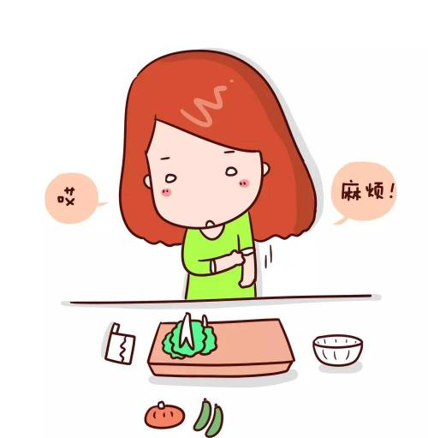
Describe the picture with the key words or phrases.
can’t be bothered to do
I can’t be bothered to cook everyday.

Slide 20
Describe the picture with the key words or phrases.
It never occurs to sb. that
It never occurred to the old couple that they had won one million Lottery prize.

Slide 21
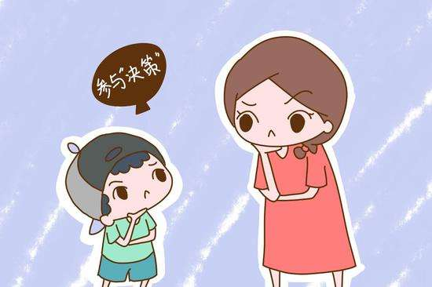
Describe the picture with the key words or phrases.
involve …in…
Mum wanted to involve his son in the family decision making.

Slide 22
The end!

Slide 23
谢谢您的观看
北京市朝阳区教育研究中心 制作

