Slide 1
必修（三）Unit 8 词汇学习（1）
朝阳区线上课堂·高一年级英语
汇文中学朝阳垂杨柳分校 赵娜

Slide 2
学习目标：
1.归纳复习本单元与“Green living ”, “ Roots and Shoots ”,“ Greening the desert”, “White bikes” on the roads主题相关的词汇及其搭配。
2.在主题语境中加深词义的理解并强化词汇的搭配意识。
3.运用所学词汇写一篇有关“世界地球日”的作文。
学法指导：
1.按主题积累词汇。
2. 关注上下文语境，体会词汇在句子或文段中所传递的意思。

Slide 3
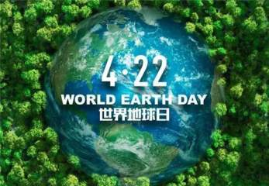
51st World Earth Day
“珍爱地球，人与自然和谐共生”

Slide 4
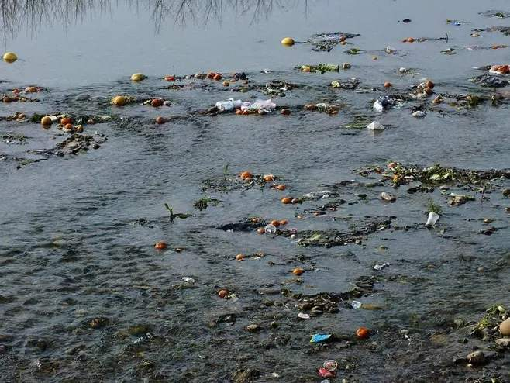
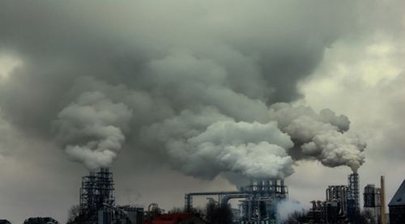
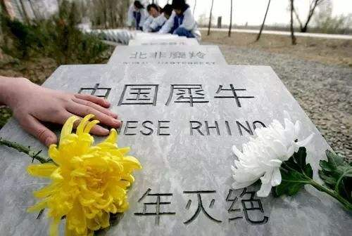
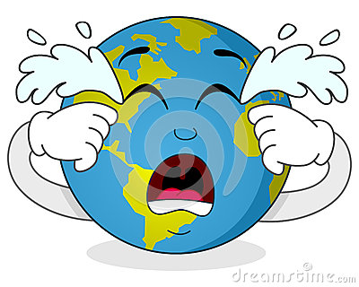
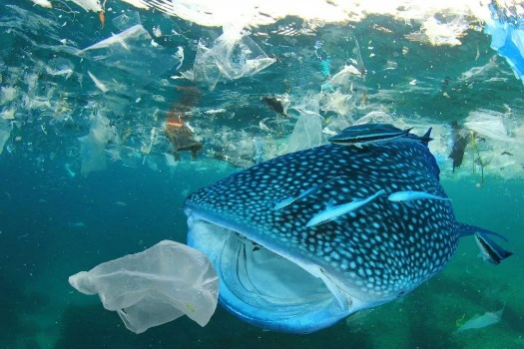
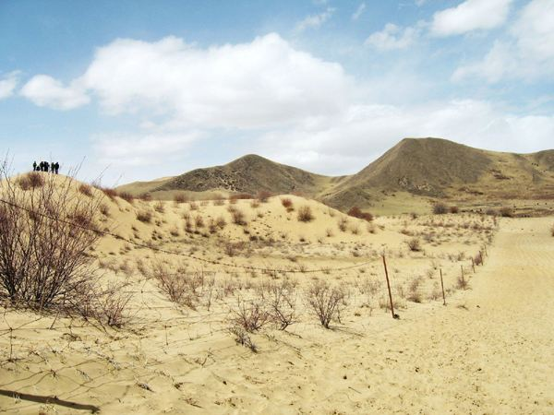
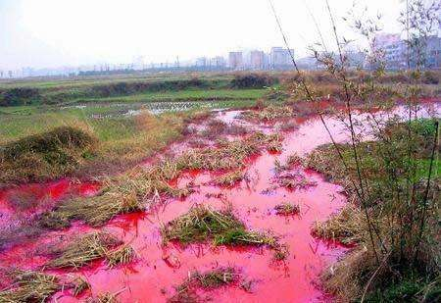
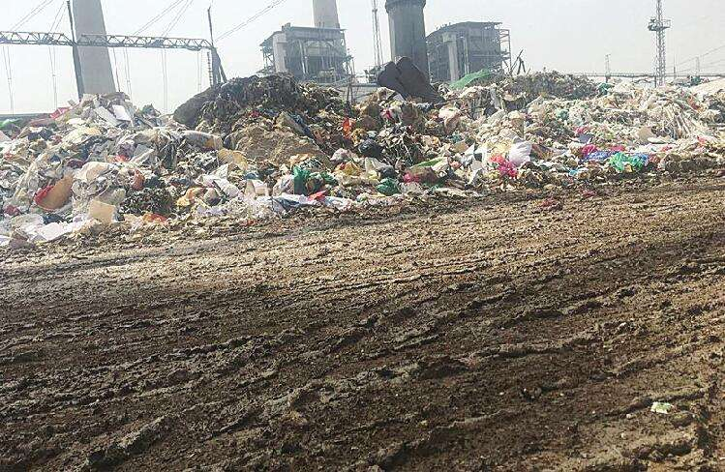
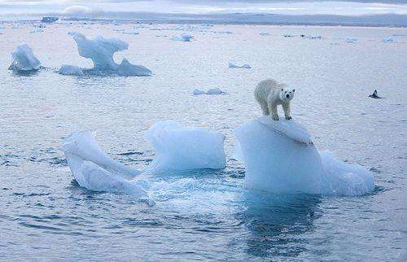
water pollution
air pollution
animal/plant extinction
ocean pollution
desert
soil pollution
industrial waste
global warming

Slide 5
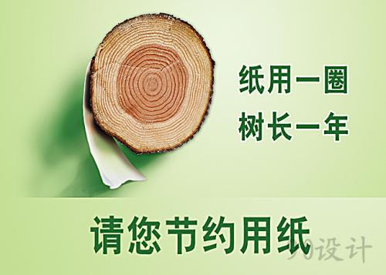
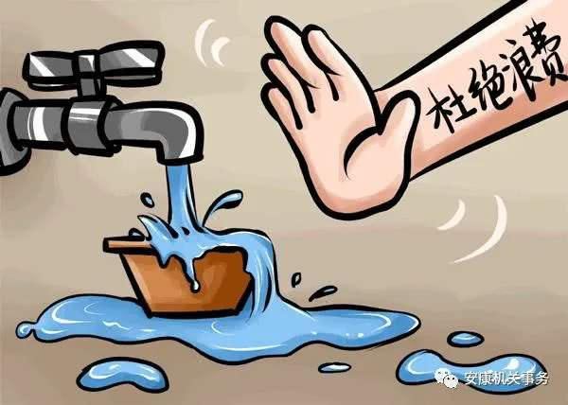
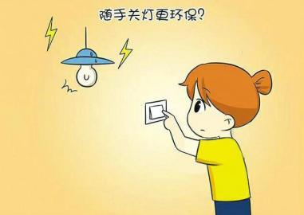
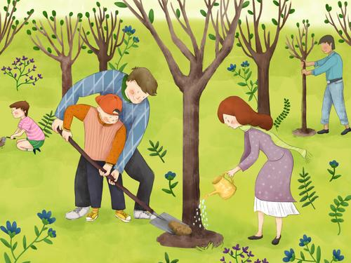
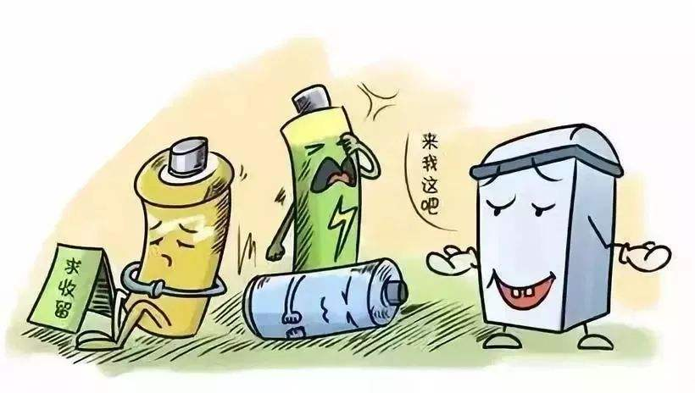
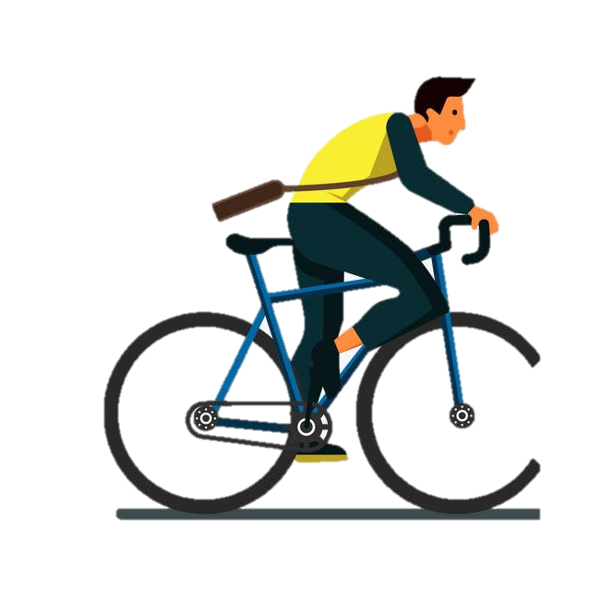
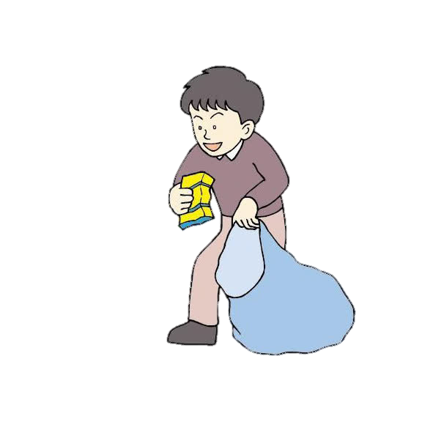
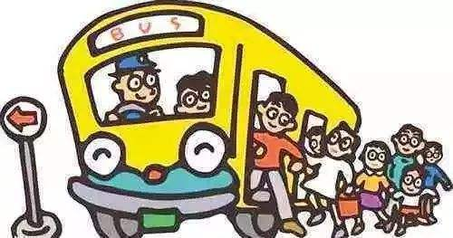
use less tissue
save water
use less electricity
plant more trees
recycle used batteries
cycle to work
pick up rubbish
choose public transport

Slide 6
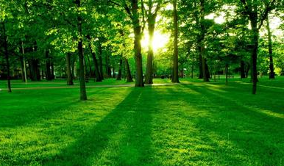
A green living is not only a kind of lifestyle but also a life attitude and one kind of life manner.

Slide 7
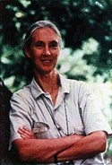
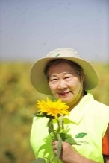
Roots and Shoots
NPO-Green life
以自我为中心
had a contented life
a terrible event occurred
worked through her sadness
made her son's dream come true
suffer from “Just-me-ism”
can't be bothered to pick up a piece of litter
leaving the tap running while brushing teeth
the institute was set up
满意的
Background
have no interest/energy to do
发生
调整情绪
研究院
Mean
ing/
purpose
roots move slowly under the ground
make a firm foundation
shoots break open brick walls
roots and shoots stand for the young people
planted trees in inner Mongolia
agreed with her proposal to plant trees in the region
坚实的基础
提议
区域
使参与
involve millions of young people in building a secure future
inspire young people to take action
every individual makes a difference
微小的
contribution
a slim chance
with determination
a survival rate of 85%
采取行动
决心
生存

Slide 8
Complete the introduction with appropriate words .
organization
Roots & Shoots is an ____________ established in the early 1990s by Dr. Jane Goodall. It is called Roots & Shoots because roots move slowly under the ground making a ______ _________. And although shoots seem small and weak, they can break open brick walls. The purpose of Roots & Shoots is to educate young people who suffer from_____________. Those people who ________________ to pick up a piece of litter they drop carelessly. In fact, these actions are very harmful. Therefore, Roots & Shoots hopes to ______ millions of young people _____ building a secure future so that we can live in peace with nature. Dr Jane Goodall believes every individual matters. What we need to do is to ___________and act together to make the world a better place.
firm
foundation
Just-me-ism
can’t be bothered
involve
in
take action

Slide 9
Complete the introduction with appropriate words .
contented
Yi jie fang is a woman of great strength. Her ________ life changed after a car accident took the life of her son. Before he died, her son was concerned about the sandstorms and the increasing size of the desert in inner Mongolia. After that, she _______________her sadness and determined to ____________________________. Yi jie fang made a ___________ to plant one million trees in the ________of inner Mongolia over ten years. And the government agreed. Although the first trees were blown away, her team continued planting more trees. Now the trees have a _________ rate of eighty five percent.
worked through
make her son’s dream come true
proposal
region
survival

Slide 10
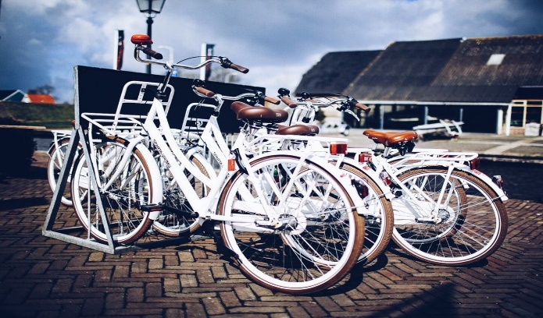
“White bikes” on the road
In the 1960s
In 1999
now
came up with an idea of White bikes
flat and therefore convenient for bikes
plenty of places for bicycle parking
had a bicycle path
disappeared in a matter of weeks
a computer tracking system
recalled every movement
take bikes to special parking place near their destination
have pedalled its way around the world
想出，想到
跟踪
v.骑，踏板
因此
车辆停放
小路，小道
目的地
消失
Amsterdam

Slide 11
Complete the introduction with the words above .
There has been a noticeable increase in the number of white bikes in our city in the past few years. Every day we see more people use them to ride to work or school. It is convenient to use white bikes as they save time, you don't have to wait for public transport or seat in heavy traffic. In addition to this, the roads in our city are _______, and most of the main roads have bicycle _________ on which bike riders can ride safely. Also, there are separate _________ areas. _________,people in our city like to use white bikes as they feel they reduce pollution and help the environment by saving energy. On top of all this, white bikes enable people to reach their __________ quickly and easily. But at first many white bikes __________ because of theft. Later, the white bikes companies used __________ system to record every bike’s move.
flat
paths
parking
Therefore
destination
disappeared
tracking

Slide 12
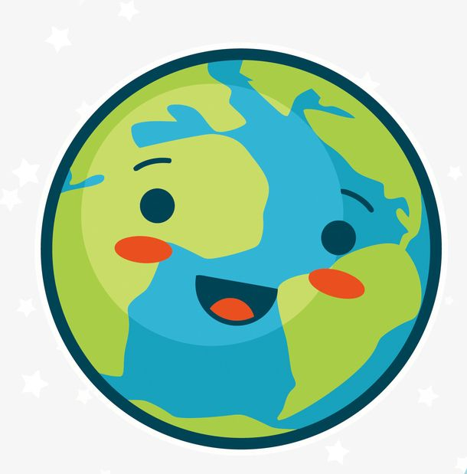
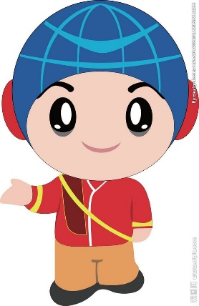
Writing task
Man: Happy earth day!
Earth : Thank you, but only on August 22nd, maybe people think of me!
上面是人类和地球的一个简短的对白。请根据对白， 结合实际，以Making everyday earth day为题写一篇短文。
提示：1.地球的现状和存在的问题？
2.人们在地球日这天用什么行动关爱地球？
3.号召人们把每一天都当作地球日，每天关爱地球

Slide 13
Making everyday earth day
Now the earth is in bad condition. For example. In some places, the air pollution is so serious that it causes many deaths. At the same time, global warming has caused extinction of many animals and plants. Luckily we human beings have realized the problems.
On April 22nd, millions of people across the world do something good for the earth. Some clean up beaches and water, some recycle used batteries while others gave speeches to call on more people to take action. But can we save our earth only by one day's work? Protecting the earth involves everyone. The future of our planet depends on our efforts. What we should do is to do our parts and make everyday earth day. Only by taking good care of it everyday, can we hope to live in harmony with nature.

Slide 14
Homework
Finish your own writing after class.

Slide 15
谢谢您的观看
北京市朝阳区教育研究中心 制作

