Slide 1
“艺术” Writing Workshop（1）
朝阳区线上课堂·高一年级英语
北京市东方德才学校 黄莹

Slide 2
学习目标
1.通过阅读文本能够获取一封正式邮件的格式和内容的有关信息
2.总结概况邮件的格式和书写策略
3.找出与咨询需求有关的表达方式并尝试运用。

Slide 3
学法指导
在学习时，同学们务必关注：
1 正式邮件的结构和书写策略
2 礼貌性提出问题的语言表达方式

Slide 4
Unit 7 Art Writing Workshop A Formal Email

Slide 5
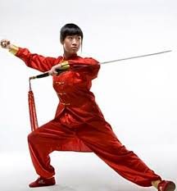
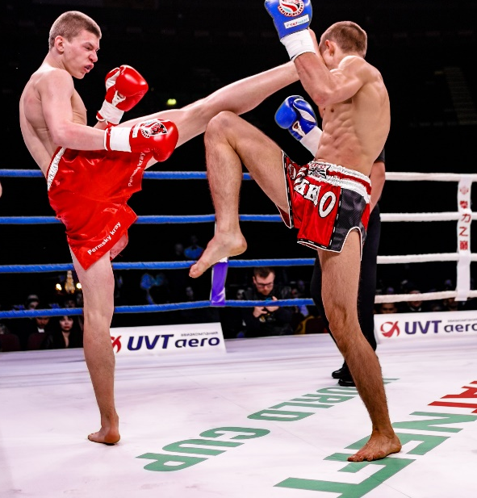
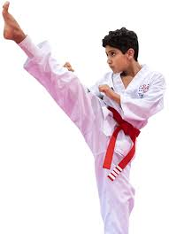
Look at the advertisement on a school website. Which activity would you like to know more about?
广告
the time between childhood and adulthood
Youth Short Film Festivall Join the contest! Great prizes!
Contact us: enquiries@***filmclub.com
New school film club starting next week! Some great films!
Room 334, Students’ Centre
Contact us: lovefilmclub@***mail.com
Martial arts classes! Great teacher and small groups!
Room 106, The Stadium
Contact us: martialarts@***mail.com
School music competition on 15 June. Some great prizes!
Contact us: lovemusic@***mail. com
competition, match… eg. a beauty contest 选美大赛
contest, match… eg. a beauty competition

Slide 6
If you decide to write an email to ask for more information about the activity you are interested in. Is it going to be a formal or informal email?
Youth Short Film Festivall Join the contest! Great prizes!
Contact us: enquiries@***filmclub.com
New school film club starting next week! Some great films!
Room 334, Students’ Centre
Contact us: lovefilmclub@***mail.com
Martial arts classes! Great teacher and small groups!
Room 106, The Stadium
Contact us: martialarts@***mail.com
School music competition on 15 June. Some great prizes!
Contact us: lovemusic@***mail. com

Slide 7
Formal vs. Informal
Formal:
Written to a professor, colleague, boss, etc.
Must always be professional
Accurate grammar, punctuation, and spelling necessary
Informal:
Written to friends and family
Accuracy and grammar(spelling and punctuation)are not important
You can make up your own rules

Slide 8
A Formal Email

Slide 9
Read the email on page 19. Answer the questions.
Why does Liu Ze write this email?
How does Liu Ze address the receiver of the email?
What information does Liu Ze want to know?
Is the style of the email formal or informal? Can you find some examples?

Slide 10
1 Why does Liu Ze write this email?
2 How does Liu Ze address the receiver of the email?
Liu Ze writes this email to ask for information about entering a film in the festival.
Liu Ze addresses the receiver of the email as Dear Sir/Madam.

Slide 11
3 What information does Liu Ze want to know?
a film or television or radio programme
that gives facts and information about a subject
纪录片
Liu Ze wants to know:
About the films for the festival
If they can accept sport documentaries
More information about how to apply for this festival
If groups and individuals can enter
If they can enter their film to another film festival at the same time
What the prizes are
If there are prizes for different age groups and for different types of films
a single person or thing 个人，个体

Slide 12
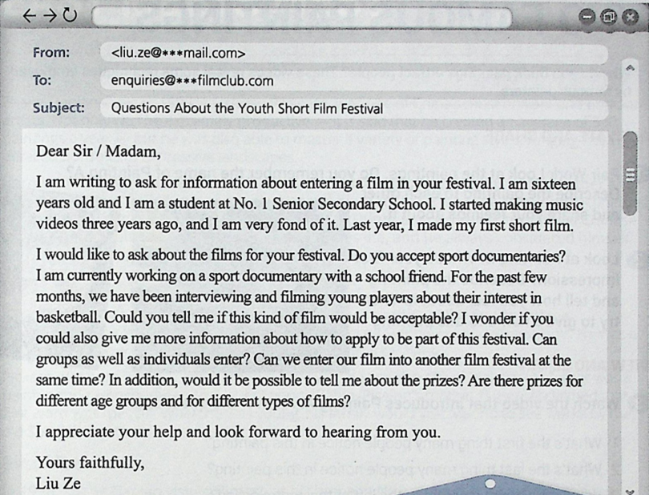
4 Is the style of the email formal or informal? Can you find some examples?
The style is formal.
Reasons could include:
Vocabulary used
Address of the receiver
Salutation
brief
introduction
salutation
body
main purpose
closing
salutation
signature—your name

Slide 13
Identify structure and useful language.
Stating the purpose of
your writing and introducing
yourself.
2. Querying the films for the festival.
3. Salutation

Slide 14
Identify structure and useful language.
I am writing to ask for information about …
I am …
I would like to ask ... Do you ... ?
Could you tell me … ? I wonder if ... ? Can we ... ? Are there … ?
I appreciate your help ...

Slide 15
Identify structure and useful language.
 | The structure | Useful language
Para. 1 | Stating the purpose of your writing and introducing yourself | I am writing to ask for information about … I am …
Para. 2
Para. 3
Querying the films for the festival
I would like to ask ... Do you ... ?
Could you tell me … ? I wonder if ... ? Can we ... ? Are there … ?
Salutation
I appreciate your help ...

Slide 16
Summarize the components of an effective email.
1. Lead with the ask.
2. Establish your credibility.
3. Make the way forward clear..
4. If you’re asking a question, propose a solution.
5. Write your subject lines like headlines.
Establish your credibility.
6. Edit your messages ruthlessly.

Slide 17
Writing practice
Look at the advertisement on a school website. Write an email to ask for more information.
School music competition on 15 June. Some great prizes!
Contact us: lovemusic@***mail. com

Slide 18
1. What is the purpose of your email? 2. Write two questions you would like to ask.
Sentence Builder
Polite Requests
I am writing to ask for information …
I would like to ask about the films for your festival.
Could you tell me if this kind of film would be acceptable?
I wonder if you could also give me more information …
Would it be possible to tell me about the prizes?

Slide 19
Outline
Stating the purpose of your writing and introducing yourself.
2. Querying the songs for the music competition.
3. Salutation
Notes:
this brochure is to instruct how to survive an earthquake.

Slide 20
Homework
Look at the advertisement on a school website. Write an email to ask for more information.
School music competition on 15 June. Some great prizes!
Contact us: lovemusic@***mail. com

Slide 21
谢谢您的观看
北京市朝阳区教育研究中心 制作

