Slide 1
必修（三）Unit 7 Lesson 2（2）
朝阳区线上课堂·高一年级英语
北京市东方德才学校 谢利亚

Slide 2
教学目标
1. 阐述采访的主要内容和被采访者的信息
2. 获取有关京剧的信息，并且分辨出说话人的主要内容和支持性的细节，学会如何摆明观点并阐述原因，以及说话人的情感态度价值观
3. 基于采访的内容，就京剧提出问题并回答，并能喜爱和弘扬我国传统文化

Slide 3
学法指导
在听的过程中，要抓住对话的大意，获取其中的主要信息、观点及其支持性的细节。关注说话人在陈述过程中的因果逻辑关系，这往往是其主要观点。而说话人列举的例子、语气、情感等，往往是对其观点的细节支撑。此外，听和说是相结合的，要在获取信息的基础上，进一步练习自己的口语表达能力。

Slide 4
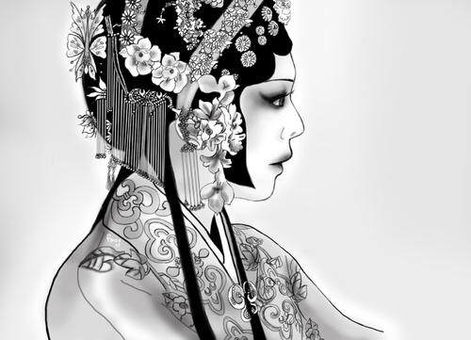
Lesson 2
BEIJING OPERA

Slide 5
Introduce Beijing Opera to a group of students from another country.
combines music, performance, dance and acrobatics
the form
in the Qing Dynasty
the cultural treasures of China
musical instruments
mask
costumes

Slide 6
ONE POSSIBLE VERSION
Beijing Opera is a form of Chinese opera,combining acting, talking, singing, music, dancing and acrobatics, all of which are difficult to master. That's why it is one of China's national treasures. There are four roles and each role has its own singing and acting styles. In early days,Beijing Opera was usually performed on open-air stages, so the performers had to sing in very high voices in order to be heard over the crowds. And in the past it was often performed on stages that were lit only by oil lamps. The costumes had to have bright and colorful patterns.
Otherwise,it would have been difficult to attract the audience's attention. It's absolutely amazing.

Slide 7
Listen to a dialogue about Beijing Opera. Answer the questions.
Who went to see Beijing Opera?
How did the person feel about it?
Lucy went to see Beijing Opera.
She felt that it was an excellent show.
3. What didn’t the person understand?
She didn’t understand the part where the main character walks across the stage with a flag on each side of her.

Slide 8
Listen and imitate. What emotions do the speakers express? Write satisfaction, worry or regret after the sentences in the blank.
Expressing Emotions (2)
1 …so colourful and exciting! ___________
2 I’m so glad you enjoyed it. ___________
satisfaction
satisfaction
3 I was worried because … _____________
4 I loved the dancing and the acrobatics. _____________
5 The performers were so talented! ______________
6 But there were quite a few things I didn’t understand. _______
7 I wish I knew more about them. ________
worry
satisfaction
satisfaction
regret
regret

Slide 9
Fill in the blanks.
form
1. Beijing Opera is a _____ of Chinese opera,combining acting, talking, singing, music, dancing and acrobatics, all of which are difficult to ______. That's why it is one of China's national _________. There are four ______ and each role has its own singing and acting styles. In early days,Beijing Opera was usually ________ on open-air stages, so the performers had to sing in very high _____ in order to be heard over the crowds. And in the past it was often performed on stages that were lit only by oil _____. The _________ had to have bright and colorful _________.Otherwise,it would have been difficult to attract the audience's attention. It's absolutely _________.
master
treasures
roles
performed
voices
lamps
costumes
patterns
amazing

Slide 10
Fill in the blanks.
2. Lucy enjoyed her first Beijing Opera though it was so ________ from theatre _______ in the US. But there were quite a few things she didn't understand because some simple __________ in Beijing Opera often represent more ________ actions, like _______ a horse or rowing a boat. She wishes she knew more about them.
different
shows
movements
complex
riding

Slide 11
Pair work
Act out a dialogue between a Chinese student and a foreign student after watching a local opera.
Here is a short video for you to enjoy.
Student A is role playing a Chinese student, who understands the video.
Student B is role playing a foreign student, who ask questions about the video.

Slide 12
谢谢您的观看
北京市朝阳区教育研究中心 制作

