Slide 1
必修（三）Unit 7 Lesson 2（I）
朝阳区线上课堂·高一年级英语
北京市东方德才学校 谢利亚

Slide 2
教学目标
1. 阐述采访的主要内容和被采访者的信息
2. 获取有关京剧的信息，并且分辨出说话人的主要内容和支持性的细节，学会如何摆明观点并阐述原因，以及说话人的情感态度价值观
3. 基于采访的内容，就京剧提出问题并回答，并能喜爱和弘扬我国传统文化

Slide 3
学法指导
在听的过程中，要抓住对话的大意，获取其中的主要信息、观点及其支持性的细节。关注说话人在陈述过程中的因果逻辑关系，这往往是其主要观点。而说话人列举的例子、语气、情感等，往往是对其观点的细节支撑。此外，听和说是相结合的，要在获取信息的基础上，进一步练习自己的口语表达能力。

Slide 4
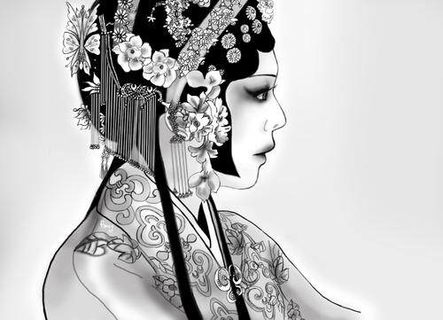
Lesson 2
BEIJING OPERA

Slide 5
WARMING UP
1. Enjoy a famous segment of Beijing Opera.
2. What do you know about Beijing Opera?
3. Do you know the main roles in Beijing Opera?
complex
Beijing Opera is a national treasure with a history of 200 years, which is the biggest kind of opera in China.

Slide 6
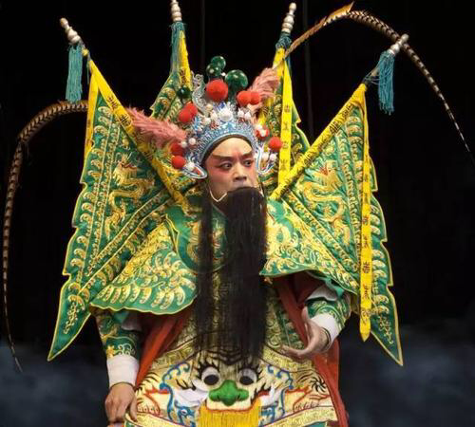
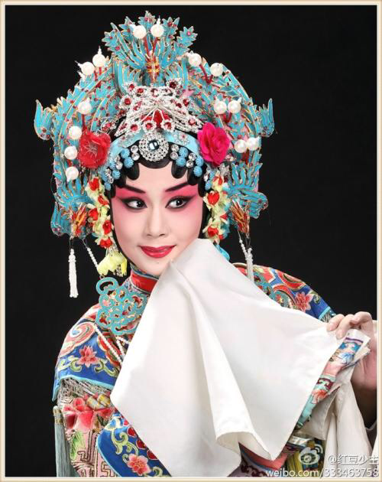
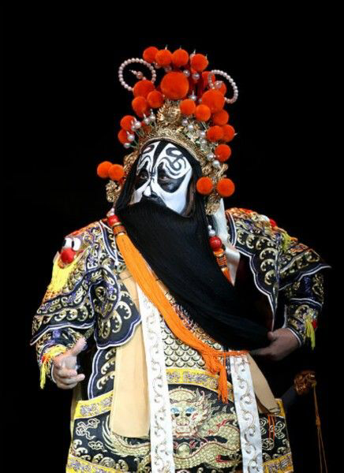
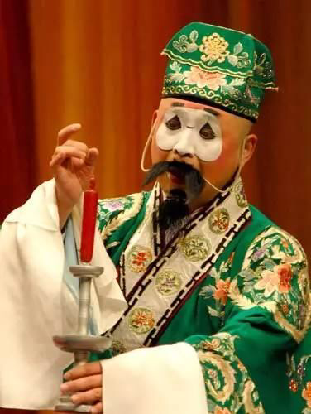
Roles in Beijing Opera:
performers
Sheng
Dan
master
female
acrobatics
carriage
Jing
Chou
clown
male

Slide 7
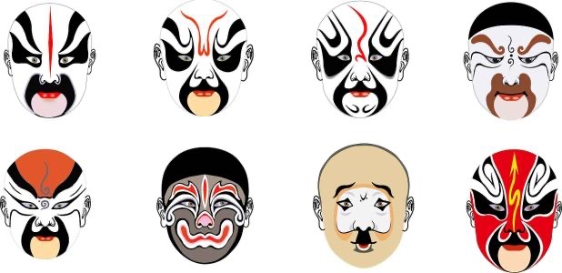
pattern
emotion
male roles with brightly painted masks

Slide 8
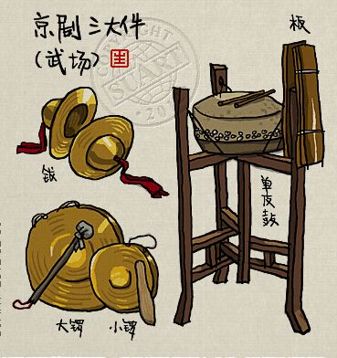
Orchestras in Beijing Opera：instrument
drum
clappers
cymbal
bss gong

Slide 9
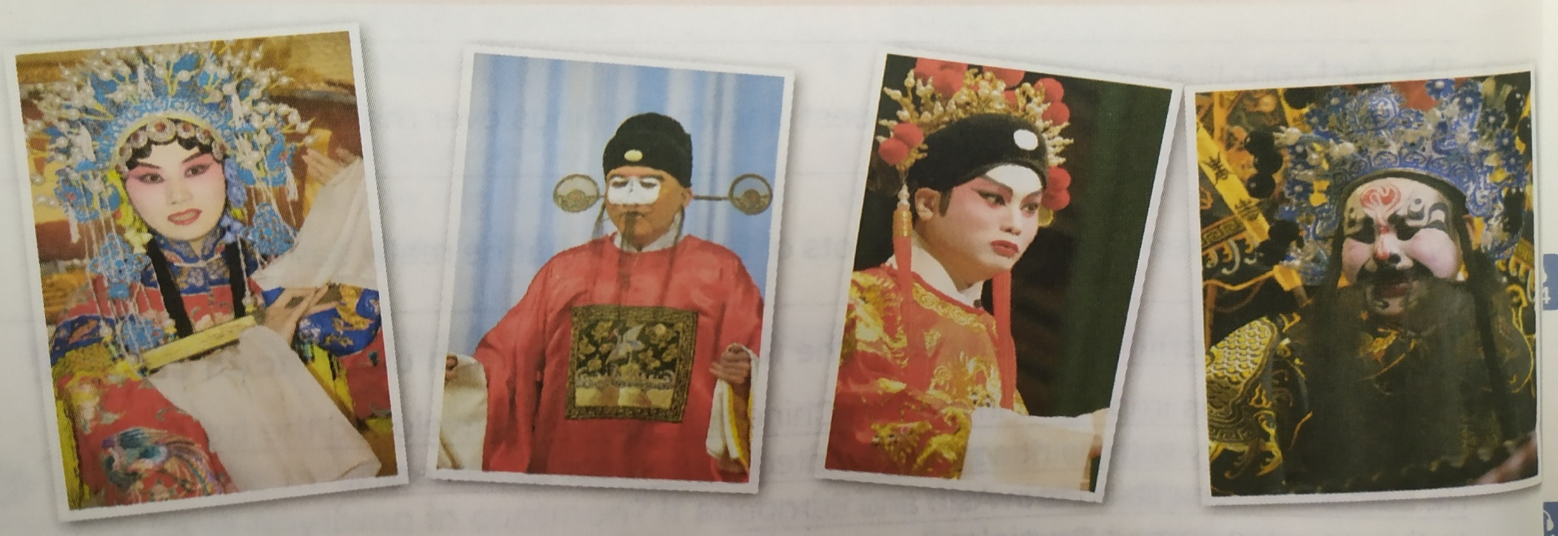
Look at the photos and choose a description for each role.
female roles;common male roles;male roles with brightly painted masks;clown roles
a
b
c
d
a_________________
b_________________
c_________________
d________________________________
female roles
clown roles
common male roles
male roles with brightly painted masks

Slide 10
Dr. Liu is talking about Beijing Opera on a radio programme. Listen and tick ( ) the aspects that are mentioned.
√
_____ main roles
_____ instruments
_____ the unique sound
_____ costumes
√
√

Slide 11
Listen again. Answer the questions.
When did Beijing Opera start?
It started in the late eighteenth century.
2. What forms of performance are combined together in Beijing Opera?
It uses acting, talking, singing, music, dancing and acrobatics.
3. How many roles can be found in Beijing Opera? What are they?
There are four roles: sheng, dan, jing, chou.
4. What are some of the special features of Beijing Opera?
It has a very unique sound and beautiful costumes.

Slide 12
Listen again and find the answers to these questions.
1. Why is Beijing Opera a national treasure of China?
2. Why do performers sing in very high voices?
3. Why are the costumes in bright colours?
While you are listening, listen for key words like why and because.
Take note of the reasons.
Pay attention to the key phrases used to give reasons:
Yes. That’s why…
This is because…
In order to be…
Otherwise, …

Slide 13
Listen again and find the answers to these questions.
1. Why is Beijing Opera a national treasure of China?
2. Why do performers sing in very high voices?
3. Why are the costumes in bright colours?
Beijing Opera is a national treasure of China because it uses acting, talking, singing, music, dancing and acrobatics. All of those forms are difficult to master.
Performers sing with very high voices because in the early days, it was usually performed on open-air stages. In order to be heard over the crowds, the music had to be loud and performers had to sing in very high voices.
Costumes are in bright colours because in the past, it was often performed on stages
that were lit only by oil lamps. The costumes had to have bright and colourful
patterns. Otherwise, it would have been difficult to attract the audience’s attention.

Slide 14
Homework
Search for more information about Beijing Opera and make a poster about the knowledge.

Slide 15
谢谢您的观看
北京市朝阳区教育研究中心 制作

