Slide 1
必修（三）Unit 7 Lesson1（1）
朝阳区线上课堂·高一年级英语
北京市陈经纶中学 韩国凤

Slide 2
Unit 7 Art
Lesson 1
Masterpieces

Slide 4
To read and talk about paintings and masterpieces
To read for general understanding
To read for specific information and understand words in context
To read for similarties between three different paintings

Slide 5
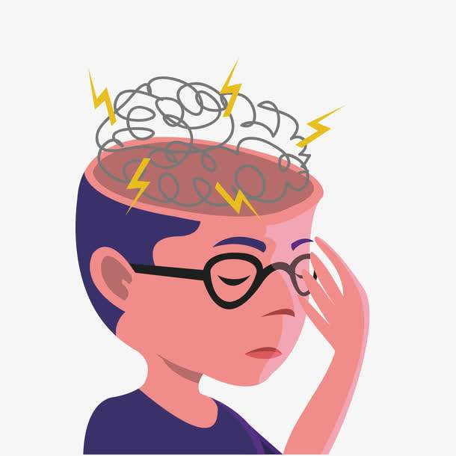
What is masterpiece?
masterpiece: a work of art that is of high quality or that is the best that a particular artist, writer etc. has created

Slide 6
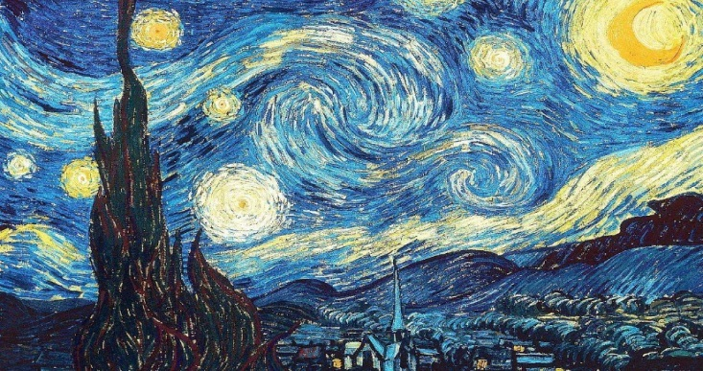
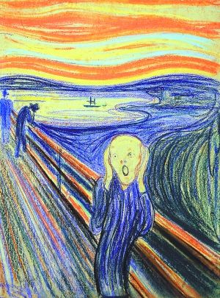
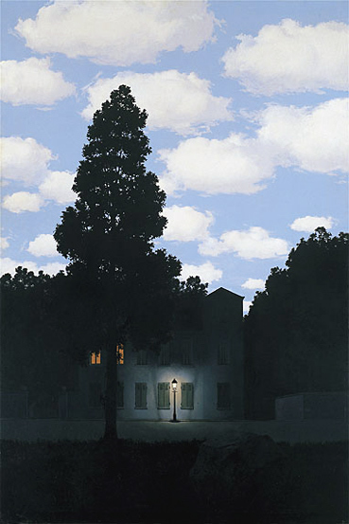
What do you see in the following paintings? Use the phrases below to help you. Do you like them? What are the names of the three paintings?
white and yellow circles an amazing sky
a thin figure a lonely tree a sleeping village
a dark stormy sea a house lit by lights from inside

Slide 7
What would you title the painting?
The Starry Night
What elements can be seen in the painting?
What is your opinion of the painting?
What emotion does the painting bring to mind?
How does the painting make you feel?

Slide 8
What would you title the painting?
The Scream
What elements can be seen in the painting?
What is your opinion of the painting?
What emotion does the painting bring to mind?
How does the painting make you feel?

Slide 9
What would you title the painting?
The Empire of Light
What elements can be seen in the painting?
What is your opinion of the painting?
What emotion does the painting bring to mind?
How does the painting make you feel?

Slide 10
You are going to read an article about materpieces, what would like to learn from it? Write down your questions that you may predict about the article in the diagram.
materpieces

Slide 11
Listen and read the descriptions of the three paintings. Underline the name of each painting and its artist. Find out what each painting is about.
Try to underline the general sentence for each paragraph.
Try to use the context to understand unknown terms.

Slide 12
Read the three descriptions again. Use the diagram below to help you take notes. Then talk about each painting.
You can use contextual clues.

Slide 13
The Starry Night
The Scream
What does the painting show?
What may have inspired the painter?
What did the artist think or say about the paintig?
The Empire of Light

Slide 14
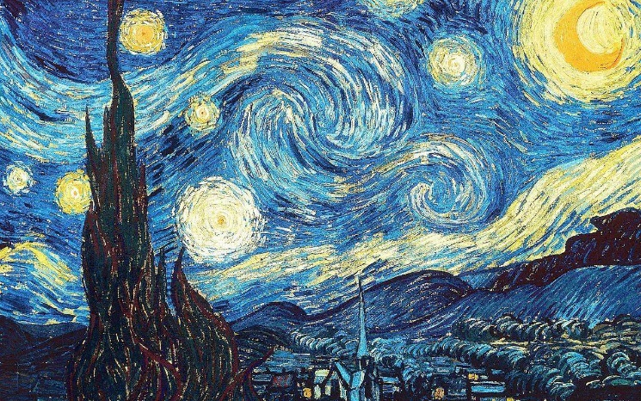
The Starry Night
What does the painting show?
What may have inspired the painter?
What did the artist think or say about the paintig?
The night sky with clouds, stars and a moon.
What he saw from the window.
He thought it was a failure.

Slide 15
The Scream
What does the painting show?
What may have inspired the painter?
What did the artist think or say about the paintig?
A thin figure with an expression of fear.
His experience of walking with friends.
Not mentioned in the text.

Slide 16
The Empire of Light
What does the painting show?
A beautiful house lit by lights from inside, surrounded by the darkness of the night.
What may have inspired the painter?
What did the artist think or say about the paintig?
He thoughts and ideas.
The contrast between day and night in the paintings was surprising.

Slide 17
Sort the expressions
Sort the expressions into the correct columns. Use them to practise introducing the paintings.
The Starry Night | The Scream | The Empire of Light

Slide 18
1 with an expression of fear
2 let out a powerful scream
3 circles of white and yellow racing across the sky
4 a burning orange-red sky
5 surrounded by the darkness of night
6 the night sky with clouds, stars and a moon
7 a beautiful house lit by lights from inside
8 full of brightness and soft white clouds
9 looks directly at the viewer
10 a sleeping village and a dark, lonely tree
The Starry Night | The Scream | The Empire of Light
3, 6, 10
1, 2, 4, 9
5, 7, 8

Slide 19
Look at the three paintings and read the first paragraph of each desccription. Do they have anything in common? If so, underline the words and phrases in the descriptions that show their common features. Explain your opinions.

Slide 20
Underline and take note of the similarities in each description.
Discuss on the similarities that you noticed.
Explain your opinions.

Slide 21
Suggested answers:
The words and phrases in the descriptions:
the massive circles of white and yellow racing across the sky; a burning orange-red sky; a daytime sky full of brightness a dark, lonely tree, a dark, stormy sea; the darkness of night
Each painting is focused on the artist’s interpretation of nature, especially the aspects of the sky. All three paintings paint the sky with bright colours and the darkness in each one manifests a typical feature.

Slide 22
Talk about the pictures
What’s your opinion of the three paintings after reading the descriptions? Do you like or dislike them more? Give your reasons.

Slide 23
1. Try to write a few sentences on each painting, expressing your opinion.
You can use the following vocabulary words:
originality, emotional, atmosphere, color scheme, dramatic, highlights, the painting makes me feel uneasy/inspired, dark and troubling, failure, powerful.
2. Prepare for a presentation
Suppose you are a volunteer in an art exhibition ,please introduce one of the paintings to the visitors.

Slide 24
谢谢您的观看
北京市朝阳区教育研究中心 制作

