Slide 1
The superhero behind Superman（1）
朝阳区线上课堂·高一年级英语
北京市朝阳外国语学校 刘佳

Slide 2
教学目标
获取克里斯托弗·里夫在电影里饰演“超人”和在现实生活中成为“超人”相关的事实性信息；
梳理克里斯托弗·里夫从电影里饰演的“超人”转变成现实生活中的“超人”所经历的情感变化；
分析并评价克里斯托弗·里夫 “超人背后的超级英雄”这一称号。

Slide 3
学法指导
通过关注每段中心句和关键词，获取文章的主要信息。
研读文本时，要关注文本的主线，即行文的逻辑。
通过结合上下文语境，猜测词义，推断人物内在情感。

Slide 4
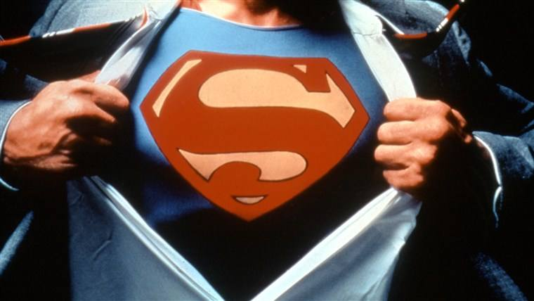
Unit 6 The Admirable
Lesson 3 Reading (P58)
The Superhero Behind Superman

Slide 5
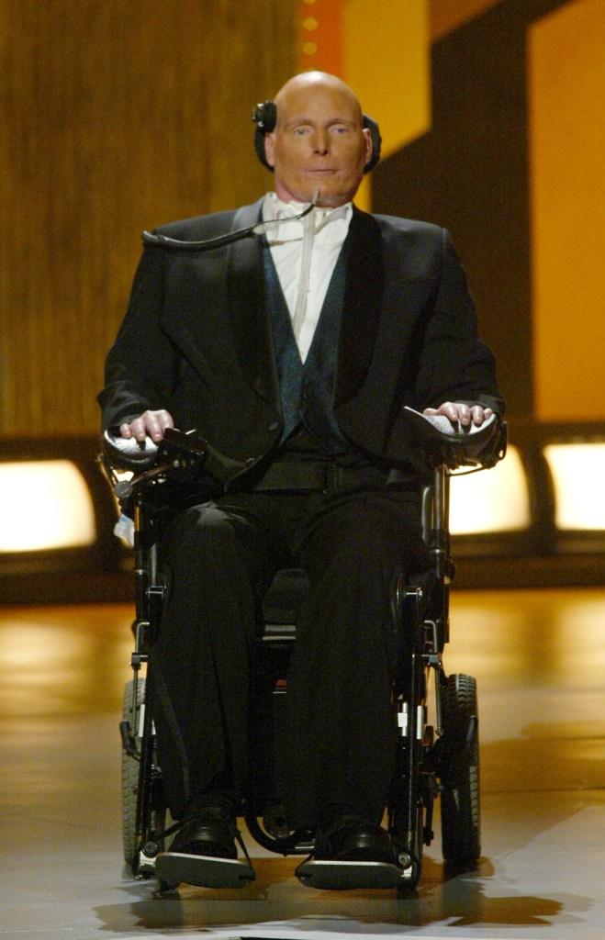
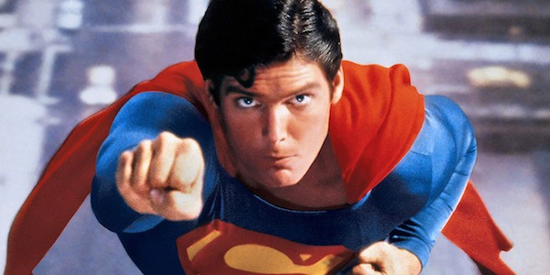
The Superhero Behind Superman
What admirable qualities does a superhero have?
Brave, helpful, intelligent, strong...

Slide 6
The Superhero Behind Superman
Who's in the pictures?
What's happening in each picture?
How has he changed?

Slide 7
What do you want to know about him?
Why is Reeve known as the superhero behind Superman?
Christopher Reeve

Slide 8
Read the text and underline the answers to these questions.
Task 1
What was Reeve's “wildly successful Hollywood career” like?
How was he injured? Why was it considered a disaster?
3. What did he do after he came out of the “nightmare”?
Para 3: He raised awareness for good causes and spoke out about health, education and child protection to help those most in need.
Para 4: He was thrown off his horse and broke his neck. His injuries were so severe that he had no movement or feeling in his body and needed a machine to help him breathe.
Para 5: He advocated for people with back injuries and disabilities, raising millions of dollars in support of medical research.

Slide 9
Read the story and take notes of important facts about Christopher Reeve in the diagram below.
Task 2
Becoming the star in Superman films
Becoming a superhero in real life
given the lead role in a Superman film
starred in four Superman films in 1978 to 1987
raising awareness for good causes
became an advocate for people with back injuries and disabilities
raising millions of dollars in support of medical research
para 2-3
para 4-5

Slide 10
Summarize Reeve's change of feelings from a superhero in films to a superhero in real life. Give your reasons.
Task 3
Occasions | Feelings | Reasons
When he succeeded in his Hollywood career | helpful, kind | He realised his roles in films had given him the opportunity to be a real-life superman. So he raised awareness for good causes.
During the early stages of living with his injury | hopeless, desperate, depressed | He wished he was dead and even thought of ending his own life. He fell into depression which lasted for many months.
For the years followed | hopeful | He gained the strength from the ongoing support of his wife, family and friends and from focusing on his goal to walk again.
During his later years | passionate, energetic, positive | He became an advocate for people with back injuries and disabilities, raising millions of dollars in support of medical research.

Slide 11
Think and voice your opinions.
Task 4
What's your understanding of the title “The Superhero Behind Superman”?
2. If you were paralysed and could not follow your dream, what do you think Reeve would say to you?

Slide 12
Watch a video about Reeve's opinion on Superman. Think and voice your opinions.
Task 4
What's your understanding of the title “The Superhero Behind Superman”?
Possible answer:
This title insinuates that Christopher Reeve is a Superhero, not just in the movie but in everyday life. He showed extraordinary courage when faced with being paralysed for life. Even though he lived in pain, he devoted his life to worthy causes and charity and inspired many lives for the better.

Slide 13
Think and voice your opinions.
Task 4
2. If you were paralysed and could not follow your dream, what do you think Reeve would say to you?
Possible answer:
“Even though you're not “superman” as I was in the films, we normal people can do extraordinary things; we are all talented and gifted and can use the strength to change our lives. Cheer up!”

Slide 14
谢谢您的观看
北京市朝阳区教育研究中心 制作

Slide 15
视频来源：
https://www.bilibili.com/video/av23927254/?spm_id_from=333.788.videocard.3
无法下载，仅供大家参考！

