Slide 1
The superhero behind Superman（2）
朝阳区线上课堂·高一年级英语
北京市朝阳外国语学校 刘佳

Slide 2
教学目标
巩固克里斯托弗·里夫遇险前后的基本信息，积累相关语块表达；
学会使用同理心分析人物情感；
基于文本资料和视频，感受人类对高尚品质的崇拜之情。

Slide 3
学法指导
通过文本语境学习词汇，及时积累话题词汇，并会使用同义词和反义词来表达意义.
结合上下文，运用自身知识储备和逻辑推理，学会用同理心理解作者表达的情感意义。
利用网络搜集的照片、视频、文章等资料，更深入了解相关话题，有助于理解人与社会的主题意义。

Slide 4
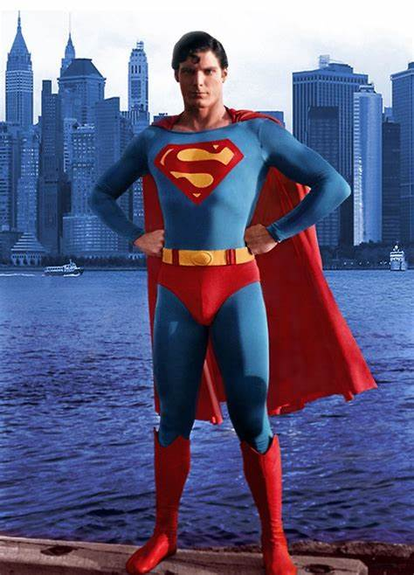
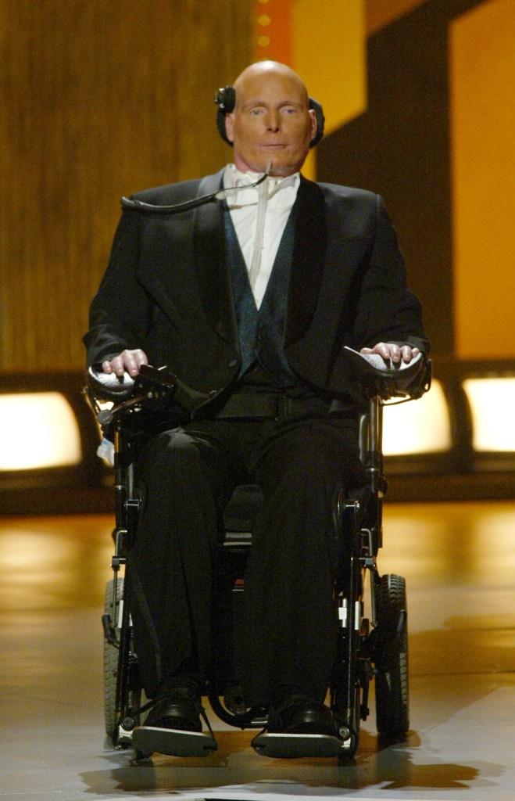
The Superhero Behind Superman
superhero in Superman films
superhero in real life

Slide 5
Complete the summary with the information from the text.
Task 1
Christopher Reeve was born on 25 September, 1952 in New York — the son of a teacher and novelist. He found his 1___________ in acting at the age of eight. Reeve 2__________ four Superman films from 1978 to 1987 and he soon gained a reputation 3_________ ___ good cause. He visited sick children in hospitals and worked with organizations to help those most 4____________. Unfortunately, in 1995 disaster 5___________ Reeve. His neck was broken in a horseback riding. He got severe injury, which made him have no movement and feeling in his body at all. His doctor didn’t believe that he 6____________. Reeve fell into a depression. With the support his family and friends, he eventually regained his will to live. In the years that followed, he 7____ ___ ______ his goal of one day walking again. Reeve undertook an intense exercise programme to help him achieve his goal. He 8____________ the muscle-rebuilding exercise and made remarkable progress. He even managed to direct, produce and star in films. He also wrote a biography and returned to his charity work. His positive attitude 9___________ many people who were stuck in illness. Sadly, on 10 October, 2004, Christopher Reeve passed away. He will always 10_____ _______ a superhero—in more ways than one.
passion
starred in
for raising awareness for
in need
struck
would survive
focused his attention on
engaged in
inspired
be remembered as

Slide 6
The Superhero Behind Superman
para 1: providing a striking contrast to Reeve's life change
para 2-3: wildy successful Hollywood career
para 4-5: description of his severe injury, hopeless situation, how he came out of the “nightmare” and what he did after that (superhero in real life)
para 6: his death and people's evaluation of him

Slide 7
Task 2
Imagine yourself in the following situations. Answer the questions.
Build Up Your Empathy with the Characters
Empathy means you try to put yourself in others' shoes and be aware of and sensitive to their feelings. You try to gain a deeper understanding of their perspective.
It's important to understand the emotions, behaviours and intentions of characters in a story.
You can use your imagination to think about how it might feel and use that understanding to empathise with them.

Slide 8
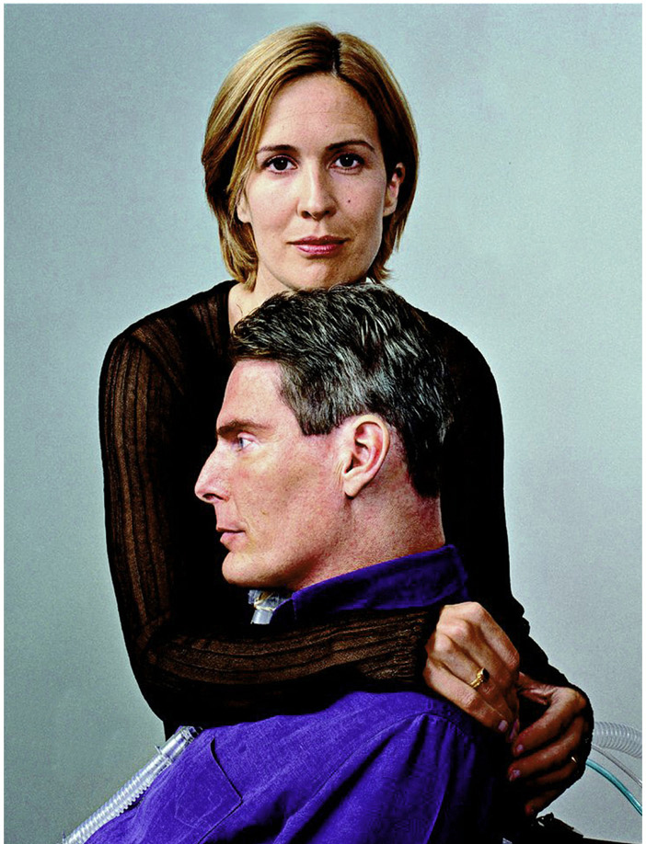
1. What emotional changes did Reeve's wife, family and friends possibly go through after the accident? What might they have said to Reeve?
Possible Answers:
They were shocked and overwhelmed with grief at first. When they found Reeve wanted to end his life, they were so worried that they thought they must do something to cheer him up. When Reeve came out of the “nightmare”, they felt relieved and proud of what he did.
“This is the low point. There's nowhere to go but up, and that's exactly where you're headed. We'll always be there for you! We're always proud of you! Cheer up and be yourself!”

Slide 9
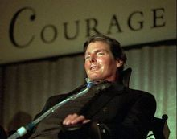
2. After Reeve became an advocate for people with back injuries and disabilities, what might he possibly have said to his audience?
Possible Answers:
There will be many choices before you, some of which you’ll welcome and celebrate, and then there will be some over which you will anguish. Some choices will choose you. How you face these choices, these turns in the road, with what kind of attitude, more than the choices themselves, is what will define the context of your life.

Slide 10
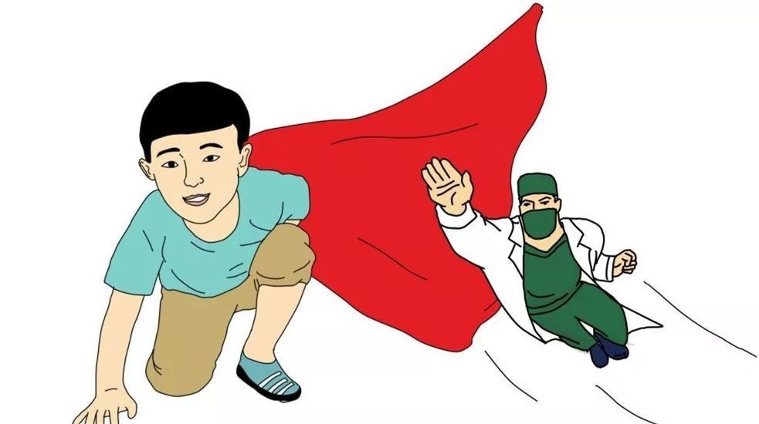
3. What might Reeve's doctors have said to Reeve directly after the accident and when he managed to return to his film career?
Possible Answers:
Directly after the accident: It's absolutely miracle that you could survive such a disaster. I absolutely believe in miracles, and believe that they are all around us, every day. Just rest and take good care of yourself!
When he managed to return to his film career: I can't believe this day finally comes! Still, you need to take good care of yourself and always put your health first.

Slide 11
Task 3
“Christopher Reeve will always be remembered as a superhero--in more ways than one.”
Can you find any examples to prove this sentence?
Can you add more words to describe Reeve's admirable qualities?

Slide 12
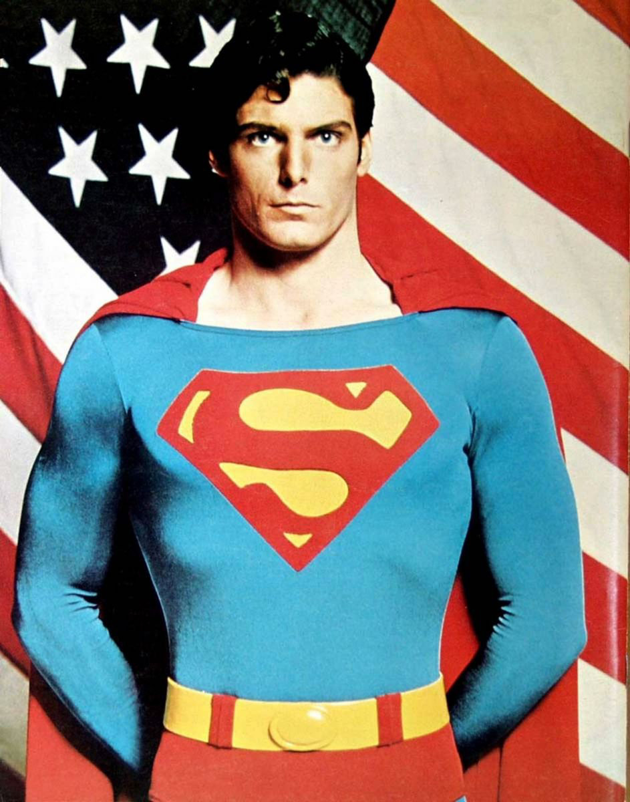
Task 3
visited sick children in hospitals and worked with organisations such as Save the Children, speaking out about health...
became an advocate for people with back injuries and disabilities
positive attitude in helping others
raised millions of dollars in support of medical research
focused his attention on his goal of one day walking again
postive attitude towards life
undertook an intense exercise programme and made remarkable progress
managed to return to his film career and charity work

Slide 13
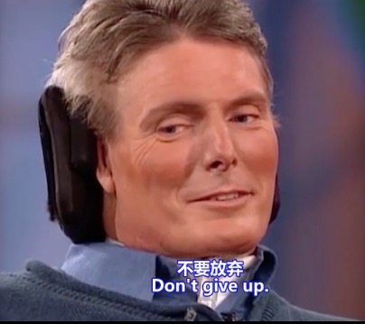
Task 4
Watch a video and think about the following question.
What inspiration do you get from Christopher Reeve?

Slide 14
What inspiration do you get from Christopher Reeve?
Possible Answers:
Never give up no matter how bad the condition is.
Have a sense of obligation, including the obligation to family, the obligation to society, etc.
You don't need to be a superman to help others. Everybody can help others with the kindness inside you.

Slide 15
Task 5
Use what you have learnt to introduce a superhero in real life that you admire. Then give a presentation in front of class within 3 min.
Tips:
1. Search online for more information about a superhero in real life that you admire.
2. Take notes about the following expressions about describing admirable qualities from text. Try to use some in your own presentation if necessary.
raise awareness for...
undertake an intense exercise programme
work with organisations
engage in...
gain a reputation
become an advocate for
raising millions of dollars in support of
make remarkable progress

Slide 16
谢谢您的观看
北京市朝阳区教育研究中心 制作

Slide 17
视频来源：
https://www.bilibili.com/video/av40500265?from=search&seid=6603532712233090218
无法下载，仅供大家参考！

