Slide 1
“令人敬佩的人” Listening（II）
朝阳区线上课堂·高一年级英语
朝阳外国语学校 梁丹丹

Slide 2
Learning objectives
1. 通过听关键词，获取文本的细节性信息。
2. 判断出说话者表达的确定和不确定的观点，并总结出相关功能用语。
3. 正确使用表达确定和不确定的语言表达观点。

Slide 3
Guidance on learning
在听的过程中，通过听关键词获取必要的细节信息；通过听取表达确定和不确定的语言，判断作者的观点。注意学习积累对话中的功能用语，在人际沟通中，恰当的表达自己的观点。

Slide 4
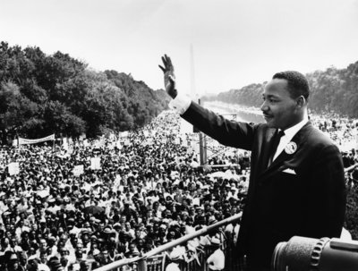
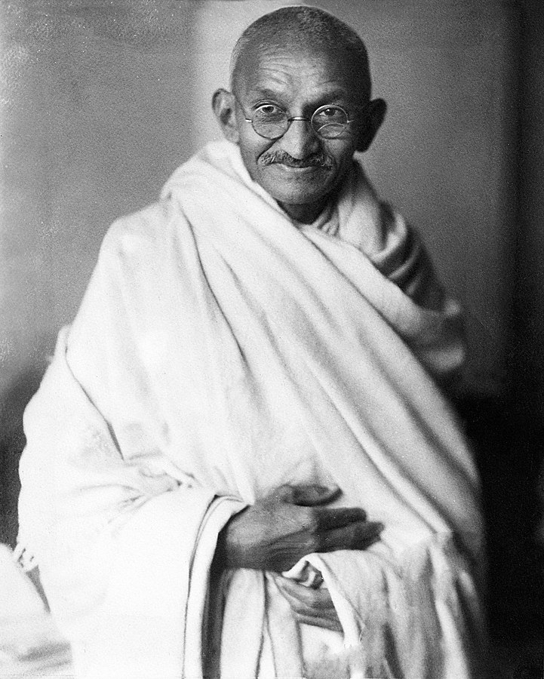
Unit 6 lesson 2 History Makers(2)
Mahatma Gandhi

Slide 5
Do they have anything in common?
He organised peaceful protests.
He suffered racial discrimination in South Africa.
He was put behind bars many times.
He inspired people around the world to fight for equal rights and justice.

Slide 6
Listen to the conversation between two students.
1. Why does the girl suggest that they talk about Mahatma Gandhi in their project?
Because she admires and respects him and because he was one of the most important figures of the 20th century.
2. Why was Gandhi so important?
Because he led India to independence from British rule.

Slide 7
Focus on function
Listen again. Are they certain or uncertain? How do you know?
They use some expressions to show certainty and uncertainty, such as I’m certain, I’m not sure….
1. The girl is certain/uncertain that Gandhi was one of the most important
figures of the 20th century.
2. The girl is certain/ uncertain about the date of India’s independence.
3. The boy is certain/uncertain that Gandhi inspired Martin Luther King.
4. The girl is certain/uncertain that Gandhi inspired Martin Luther King.
5. The boy is certain/uncertain that Gandhi did not win the Nobel Peace
Prize.

Slide 8
Expressing certainty and uncertainty.
Certainty
_____________that he was one of the most important figures of the 20th century.
Yes, I ________
Actually, I __________Gandhi ever won a Nobel Peace Prize.
I’m pretty ________he didn’t.
Uncertainty
_________about the exact date.
_________? Are you ________________?
__________ if that’s true…
__________We should check a few other websites.
There’s no doubt
’m certain.
don’t think
sure
I’m not sure
Really
sure about that
I don’t know
Perhaps
Listen again and complete the Talk builder.

Slide 9
Speaking
Please speak out the answers directly. Use some expressions to show your certainty or uncertainty.
1. If you are asked to introduce an admirable person in China, who will you choose?
2. Why do you think he/she is important?
3. Are you sure all of your friends know him/her?
4. Do you know anything about his/her background? Are you sure about that?
5. What did he/she do? When did he/she do that?
6. Is there anything interesting about him/her? How can you know it?

Slide 10
Speaking Possible answers.
1. If you are asked to introduce an admirable person in China, who will you choose?
There are many great people in the history of China. But I may choose Tuyouyou.
2. Why do you think he/she is important?
Because she was the first Chinese female scientist to be awarded a Nobel Prize. She discovered artemisinin which has saved the lives of millions.
3. Are you sure all of your friends know him/her?
Yes. I’m certain. She is well-known.
4. Do you know anything about his/her background? Are you sure about that?
I know she was born in Zhejiang Province and studied medicine at Peking University.
I’m sure about these because I learned the inforamtion from our textbook.
5. What did he/she do? When did he/she do that?
She discovered the life-saving drug--artemisinin with her team. But I don’t know the exact year.
6. Is there anything interesting about him/her? How can you know it?
I’m not sure. Perhaps I can find some on the Internet.

Slide 11
What have you learned about Mahatma Gandhi?
Gandhi was one of the greatest important figures of the 20th century. He led India to independence from British rule in 1947. he believed in the power of peaceful protests where no one was hurt. He inspired many people in the world, including Martin Luther King. But he never won a Nobel Peace Prize.

Slide 12
Homework
Choose a person whom you regard as a history maker for China. Search online and find information about him/her. Make a short presentation about the person.
Using the following titles as a guideline:
Reasons for choosing this person.
His/her background.
What did he/she do?
What did he/she achieve?

Slide 13
谢谢您的观看
北京市朝阳区教育研究中心 制作

