Slide 1
“令人敬佩的人” Listening（I）
朝阳区线上课堂·高一年级英语
朝阳外国语学校 梁丹丹

Slide 2
Learning objectives
获取和梳理关于Martin Luther King的事实性信息。
按照时间和事件发展顺序，介绍Martin Luther King的人物事迹。
利用获取的信息推断Martin Luther King的精神品质。

Slide 3
Guidance on learning
在听的过程中，要注意听取对话者的问句和回答，掌握材料的大意。在涉及到人物故事时，不仅要听关键词获取关于人物故事的细节性信息，还要注意听表示时间和顺序的词语和表达，掌握事件发生的先后顺序，从而更好的了解人物身上发生的故事。

Slide 4
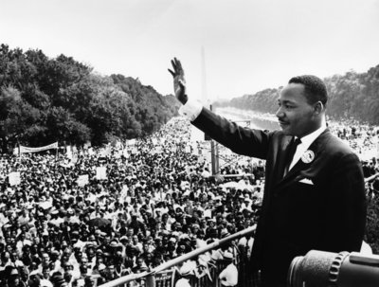
Unit 6 lesson2 History Makers(I)
Martin Luther King

Slide 5
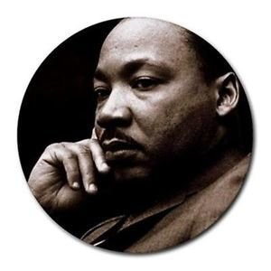
What do you know about Martin Luther King?
Pick out the right information for him.
( )1 He fought to win equal rights for black people in the US.
( )2 He led his country to independence from British rule.
( )3 He organised peaceful protests.
( )4 He suffered racial discrimination in South Africa.
( )5 He gave a famous and inspiring speech which started with
the words “I have a dream”.
( )6 He was put behind bars many times.
( )7 He inspired people around the world to fight for equal rights
and justice.
( )8 He won the Nobel Peace Prize.

Slide 6
What do you know about Martin Luther King?
Pick out the right information for him.
√
( )1 He fought to win equal rights for black people in the US.
( )2 He led his country to independence from British rule.
( )3 He organised peaceful protests.
( )4 He suffered racial discrimination in South Africa.
( )5 He gave a famous and inspiring speech which started with
the words “I have a dream”.
( )6 He was put behind bars many times.
( )7 He inspired people around the world to fight for equal rights
and justice.
( )8 He won the Nobel Peace Prize.
×
√
√
√
√
√
√

Slide 7
Complete the sentences with the words given.
right, independence, racial discrimination, protest, bars, inspire
1. We shouldn’t have ____________.
2. The life of Helen Keller has _______thousands of people in the world.
3. Workers stopped work to show their _______against the new policy.
4. Jean is fighting for equal _______for women.
5. He was behind _____because of murder.
6. Mexico achieved _________from Spain in 1821.
racial discrimination
inspired
protest
rights
bars
independence

Slide 8
Order the sentences about Martin Luther King.
Skill Builder
He ①_d_ ② ___ ③ ___ ④ ___ ⑤ ___
a organised a march to Washington,D.C. _____
b organised a bus protest to help black people win the
right to sit next to white people on buses. _____
c was killed. _____
d had to give up his seat to two white people on a bus
because he was black. _____
e received the Nobel Peace Prize. _____
When listening, pay attention to words related to order and sequence, e.g. first, after, the next year, later, in the end.
Add the year for each sentence.
Listen and check your answers.

Slide 9
Order the sentences about Martin Luther King.
b
a
e
c
He ①_d_ ② ___ ③ ___ ④ ___ ⑤ ___
a organised a march to Washington,D.C. _____
b organised a bus protest to help black people win the
right to sit next to white people on buses. _____
c was killed. _____
d had to give up his seat to two white people on a bus
because he was black. _____
e received the Nobel Peace Prize. _____
1963
1955
1968
1943
1964

Slide 10
Listen again. Complete the answers to the questions about Martin Luther King.
Martin Luther King
What did he suffer? | He suffered_____________
_____________ | He organized____________ He helped black people____________
_____________ | He received _____________ He inspired people around the world______________
racial discrimination.
a bus protest and many peaceful protests, a march to Washington D.C. and made a speech.
What did he do?
win the right to sit next to white people on buses.
the Nobel Peace Prize.
What did he achieve?
to fight for equal rights and justice.

Slide 11
What do you remember about Martin Luther King?
Speaking:
Make a brief summary of what Martin Luther King did in the following years. Add more information you’ve learned about him if you can.
1955
1964
1943
1963
1968
Use any specific dates or time expressions, e.g. in 1943, after, later, the next year…. to make your summary more coherent or logical.

Slide 12
Possible version:
Martin Luther King was a great man in the history who fought to win equal rights for black people in the US. He suffered racial discrimination in his childhood. In 1943, he was asked to give his seat to white people on the bus. But he didn’t want to give up his seat. In 1955, He organised a bus protest and won the right for black people to sit next to white people on buses. After this victory, he made many peaceful protests. In 1963, He organized a march to Washington, D.C. and made his famous and inspiring speech starting with the words “I have a dream”. The next year, King received the Nobel Peace Prize. But unfortunately , He was killed a few years later in 1968….

Slide 13
What kind of person do you think Martin Luther King was? Find evidence from the text to support your idea.
E.g. I think Martin Luther King was brave because he didin’t give up fighting for equal rights although he was put behind bars many times for doing so.
inspiring----He has inspired people around the world to fight for equal rights and justice.
with a sense of justice----he believed that black people should be treated the same as white people.
tenacious(determined and not give up easily)----after some struggles, they won the right to sit next to white people on buses.
dedicated----he did a lot to help black people in the US.

Slide 14
Why is Martin Luther King a history maker?
Possible answer:
He made a great contribution to winning the equal rights and justice for black people in the US and his spirit has inspired people all around the world.

Slide 15
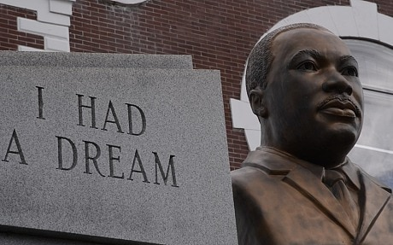
Homework
Design an impressive profile of Martin Luther King.

Slide 16
谢谢您的观看
北京市朝阳区教育研究中心 制作

