Slide 1
“令人敬佩的人” 词汇学习（2）
朝阳区线上课堂·高一年级英语
北京市朝阳外国语学校 董晓玉

Slide 2
学习目标：
1.在主题语境中理解词义，辨别词性。
2.借助上下文辨析下列词Recipe; promising; cause; commitment; strike; subject的词义。
3.借助上下文完成句子，掌握词汇的搭配。
学法指导：
关注上下文语境，分析词义，词性。
关注一词多义，旧词新义。

Slide 3
Word study
Task 1: Figure out the meanings and part of speech based on the context / the suffixes.
Words from the texts | Part of speech(词性） | Root word (词根) | 词义 | 相关词
Scientists are admirable for their contribution .
An effective drug
The prize is recognition and encouragement for all scientists in China.
值得崇敬的
admiration n. 崇拜之情
admirer n. 崇拜者
admire v.
Adj.
Adj.
effect n.
affect v.
有效的
recognize v.
recognizable adj.
n.
认可
Adj. encouraging鼓励的
encouraged 受到鼓励
encourage v.
鼓励

Slide 4
Word study
Words from the texts | Part of speech (词性） | Root word (词根） | 词义 | 相关词
Tu Youyou used old wisdom and new methods.
He made an inspiring speech
智慧
words of wisdom至理名言
wisely adv.
n.
wise adj.
inspired adj.
inspiration n.
adj.
inspire v.
鼓舞人心

Slide 5
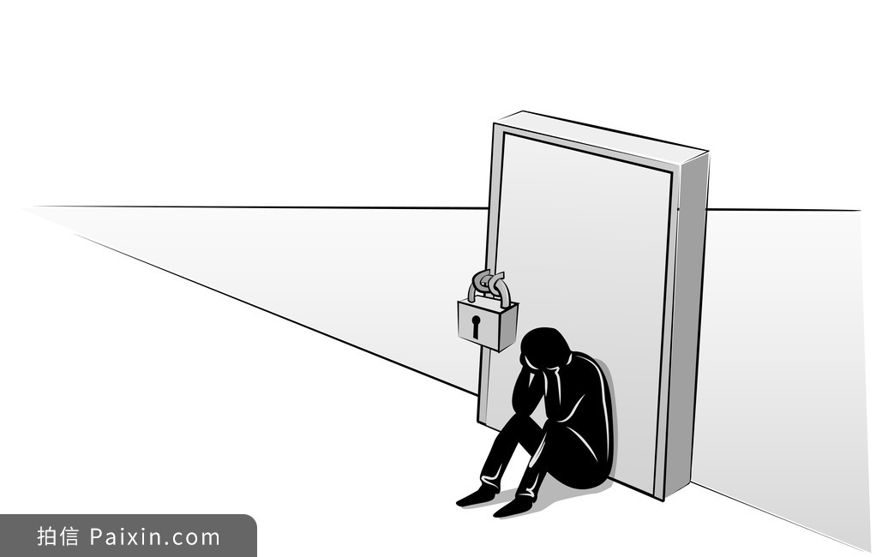
Word study
Words from the texts | Part of speech (词性） | Root word (词根） | 词义 | 相关词
He fell into depression.
One of the most influential figures
He raised awareness for good causes.
n.
depress v.
抑郁
depressed; depressing
influence
v. n.
有影响力的
adj.
have an influence on …
n.
aware adj.
be aware of sth. 意识到…
意识

Slide 6
Word study
Words from the texts | Part of speech (词性） | Root word (词根） | 词义 | 相关词
Reeve became a passionate and energetic advocate.
adj.
passion n.
energy n.
激情的
活跃的
passionately; energetically
（adv.）

Slide 7
Word study---have a check
admire; admirable; admiration; admirer
She's got a secret _________ who keeps sending her gifts.
All those who knew him will ________ him for his work.
I'm full of ___________ for those who handled this outbreak of novel coronavirus.
The police did an ___________ job in keeping the fans calm.
admirer
admire
admiration
admirable

Slide 8
Word study-have a check
recognize; recognition; recognizable
When he returned to his home town after the war, he found it had changed beyond all ____________.
The international community has refused to _________ the newly independent nation state.
The World Health Organization has _________ alcoholism as a disease since 1951.
The Eiffel Tower in Paris is an instantly ____________ landmark.
recognition
It had changed so much that he couldn’t recognize it.
recognize
to officially accept
recognized
recognize …as…
recognizable
despite
Easy to recognize

Slide 9
Word study-have a check
encourage; encouraging/encouraged; encouragement
She felt ___________ by the many letters of support.
My mother smiled _____________ at me as I went up on stage.
Mick was always ready to offer advice and words of _____________.
encouraged
encouragingly
encouragement
severe
despite

Slide 10
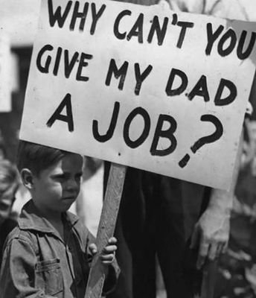
Word study-have a check
depress; depressed/depressing; depression
I find this weather so ___________ with the rain continuing for days .
It _________ me to think that I'll probably still be doing exactly the same job in ten years' time.
High interest rates(利率) are continuing to ________ the economy.
The country is experiencing a severe economic ___________.
She became deeply __________ when her husband died.
depressing
depresses
=It makes me unhappy
让经济低迷
depress
depression
经济大萧条
depressed
despite

Slide 11
Word study-have a check
influence/influential; aware/awareness
She wanted to work for a bigger and more ____________ (= powerful) newspaper.
He is a bad _________ on the kids. Don’t let him get too close.
My dad _________ me to do electronics as he was a great electronic engineer.
They were well/fully _______that the company was losing money.
Environmental ____________ has increased dramatically over the past decade.
influential
=He has a bad influence on the kids.
influence
influenced
充分意识到
aware
awareness
环保意识

Slide 12
Word study-have a check
Passion/passionate; energy/energetic
She had a _______ for gardening.
I've always been __________ about football.
She was full of ________ after her vacation.
Oil shortages have brought on an ______ crisis..
She seems remarkably _________ for a woman her age.
passion
have a passion for sth.
passionate
be passionate about sth.
能量满满
energy
能源危机
energy
energetic

Slide 13
The end of task 1
Task 2：?

Slide 14
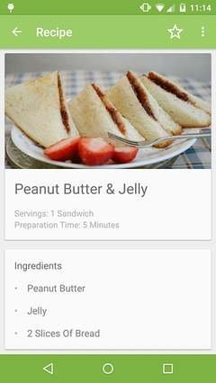
Task 2--Figure out the meaning of the underlined words based on the context.
1. Tu Youyou researched hundreds of traditional recipes connected to anti-malarial cures.
recipes n. 1） a set of instructions for cooking 食谱
2）（旧时的）处方=prescription
3)--Five small boys on skis was a recipe for disaster , not a holiday.
后患无穷
--If there is any recipe for success, I would say it‘s hard work.
成功的诀窍

Slide 15
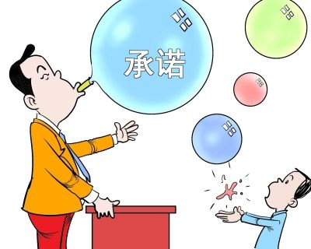
Task 2--Figure out the meaning of the underlined words based on the context.
2. After hundreds of failed experiments, they eventually came across a promising chemical.
Come across ---to discover sth. by chance
promise 1 (n.)
---make a promise
---keep/honor one’s promise/live up to one’s promise
---break one’s promise
promise 1 (v.)
-Her parents promised her a new car if she passed her exams.(promise sb. sth.)
-She's promised to do all she can to help.(promise to do..)

Slide 16
Task 2--Figure out the meaning of the underlined words based on the context.
2. After hundreds of failed experiments, they eventually came across a promising chemical.
有希望会奏效的化学物质
Promise 2 (v. n.) (to show )signs of something 有…迹象；有希望会…
It promises to be a really exciting match.这会是一场十分刺激的比赛
Dark clouds promised the showers later. 乌云预示着阵雨要来。
promising (adj.): showing signs of being successful or good in the future 很有前途的
--a promising career in law --a promising young actor

Slide 17
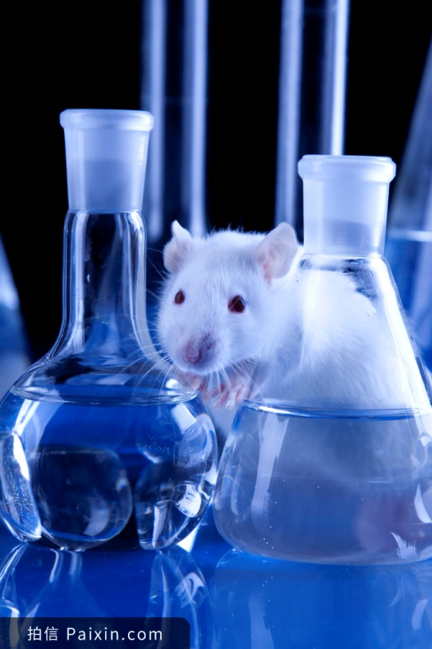
Task 2--Figure out the meaning of the underlined words based on the context.
3. The chemical worked well on animals, but they had to know if it was safe for humans. Youyou bravely volunteered to be the first human subject when they were ready to start testing.
a person or animal that is used in a test or experiment
subject(n.)科目;主语;主题…

Slide 18
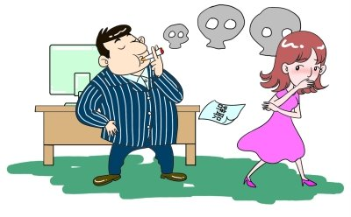
What does subject mean in the following sentences?
In recent years, she has been subject to attacks of depression.
The man had subjected his wife to years of second-smoke.
subject adj.
Be subject to sth.---to experience sth. unpleasant遭受
subject v.
subject sb. to sth.---to make sb. experience sth. unpleasant使某人遭受……

Slide 19
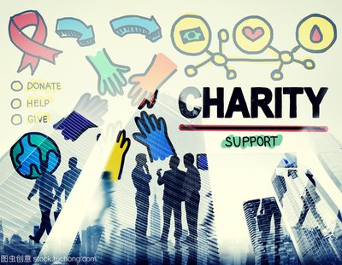
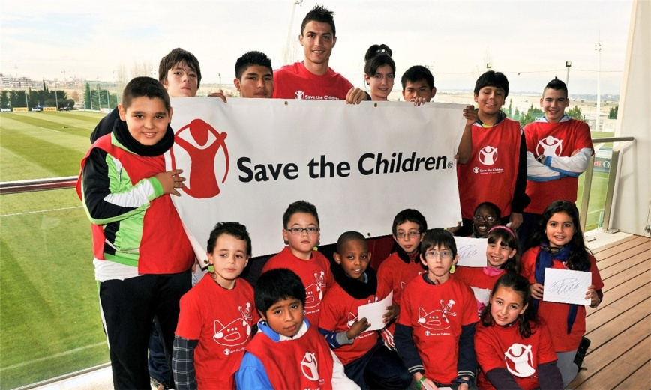
Task 2--Figure out the meaning of the underlined words based on the context.
4. He soon gained a reputation for raising awareness for
good causes. He visited sick children in hospitals and worked with organizations such as Save the Children…
慈善事业
Gain a reputation:赢得声誉
raise awareness for … : 增强……意识

Slide 20
Task 2--Figure out the meaning of the underlined words based on the context.
Other uses of “cause”
The police are still trying to establish the cause of the fire. She had died of natural causes.
The difficult driving conditions caused several accidents. The bright light caused her to blink.
cause n. =the reason why something, especially something bad, happens 起因
cause v. =to make sth. happen

Slide 21
Task 2--Figure out the meaning of the underlined words based on the context.
5. Unfortunately, in 1995 disaster struck Reeve.
Strike (struck; struck) v.
(something bad) suddenly happen to attack/damage/harm someone
Similar use: The disease has struck the whole community, sometimes wiping out whole families.
The clock was striking ten as we went into the church.
She struck a match and lit another cigarette.
A snowball struck him on the back of the head.
A rather worrying thought struck me.
Teachers went on strike last week to demand job security.
American aircraft carriers have launched several strikes .
strike v. ---敲响
strike v. ---划火柴
strike v. =hit
strike v. ---突然想起
strike n. 罢工
strike n. =attack

Slide 22
Task 2--Figure out the meaning of the underlined words based on the context.
6. With a new sense of energy and commitment, Reeve undertook an intense exercise programme to help him walk again.
Commitment: when you are willing to give your time and energy to something 致力投入
e.g. Martin Luther King is respected for his commitment to the cause of equal rights for black people.
commit v. ---犯罪
commit suicide 自杀
He was sent to prison because he had committed a crime.
The government must commit itself to improving health care.
Like so many men, he has problems committing himself to a relationship.
I'd committed myself and there was no turning back.
Commit oneself to doing. ---致力于做……
忠实于
尽我全力

Slide 23
Check yourself
complete the sentences with the words mentioned above.
Recipe; promising; cause; commitment; strike; subject
I was impressed by the energy and ____________ shown by the players.
They won the award for the most ___________ new band of the year.
She made a ___________ to visit them once a month.
Can we just drop the ___________ now, please.
The ___________of this experiment were all men aged 18-35.
commitment
promising
promise
subject
subjects

Slide 24
Check yourself
complete the sentences with the words mentioned above.
Recipe; promising; cause; commitment; strike; subject
cause
6. They are trying to determine the ______ of the crash.
7. The Raleigh International Bike Ride is open to anyone who wants to raise money for a good ______.
8. For real Indian food, just follow these __________.
9. Have you ever been _____ by lightning? 10. It suddenly _______ me how we could improve the situation. I immediately shared my idea with my colleagues.
cause
recipes
struck
struck

Slide 25
The end!

Slide 26
谢谢您的观看
北京市朝阳区教育研究中心 制作

