Slide 1
“令人敬佩的人”A Medical Pioneer (1)
朝阳区线上课堂·高一年级英语
东北师范大学附属中学朝阳学校 孔芳

Slide 2
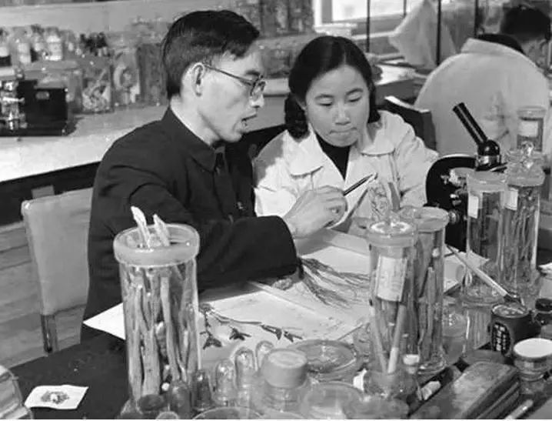
Lesson 1 A Medical Pioneer (1)

Slide 3
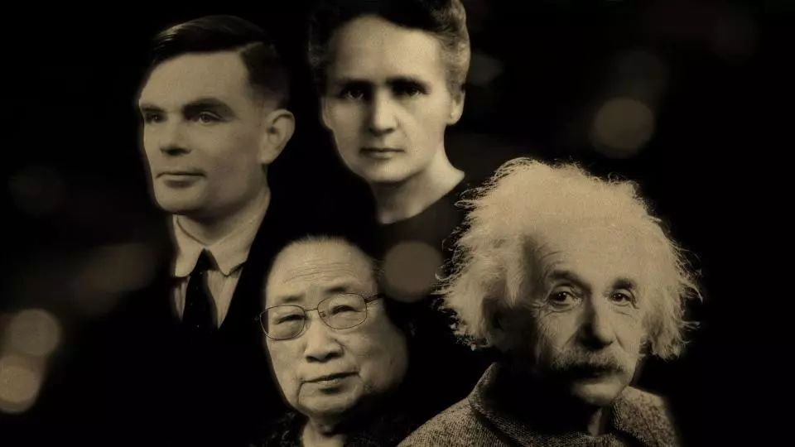
What is a “pioneer” ?
a person who is the first to study and develop a particular area of knowledge, culture, etc. that other people then continue to develop

Slide 4
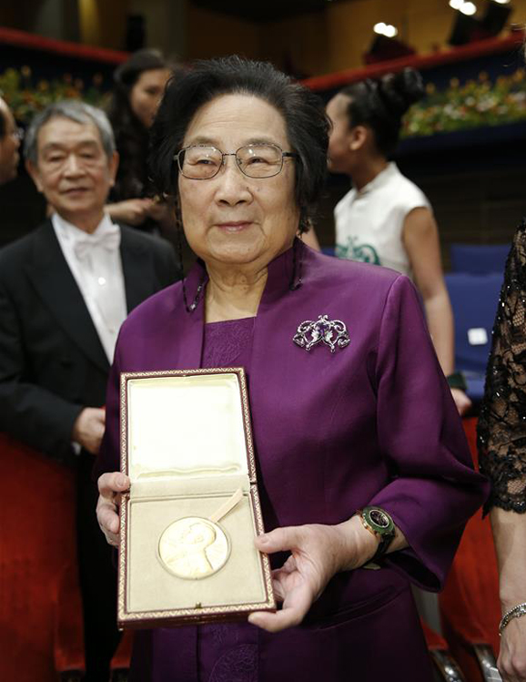
What do you know about her?
She is a Nobel Prize Winner.
She has discovered a life-saving drug called artemisinin /,ɑːtɪ'miːsɪnɪn/(青蒿素) to cure malaria /məˈleəriə/(疟疾).

Slide 5
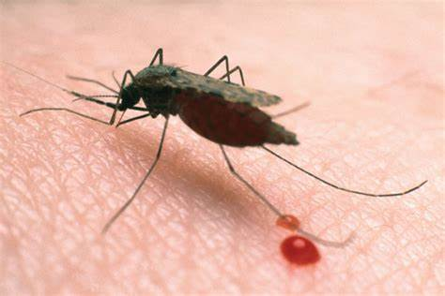
What do you know about malaria?
1. Malaria is a mosquito-borne and infectious disease.
2. People suffer from high fever, serious vomiting and terrible headaches when they have the disease.
3. Malaria kills over 1,000,000 people a year.

Slide 6
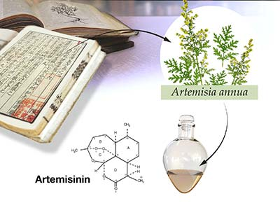
Tu Youyou found a cure for malaria. The drug is called artemisinin.

Slide 7
Prediction
If you are going to read a news report about Tu Youyou, predict what aspects will be written about her.
The Nobel Prize?
Her life experience?
How did she discover the drug?

Slide 8
Reading for main idea
Read the text and tick out.
What aspects about Tu Youyou were written in this article?
1. basic personal information
2. appearance and personality
3. attitudes towards fame and future research
4. scientific work
5. the Nobel Prize Award
para2
✔
×
para5
✔
para3-4
✔
para1
✔

Slide 9
Reading for details.
Read again and complete the flow chart.
The Nobel Prize Award
Basic information
Scientific work
Attitudes
Time:
The Committee's
comment:
Tu Youyou's opinion:
Date of birth:
Birthplace:
Education:
Task and difficulties:
Research:
Discovery:
Towards the honour:
Towards future research:

Slide 10
Para1 : The Nobel Prize Award
Time:
on 7 December, 2015
The Committee's comment:
have saved the lives of millions
Tu Youyou's opinion:
recognition and encouragement for all scientists in China

Slide 11
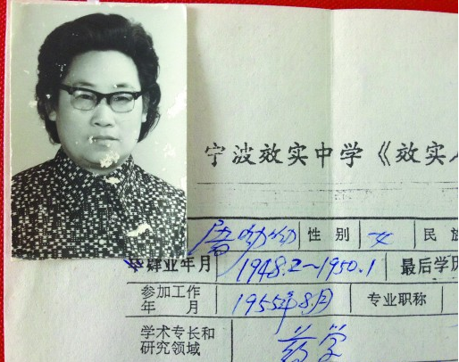
Para2: Basic information
Date of birth:
on 30 December, 1930
Birthplace:
in Zhejiang Province, China
Education:
studied medicine at Peking University
studied Chinese medicine with experts in the field

Slide 12
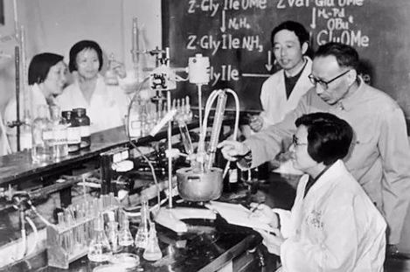
Para3-4: Scientific work
Task and difficulties:
Task: to find a cure for malaria
Difficulties: limited resources, not
enough staff, poor working condition
Research:
1. tested more than 240, 000 chemicals
2. researched hundreds of traditional recipes
3. voluntered to test herself
Discovery:
artemisinin, the most effective drug

Slide 13
Para5: Attitudes
Towards the honour:
not interested in fame
Towards future research:
great potential, fully integrated

Slide 14
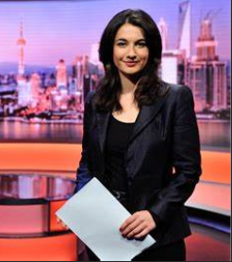
Making a news report.
Good morning, this is the BBC news.
On 7 December, 2015, the Chinese female scientist Tu Youyou was awarded ....

Slide 15
Suppose you were a news reporter from BBC news, write down a brief news report entitled Chinese Female Scientist Tu Youyou Won the 2015 Nobel Prize for Medicine based on the article we learnt today.

Slide 16
谢谢您的观看
北京市朝阳区教育研究中心 制作

