Slide 1
“令人敬佩的人”A Medical Pioneer (2)
朝阳区线上课堂·高一年级英语
东北师范大学附属中学朝阳学校 孔芳

Slide 2
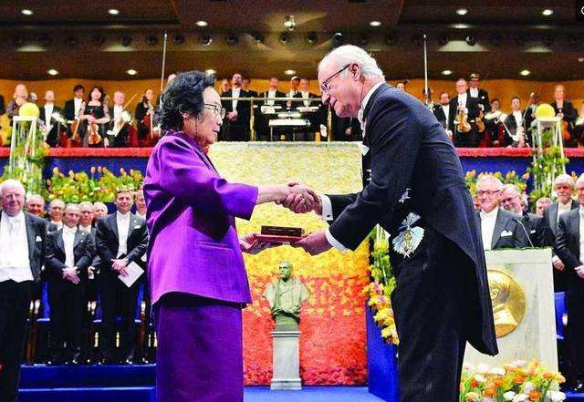
Lesson 1 A Medical Pioneer (2)

Slide 3
Deep reading
Word bank:
careful
patient
brave / courageous
wise / intelligent
creative / innovative capable
hard-working
tolerant
passionate
persistent
optimistic
dedicated
modest
determined
knowledgeable
indifferent to fame and fortune
What qualities do you think Tu Youyou has?
Use three words or phrases to summarise Tu Youyou's personal qualities. Give your reasons or evidence from the text.

Slide 4
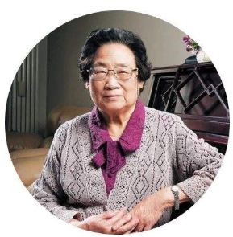
Let's analyze Tu Youyou's qualities together!
1. When thanking the committee for the honour, Tu Youyou said, “This is not only an honour for myself, but also recognition and encouragement for all scientists in China.”
modest

Slide 5
2. Later, she studied Chinese medicine for two and a half years with experts in the field from whom she gained a deep knowledge about traditional practices.
knowledgeable

Slide 6
3. They tested more than 240,000 chemicals with no success. However, Tu Youyou had an idea that Chinese herbs might hold the secret.
creative /
innovative

Slide 7
4. She researched hundreds of traditional recipes connected to anti-malaria cures. Then Tu Youyou and her team began using modern research methods to study these Chinese herbs one by one.
careful

Slide 8
5. This was not an easy task. The reason why this was difficult was that the team had limited resources. They did not have enough staff, and the laboratory in which they worked had poor air quality.
hard-working
tolerant

Slide 9
6. However, after hundreds of failed experiements, they eventually came across a promising chemical.
patient
persistent

Slide 10
7. It worked well in experiments on animals, but they had to know if it was safe for humans. Tu Youyou bravely volunteered to be the first human subject when they were ready to start testing and the rest of her team followed her.
brave / courageous

Slide 11
indifferent to fame
8. Even though Tu Youyou is not interested in fame, she has become a scientist whose work is internationally renowned.

Slide 12
9. Tu Youyou was noted for her bravery in being a scientist during a difficult time for science in China, her ability to use old wisdom and new methods to achieve her goals...
brave
capable

Slide 13
10. Today Tu Youyou continues to conduct research despite her age.
passionate
dedicated

Slide 14
11. “... There is great potential for future advances if these two kinds of wisdom can be fully integrated,” she said.
optimistic

Slide 15
What quality of Tu Youyou do you admire most? Why?
modest
knowledgeable
innovative
careful
patient
persistent
hard-working
tolerant
brave
courageous
indifferent to fame
capable
...
e.g. The quality that I admire most is Tu Youyou's bravery of risking her life to test the chemical. She might have lost her life.

Slide 16
What typical writing features can you identify in this news article?
Structure of the news article:
Headline 标题
Lead 导语
Body 正文

Slide 17
Writing features：
1. The headline is short and interesting.
2. Quotes and photographs are included.
3. The lead covers the most important information.
4. The body provides backgroud information.

Slide 18
Language focus
be awarded a Nobel Prize
an honour for myself
recognition and encouragement
gain a deep knowledge about...
establish a team
Chinese medical literature
come across a promising chemical
internationally renowned
conduct research despite her age
be fully integrated
被授予诺贝尔奖
对我个人的荣誉
认可和鼓励
对...获得深厚的知识
建立一个团队
中医医学文献
发现一种有前景的化学物质
国际知名的
进行研究尽管上了年纪
完全融合

Slide 19
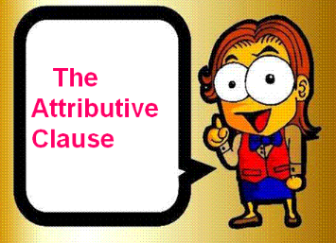
Grammar
Find out all the sentences with the attributive clauses.
1. She began to talk about the life-saving drug, artemisinin, which she had discovered with the help of her team in the 1970s.
关系代词引导的定语从句

Slide 20
2. A scientist who was on the Nobel Prize Committee called Hans Forssberg explained that “the discovery of artimisinin has led to the development of new drugs which have saved the lives of millions.
关系代词引导的定语从句

Slide 21
3. Later, she studied Chinese medicine for two and a half years with experts in the field from whom she gained a deep knowledge about traditional practices.
介词+whom 引导的定语从句

Slide 22
4. The reason why this was difficult was that the team had limited resources.
关系副词引导的定语从句

Slide 23
5. The laboratory in which they worked had poor air quality.
介词+which引导的定语从句

Slide 24
6. Even though Tu Youyou is not interested in fame, she has become a scientist whose work is internationally renowned.
关系代词引导的定语从句

Slide 25
The Attributive Clause
关系代词引导的定语从句 （which / who / whom /whose）
关系副词引导的定语从句 （when / where / why）
介词 +关系代词引导的定语从句 （介词 + which / whom)

Slide 26
Suppose your school wants to choose three most admirable people as role models. You have one minute to persuade the committee to include Tu Youyou. Use at least three relative clauses to present your recommendation.
Example: Tu Youyou is the scientist whose discovery has led to the development of new drugs which have saved millions of lives.

Slide 27
谢谢您的观看
北京市朝阳区教育研究中心 制作

