Slide 1
“令人敬佩的人” Vocabulary （1）
朝阳区线上课堂·高一年级英语
北京市朝阳外国语学校 董晓玉

Slide 2
学习目标：
1.归纳复习本单元与“the admirable qualities”,“A Medical Pioneer”,“History Makers”, “The Superhero”主题相关的词汇及其搭配。
2.在主题语境中加深词义的理解并强化词汇的搭配意识。
学法指导：
1. 按主题积累词汇。
2. 关注上下文语境，强化词汇的搭配意识。

Slide 3
主题一：admirable qualities
careers | what they do(V.+N.) | qualities(adj.-n.)
doctor | _________diseases _________ lives
scientist | ______ important discoveries ______ a difference to the world ______remarkable contributions to mankind
firefighter | __________ fires __________ people from danger ______ their own lives to save others
cure
brave-bravery 勇敢（courageous-courage）
intelligent-intelligence
wise-wisdom 智慧
creative-creativity 创造力
capable-capability能力
committed-commitment（承担，奉献）
Empathetic-empathy（同情）
save
make
make
make
put out
protect
risk

Slide 4
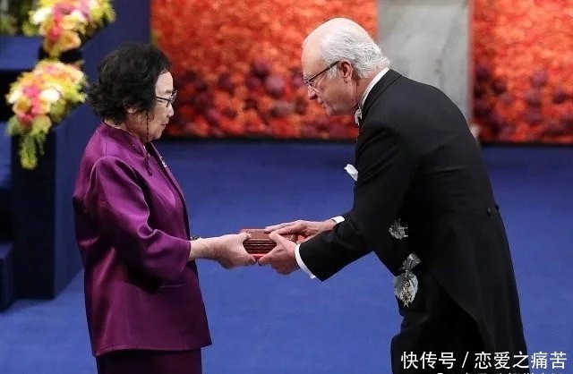
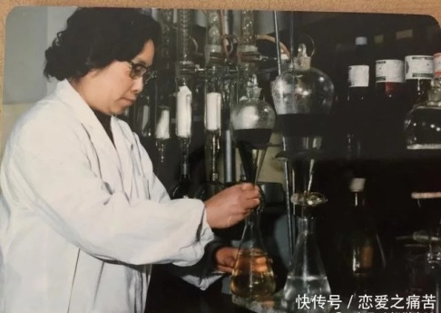
Now think : what qualities make Tu Youyou admirable?
主题二：A Medical Pioneer-
Tu Youyou
Her bravery, wisdom, creativity, commitment to scientific research.
malaria
artemisinin
青蒿素
medical pioneer
the first person to find the cure.
=world famous
传染的
A
B
an internationally renowned scientist
one of the most influential figures of science in the 20th century
the first Chinese female scientist to be awarded a Nobel Prize
research traditional Chinese recipes
integrate easten and western wisdom
bridge Chinese and western medicine
conduct research in spite of age
C
an infectious disease
suffer from high fever, vomiting and headaches
no effective vaccines against it
prove to be the most effective cure for malaria
life-saving medicine
有影响力的人物
=methods
呕吐
=combine
V. form a bridge
有效的疫苗

Slide 5
Have a check: Be a matchmaker and translate them.
infectious
suffer from
effective
major in
internationally
bridge
be awarded
influential
limited
establish
vaccines
vomiting
medicine
renowned
Chinese and western medicine
figures
a Nobel Prize
resources
diseases
a team

Slide 6
Complete the introduction with the words .
Tu Youyou is the first Chinese ________ scientist who was ________ the Noble Prize. In 1969, she was chosen to _________ a team to find a _______ for malaria-an _________ disease that killed millions of people every year. Tu Youyou’s team had _______ resources and they didn’t have enough ______. She studied ancient Chinese medical literature and visited _______ in traditional Chinese medicine. After hundreds of failed _________, they eventually discovered artemisinin, which is now the most ________ drug for fighting malaria. Tu Youyou was selected as one of the most _________ figures of science in the 20th century.
female
awarded
establish
cure
infectious
limited
staff
experts
experiments
effective
influential

Slide 7
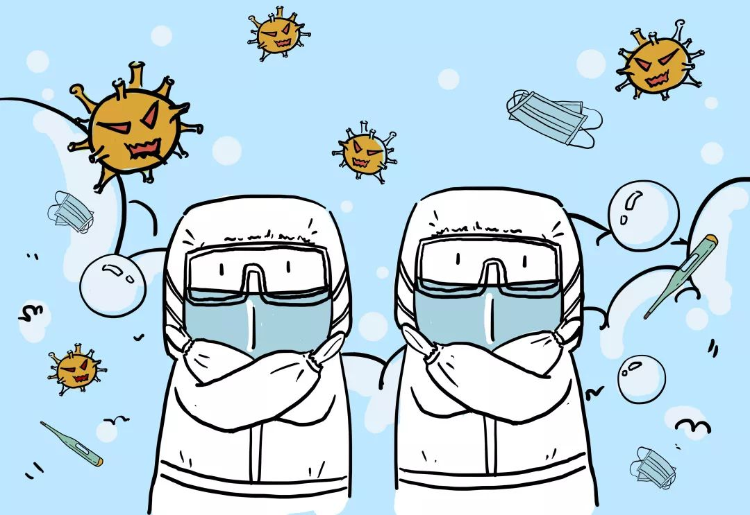
Use the given words to make sentences about the pictures.
infectious; effective vaccine; conduct; recipes
Covid-19 is an infectious disease that is striking the whole world. So far there have been no effective vaccine against it. But scientists and doctors are conducting research into different recipes to fight against the disease.

Slide 8
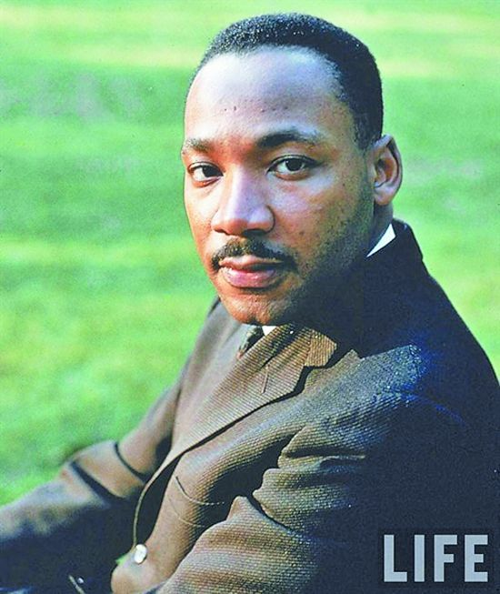
主题三：History makers
n. 抗议
fought for equal rights for black
organised peaceful protests
种族歧视
fought against racial discrimination
/racism; racist(种族主义；种族分子）
organized the Civil Rights March
Martin Luther King
民权游行
n. 不公正对待
made an inspiring speech
fought against unfair treatment
(be unfairly treated)
adj. 鼓舞人心的
received the
Nobel Peace Prize
was put behind bars
=was in prison/jail

Slide 9
Fill in the blanks with the words mentioned above.
His bravery, empathy and commitment to civil rights for black people.
Now think : what qualities of King’s impress you most?
Martin Luther King is a great man who fought to win __________ for the black people in the US. As a small boy he suffered from _________________, which is when people were treated _________ due to their skin colour.
He was put behind ______ many times for organsing peaceful ___________. In 1963, he organised the Civil Rights __________ to Washington, D.C., during which he made the famous and ___________ speech“I have a dream” .
The next year, he _________ the Noble Peace Prize, but unfortunately, he was killed in 1968 by some ______.
equal rights
racial discrimination
unfairly
bars
protests
March
inspiring
received
racists

Slide 10
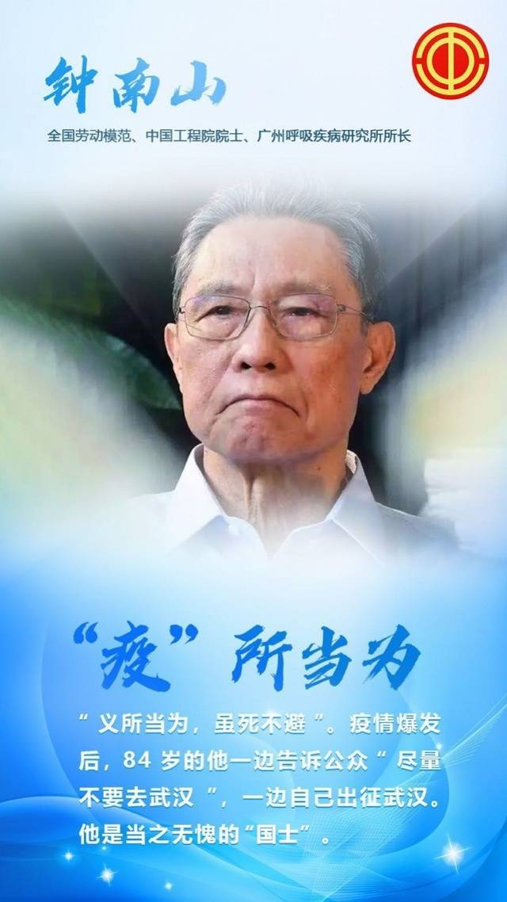
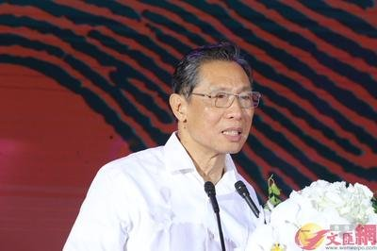
Use the given words to make sentences about the pictures.
influential figure; inspiring; fight against
Zhong Nanshan is the most influential figure during our fight against Covid-19 as he has given the public lots of inspiring words on how to protect ourselves and stop the virus from spreading.

Slide 11
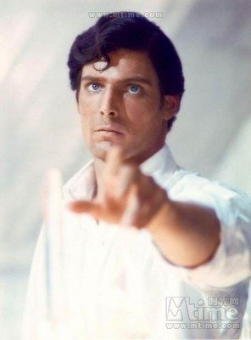
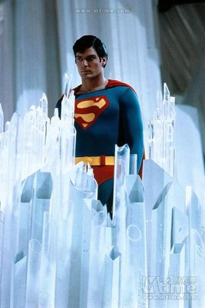
What do you remeber about the “superman”?
主题4：
Task: Make a phrase about superman based on the text.
A _________ successful Hollywood career.
Life-___________ injury
_________ in four Superman films
(played the ________ role in these films)
________ awareness for good causes and _______ a reputation
Helped those most ________
Suffered a ________ injury while horseback riding
Fell into a __________
undertook an _______ exercise programme
___________in a wide range of exercises
Wrote a __________
Became a ___________ and ___________ advocate
wildly
threatening
starred
leading
raised
gained
in need
severe
depression
n. 抑郁
intense
engaged
biography
n. 支持者
passionate energetic

Slide 12
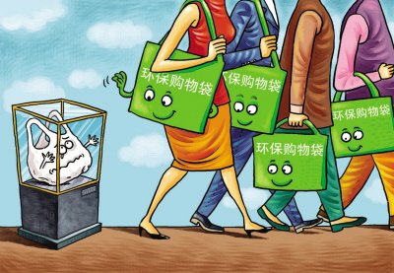
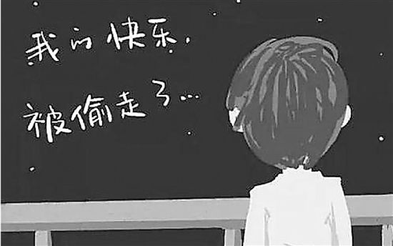
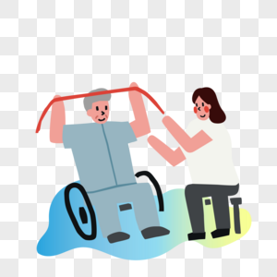
Practice: Complete the sentences with the phrases above.
As a specialist he tried hard to _____________ for environmental protection.
When he realised his severe situation, Reeve _________________.
Reeve ___________ a wide range of exercises to help him achieve his goal of walking again.
An aircraft overshot the runway and
was ___________ damaged. 一架飞机冲出了跑道后严重受损。
raise awareness
fell into depression
engaged in
severely

Slide 13
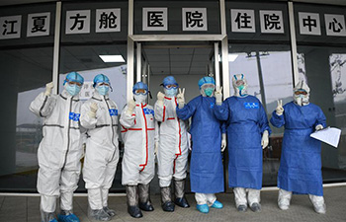
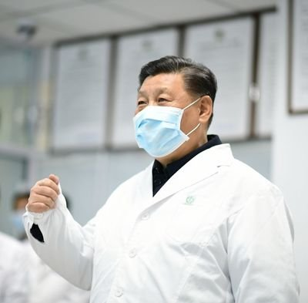
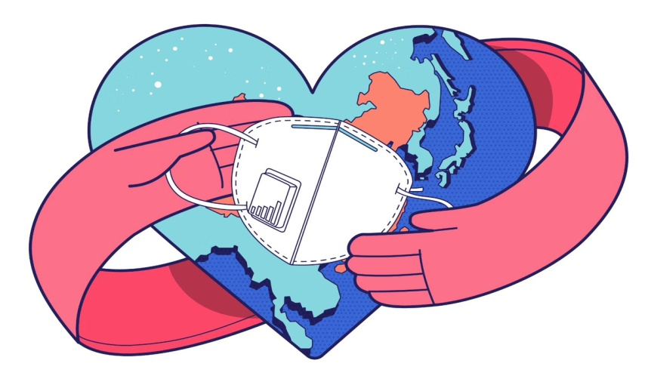
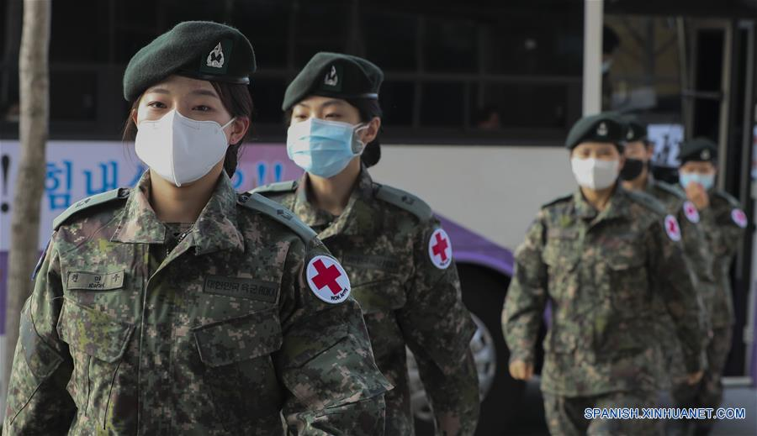
Use the given words to make sentences about the pictures.
life-threatening; severe; pioneer
play a leading role
Despite the severe attack of this life-threatening virus, Chinese people are playing a leading role as the brave pioneers to protect not only ourselves but also the world.

Slide 14
Introduce a person you admire most use the language you have learned
Start your introduction with “The person I
admire most is …, who is a scientist/novelist/….”
2. Then, introduce what he/she did/does (things)
3. Finally, give your comment on his/her quality.

Slide 15
The person the teacher admire most..!
The person I admire most is Tu Youyou, a female
scientist who discovered the life-saving drug artemisinin in the 1970s. It was really difficult to conduct their research at that time because they had limited resources and not enough staff. She also bravely volunteered to be the first human to be tested on after they discovered the drug. In spite of the international fame she has gained, she is not interested and continues to do research. I am deeply impressed by her courage, capability and commitment to her work.

Slide 16
Homework:
Write down your own introduction to the person you admire most using as many of the words you have learned as possible.
You can find out more about that person online to make your introduction more informative.

Slide 17
谢谢您的观看
北京市朝阳区教育研究中心 制作

