Slide 1
“人与自然” Writing Workshop（1）
朝阳区线上课堂·高一年级英语
人大附中学朝阳学校 曹雨

Slide 2
学习目标
能够理解“手册”的使用语境
能够总结“手册”的结构及语言特点
能够迁移新情境，撰写指示性段落

Slide 3
学法指导
学习时，同学们务必关注：
“手册”的结构和语言特点
祈使句和指示性语言的使用

Slide 4
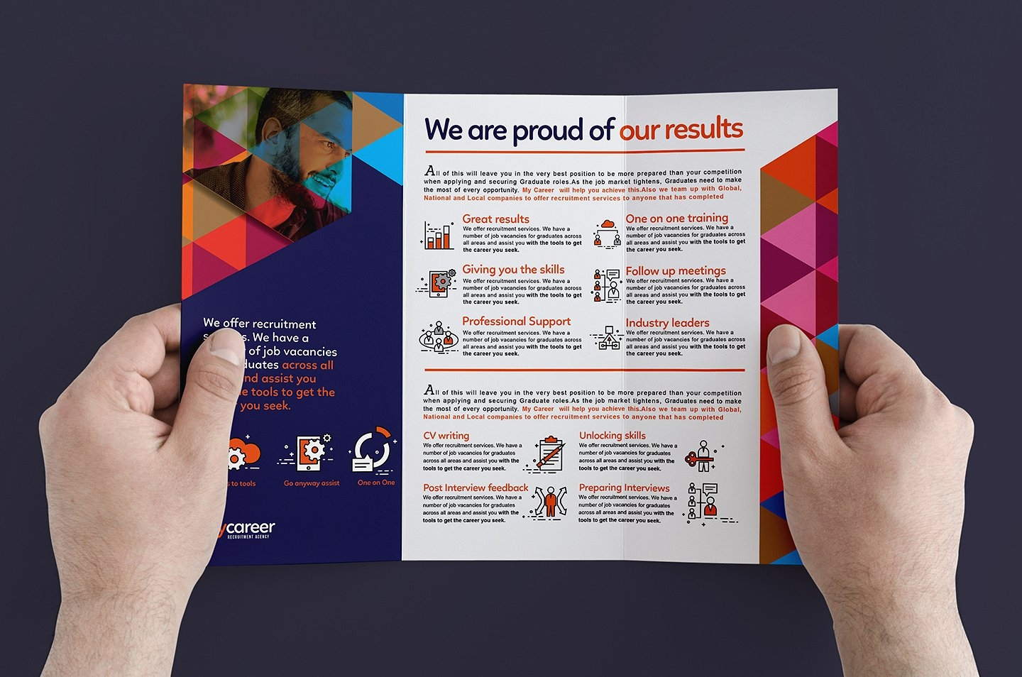
a small book or pamphlet containing pictures and information about a product or service
brochure
Notes:
they are used for give instructions. guide people how to do sth.

Slide 5
Unit 5 Writing Workshop A Brochure

Slide 6
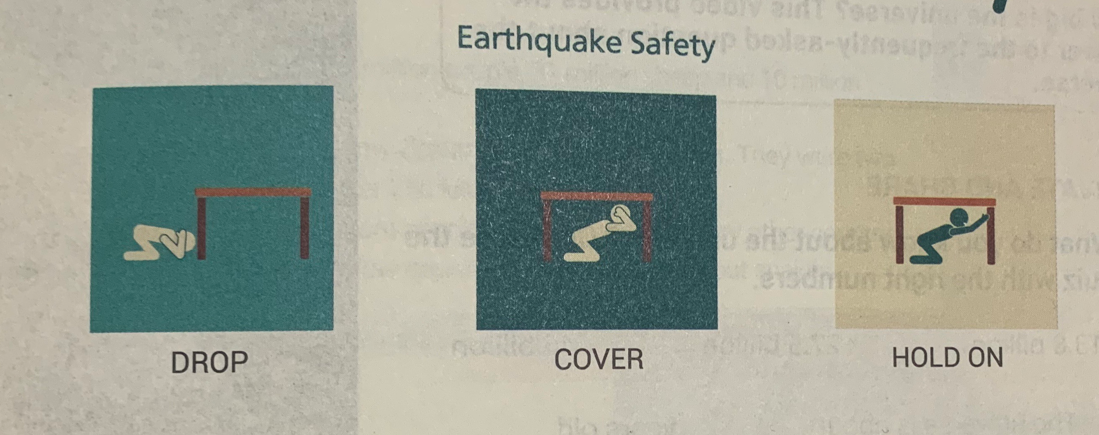
Prediction
What's the purpose of the brochure?
Notes:
this brochure is to instruct how to survive an earthquake.

Slide 7
If you’re indoors
·Don’t run, but protect yourself. Don’t try to run out of the building during an earthquake. The most important thing is to protect yourself as much as you can.
·Drop, cover and hold on. DROP down onto your hands and knees. COVER your head and neck with your hands, arms or hard objects. If possible, find a strong shelter nearby which will cover your whole body. HOLD ON to your shelter until the shaking stops.
做…是最重要的
趴下，落下
The most important thing is to study hard.
to maintain a grasp on something 紧抓，握住不放
n. 遮盖物，避难所

Slide 8
If you’re outdoors
从…离开
Move away from anything that can fall. Move to open areas. Buildings, trees, streetlights and power lines can fall down during an earthquake.
Find a shelter where you can stay. If you are near objects that can fall, find a shelter to protect yourself from them.
Wait before moving to another place. Objects may also fall after an earthquake and there are always strong aftershocks. Observe carefully before you move away.
n. 街灯，路灯
n. 输电线
n. 余震
Vt.观察，注意
eg. As a child, he liked to observe the behavior of birds.

Slide 9
If you’re in a car
Stop. Stop your car as soon as you can, but avoid stopping near a building or under a tree.
Stay seated. Stay calm in your car. The car’s metal body can protect you from falling objects.
Drive carefully when the quake stops. Avoid bridges that have been damaged or may be damaged by the aftershocks.
avoid doing sth. 避免做某事
n.金属
保护...；使免受

Slide 10
Read for structure
imperatives
How to survive an earthquake？
Situation1:___________
Don't run, but protect yourself.
indoors
Drop, cover and hold on.
Move away from anything that can fall.
Situation2:___________
outdoors
Find a shelter where you can stay.
Wait before moving to another place.
Stop.
Situation3:___________
in a car
Stay seated.
Drive carefully when the quake stops.
Notes:
when we write a brochure, we need to make sure the specific situations. and then, what are they? What kind of sentences are used here?

Slide 11
how
Drop, cover and hold on. DROP down onto your hands and knees. COVER your head and neck with your hands,arms or hard objects.
Stay seated. Stay calm in your car. The car's metal body can protect you from falling objects.
why
Notes:
then how about these information. what are they? they are details. What are these details mainly about?

Slide 12
Pair work: How to write an instructional paragraph?
First, make sure of the __________.
Second, when giving instructions, use ____ and ____ language.
Third, most importantly, explain '___' or '___'the readers should follow your instructions.
Lastly, use the ________ tense.
specific situation
clear
direct
how
why
present

Slide 13
Practice
Situation
(1 sentence)
Imperaive Statements
'Do' or 'Don't'
(1-3sentences)
'How' or 'Why'
The narrator made three important observations, but his brother was too frightened and stayed in the boat.
Do stay calm!
Focus on positive thoughts in order to keep your mind off things you cannot control.

Slide 14
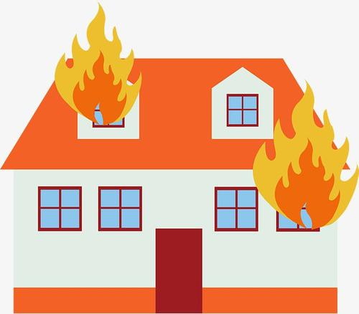
Read and Analyze: How to Survive a Fire?

Slide 15
How to survive a fire?
present tense
1. For small fire:
·Try putting out a small fire with water. Water or fire extinguisher can control a small fire easily.
2. For big fire:
·Warn everyone else in the building. Hit the fire alarm or loudly yell “Fire!” and earn enough time for your family to get out.
·Call 119 as soon as possible. 119 can offer you emergency services. If you are missing someone, tell the firefighters where they might be located in the building.
·Touch doorknobs to test them before opening. If the doorknob or door itself is hot, leave it closed and pick another exit.
Specific situations
why
Clear and direct language
how
why
how

Slide 16
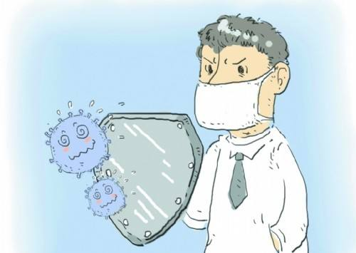
Homework: How to Prevent a Flu?
Could you please write a brochure on how to prevent a flu for foreign students?
Tips: make sure to follow the structure and requirements of a brochure.
Notes:
be sober in advance and guard against the disasters.

Slide 17
谢谢您的观看
北京市朝阳区教育研究中心 制作

