Slide 1
“人与自然” Writing Workshop（2）
朝阳区线上课堂·高一年级英语
人大附中学朝阳学校 曹雨

Slide 2
学习目标
能够根据“手册”的语言特点撰写完整的“手册”

Slide 3
学法指导
学习时，同学们务必关注：
1.“手册”的结构特点
2. 使用祈使句式
3. 使用简明、清晰的指示性语言

Slide 4
Unit 5 Writing Workshop A Brochure(2)

Slide 5
Revision
How to write a brochure?
First, make sure of the specific situation.
Second, when giving instructions, use clear and direct language.
Third, explain ‘how' or ‘why’ the readers should follow your instructions.
Lastly, use the present tense.

Slide 6
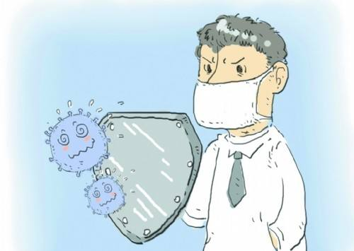
Homework: How to Prevent a Flu?
Could you please write a brochure on how to prevent a flu for foreign students?
Tips: make sure to follow the structure and requirements of a brochure.
Notes:
be sober in advance and guard against the disasters.

Slide 7
Outlining
First, make sure of the specific situation.
Notes:
this brochure is to instruct how to survive an earthquake.

Slide 8
How to prevent a flu？
Situation1:___________
If you are at home
Situation2:___________
If you are outdoors
Situation3:___________
If you feel unwell
Notes:
when we write a brochure, we need to make sure the specific situations. and then, what are they? What kind of sentences are used here?

Slide 9
Drafting
Second, when giving instructions, use clear and direct language.
Notes:
this brochure is to instruct how to survive an earthquake.

Slide 10
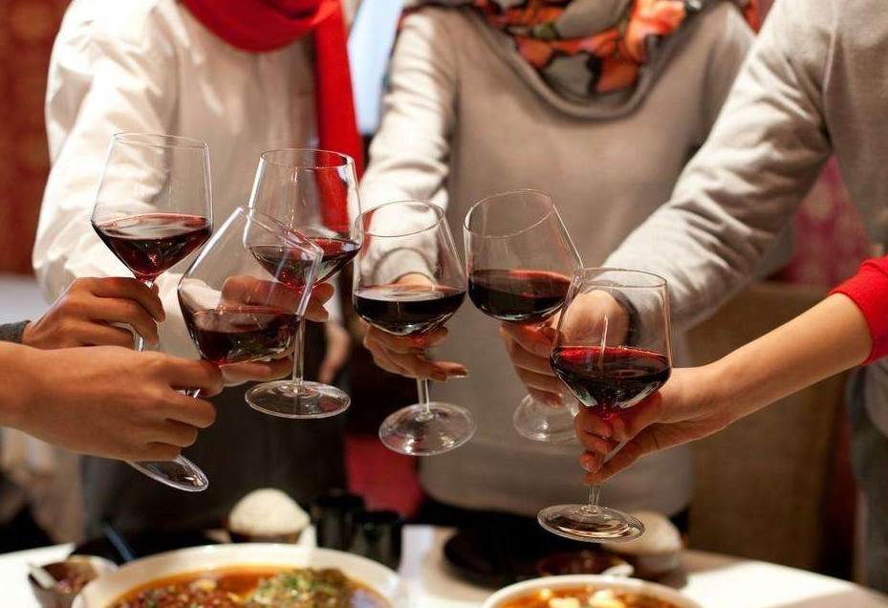
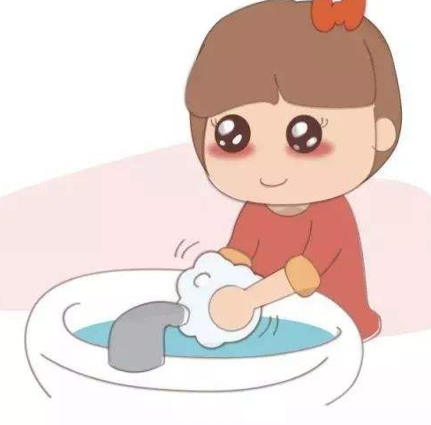
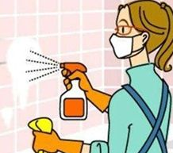
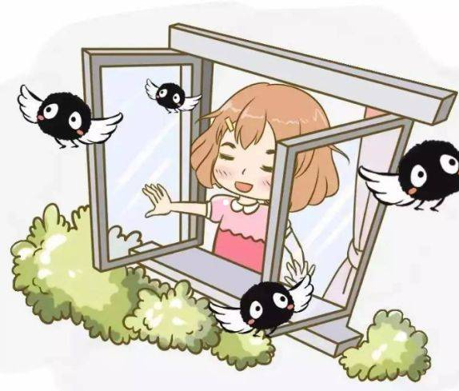
If you are at home
Wash your hands.
Don’t get together.
Prevent flus
Dos
Prevent flus
Don’ts
Clean and disinfect.
Don’t eat uncooked food.
Open the window.
Keep ventilation(通风).

Slide 11
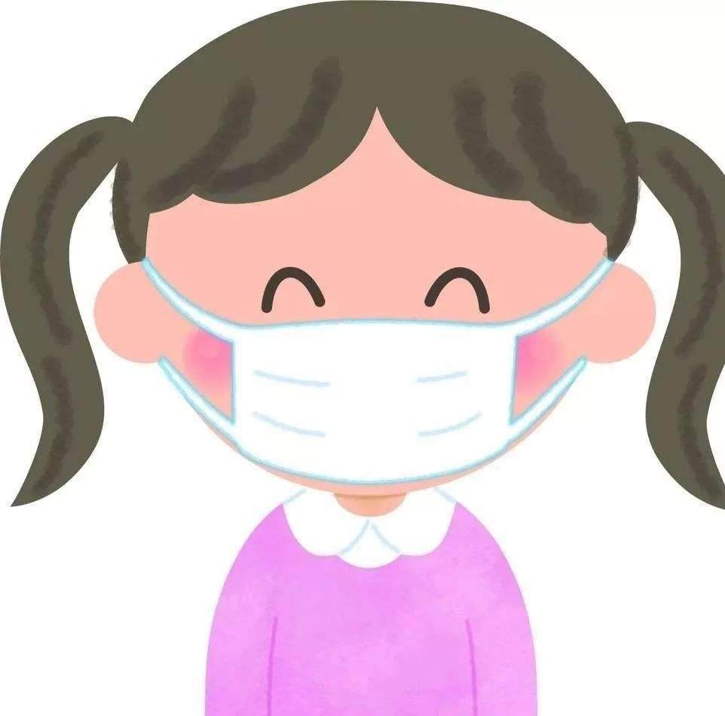
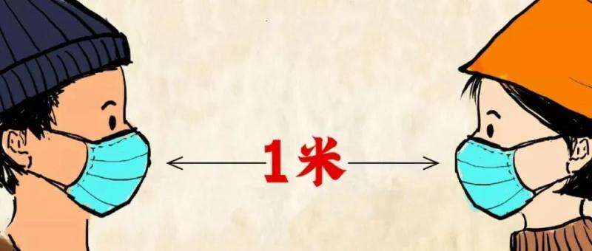
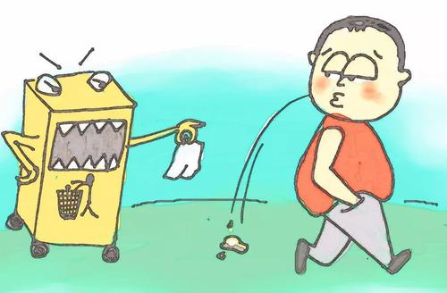
If you are outdoors
Dos… | Don’ts
Wear a face mask.
Don’t touch eyes, mouth or nose.
Maintain social distancing.
Don’t spit everywhere.

Slide 12
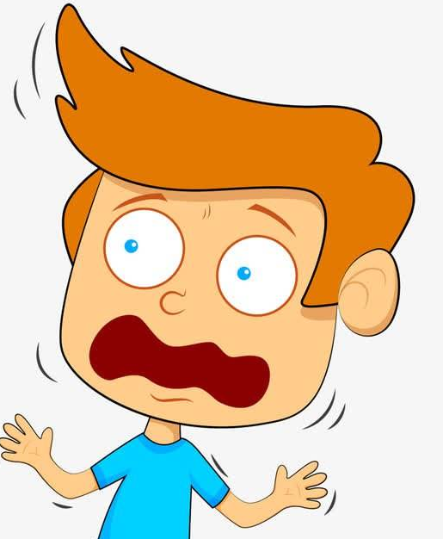
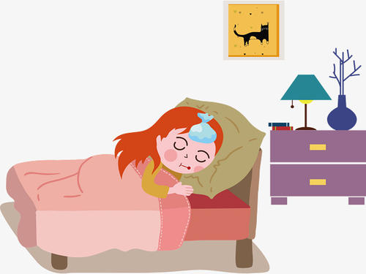
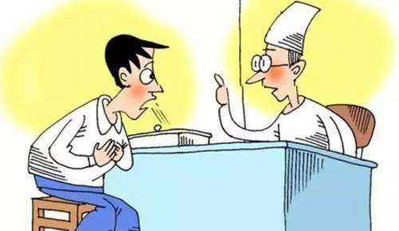
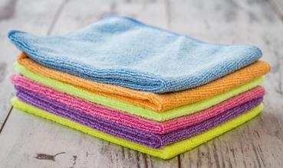
If you feel unwell
Dos… | Don’ts
Stay at home with mild signs of infection.
Don’t panic.
Seek medical attention.
Don’t share the towel among family.

Slide 13
More dos and don’ts of preventing flus.
Dos… | Don’ts
Cover your nose and mouth when you cough or sneeze. | Don’t go outside unless you have to.
Clean and disinfect frequently touched objects and surfaces. | Don’t touch anything that may carry virus.
Keep your clothes clean and dry the clothes in the sun. | Don’t throw your waste masks anywhere.
… | …

Slide 14
Drafting
Third, explain ‘how' or ‘why’ the readers should follow your instructions.
Lastly, use the present tense.
Notes:
this brochure is to instruct how to survive an earthquake.

Slide 15
If you are at home
Clean and disinfect your house. Clean and disinfect frequently can protect your family from the virus.
Open the windows and keep ventilation. Open the windows for at least 1 hour a day to refresh the air.
Wash your hands with an alcohol-based hand cleaner. Washing your hands kills viruses that may be on your hands.
Notes:
then how about these information. what are they? they are details. What are these details mainly about?

Slide 16
If you are at home
Don’t get together. Getting together will increase the risk of infection because you cannot make sure whether your guest is healthy.
Notes:
then how about these information. what are they? they are details. What are these details mainly about?

Slide 17
If you are outdoors
Wear a face mask. Wear a face mask to cover your mouth and nose. Avoid touching the mask once it’s on and immediately discard（vt.丢弃） it after use and wash hands.
Maintain social distancing. Stay at least one meter away from anyone who is coughing or sneezing. They may release small drops of liquid from their nose or mouth which may contain the virus.
Notes:
then how about these information. what are they? they are details. What are these details mainly about?

Slide 18
If you are outdoors
Don’t touch eyes, nose or mouth. Your hands touch many surfaces where viruses can survive. Once contaminated(vt. 污染，弄脏), hands can carry the virus to your eyes, nose or mouth.
Don't spit everywhere. Pack your phlegm(痰) and throw it into dustbin.
Notes:
then how about these information. what are they? they are details. What are these details mainly about?

Slide 19
If you feel unwell
Stay at home. Stay at home even with mild signs(轻微的症状) of infection such as the headache and slight runny nose（流鼻涕）.
Seek medical attention. If you have a fever, cough and difficulty breathing, seek medical attention and follow the direction of your doctors.
Don't share towels with your family. Your towel may contain the viruses, which are dangerous for your family.
Notes:
then how about these information. what are they? they are details. What are these details mainly about?

Slide 20
Peer Editing
A brochure
Does the writer focus on a clear topic?
Does the writer make clear and direct points?
Does the writer use simple and clear language?
Does the writer give advice with reasons for different situations?
Does the writer use the present tense and imperatives?
Notes:
this brochure is to instruct how to survive an earthquake.

Slide 21
Homework
Read the three brochures again.
1.How to Survive an Earthquake?
2.How to Survive a Fire?
3.How to Prevent a Flu?
Notes:
be sober in advance and guard against the disasters.

Slide 22
谢谢您的观看
北京市朝阳区教育研究中心 制作

