Slide 1
“人与自然” Reading Club（2）
朝阳区线上课堂·高一年级英语
中国人民大学附属中学朝阳学校 何维

Slide 2
Unit 5 Humans and Nature

Slide 3
Reading Club 2:
Nature Films

Slide 4
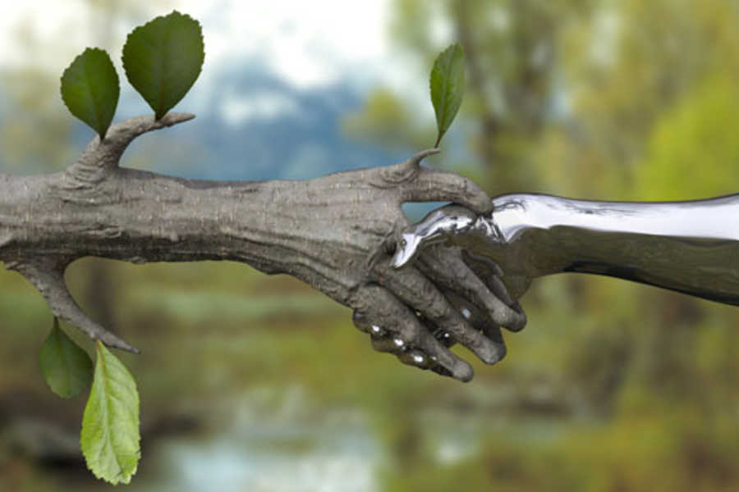
【学习目标】
1. 能够提炼文本中的信息和观点;
2. 能够掌握介绍电影的基本方法和相关词汇;
3. 能够批判性地思考自然和人和谐相处的关系和方法。

Slide 5
【学法指导】
阅读时，重点关注并学习：
1. 介绍一部电影方法，包括介绍的角度以及所用词汇。
2. 如何提取语篇中直接陈述的情感态度、价值观和社会文化现象。

Slide 6
A Place to discuss nature films
Wildlife on the Silver Screen
Where can we see a discussion like in this text?
In an online chatroom.
It’s an online discussion.
Notes:
Please turn to Page 44, and where can we see…
Yes, it’s an online discussion about nature films.

Slide 7
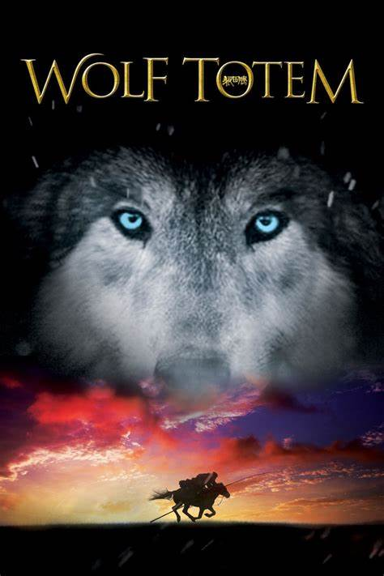
Have you ever seen the film Wolf Totem?
Notes:
Tomtom just watched the film wolf totem. Have you…

Slide 8
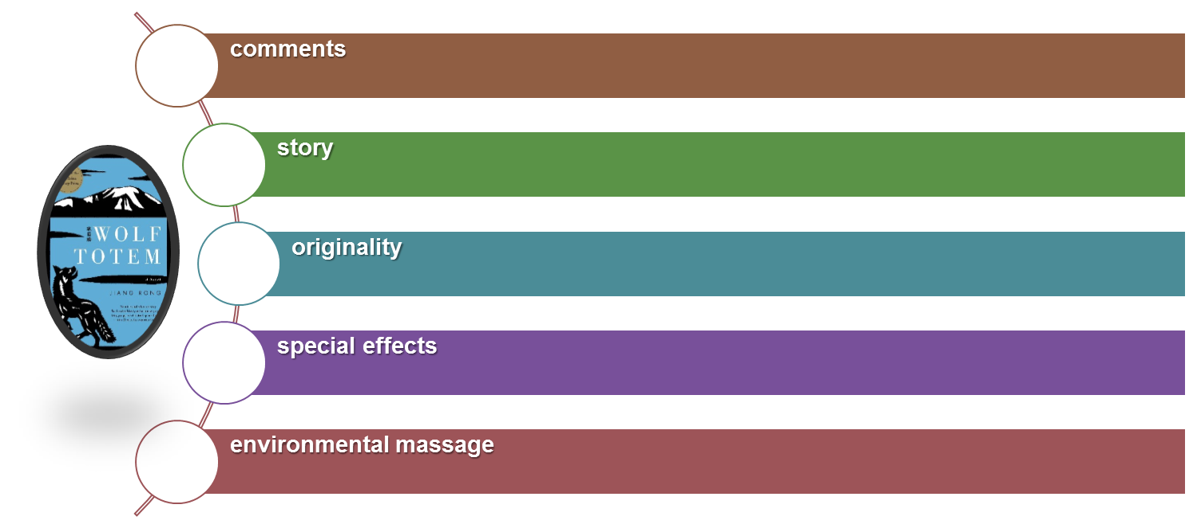
Skim the text and find out what aspects of the film are talked about.
Notes:
Please skim the text and ….
Ok, altogether five aspects are talked about here. They are…Have you found them all?

Slide 9
Skim the text and find out what aspects of the film are talked about.
A young student became interested in wolves on the grassland of Inner Mongolia.
comments
special effects
There’s not a lot of CGI in Wolf Totem. Almost all of the shots are of real wolves!
environmental massage
It is very easy for humans to upset the natural balance of the environment.
originality
It was based on a story of Chinese writer Jiang Rong’s experience in the 1960s.
story
TomTom enjoyed the film.
Notes:
Please read the text carefully and find out the details.
You can underline the details on your textbooks, or write down on your students sheets.
Don’t hesitate to pause…
Ok. Let’s see what you’ve got.
What did TomTom think about it?...
What is the film about?
Is the film an original story?
How were the special effects?
What environmental message was portrayed?

Slide 10
Notes:
Good. This time I’d like you to think about two questions.
Find the answers and don’t forget to underline the evidence.

Slide 11
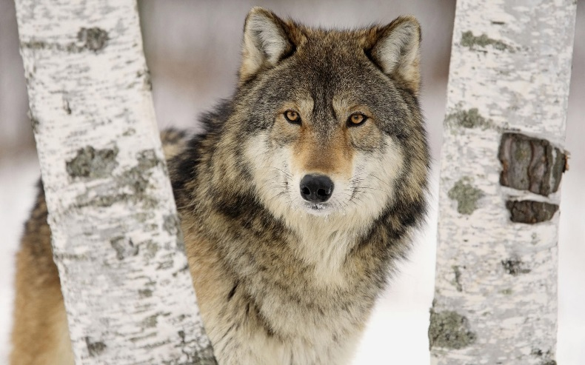
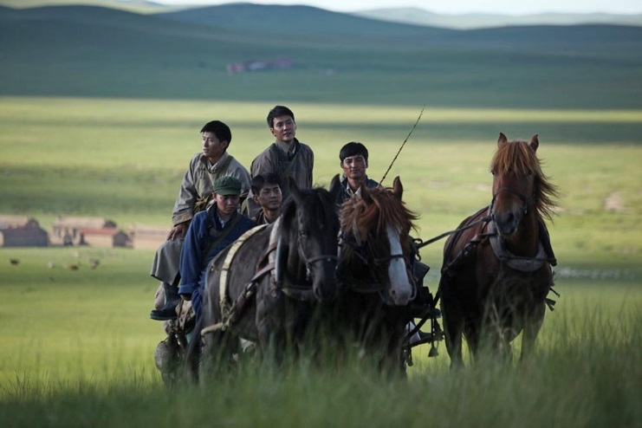
List the reasons why people enjoy the film:
exciting scenes
shots of real wolves and the grasslands of Inner Mongolia
good chance to learn about a different part of China
strong environmental message
Notes:
Please tell me the reasons…
It has …and great shots of real wolves and the grasslands…so it is a good chance…
What’s more, it delivers strong…

Slide 12
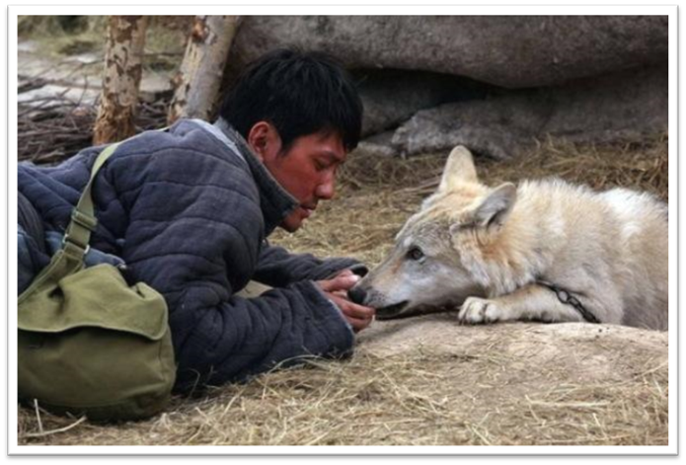
Why does TomTom admire the crew’s treatment of the wolves in the film? Underline the evidence.
Because they had wolf cubs specially trained for the film, so they would trust humans and not be afraid of cameras.
Notes:
Then why…
Because…

Slide 13
Critical thinking:
What do you think the writer Jiang Rong wants to say about people and wolves?
Choose the following statements and use evidence from the text to support your choices.
A. People are more dangerous than wolves.
B. People should kill dangerous animals.
C. People should leave animals alone.
D. Wolves are not very dangerous.

Slide 14
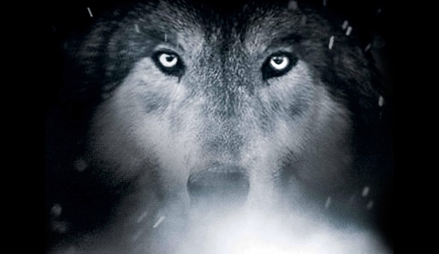
Evidence:
Some greedy people steal a lot of meat from the wolf pack, which causes wolves to attack people.
The farmers kill the wolves. When there are no wolves, the grassland are destroyed by other animals and finally brings disaster to the grassland and farmers.
The book said, “If we don’t kill wolves, there’ll be fewer of us. But if we kill too many of them, there’ll be even fewer.”
Notes:
What evidence did you find to support your choice?
In the film, at one point,…

Slide 15
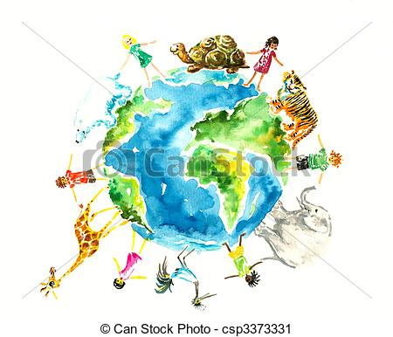
Discussion
How do you understand the relationship between humans and wildlife?
Notes:
Let’s voice our opinions. How

Slide 16
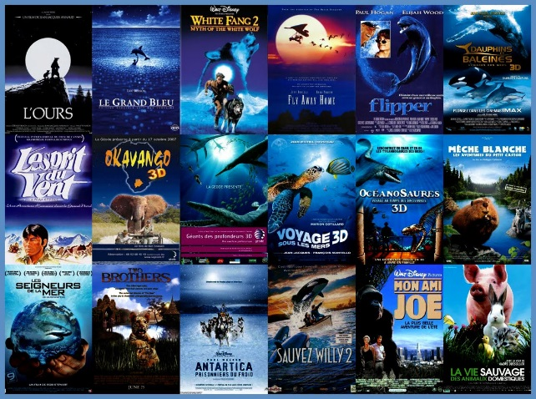
Optional Task:
1. Watch the film Wolf Totem after class
and write a movie review about it.
2. Find more films about humans and
nature and recommend them to your
classmates next class.

Slide 17
谢谢您的观看
北京市朝阳区教育研究中心 制作

