Slide 1
“人与自然” Lesson2（II）
朝阳区线上课堂·高一年级英语
中国人民大学附属中学朝阳学校 孙晓梅

Slide 2
教学目标
1. 获取地震中在室内、室外、被困三种情境下的逃生建议
2. 判断出说话人维持、打断、结束一段对话的意图，并总结出相关表达
3. 模拟情境，在对话中礼貌地打断、维持和结束对话

Slide 3
学法指导
在听的过程中，要根据不同的情境，有侧重点地获取所需信息。在人际沟通中，要注意积累并运用恰当的语言形式，礼貌地表达自己的意图，例如打断对话、结束一段对话等。

Slide 4
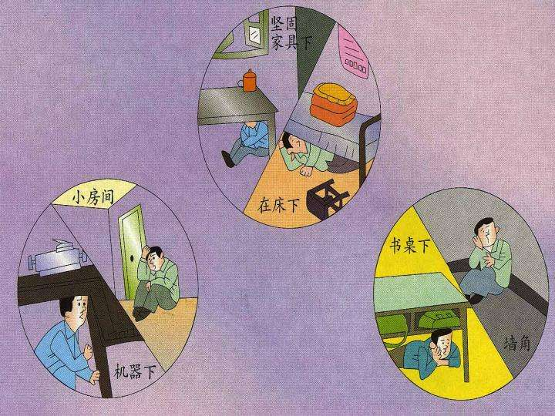
Unit 5
Lesson 2 Professional Rescue Team

Slide 5
Activate and share
What should we do to protect ourselves when an earthquake happens?

Slide 6
Listen for understanding
Listen to the second part of the interview. What advice does Mr. Wang give about surviving an earthquake when you’re outdoors, indoors or trapped?
Outdoors | Indoors | Trapped
________________ _______from any building or streetlights. | _____________ anything that can break or fall. | _______________ to help people find you and __________ when someone is nearby.

Slide 7
Listen for understanding
Listen to the second part of the interview. What advice does Mr. Wang give about surviving an earthquake when you’re outdoors, indoors or trapped?
Outdoors | Indoors | Trapped
________________ _______from any building or streetlights. | _____________ anything that can break or fall. | _______________ to help people find you and __________ when someone is nearby.
Stay there and move
Stay away from
Knock on a wall
away
only shout

Slide 8
Listen for speaking
Listen and imitate. Decide whether the phrases in italics are used to: maintain (M), interrupt (I) or end (E) a conversation. Write the correct letter in the brackets.
Maintaining, Interrupting and Ending a conversation
1. Excuse me, Mr Wang, but can’t I interrupt you there? ( )
2. Ok, if I’m outdoors… ( )
3. Sorry, but my advice is to … ( )
4. Sorry for interrupting again… ( )
5. Well, I’d love to know more, but unfortunately, we’ve run out of time. ( )
6. So , I’m very sorry, but we’ll have to finish there. ( )
Talk Builder

Slide 9
Listen for speaking
Listen and imitate. Decide whether the phrases in italics are used to: maintain (M), interrupt (I) or end (E) a conversation. Write the correct letter in the brackets.
Maintaining, Interrupting and Ending a conversation
1. Excuse me, Mr. Wang, but can I interrupt you there? ( )
2. Ok, if I’m outdoors… ( )
3. Sorry, but my advice is to … ( )
4. Sorry for interrupting again… ( )
5. Well, I’d love to know more, but unfortunately, we’ve run out of time. ( )
6. So , I’m very sorry, but we’ll have to finish there. ( )
I
M
Talk Builder
I
I
E
E

Slide 10
Listen for speaking
What are polite ways to interrupt, maintain and end a conversation? Can you find more expressions? Write them below.

Slide 11
Maintain a conversation
OK …
Well…
Avoid asking simple “yes/no” questions.
e.g. Instead of asking the question “You have read the book the Old Man and the Sea, right?“, try asking "What do you think of the book the Old Man and the Sea? ”
Never answer questions with only one word.
Maintain proper body Language

Slide 12
Interrupt a conversation politely
Excuse me, but…
Sorry to butt in.
I’m sorry to barge in like this, but I need your help...
Can I say something?
I’m sorry to cut you off, but I've got something urgent to tell you.
I'm sorry to interrupt, but may I ask you something quickly?
to interrupt a conversation or discussion or someone who is talking
to interrupt
to stop people from continuing a telephone conversation by breaking the telephone connection

Slide 13
End a conversation politely
It’s been great talking to you, but I have to …
If you'll excuse me, I need to…
I really enjoyed our conversation. I hope …
I’d like to continue our conversation later, when we both have more time.

Slide 14
speak
Practise maintaining, interrupting and ending a conversation in the following situations. Use the expressions to help you.

Slide 15
Situation 1: Two friends talking on the phone
Friend 1: talking about his / her worries for the next day’s presentation
Friend 2: needs to end the conversation so as to catch a train
Situation 2: An English teacher and a student in an English class.
English teacher: explaining how to use relative clauses
Student: needs to interrupt so as to ask a question

Slide 16
student 1: I have a presentation about my favorite book in English class tomorrow. But I haven’t figured out the structure.
student 2: What about a brief introduction of the author and the story? Oh, you can also talk about your favorite part, and…sorry, I’d like to help you with that, but right now I must leave for the railway station, otherwise I will miss the train. I can talk to you later.

Slide 17
Language focus
search and rescue vehicles
rescue attempts
provide medical help
It must have been really tough.
It was a battle against time.
It is our duty to do…
stay away from
sorry for interrupting again.
maintain/end a conversation
run out of time
breathe in a dangerous amount of dust
搜索和救援车辆
救援行动(努力)
提供医疗帮助
这一定很艰难
这是和时间的较量。
…是我们的责任
远离…
抱歉再次打断您。
维持/结束一段对话
没有时间了
吸入大量灰尘

Slide 18
Language focus
search and rescue vehicles
rescue attempts
provide medical help
It must have been really tough.
It was a battle against time.
It is our duty to do…
stay away from
sorry for interrupting again.
maintain/end a conversation
run out of time
breathe in a dangerous amount of dust
搜索和救援车辆
救援行动(努力)
提供医疗帮助
这一定很艰难
这是和时间的较量。
…是我们的责任
远离…
抱歉再次打断您。
维持/结束一段对话
没有时间了
吸入大量灰尘

Slide 19
谢谢您的观看
北京市朝阳区教育研究中心 制作

