Slide 1
“人与自然”Lesson2（I）
朝阳区线上课堂·高一年级英语
中国人民大学附属中学朝阳学校 孙晓梅

Slide 2
教学目标
1. 阐述采访的主要内容和被采访者的信息
2. 获取有关救援活动的信息，并且分辨出说话人的主要观点和支持性的细节
3. 基于采访的内容，就专业救援提出问题并回答

Slide 3
学法指导
在听的过程中，要抓住对话的大意，获取其中的主要信息、观点及其支持性的细节。关注说话人在开头结尾的陈述，这往往是其主要观点。而说话人列举的例子、数据等，往往是对其观点的细节支撑。此外，听和说是相结合的，要在获取信息的基础上，进一步练习自己的口语表达能力。

Slide 4
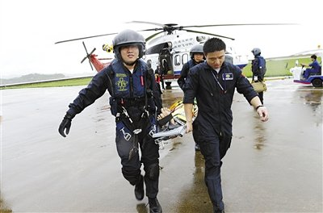
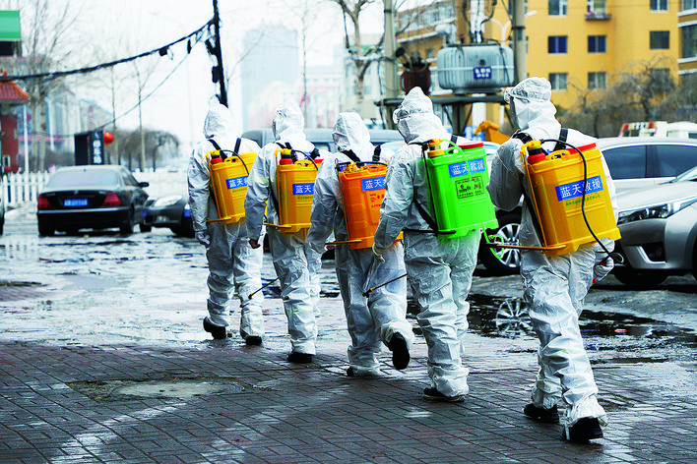
Unit 5
Lesson 2 Professional Rescue Team

Slide 5
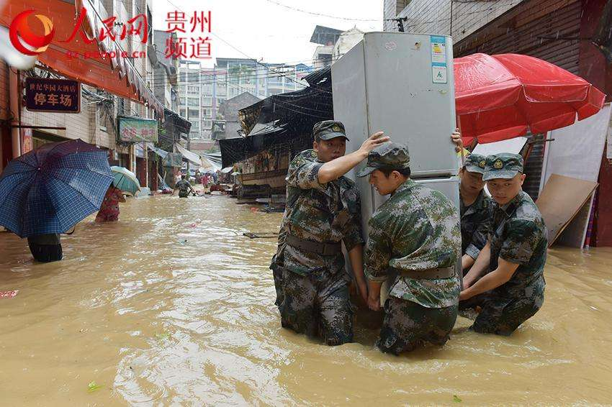
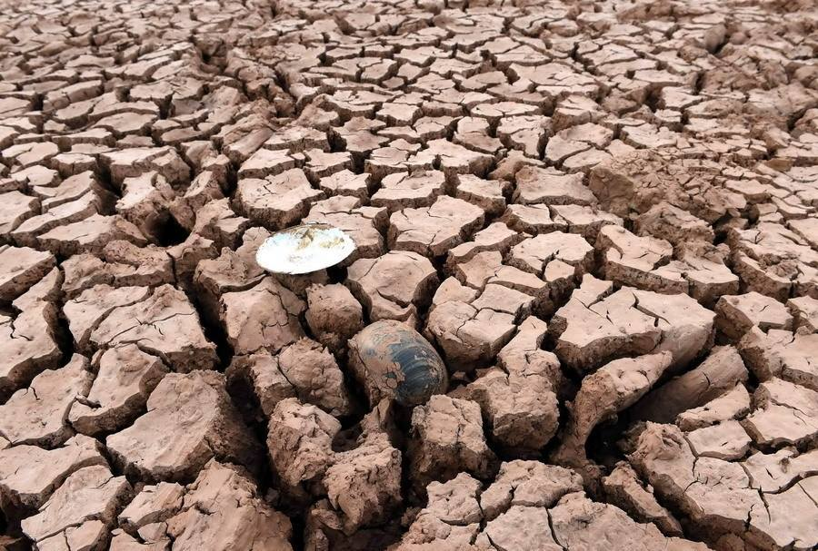
What are the natural disasters in the pictures?
Activate and share
flood
drought

Slide 6
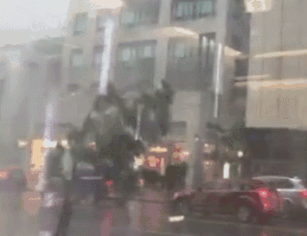
What are the natural disasters in the pictures?
forest fire
storm

Slide 7
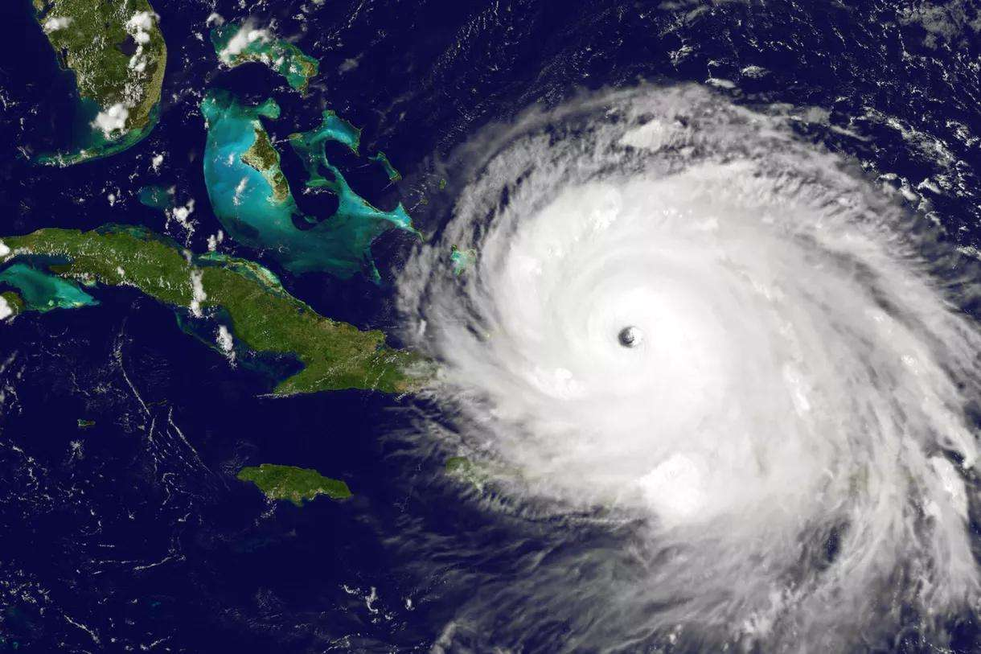
What are the natural disasters in the pictures?
landslide
hurricane

Slide 8
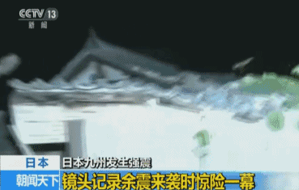
What are the natural disasters in the pictures?
volcanic eruption
earthquake
aftershock

Slide 9
What is happening in each photo? Match the photos (a-d) with the descriptions (1-4).
d
( ) 1. Search and rescue vehicles are brought into destroyed areas. ( ) 2. Trained dogs are used to help search for anyone who is still alive. ( ) 3. Rescue teams try to save people trapped under buildings. ( ) 4. Many houses are destroyed by the terrible flood.
c
a
b

Slide 10
Listen for understanding
Listen to the first part of the interview. Answer the questions.
1. What is the interview about?
2. Who is the interviewee?
3. Which two disasters are mentioned?

Slide 11
Listen for understanding
1. What is the interview about?
The interview is about what search and rescue teams do when a natural disaster happens.
2. Who is the interviewee?
The interviewee is Mr Wang, who is from China International Search and Rescue Team.
3. Which two disasters are mentioned?
They mentioned two disasters, namely the Wenchuan earthquake, the Nepal earthquake.

Slide 12
Listen for understanding
Listen again. Complete the sentences. Then decide if the sentences contain a main idea (MI) about rescue attempts or a detail (D). Write the correct letter in the brackets.

Slide 13
Listening for Main Ideas and Details
Main ideas are the key points of a presentation
or a talk. They are supported by details.
When you listen, pay close attention to the statement that is emphasized by the speaker (usually at the beginning and end of the talk). This is often the main idea.
Listen carefully for key words, phrases and ideas that are repeated. These will confirm the main idea.
Now listen for specific information that supports the main ideas, e.g. examples, causes, reasons, facts and description. These are the details.

Slide 14
Listen for understanding
What happens on rescue attempts
1. Our first and most important goal is to __________.
2. We use ________________vehicles and ____________to look for anyone who is still alive.
3. In a rescue attempt during the Nepal earthquake:
Over _____ members and _____ dogs took part, and we were there for ______ days.
We rescued ____ people and provided medical help to over ______ people.
4. It’s our duty to try to reduce __________ and _____________.

Slide 15
Listen for understanding
What happens on rescue attempts
1. Our first and most important goal is to __________.
2. We use ________________vehicles and ____________to look for anyone who is still alive.
3. In a rescue attempt during the Nepal earthquake:
Over _____ members and _____ dogs took part, and we were there for ______ days.
We rescued ____ people and provided medical help to over ______ people.
4. It’s our duty to try to reduce __________ and _____________.
save lives
MI
search and rescue
trained dogs
D
sixty
six
twelve
D
two
2000
D
suffering
the loss of life
MI

Slide 16
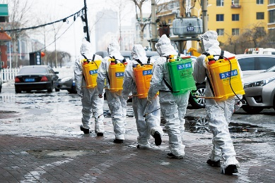
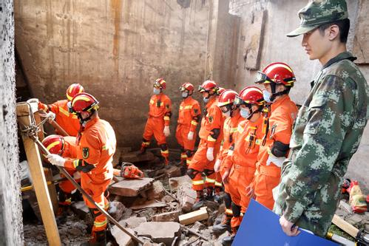
speak
If you were the interviewer, what questions would you ask according to the information in Activity 3? Work out four questions and then answer them.

Slide 17
speak
Possible questions and answers
1. What is the most important goal of search and rescue attempts?
To save lives
2. How do rescue teams search for people who might be alive?
By using search and rescue vehicles and trained dogs

Slide 18
speak
3. Who took part in the rescue attempt in Nepal after the earthquake?
Over sixty members and six dogs.
4. What do you think of your job?
Although it is hard, but it is our duty to reduce suffering and the loss of life.

Slide 19
谢谢您的观看
北京市朝阳区教育研究中心 制作

