Slide 1
情景作文的主题立意
朝阳区线上课堂·高三英语总复习
华中师大一附中朝阳学校 李梅

Slide 2
目 录
教学内容
情景作文的主题立意
1、分析2019年朝东西海四区一模和二模情景作文考察的
话题内容与主题立意；
2、结合典型例题，掌握写好情景作文主题立意的方法。
教学目标
教学准备
2019年朝东西海四区英语一模和二模试题。
教学过程
依据课标要求，分析2019年朝东西海四区一模和二模情景作文考察的话题内容与主题立意，结合典型例题，掌握如何写好情景作文主题立意的方法。
高三英语复习系列

Slide 3
复习：情境作文写作如何实现一档文呢？
1. 要点明确，细节有效
2. 用词准确，句式丰富
3. 内容连贯，结构紧凑
高三英语复习系列

Slide 4
《普通高中英语课程标准》要求：
1.选择性必修要求学生要具有以下英语语言技能：以书面形
式描述、概括经历和事实，并表达情感。
2. 主题语境包括人与自我，人与社会和人与自然，学生对主
题意义的探究应是学生学习语言的最重要内容；推动学生对
主题的深度学习，能够帮助学生树立正确的世界观、人生观
和价值观，实现知行合一。
高三英语复习系列

Slide 5
2019年朝东西海四区一模中情景作文的话题分析与主题立意归纳
城区 | 话题 | 主题立意
朝阳区 情景作文 | 介绍李华上个月参加学校组织“绿色出行，从我做起”活动的完整过程，并以“Green Travel in My Family”为题，给校刊“英语角”写一篇英文稿件。 | 引导学生思考人与自然的关系，倡导爱护环境和实践健康的生活方式。
东城区 情景作文 | 李华和同学在寒假期间去医院参加了志愿者活动后，给校刊英语角写一篇英文稿件，介绍此次经历。 | 鼓励学生参加志愿者服务与公益事业，体现了社会主义核心价值观中的“友善”，传递人与人之间的真情。
西城区 情景作文 | 写一篇英文周记,记录上周李华制作以 “我眼中的改革开放40年”为主题的小报的全过程。 | 关注科技发展和社会进步，增强学生的民族自豪感和爱国主义精神。
海淀区 情景作文 | 以“A New Way to Explore the Forbidden City”为题，用英语写一篇短文向校刊“英语园地”投稿，记述上周末李华带英国朋友Jim游览故宫的全过程。 | 让学生用英文介绍中国非物质文化遗产，弘扬中国优秀传统文化。
高三英语复习系列

Slide 6
2019年朝东西海四区二模中情景作文的话题分析与主题立意归纳
城区 | 话题 | 主题立意
朝阳区 情景作文 | 为迎接建国70周年，上个月学校组织了“祖国在我心中”主题知识竞赛。请根据以下四幅图的先后顺序，介绍李华和同学们参加活动的完整过程，并以“A Significant Event”为题，给校刊“英语角”投稿。 | 突出学生间的团队合作精神，关注国家历史，社会，政治，经济和科技的发展，增强爱国主义教育。
东城区 情景作文 | 给某英文报刊投稿，记录李华参加的绿化社区活动。 | 号召学生参与社区活动，爱护身边的环境，培养健康的生活方式和积极的生活态度，增强社会责任感。
西城区 情景作文 | 毕业之际，李华班级开展了感谢学校教职员工的活动，写一篇英文周记，记述活动的全过程。 | 倡导做人要拥有一颗感恩的心，立德树人，树立正确的人生观和价值观。
海淀区 情景作文 | 给校刊“英语园地”写一篇英文稿件，记述李华和班级同学上周参加“纸文化”实践活动的全过程。 | 讲述体验中国四大发明之一的造纸术和中国传统手工艺的经历，突出了为祖国感到自豪和爱国的社会主义核心价值观。
高三英语复习系列

Slide 7
如何写好情景作文的主题立意？
如有标题，全文要紧扣题意
第一段
事件+主题
中间段
细节支撑
结尾段
升华主题
高三英语复习系列

Slide 8
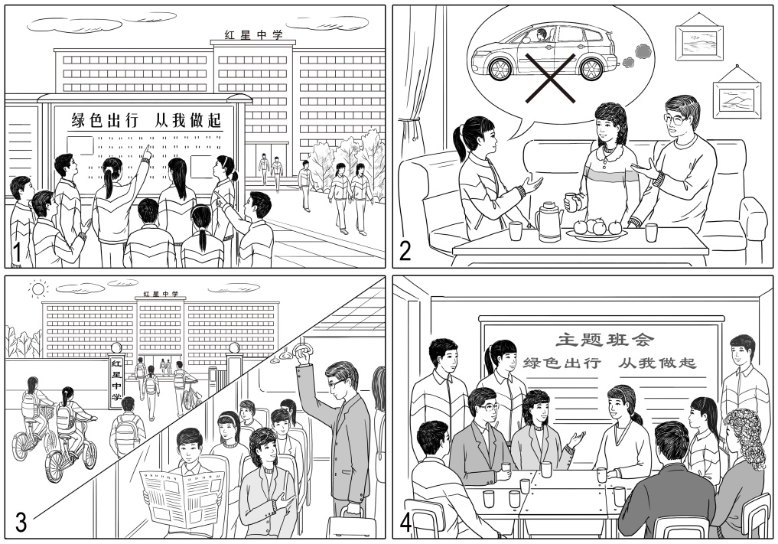
如何写好情景作文的主题立意？
假设你是红星中学高三的学生李华。请根据以下四幅图的先后顺序，介绍上个月你参加学校组织的“绿色出行，从我做起”活动的完整过程，并以“Green Travel in My Family”为题，给校刊“英语角”写一篇英文稿件。
注意：词数不少于60。
2019 朝阳一模
高三英语复习系列

Slide 9
2019年朝东西海四区二模中情景作文的话题分析与主题立意归纳
标题 全文紧扣题意 | Green Travel in My Family
第一段 事件+主题 | Last month, our school organized an activity named “Green Travel, Start with Me”, which has played an educative role.
中间段 细节支撑 | 图1 Seeing the proposal on the bulletin board, my classmates and I were deeply interested … . Everyone expressed their willingness to participate. 图2 After getting home, I talked to my parents about my ideas. They were very supportive, … . 图3 In the following weeks, as we promised, I went to school by bike every day, while my parents went to work by bus. Tired as we were, we all felt happy. 图4 Last Friday, a class meeting was held as scheduled. Some parents were invited, … . All of us held the same view that environmental protection is so important for our life.
结尾段 升华主题 | Through the activity, we find it our duty to protect the environment. I hope more and more people will join us in green travel.
添加表达情感态度的词句来支撑主题立意。
2019 朝阳一模
高三英语复习系列

Slide 10
Green Travel in My Family
Last month, our school organized an activity named “Green Travel, Start with Me”, which has played an educative role.
Seeing the proposal on the bulletin board, my classmates and I were deeply interested and had a heated discussion. Everyone expressed their willingness to participate. After getting home, I talked to my parents about my ideas. They were very supportive, saying they wouldn’t drive to work from the next day. In the following weeks, as we promised, I went to school by bike every day, while my parents went to work by bus. Tired as we were, we all felt happy. Last Friday, a class meeting was held as scheduled. Some parents were invited, including my father and mother. We shared our experiences and thoughts during the activity. All of us held the same view that environmental protection is so important for our life.
Through the activity, we find it our duty to protect the environment. I hope more and more people will join us in green travel.
2019 朝阳一模
高三英语复习系列

Slide 11
一、如何在文章的第一段写好主题立意？
如有标题，要全文紧扣题意
1. 活动的目的，时间和内容
第一段
事件+主题
2. 活动的时间，内容和感受
高三英语复习系列

Slide 12
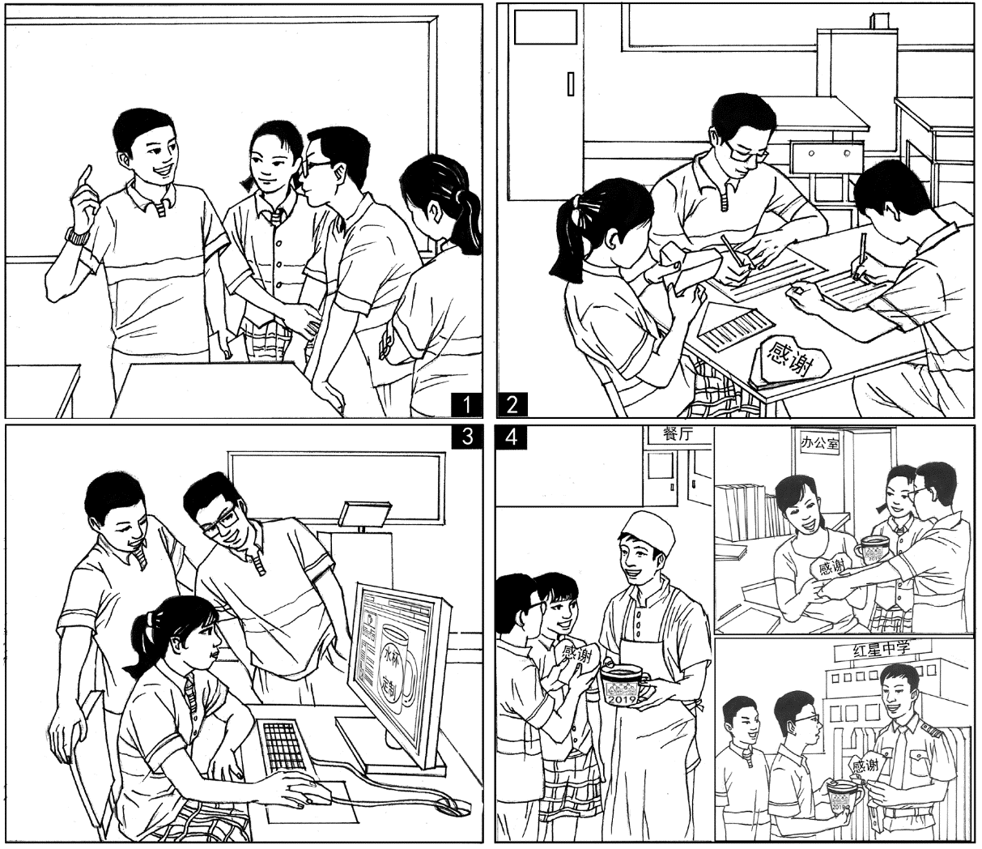
一、如何在文章的第一段写好主题立意？
假设你是红星中学高三学生李华。毕业之际，你们班开展了感谢学校教职员工的活动。请根据下面四幅图的先后顺序，写一篇英文周记，记述活动的全过程。
注意：词数不少于60。
提示词：教职员工 teachers and staff
Before graduation, in order to express our sincere gratitude to our beloved teachers and the hard-working staff, we prepared special gifts and “thank you” notes.
活动的目的，时间和内容
2019 西城二模
高三英语复习系列

Slide 13
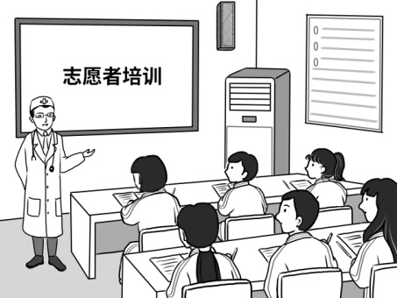
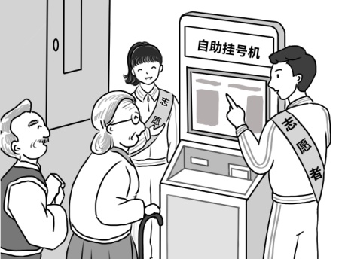
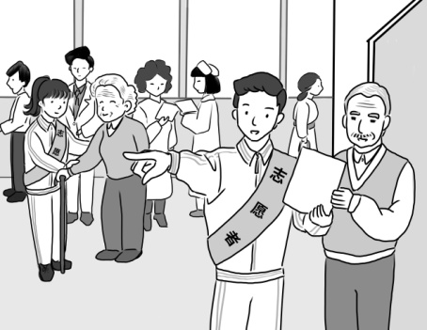
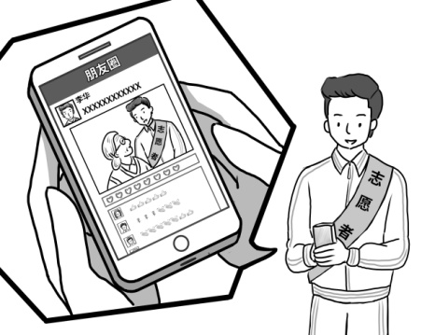
一、如何在文章的第一段写好主题立意？
假设你是红星中学学生李华。你和同学在寒假期间去医院参加了志愿者活动，请按照以下四幅图的先后顺序，给校刊英语角写一篇英文稿件，介绍此次经历。
注意：词数不少于60。
提示词：自助挂号机 self-service registration machine
Last winter vacation, my classmates and I worked as volunteers in a hospital. Tired as we were, we experienced the happiness of helping others.
活动的时间、内容和感受
2019 东城一模
高三英语复习系列

Slide 14
二、如何在文章的中间段支撑主题立意？
如有标题，要全文紧扣题意
1. 活动的目的，时间和内容
第一段
事件+主题
2. 活动的时间和内容和感受
运用形容词，副词，名词，动词短语和句式等表达情感态度和观点看法。
中间段
细节支撑
高三英语复习系列

Slide 15
二、如何在文章的中间段支撑主题立意？
图1 Last Monday after class, our monitor came up with an idea to extend our sincere appreciation to the school faculty. After much thought, we decided to present them with cups featuring our class picture as well as write them “thank you” notes.
图2 Soon afterwards, we began our project. In the following two days, some of us wrote the notes conveying our heartfelt appreciation while others carefully folded the finished notes into the shape of a heart.
图3 We also eagerly logged onto a self-customization cup website in the school’s computer room, chose our best class photos to customize the cups and made the purchases.
图4 Last Friday, we received the delivery. With excitement, we got into small groups and presented our special gifts to all the dedicated teachers and staff. Holding the gifts, they all expressed their thanks and best wishes to us. Every day for the past three years, we have enjoyed interesting lessons, delicious meals, and a clean and safe campus. It is their hard work and devotion that has helped us become responsible people.
运用 形容词，副词，名词，动词短语和句式等表达情感态度和观点看法。
2019 西城二模
高三英语复习系列

Slide 16
二、如何在文章的中间段支撑主题立意？
图1 On our first morning, a doctor gave us a lecture, informing us of our roles as volunteers. It was the first time for me to know the daily routines in a hospital and I even expected to help the patients here.
图2 The next morning, fully prepared, we went to different posts and started our job. Together with my classmates, I assisted some patients when they didn’t know how to use the self-service registration machine. For senior citizens, we helped them register to save them the trouble. When I saw big smiles appeared on their faces, I felt all my hard work was worthwhile.
图3 Besides, I showed people the way to different consulting rooms. For those elderly patients, we offered to accompany them all the way until it was their appointment time. They really appreciated our help.
图4 Later, I shared my picture in the hospital on WeChat Moments. In no time, I received lots of likes from my friends. Some even expressed their great interest in the voluntary work. Immediately, I had a strong sense of achievement.
运用 形容词，副词，名词，动词短语和句式等表达情感态度和观点看法。
2019 东城一模
高三英语复习系列

Slide 17
三、如何在文章的结尾段升华主题立意？
如有标题，要全文紧扣题意
1. 活动的目的，时间和内容
第一段
事件+主题
2. 活动的时间和内容和感受
运用形容词，副词，名词，动词短语和句式等表达情感态度和观点看法。
中间段
细节支撑
1. 总结活动, 谈谈感想
结尾段
升华主题
2. 总结活动, 发出号召
高三英语复习系列

Slide 18
三、如何在文章的结尾段升华主题立意？
假设你是红星中学高三学生李华。毕业之际，你们班开展了感谢学校教职员工的活动。请根据下面四幅图的先后顺序，写一篇英文周记，记述活动的全过程。
注意：词数不少于60。
提示词：教职员工 teachers and staff
All the teachers and staff here once provided us their best support, we really hope to do something to show our gratitude to them. Graduation will come and go, but the love for our school will last a lifetime.
总结活动, 谈谈感想
2019 西城二模
高三英语复习系列

Slide 19
三、如何在文章的结尾段升华主题立意？
假设你是红星中学学生李华。你和同学在寒假期间去医院参加了志愿者活动，请按照以下四幅图的先后顺序，给校刊英语角写一篇英文稿件，介绍此次经历。
注意：词数不少于60。
提示词：自助挂号机 self-service registration machine
Through this activity, I had the most amazing experience doing very simple things for others. Actually, working as volunteers contributes a lot in various fields. I hope more people will take actions and do our bits.
总结活动, 发出号召
2019 东城一模
高三英语复习系列

Slide 20
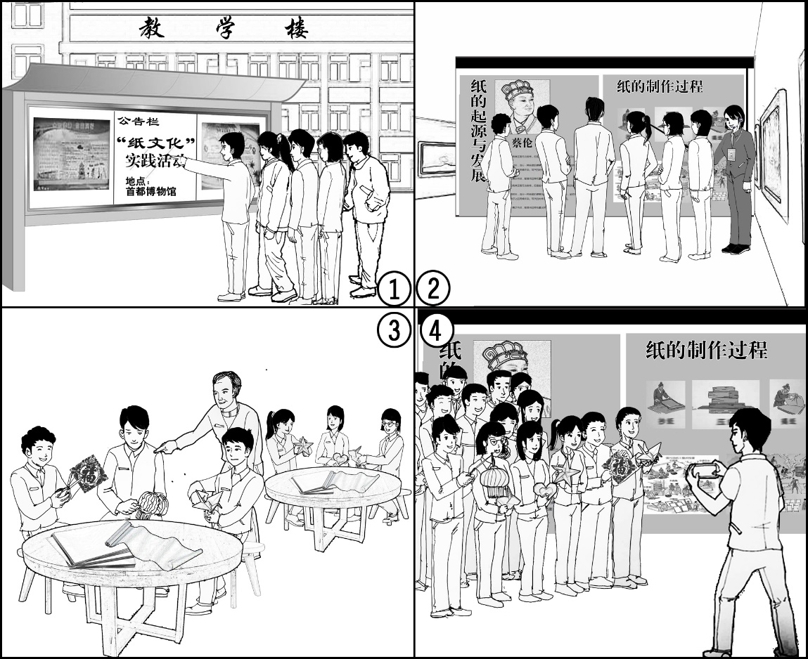
四、情景作文的主题立意——总结与赏析
假设你是红星中学高三学生李华，请根据以下四幅图的先后顺序，给校刊“英语园地”写一篇英文稿件，记述你班同学上周参加“纸文化”实践活动的全过程。
注意：词数不少于60。
2019 海淀二模
高三英语复习系列

Slide 21
四、情景作文的主题立意——总结与赏析
Last week, our class participated in an extracurricular activity on paper culture, which was really an unforgettable experience.
On Monday morning, some classmates and I noticed an announcement on the school bulletin board, saying an activity on paper culture would be held in the Capital Museum. Attracted by it, we signed up without any hesitation. The activity started on Friday with a visit to the exhibition in the museum. Following the guide, we learned about the origin and development of paper and the detailed process of papermaking. What especially impressed us was how paper contributed to the preservation and spread of human civilization. After that, we had some hands-on experience in making paper handicrafts. Divided into different groups, we learned with great enthusiasm. With the help of a master working there, the group of boys managed to create some paper cuts and lanterns while the girls tried different folding patterns, such as hearts, stars and birds. Not until then did we fully realize that paper can be made into so many objects in our life, either decorative or functional.
Before we left, we took a group photo to record the day. With the little pieces of work in our hands, we smiled heartily to the camera. At that moment, I came to know that the wisdom of our ancestors shown in paper culture should definitely be honored, recorded and passed down.
第一段： 活动的时间内容和感受
中间段：运用形容词，副词，名词，动词短语和句式等表达情感态度和观点看法。
最后一段：总结活动, 发出号召
2019 海淀二模
高三英语复习系列

Slide 22
小结：情景作文的主题立意
如有标题，要全文紧扣题意
1. 活动的目的，时间和内容
第一段
事件+主题
2. 活动的时间，内容和感受
运用形容词，副词，名词，动词短语和句式等表达情感态度和观点看法。
中间段
细节支撑
1. 总结活动, 谈谈感想
结尾段
升华主题
2. 总结活动, 发出号召
高三英语复习系列

Slide 23
谢谢您的观看
北京市朝阳区教育研究中心 制作

