Slide 1
必修（二）Unit 5 Lesson1（1）
朝阳区线上课堂·高一年级英语
北京市第十七中学 乔秀燕

Slide 2
Lesson 1
A SEA STORY (P30)
学习目标：
能够概括该故事的主要内容;
能够提炼该故事的情节和主人公的情感;
能够使用时间词讲述该故事。

Slide 3
Lesson 1
A SEA STORY (P30)
学习策略:
阅读时，务必关注故事的两条线索：
1. 故事发生的时间、地点、人物及发展。
2. 主人公在不同时间段体现出的情感变化。

Slide 4
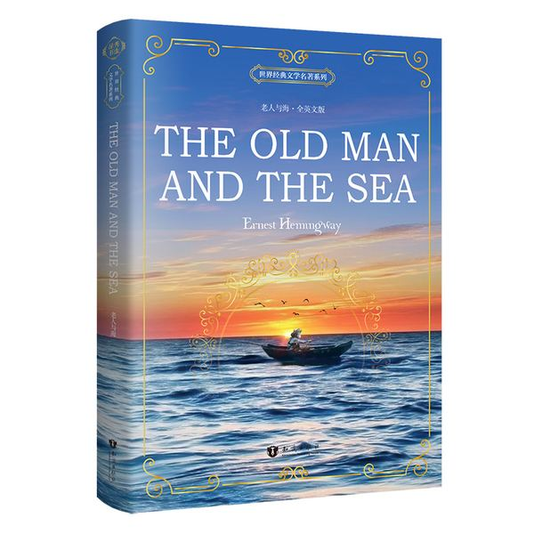
Do you know any stories about people and the sea?

Slide 5
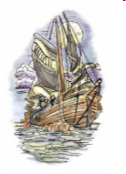
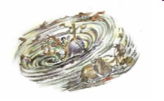
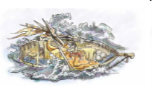
A fisherman is trying to survive a storm.
n. 漩涡
n. 波浪；
a fisherman, a fishing boat, a whirlpool, waves, to escape, to survive a storm, to float, wild
v. 逃离
v. 幸存
v.漂浮

Slide 6
A fisherman is trying to survive a storm. He is in the center of a whirlpool. The waves are wild.
The fisherman is in great danger. He is trying to find ways to escape from the whirlpool.
The whirlpool becomes less wild. There is a fishing boat floating on the sea. Maybe he is saved.

Slide 7
We are going to read a text adapted from the short story “A Descent into the Maelstrom”(《莫斯肯漩涡沉浮记》). Read the fact file on the textbook. Answer the questions.
n. 档案，卷宗
1 What is a “Moskoe-storm”?
2 Who wrote the story?
3 What do you think will happen in the story?
It is a system of tidal whirlpools in the Norwegian Sea.
Edgar Allan Poe (埃德加·爱伦·坡) wrote the story.

Slide 8
Read and answer
Sum up the main idea of the story:
When and where did the story happen?
2. Who are the main characters in the story?
3. What happened to the main characters?
4. Who is telling the story?
5. What effect did the terrible experience have on the storyteller?
This story happened about three years ago in the sea.
The main characters are the fisherman and his brothers.
The fisherman survived the storm. His two brothers died.
The fisherman is telling the story.
It broke his body and soul. (It took less than a single day to change his hair from black to white.)

Slide 9
Read again and complete the information in the boxes (P31). Then add the storyteller’s feelings during each situation.
When we were coming back from the islands, the sky ____________. Then a huge wave _______________ and my younger brother _____________. My elder brother ____________ “Moskoe-storm!”
The wind and waves carried us ____________________________.
Then, we were ____________ it.
Suddenly, we ______________.
The boat was on the inside of _______________and we were going round __________. After I made three important observations, I tied myself to _______. I tried to make my brother _______, but he was ______.
Soon afterwards, the whirlpool ________________. The waves soon carried me away and finally a boat ______________.
The storyteller’s feelings:
___________ __________ __________ _______

Slide 10
When we were coming back from the islands, the sky __________________________. Then a huge wave _______________ and my younger brother _____________. My elder brother ____________ “Moskoe-storm!”
was covered with dark clouds
covered our boat
fell into the sea
cried out
The storyteller’s feelings: ___________
frightened

Slide 11
The wind and waves carried us _________________________________.
Then, we were _____________ it.
Suddenly, we ________________.
towards the direction of the whirlpool
on the edge of
went over the edge
在…的边缘
越过…的边缘
hopeless
The storyteller’s feelings: ___________

Slide 12
the huge whirlpool
The larger the bodies were, the more rapidly it fell.
Between two objects of equal extent, round objects fell down less rapidly.
Between two objects of the same size, objects shaped like a tube fell down more slowly.
The boat was on the inside of ________________ and we were going round _____________________. After I made three important observations, I tied myself to _____________________. I tried to make my brother __________, but he was ___________________.
in circles at great speed
a barrel to help me float
understand
n. 观察
too frightened to get it
n. 桶
calm
The storyteller’s feelings: ___________

Slide 13
became less wild
Soon afterwards, the whirlpool ________________. The waves soon carried me away and finally a boat ______________.
picked me up
tired
The storyteller’s feelings: ___________

Slide 14
Why did the storyteller survived while his elder brother didn’t?
The fisherman survived because he was calm in the whirlpool and made clear observations. Based on the observations, he saved himself by tying himself to a barrel to help him float and jumped into the sea.
His elder brother was too frightened and stayed in the heavy boat, which was pulled into the bottom of the whirlpool.
It is important to overcome fear and stay calm in a dangerous situation so that we can have a clear mind to make observations and come up with ways to escape from danger.

Slide 15
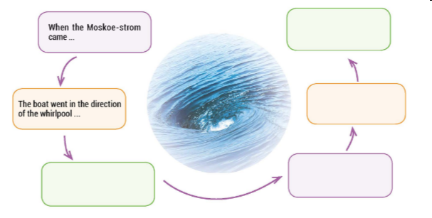
Read again and complete the illustration about how the storyteller overcome his fear and struggled to survive from the whirlpool.

Slide 16
The waves carried me to an area where the other fishermen were. A boat picked me up.
When the Moskoe-storm came, I became very frightened.
The boat went in the direction of the whirlpool. we were hopeless.
I tied myself to a barrel. I jumped into the sea to try and escape.
I became curious about the whirlpool itself and made three observations.
When we were on the edge of the whirlpool, I became calmer. We went over the edge.

Slide 17
About three years ago,
One day,
All at once,
Suddenly,
The moment…,
At that moment,
After a while,
Then,
Without waiting,
Some time after…,
Soon after that,
In the end,
How is the text organized?
Time order.
Read again
and circle the time words.

Slide 18
Tell the story using the time words.
About three years ago,
One day,
All at once,
Suddenly,
The moment…,
At that moment,
After a while,
Then,
Without waiting,
Some time after…,
Soon after that,
In the end,
The waves carried me to an area where the other fishermen were. A boat picked me up.
When the Moskoe-storm came, I became very frightened.
The boat went in the direction of the whirlpool. we were hopeless.
I tied myself to a barrel. I jumped into the sea to try and escape.
I became curious about the whirlpool itself and made three observations.
When we were on the edge of the whirlpool, I became calmer. We went over the edge.

Slide 19
Summary
About three years ago, something terrible happened to me. When the Moskoe-storm came, I became very frightened. Then the boat went in the direction of the whirlpool. We were hopeless. At that moment, when we were on the edge of the whirlpool, I became calmer. Suddenly, we went over the edge. After a while, I became curious about the whirlpool itself and made three observations. Then I tied myself to a barrel. Without waiting, I jumped into the sea to try and escape. Some time after I left the boat, the waves carried me to an area where the other fishermen were. In the end, a boat picked me up.

Slide 20
Summary
How to read or write a story?
who,
when&where,
what (events in time order)
how (feelings)

Slide 21
Suppose you were the fisherman, prepare to tell the story using the time words.
/Prepare a story of your own using the time words.
2. Finish Exercise 7&8 (P32)

Slide 22
谢谢您的观看
北京市朝阳区教育研究中心 制作

