Slide 1
必修（二）Unit 5 lesson 3（1）
朝阳区线上课堂·高一年级英语
北京市三里屯一中 喻瑜

Slide 2
教学目标
获取有关南极点争夺赛的事实性信息；
梳理斯科特队到达南极和返程过程中的情感变化；
分析并评价斯科特队在此次南极比赛中的得与失。

Slide 3
学法指导
通过关注每段中心句和关键词，获取文章的主要信息。
研读文本时，要关注文本的主线，即行文的逻辑。
通过结合上下文语境，猜测词义，推断人物内在情感。

Slide 4
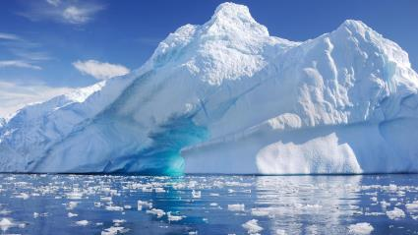
Unit 5 Humans and Nature
Lesson 3 Reading (P36)
Race to the Pole
？

Slide 5
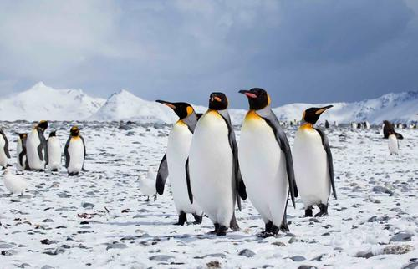
Race to the Pole
Who? When?
What was the result?
Antarctica:
The South Pole
For centuries, Antarctica was the ultimate goal, the last challenge of exploration.

Slide 6
Read the text and underline the answers to these questions.
Task 1
Who took part in the race?
When did the race begin?
What was the result?
Tip:
Text in italics are the words from explorer’s diary and letter.
Eg. “Well, we have now lost the goal of our ambition…”

Slide 7
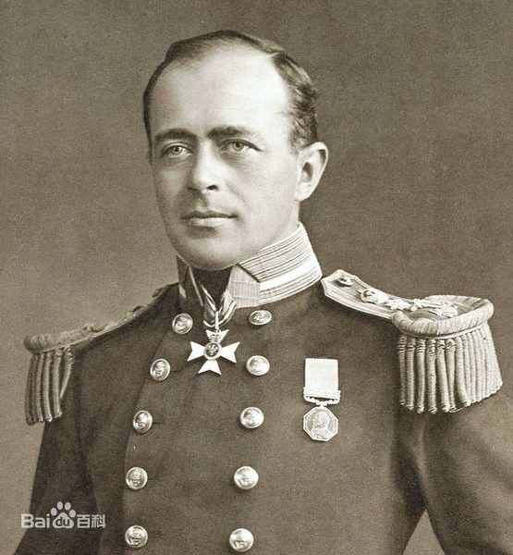
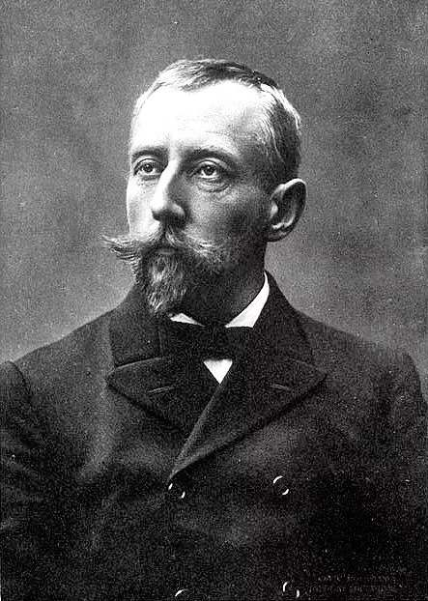
Read the text and underline the answers to these questions.
Task 1
Who took part in the race?
When did their race begin?
What was the result?
Para 1: British Captain Robert Falcon Scott
Norwegian explorer Roald Amundsen
Para 1: June, 1910.
General introduction of the race
Para 4: Amundsen reached the Pole on Dec. 14, 1911 and arrived safely back.
Para 5: Scott arrived at the Pole with four team members on Jan. 17, 1912.
Detailed account of Scott’s return journey
Para 6-11: Scott with four members all died on the return journey.
Scott
Amundsen

Slide 8
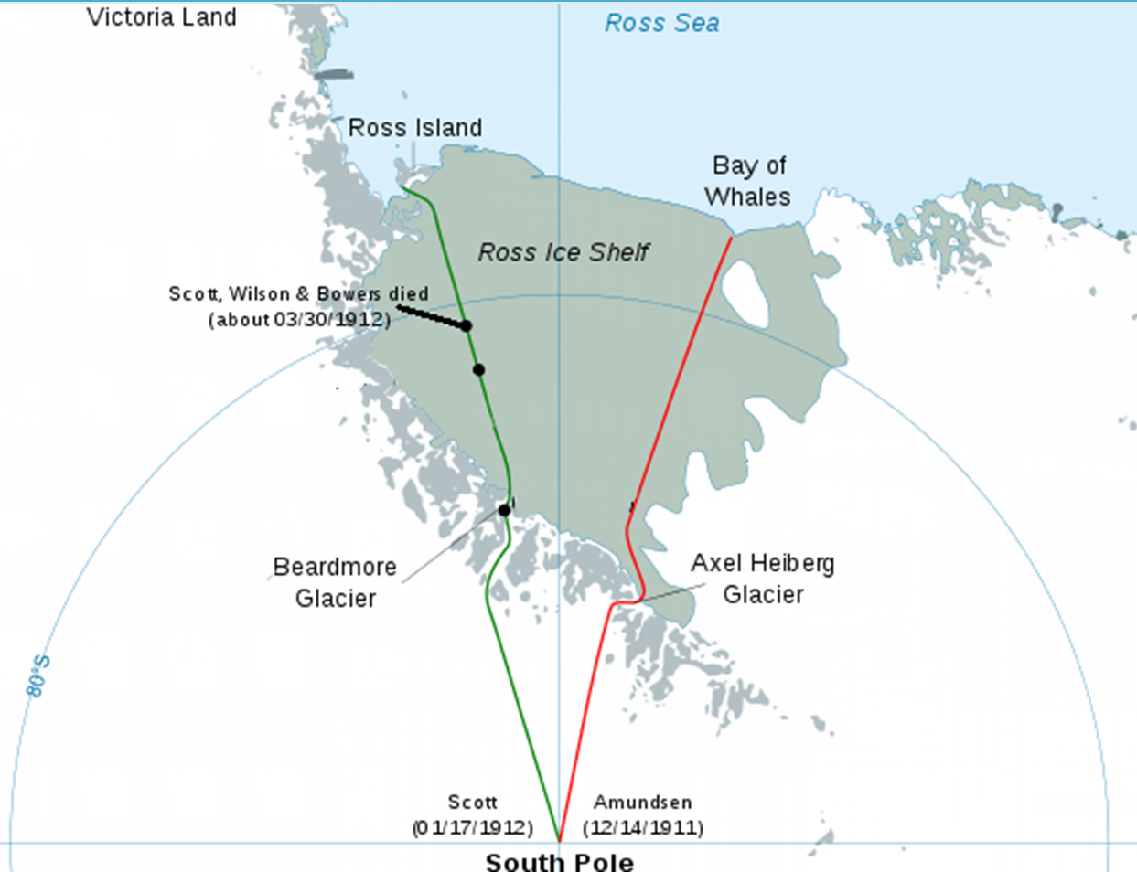
Task 2
Add more information about the two exploration teams on the map.
Scott
Amundsen

Slide 9
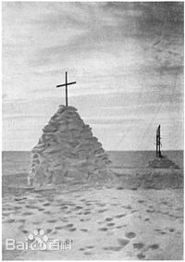
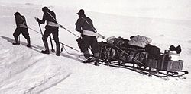
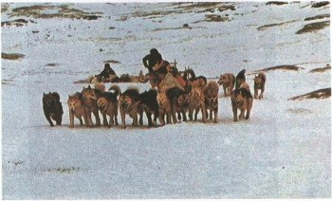
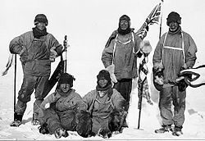
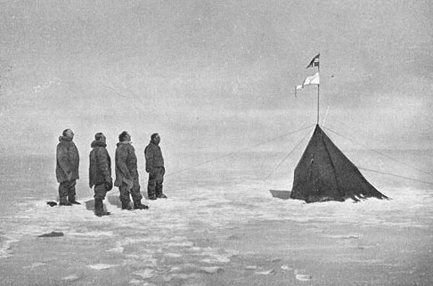
Task 2
Both prepared food bases.
Amundsen
11/1/1911
Scott
01/25/1912
09/08/1911
safely
Problems:
sledges horses
Men pushed the sledges.
Dogs pulled the sledges.
Men were on skis.
A terrible storm came.
Captain Oates died.
Rapid progress
Evans died.
Looking for rocks
Being tired
Running out of food
shocked

Slide 10
Summarize the change of feelings on Scott’s team’s return journey. Give your reasons.
Task 3
Occasions | Feelings | Reasons
At the beginning of the return journey | hopeless and helpless | The men were tired and were running out of food. The weather condition was terrible.
When they looked for rocks | determined and devoted | They carried 20 kilos of rocks all the way for the further research.
When two members died | sad but courageous | We knew that was the act of a brave man and an English gentleman. We all hope to meet the end with a similar spirit.
When they were trapped by a storm | full of sadness, completely hopeless, sorry | Scott wrote to his wife that he had lots of stories for the boy, but he paid a huge price. It seemed a pity…

Slide 11
Think and voice your opinions.
Task 4
Why do you think Scott’s team lost the race? Can you give any suggestions for better preparation?
Would you say that Scott’s team were losers? Why or why not?

Slide 12
Think and voice your opinions.
Task 4
Why do you think Scott’s team lost the race? Can you give any suggestions for better preparation?
Possible answer:
Scott wasn’t as experienced as Amundsen. He should use dogs instead of horses and set closer food bases. He also had to check whether his sledges and other equipment were suitable for the terrible condition. Besides, he could start his journey earlier.

Slide 13
Think and voice your opinions.
Task 4
2. Would you say that Scott’s team were losers? Why or why not?
Possible answer:
Even though Scott and his team lost the race to the Pole, they showed true determination and strength of character which is seen in heroes. Scott and his team are inspirational and not losers. Scott’s team had always kept their goals in mind. They carried the rocks even in extremely difficult situations. The spirit and what they have done helped followers do further research.

Slide 14
谢谢您的观看
北京市朝阳区教育研究中心 制作

Slide 15
视频来源：
https://www.bilibili.com/video/av77320726?t=2253&p=2
播放片段：
3:10-5：50
无法下载，仅供大家参考！

