Slide 1
必修（二）Unit 5 lesson 3（2）
朝阳区线上课堂·高一年级英语
北京市三里屯一中 喻瑜

Slide 2
教学目标
巩固南极探险之争的基本信息，积累相关语块表达；
推断斯科特日记的内在含义，论证他的优秀品质；
基于文本资料和视频，感受人类对探索自然的执着追求。

Slide 3
学法指导
通过文本语境学习词汇，及时积累话题词汇，并熟悉构词法。
结合上下文，运用自身知识储备和逻辑推理，理解作者表达的隐含意义。
利用网络搜集的照片、视频、文章等资料，更深入了解相关话题，有助于理解人与自然的主题意义。

Slide 4
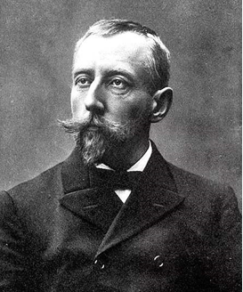
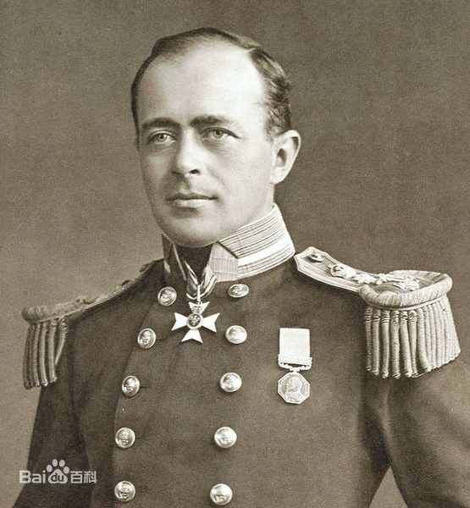
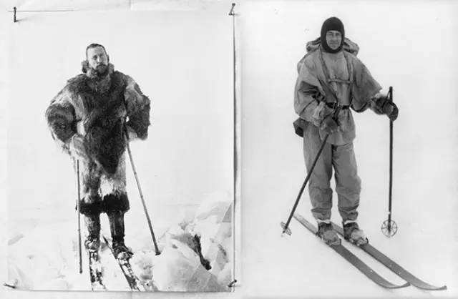
Race to the Pole
V.S.
Amundsen
Scott

Slide 5
Complete the summary with the information from the text.
Task 1
explorer
Captain Scott had a race to the South Pole with Norwegian 1.________Amundsen in 1911. During the polar summer, both teams organized food bases 2._______________their journeys. On 8 September, 1911, Amundsen was the first to leave for the South Pole. He 3.__________________ on the way and reached the pole on 14 December, 1911. He put a Norwegian flag there and returned safely 4.________ their planned schedule. Scott left on 1 November and soon had problems. He finally arrived at the Pole with four team members on 17 January, 1912. Unfortunately, their return journey was one of the 5.______in the history of exploration. They 6.________ food and the weather conditions were 7._______. Later, two of his team members died. Scott and the rest two members 8._________ with rocks they found. But then they were trapped by a terrible storm and died in a tent within eleven miles of one of their food bases. Although Scott’s team 9.___________ win the race to the Pole, their great courage made them 10.________.
in preparation for
made rapid progress
ahead of
worst
ran out of
terrible
carried on
had failed to
heroes

Slide 6
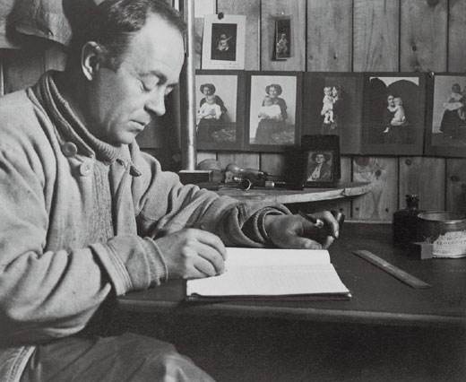
Race to the Pole
General introduction of the race
Scott’s diary
and letter
Detailed account of Scott’s return journey

Slide 7
Task 2
Try to understand what Scott was saying in his diary and letter, and write down your inference of the underlined sentences.
Making inference:
Sometimes things are not stated explicitly(=clearly) in the text. To understand what is meant, you need to read between the lines.
Read the sentence/ paragraph carefully.
Read the lines before and after it.
Use your logic and knowledge to understand the implied meaning.

Slide 8
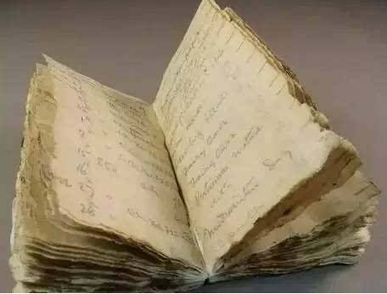
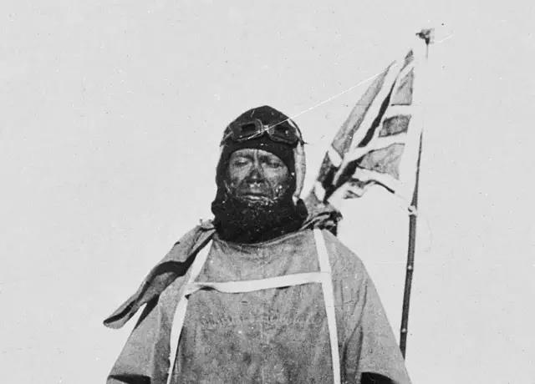
Line 20: “Well, we have now lost the goal of our ambition and must face 800 miles of hard pushing—and good bye to most of our dreams.”
ambition: n. something that you want to do or achieve very much
Scott left on 1Novemember and soon had problems.
They were shocked when they saw the Norwegian flag.
Inference:
They failed to achieve their goal and felt discouraged.
They lost the reason for journey.

Slide 9
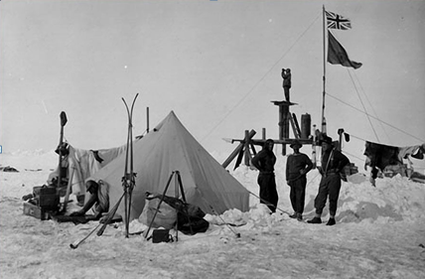
Line 25: “We are very cheerful, but what each man feels in his heart I can only guess. Putting on our shoes in the morning is getting slower and slower.”
cheerful: adj. happy and showing it in one’s behaviour
Each one wanted to encourage the other, but no one was really sure about what’s going to happen.
The men were soon very tired and were running out of food. The weather conditions were terrible.
Inference:
The men were getting weaker.

Slide 10
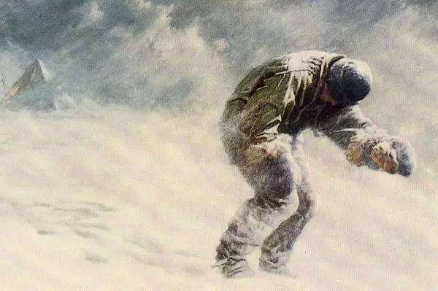
Line 33: “He said, ‘I am just going outside and may be some time.’… We knew that poor Oates was walking to his death, but though we tried to stop him, we knew that it was the act of a brave man and an English gentleman. We all hope to meet the end with a similar spirit, and certainly the end is not far.”
English gentleman: man who is polite and educated, and can be trusted
…Captain Oates, who was having great difficulty walking.
Although they were facing extreme difficulties, no one wanted to show the weakness. All the team members wanted to act like a gentleman and die bravely.
Inference:
He was going to walk into the cold and die away
from the team. He didn’t want to be a burden.

Slide 11
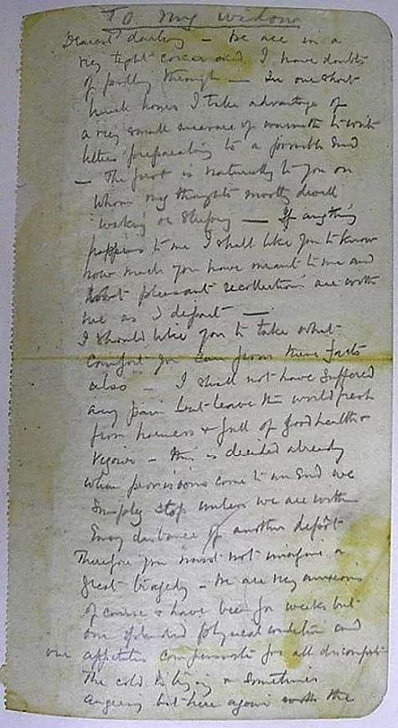
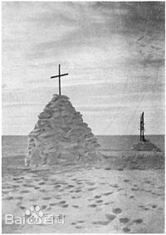
Line 41: “I could tell you lots and lots about this journey. What stories you would have for the boy…but what a price to pay.”
“We are getting weaker and weaker and the end can’t be far. It seems a pity, but I do not think I can write more.”
Scott fully understood that they could not survive and they came to their final time. He thought the exploration was worthwhile, but it just cost too much.
Inference:
The journey cost the men their lives.

Slide 12
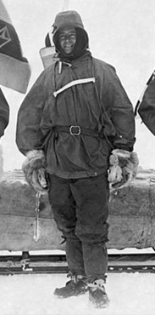
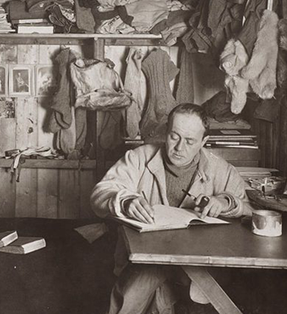
Task 3
The news of Scott’s death shocked the world. Even Amundsen was moved by Scott’s death saying “Captain Scott left a record, for honesty, sincerity, for bravery, for everything that makes a man”.
sincerity: n. the quality of being truthful and honest
--adj. sincere
Can you find any example to prove these characters?
Can you add more words to describe Scott’s characters?

Slide 13
Task 3
eg. Captain Scott wrote a diary about his journey, each entry was truthful and honest. He was honest about the feelings of his team and his fears.
honest, sincere
eg. Captain Scott had great courage to challenge the hard exploration of the South pole and overcame many difficulties.
brave
eg. Captain Scott and his team brought back rocks for research even though walking in the snow was difficult for them. They showed selfless devotion to research.
selfless
Scott’s
characters
determined, ambitious, calm…

Slide 14
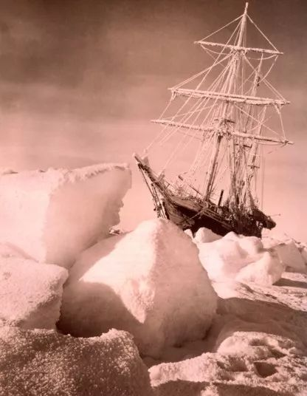
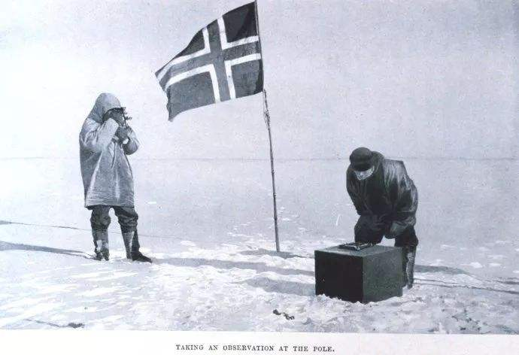
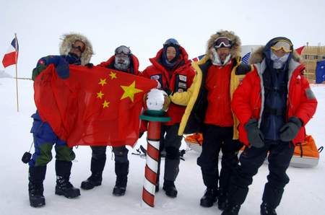
Task 4
Watch a video and think about the following questions.
What does the “race” mean for Scott and other explorers?
2. Why do people try to explore the toughest part of the Earth?

Slide 15
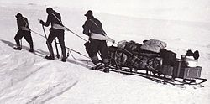
What does the “race” mean for Scott and other explorers?
It’s a race between Scott’s team and Amundsen’s team to see who can get to the Pole first.
For all the explorers, it’s a race between survival and death.
It’s also a race between the terrible condition the team face and their perseverance and bravery.

Slide 16
2. Why do people try to explore the toughest part of the Earth?
We took risks, we knew we took them [...] Had we lived, I should have had a tale to tell of the hardihood, endurance, and courage of my companions which would have stirred the heart of every Englishman. These rough notes and our dead bodies must tell the tale, but surely, surely, a great rich country like ours will see that those who are dependent on us are properly provided for.
----from Scott’s last letter
“我们这么做是冒险的，我们深知这点...如果我们得以幸存，我将向世人讲述我的同伴的毅力、进取和勇气，并将以此激励每一个英国人。我们的遗骸和这些潦草的便条也将一定会讲述我们的故事，而且我们富强的祖国会证明，一定会证明，那些支持着我们的人的信心没有被辜负。

Slide 17
Task 5
If you have a chance to explore the Antarctica with Chinese explorers, write about what difficulties you may have and what preparations you need make.
Tips: 1. Search online for more information about China’s Antarctica exploration.
2. Take notes about the following expressions about exploration from text. Try to use some in your own writing if necessary.
Exploration:
begin one’s journey to
organize food bases
be on the way to
the race to
in preparation for
be the first to leave
make rapid progress
ten days ahead of the planned schedule
run out of food
have difficulties with
have a terrible disease
break down
be on skis
pull the sledges
the return journey
the act of a brave man

Slide 18
谢谢您的观看
北京市朝阳区教育研究中心 制作

Slide 19
视频来源：
https://www.bilibili.com/video/av77320726?t=2253&p=2
播放片段：
05:52-07:25
31:10-37:20中间截取
无法下载，仅供大家参考！

