Slide 1
必修（二）Unit 5 词汇学习 （2）
朝阳区线上课堂·高一年级英语
北京市第十七中学 李海燕

Slide 2
学习目标：
1.识别归纳本单元生词中与“灾难与救援”“极地之行”
主题相关的词汇。
2.了解地震及斯科特南极之行,能在不同语境中理解以下词汇的意思。
trap， measure，conduct，base，break down， run out(of)
3.运用所学词汇描写一次灾难、意外或探险的经历。
学法指导：
1.关注上下文语境，体会词汇在句子或文段中所传递的意思。
2.养成按主题积累词汇的习惯，学会借助图片，导图，词根、词缀等方式记单词。

Slide 3
Humans and Nature
disasters & rescue
Journey to Antarctica
主题词汇
一词多义

Slide 4
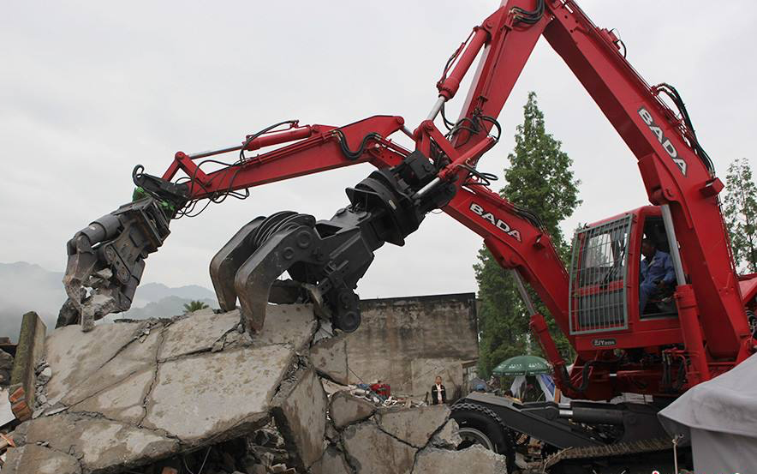
Some words about disasters and rescue.
vehicle n.
车辆
die v. —death n.
死亡
lose v. —loss n.
site n.
丧失
场所，地点
damage n./v.
伤害，损失
duty n.
职责，义务
disasters &rescue
vehicle on earthquake site
suffer v. 遭受
suffering n.
痛苦；折磨
shelter n.
躲避，庇护所
protect v. 保护
protection n.
process n.
过程，进程
保护，防护
battle n.
较量；战斗

Slide 5
Understand the meanings of the words in context.
Some natural disasters can cause death and other loss and damage. It also brings suffering for survivors. So we need to know some knowledge about self-protection.
After the disaster, the rescue team and vehicles would arrive at the site. Their duty is to save lives and reduce suffering. The process is challenging since it is a battle against time.

Slide 6
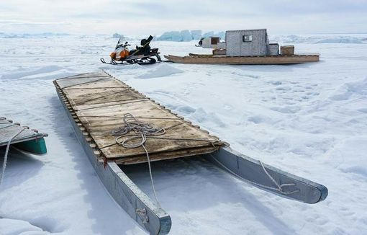
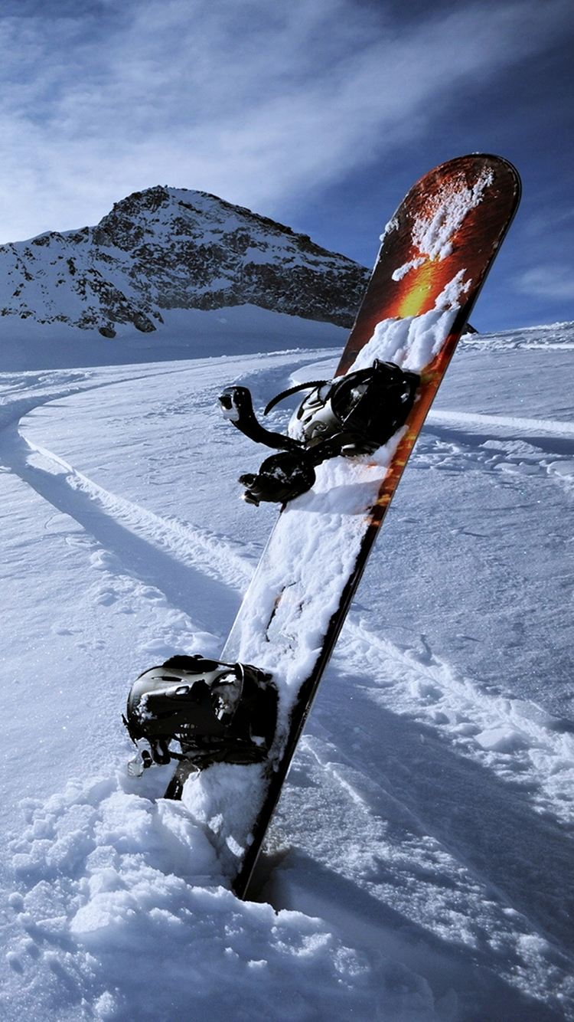
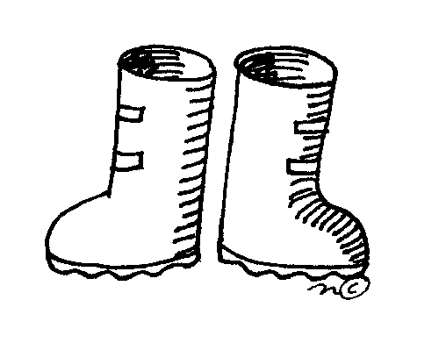
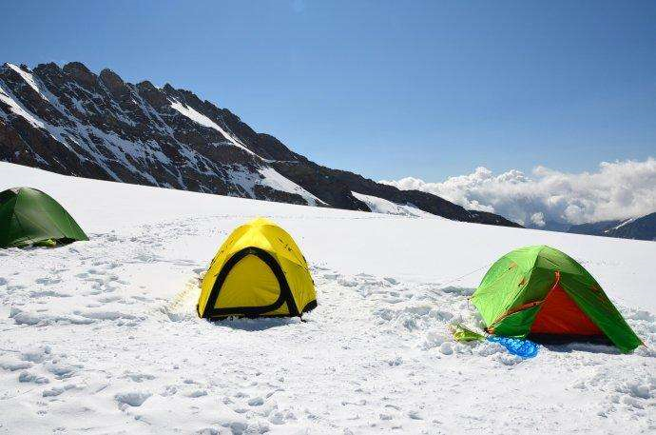
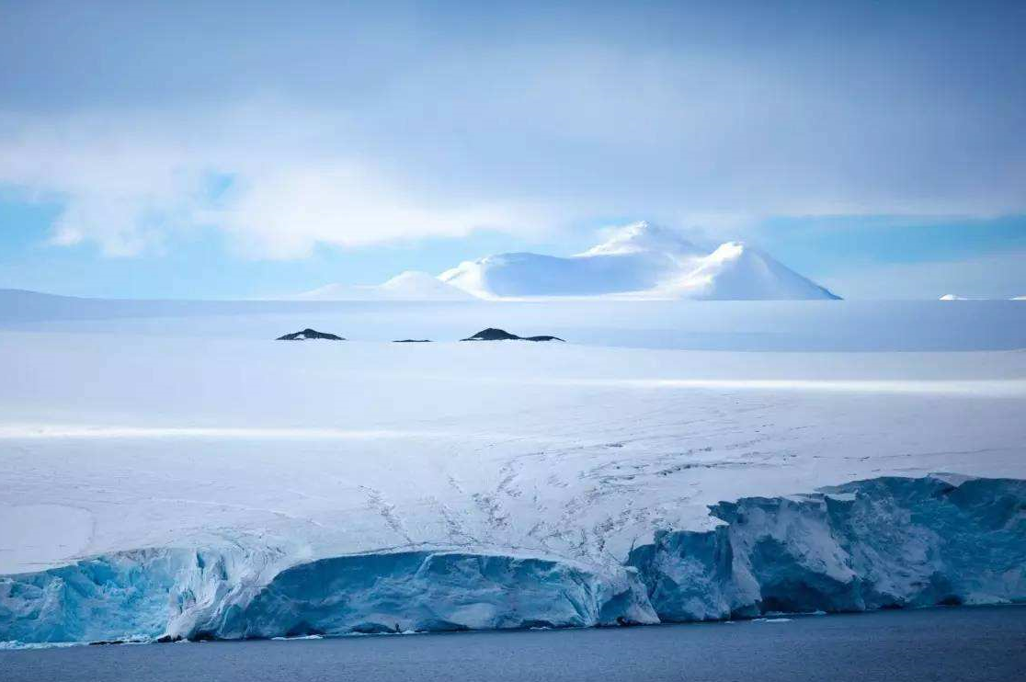
Some words about journey to Antarctica.
preparation n.
预备，准备
continent n. 洲，大陆
pole n. polar adj. 极地的
sledge 雪橇
distant adj. 久远的，遥远的
ski n. 滑雪板
v.滑雪
Journey to
Antarctica
exploration n. 探险
explorer n. 探险者
boot n. 靴子
brave adj.
bravery n. 勇气，
勇敢的行为
tent n. 帐篷

Slide 7
Understand the meanings of the words in context.
Antarctica is a polar continent. It is cold and distant. Humans knew little about it. From the early 20th century, some explorers began the journey to it. The exploration is surely dangerous and challenging. Full preparations should be made. Equipment like tents, sledges and skis is necessary. Certainly, what is most needed is bravery.

Slide 8
一词多义

Slide 9
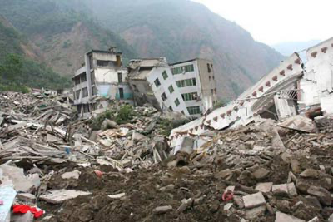
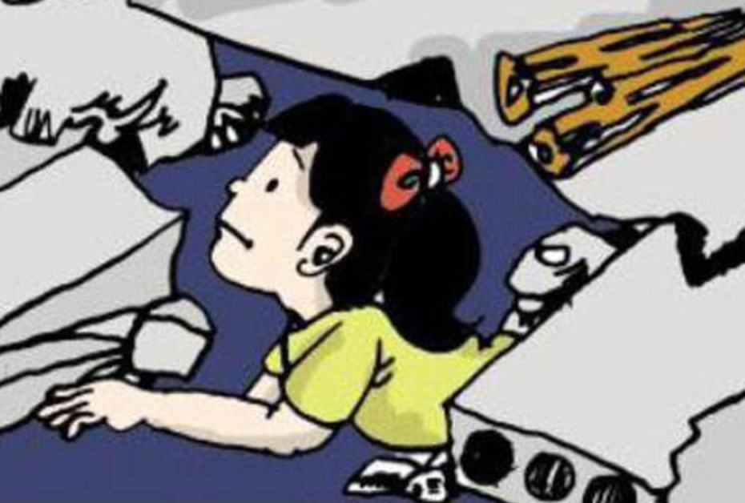
Which natural disaster do the pictures show?
What happened in an earthquake?
Buildings fell down and people were trapped inside.
v. [ to be in a dangerous place]

Slide 10
trap v.
v. [ to be in a dangerous place]
The door closed behind them and they were trapped.
A man ___________(被困在)on the top floor of a
burning house.
[ to be in a bad situation]
Many women are trapped in the loveless marriages.
was trapped

Slide 11
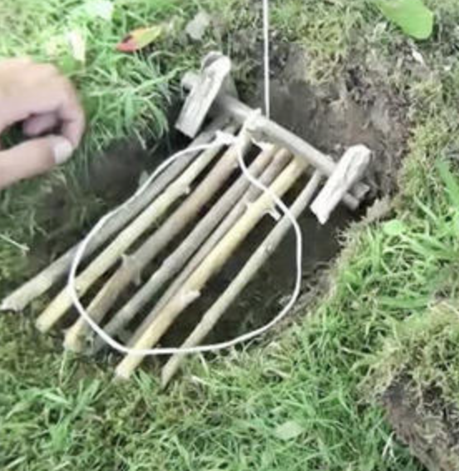
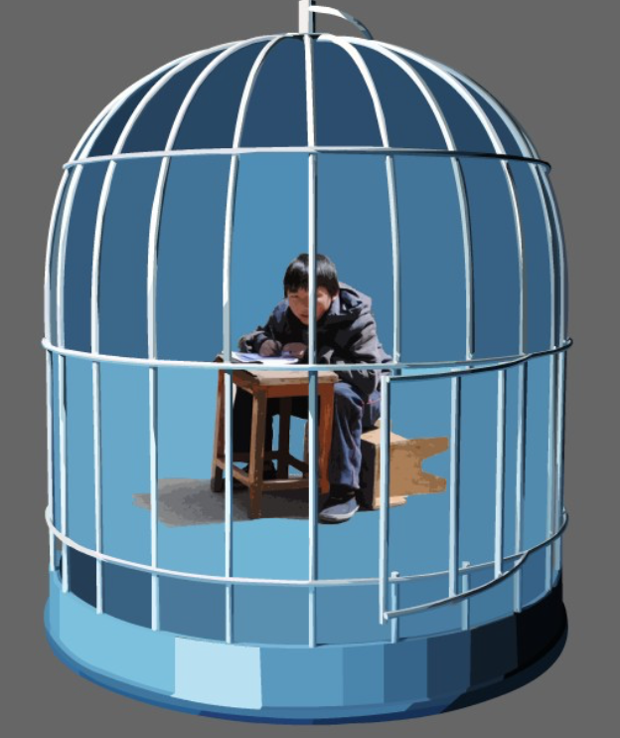
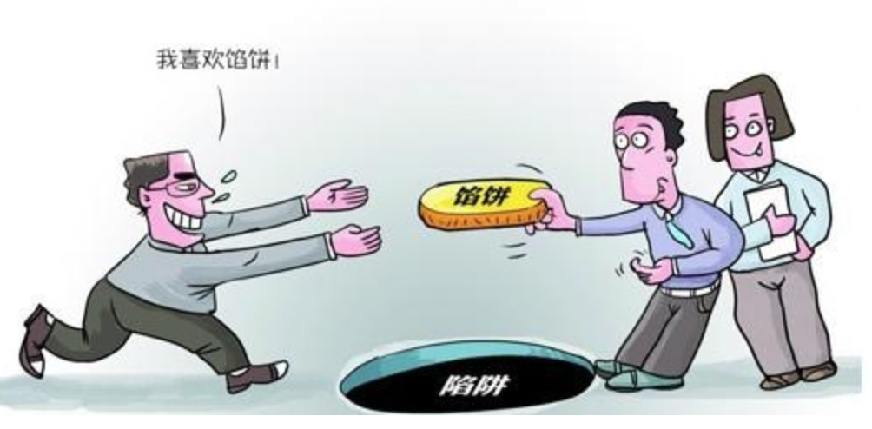
trap n.
lay/set a trap (for sb)
fall/walk into the trap
1.[for animals]
2. [bad situation]
3.[clever trick]
Translate the sentence and tell the meaning of “trap”.
The police set a trap to catch the thief.
The rabbit’s leg was caught in the trap.
Somebody thought marriage was a trap.
3.诡计，圈套
1. 夹子
2. 困境，牢笼

Slide 12
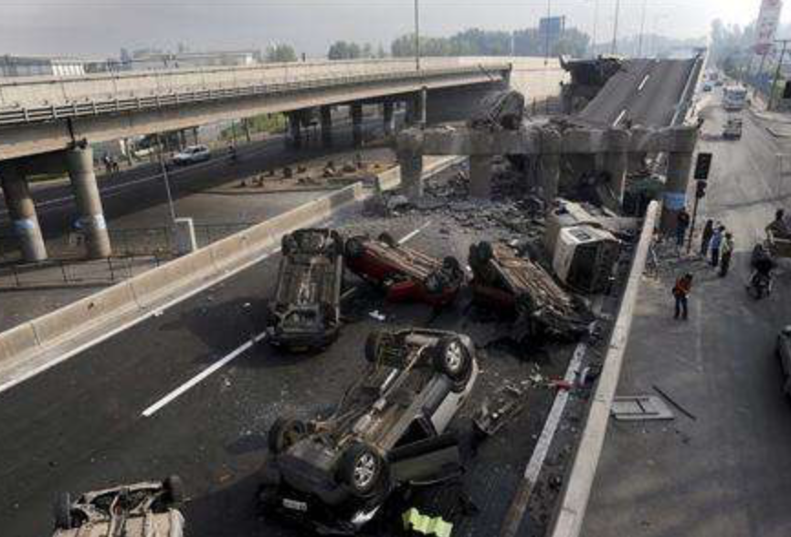
Do you know how much loss and damage a big earthquake can cause?
The loss and damage is hard to measure. (P102)
v. [to judge the value or effect]

Slide 13
measure v./n.
Doctors say it is too early to measure the effectiveness of the drug.
They measured the room to find out how big it is.
The room measures 6 × 6 meters.
The government should take some measures to prevent air pollution.
v. 评估，衡量
v. 测量
v.系动 （尺寸、数额等）为，是
n. [official action]

Slide 14
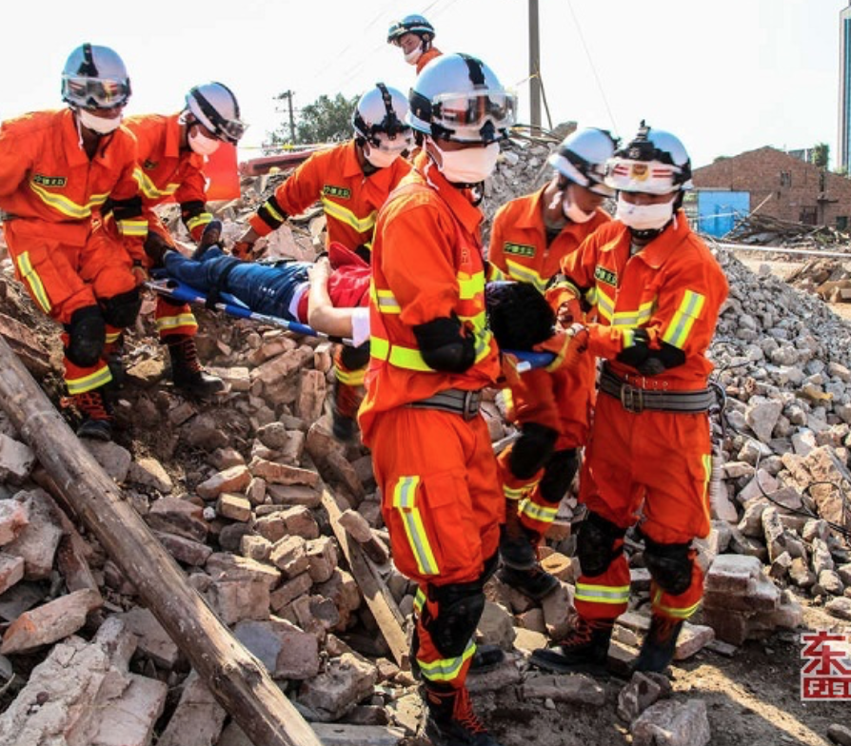
What do rescue teams do after the earthquake?
v. [to carry out]
They conduct the rescue attempts. (P103)
Rescue teams try to save people trapped under the building. (P34)

Slide 15
conduct v./n.
v. [to carry out]
What phrases can it form?
conduct an experiment/ a survey/an interview/a test
The data came from a survey conducted by the company last fall.
Is it really necessary to ________________ (进行实验)on animals?
Education is not only to teach knowledge, but also to teach students how to conduct well in society.
He was punished for his bad conduct in class.
conduct experiments
v. [to behave]
n. [behavior]

Slide 16
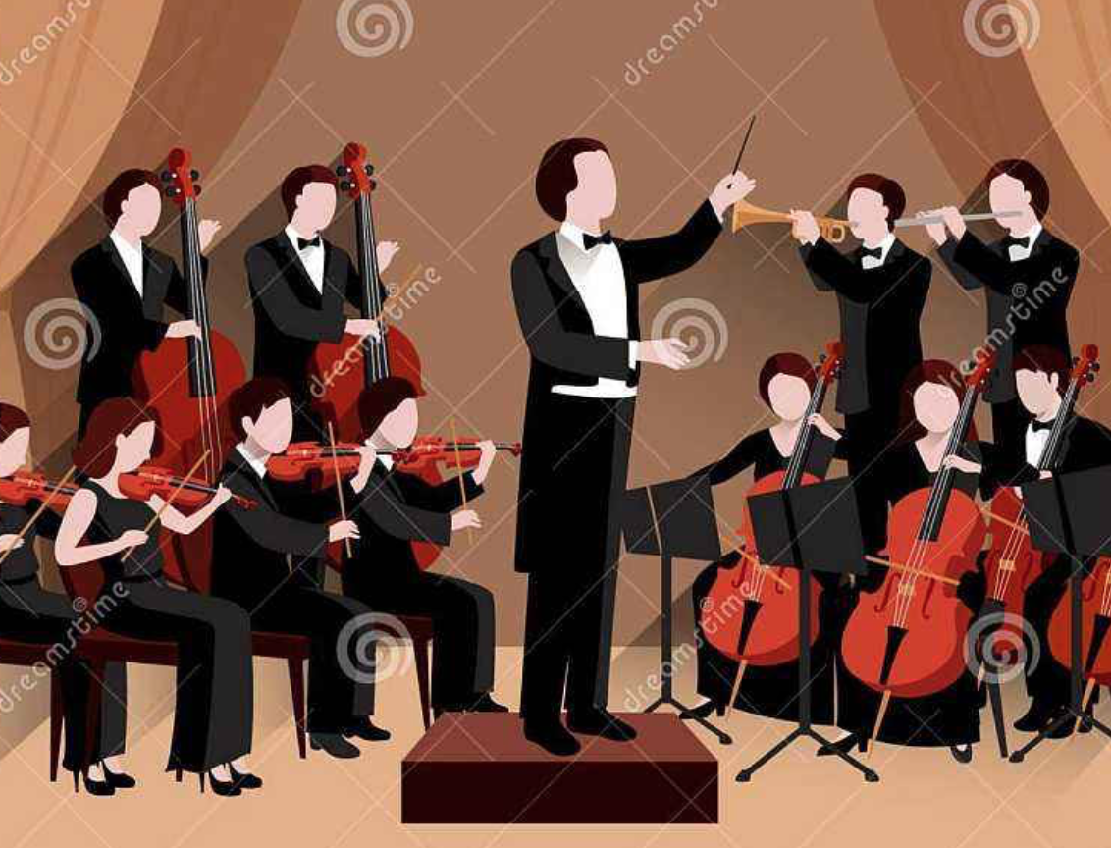
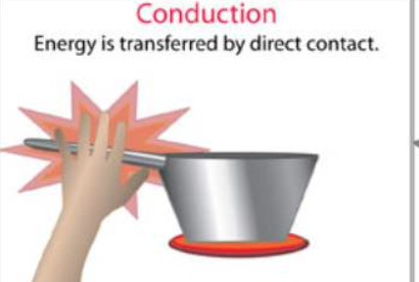
v. [to direct singing or playing]
conduct an orchestra/a choir
指挥
conduct electricity/heat
传导
v. [to pass along or through]

Slide 17
Fill in the blanks with the proper form of the words above.
A big earthquake struck Tangshan in 1976. In a few seconds, the city lay in ruins. The number of people who were killed or injured reached more than 400,000. The loss and damage is hard to_________. Soon after the quakes, soldiers came to ________the rescue work. They dug out those who were________. Workers built ________for survivors. Fresh water was taken to the city by train, truck and plane. Slowly, the city began to breathe again.
measure
conduct
trapped
shelters

Slide 18
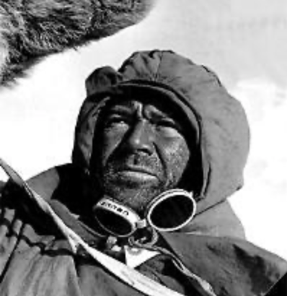
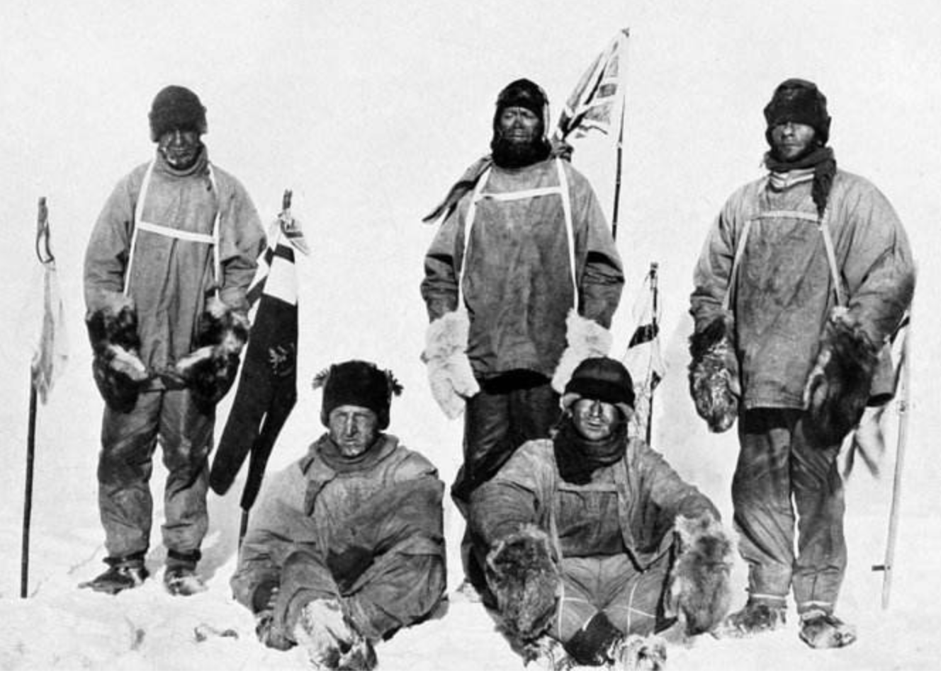
n. 基地，据点
What did they do?
What preparations did they make before the journey？
They organized food bases in preparation for the journeys.（P36）
Captain Scott and his team

Slide 19
base
Amundsen and his team arrived safely back to their starting base
on 25 January, 1912, ten days ahead of their planned schedule.(P36)
The company has its base in New York, and branch offices all over the world.
The lamp has a heavy base.
The country needs a strong economic base.
The study was based on data from 2,100 women.
sth is based on…=base sth on 以…为基础
这部小说基于他的早期经历。
The novel is based on his early experience.
n. [据点，基地]
n. [底座，底部]
n. [总部]
n. [基础]
n. [总部]
n. [底座，底部]
n. [基础]
v.

Slide 20
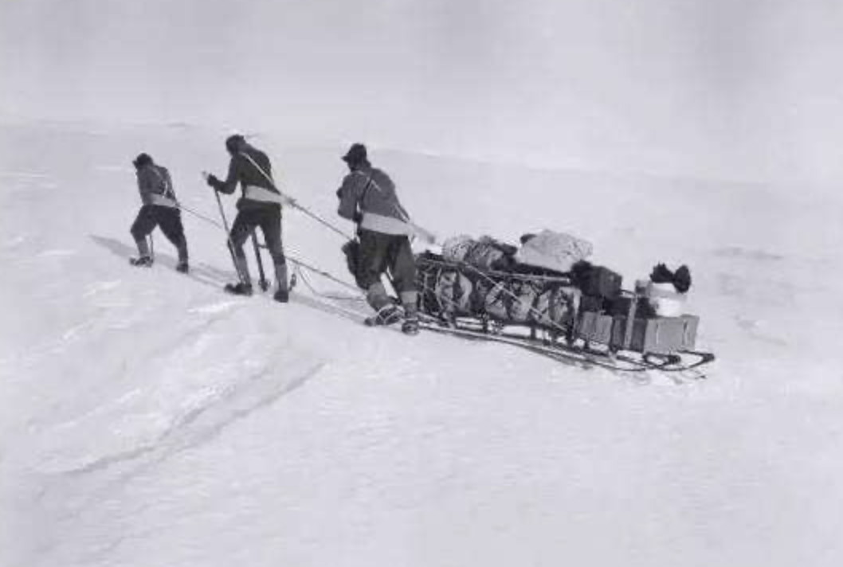
What problems did they meet after they left?
to stop working
What was the result?
The sledges broke down and the horses had difficulties with the snow and cold. (P36) So, they had to push the sledges themselves. On the return journey, they met storm and ran out of food. As a result, they all died.
to use up

Slide 21
break down
The bus we travelled in broke down on the way.
___________________, (电梯坏了) so we had to walk up the stairs.
Talks with business leaders broke down last night.
If she continues to work like this, she will break down soon.
She broke down and cried when she heard the news.
The question can be broken down into two parts.
The lift broke down
[to fail]
[to lose control of feelings and cry]
[to divide into parts]

Slide 22
run out(of)
The men were soon very tired and were running out of food.(P37)
Conditions are getting worse and supplies are running out.
The problem is that we ____________________.(已经用光钱)
We must act now because __________________.（时间不多了）
My contract(合同) runs out in September.
run out of=use up +sth 主语通常是人
run out= be used up 主语一般为物
have run out of money
time is running out
[come to an end]
I’m sorry to tell you that _______________________
your passport has already run out.
(你的护照已经过期)

Slide 23
On 1 June, 1910, Captain Scott left London to begin his journey to Antarctica. His ambition was to become the first to reach the Pole. He had a competitor, the Norwegian _______ Roald Amundsen. After organizing the food_____, Scott's team left on 1 November and soon had problems. His two sledges ___________and the horses began to have serious difficulties with the snow. They had to push the sledges themselves. Scott finally arrived at the Pole on 17 January, 1912, but they were shocked to see the Norwegian flag. The return journey was one of the worst in the history of _________. The men were tired and were ____________food. What was worse, they met storm. The members died one after another on the _________ and cold continent. Though Scott failed the race, the rocks they carried proved to be very useful in the research. As Amundsen said “Captain Scott left a record, for honesty, sincerity, for _________, for everything that makes a man.
explorer
base
broke down
exploration
running out of
distant
bravery

Slide 24
Summary: list the meanings of the following words or phrases as many as possible.
trap v./n.
measure v./n.
conduct v./n.
base n./v.
break down
run out(of)
使陷于危险/困境; 陷阱、捕捉器；圈套；困境
评估；测量；（高度、长度等）为/是；措施
实施；指挥；传导；行为举止
基地；总部；基础；底部；以…为基础
出故障；破裂；分解；(精神/身体 )崩溃/垮掉
用尽；到期、结束

Slide 25
Practice 1: Match Column A with Column B
conduct
take
set
measure
a trap
measures
speed
distance
an experiment
electricity
A
B

Slide 26
Match Column A with Column B
clever
economic
honorable
effective
base
conduct
measure
trap
A
B

Slide 27
Choose the correct explanation of the underlined words or phrases.
Practice 2
1. Education shouldn’t be measured only by examination result.
A. to find the size, length or amount of sth.
B. to judge the value or effect.
C. official action
B
2. The only way to catch mice is to set a trap.
A. a piece of equipment for catching animals or birds
B. a clever trick
C. a difficult situation
A

Slide 28
Choose the correct explanation of the underlined words or phrases.
C
3. The northeast of China is the important food base of China.
A. the most important part of sth from which new ideas develop
B. the lowest part
C. the main place
4. The relationship between them has completely broken down.
A. to fail
B. to stop working
C. to lose control of
A

Slide 29
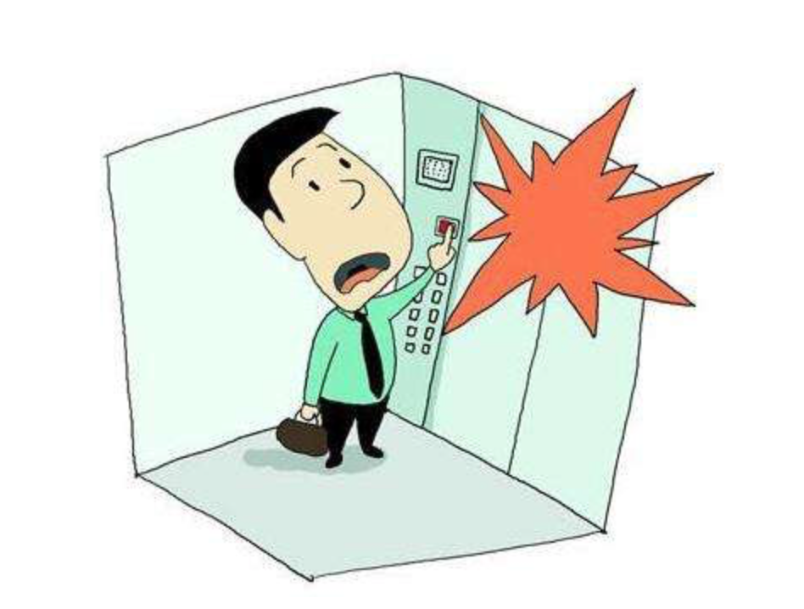
Describe the picture with the key words or phrases.
Practice 3
break down,
trap
The lift broke down and he was trapped inside.

Slide 30
Describe the picture with the key words or phrases.
run out
break down
Petrol had run out and the car broke down on the road.

Slide 31
Write an experience of disaster, accident or an adventure.
Try to use the words and phrases we have learned today.
disasters & rescue
Journey to Antarctica
death, loss, damage, suffering protection, site, vehicle, duty, process, shelter, battle
continent, polar, distant, ski exploration, explorer, preparation,
bravery, sledge, tent, boot,
trap， measure， conduct，
run out(of)，break down，base，

Slide 32
Homework:
Review the words and phrases and describe an experience with them.

Slide 33
谢谢您的观看
北京市朝阳区教育研究中心 制作

