Slide 1
必修（二）Unit 5 词汇学习（1）
朝阳区线上课堂·高一年级英语
北京市第十七中学 余芬

Slide 2
学习目标：
1.归纳识别与自然景物相关的词汇,如：
wildlife;landscape; natural disaster; flood; drought;
hurricane; landslide; volcanic eruption等。
2.理解并正确运用以下词汇。
shock; curious; escape; survive; observe; equal;
extent; turn one's back on sb./sth.
3.运用所学词汇谈论自然以及人与自然的关系。
学法指导：
1.通过联想法和词图匹配的方式记忆名词。
2.通过上下文语境，体会其它词在句子或文段中传递的意思。

Slide 3
Unit5 Humans and Nature
How much ......

Slide 4
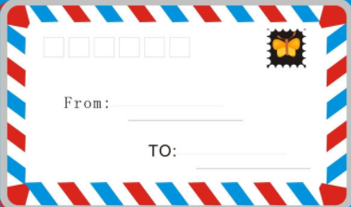
2 0 1 3 1 4
Nature
Everyone

Slide 5
My dear baby,
It’s my first time to write a letter to you. Are you curious? I just want you to listen to my heart.
You know, I’m beautiful and each part of myself is a wonderful landscape, such as the earth and the sky, the forest and fields, lakes and rivers, the mountain and the sea. I'm loved by the wildlife and other living things. I’m always happy. But sometimes, I become horrible and in cold blood. I am not willing to turn my back on you, making you shocked and frightened. But I can’t control myself.
Can you help me? Help me not be angry. Help me always be a gentle and kind of loving mother.
Love your
Mum

Slide 6
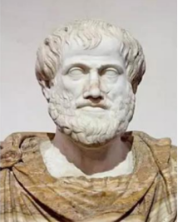
Every field of nature is wonderful.
大自然的每一个领域都是美妙绝伦的。

Slide 7
jungle n.
(热带)丛林

Slide 8
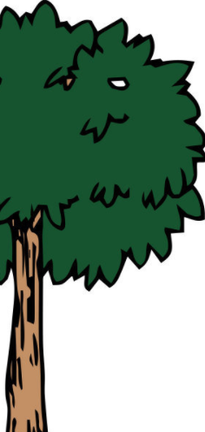
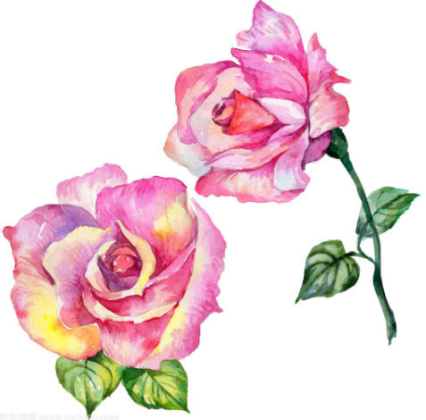
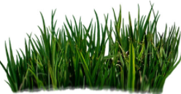
landscape n.
风景；景色

Slide 9
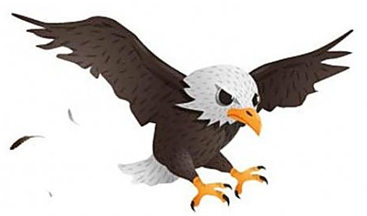
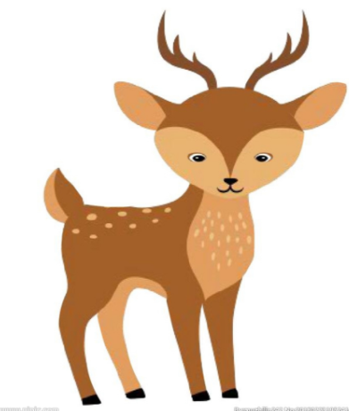
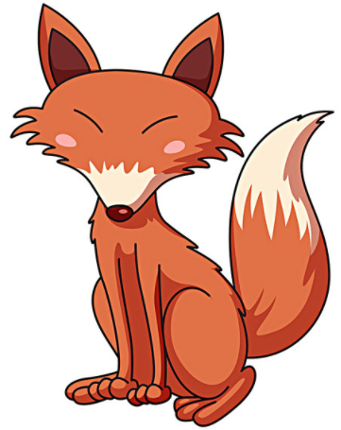
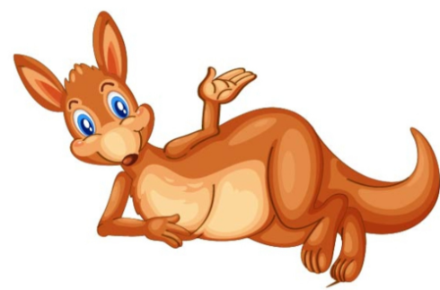
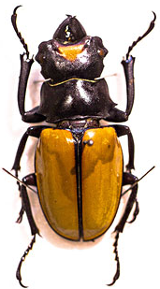
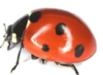
eagle
wildlife n.
野生动植物
deer
weed
fox
kangroo
soil
insect

Slide 10
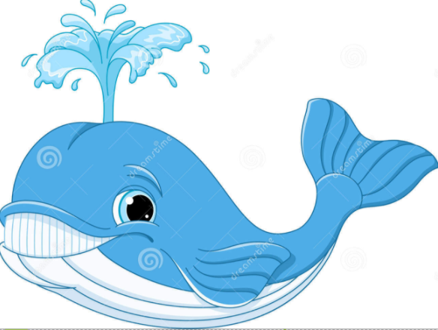
living things n.
生物
dolphin
shark
whale

Slide 11
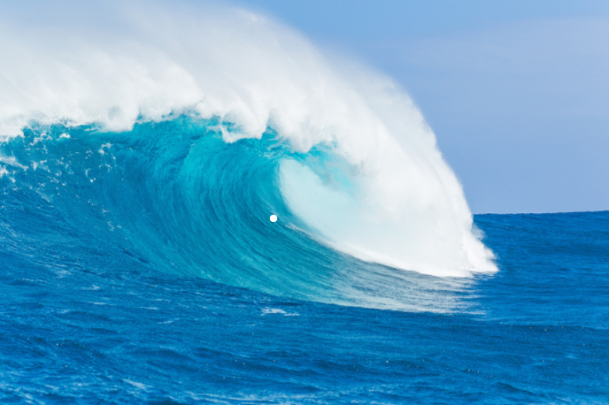
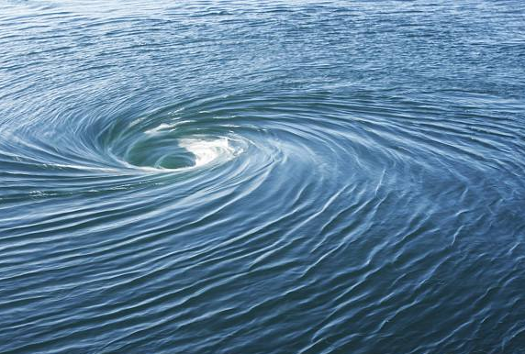
float vi.
漂；浮
wave
海浪；波浪
tidal whirlpool 潮汐漩涡
mystery n .
神秘

Slide 12
Let's check

Slide 13
scape
land
j gle
un
forest
sea
s l
oi
things
my
living
things of stery
tree
sh k
ar
fl t
w d
oa
ee
sect
in
dol
phin
tidal
whirlpool
f x
o
wh le
a
life
wild
w v
a
e
kang
roo
d r
ee
gle
ea

Slide 14
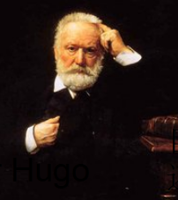
Nature is a kind of loving mother,
but also a butcher in cold blood.
自然不仅是位慈爱的母亲,
还是个冷血的屠夫。
Victor Hugo

Slide 15
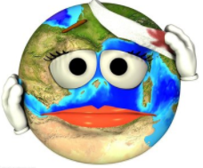
terrible
If I get angry,
I will bcome horrible and make you shocked and frightened.
If I get hurt and feel pain,
I will turn my back on you.

Slide 16
shock
vt.震惊;难以置信
1.The news that the forest fire in Australia lasts for 5
months shocked me a lot.
2.It was a real shock to find out that chickens could tell
what color they were eating.
3.The lecture was so shocking that the two students
were shocked by the fact that our humans harmed
nature so much. (P29)
n.震惊；难以置信
adj.令人震惊的
adj.感到震惊的
4.Make your own sentence with shock.

Slide 17
turn one's back on sb./sth.
对......置之不理； 对......撒手不管
1.I won't forgive my sister——she turned her back on me
and refused to give me a hand when I lost my job.
2.My father deserted(抛弃) my mother and me when I was
5 years old. But I can't turn my back on him now that
he's old and sick.
3.As a result, nature got hurt, felt pain, and finally turned its
back on us.(P29)
4.无论发生什么，他都不会对她置之不理。（汉译英）
No matter what happend, he would never turn his back on her.

Slide 18
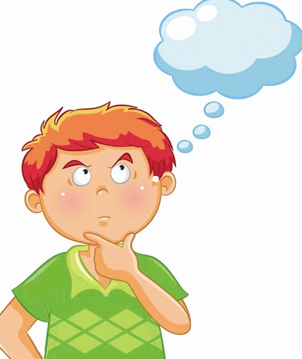
Can you imagine what nature will be,
if she turns angry?

Slide 19
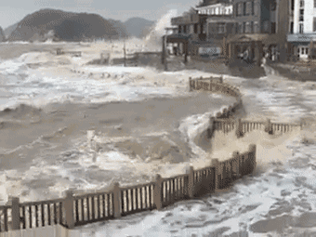
flood
洪水，水灾

Slide 20
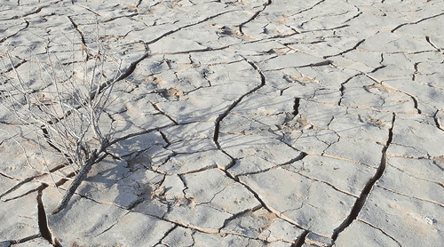
drought
旱灾；干旱

Slide 21
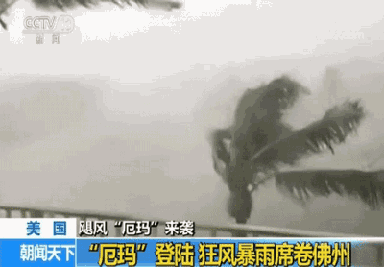
hurricane n.
飓风

Slide 22
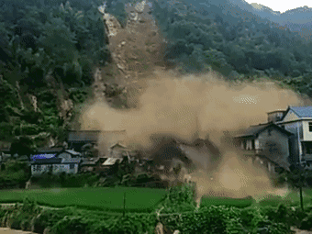
landslide
滑坡；塌方

Slide 23
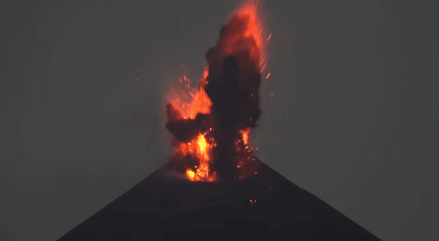
volcanic eruption
火山爆发

Slide 24
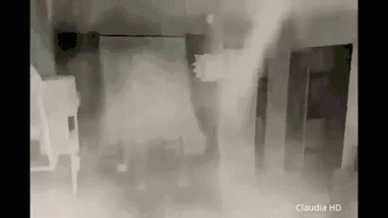
earthquake
地震

Slide 25
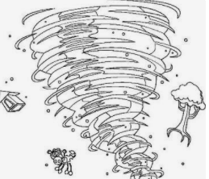
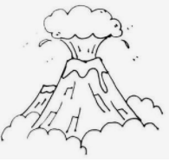
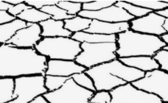
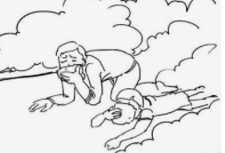
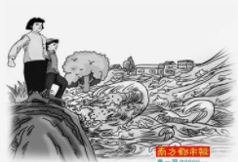
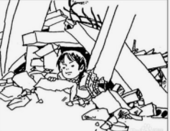
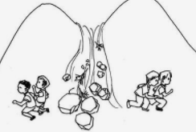
Natural Disasters
Label the pictures with the words in the box.
drought flood hurricane landslide
volcanic eruption forest fire earthquake
1
2
3
1
hurricane
2
volcanic eruption
drought
3
4
5
4
forest fire
5
flood
6
7
earthquake
6
7
landslide

Slide 26
Why is nature so changeable?
Are you curious about her?
It is our humans that makes nature changeable. It will be very difficult for us to escape natural disasters and survive.
So, to some extent, observing our mother's feeling is necessary.
Everyone has a equal right to be cared.

Slide 27
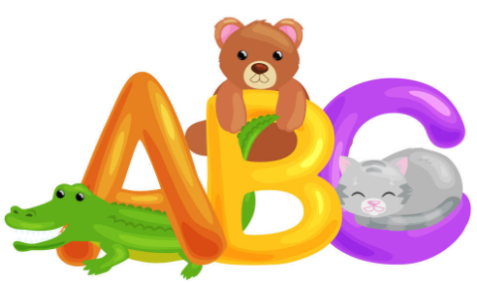
Word Study
curious
escape
survive
extent
observe
equal

Slide 28
curious
be courious about 对......感到好奇
be curious to do 渴望做.....急于做......
1.Children always like to ask their parents questions
because they are curious about everything around them.
adj. 好奇的
2.Tom found a good way to solve this math problem and
he was curious to share with others.
adj. 渴望的，急切的
3.Describe the picture with curious.

Slide 29
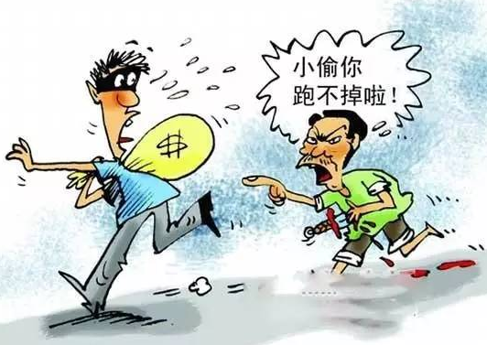
vi./vt./n. 逃离；逃脱
escape
1.Fortunately, Sarah managed to escape serious injury
out of the volcanic eruption.
2.The soldier escaped from the enemy's prison and
returned to his motherland.
3.He made his escape in disguise(伪装).
4.Describe the picture with escape.

Slide 30
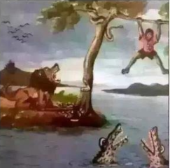
vi./vt. 幸存；活下来
survive
1.She died in a car accident. If she had been wearing her
seat-belt, she might have survived.
2.These drugs can help people survive heart attacks.
3.Describe the picture with survive.

Slide 31
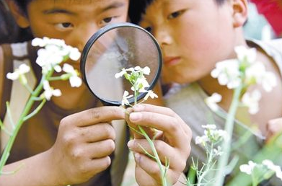
observe
vt. 观察,注意
1.Children learn by observing their parents.
2.Objects may also fall after an earthquake. Observe
carefully before you move away.(P41)
3.By 14 days of observation of the monkeys, this team
gained a lot of studying material.
4.Describe the picture with observe.

Slide 32
equal
1. There are 14 girls and 14 boys in Class2. So we can say
the number of boys and girls is equal.
相等的
2.In old times, women and men are not equal. but now
they have equal rights to get education and do many
things.
平等的
3.Make your own sentence with equal.

Slide 33
extent
To some extent 在一定程度上
1. The garden is about two acres(英亩)in extent.
2. He didn't pass the exam. But, to some extent, it's good
for him to think about his ways to study.
面积；长度
程度；范围
3.在很大程度上，我同意你的观点。（汉译英）
To a large extent, I agree what you said.

Slide 34
Blank filling
curious extent escape observe equal survive
One day, a fisherman met a huge whirlpool in the sea. He was going round in circles at great speed. He saw clearly that there were other objects in the whirlpool—trees and barrels. After a while, he became about the whirlpool itself. He then made three important . The first, the larger the bodies were, the more rapidly they fell; the second, between two objects of , round objects fell down less rapidly; and the third, between two objects of the same size, objects shaped like a tube fell down more slowly. So he tied himself to a barrel to help him float. Without waiting, he jumped into the sea to try and .
Finally, he managed to and went back home.
curious
observations
equal extent
escape
survive

Slide 35
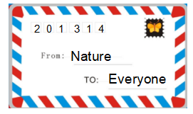
Reply
Including：
1.The detailed information about Nature.
(something that makes you comfortable while
something that makes you frightened.)
2.The reason why she was angry and became horrible.
3.The ways to help her.

Slide 36
Dear Mum,
Yours

Slide 37
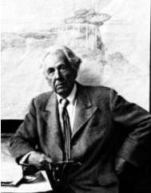
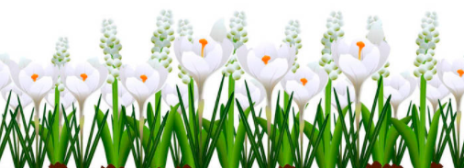
Study nature,
love nature,
stay close to nature,
it will never fail you.
—Frank Lloyd Wright

Slide 38
Writing: A Story of Nature

Slide 39
谢谢您的观看
北京市朝阳区教育研究中心 制作

