Slide 1
必修（二）Unit 5 定语从句总复习+后缀
朝阳区线上课堂·高一年级英语
北京市三里屯一中 罗云屏

Slide 2
【 Learning objectives 】 By the end of the class, you will be able to
Summarize the grammar rules of relative clauses
Identify suffixes of different part of speech--noun, adj., adv.

Slide 3
【 Learning objectives 】 By the end of the class, you will be able to
3. Write a brief introduction of a famous explorer using relative clauses and words with correct suffixes.

Slide 4
【Learning strategy 】
meaning >form
Pay attention to the part of speech of a word to make your expression more accurate

Slide 5
【task 1】 Finish the following chart.
先行词 (noun) | 关系代词/关系副词 | 在定语从句中充当的成分
people
thing
time
place
reason
who (that)
主语 ，宾语
whose
定语
which (that)
主语 ，宾语
whose
定语
when
状语
where
状语
why
状语

Slide 6
【task 2】Match the sentence from column A to an appropriate word and a relative clause in columns B and C.
Column A | Column B | Column C
That is the reason Xia Boyu is a great climber Rescue teams try to save people Amundsen will never forget the time The scientists hope to discover the drug My brothers and I went back from the islands People all over the world were moved by the courage | who which that whose when where why | are trapped under buildings. they set foot on the South Pole. was shown by Scott and his men. we often got more fish than others. is used to treat the pneumonia (肺炎) Scott won the respect of the whole world. experience has been an inspiration to us.

Slide 7
【task 2】
Column A | Column B | Column C
That is the reason | why | Scott won the respect of the whole world.
The scientists hope to discover the drug | which (that) | is used to treat the pneumonia (肺炎)
Xia Boyu is a great climber | whose | experience has been an inspiration to us.
Amundsen will never forget the time | when | they set foot on the South Pole.
My brothers and I went back from the islands | where | we often got more fish than others.
Rescue teams try to save people | who (that) | are trapped under buildings.
People all over the world were moved by the courage | which (that) | was shown by Scott and his men.

Slide 8
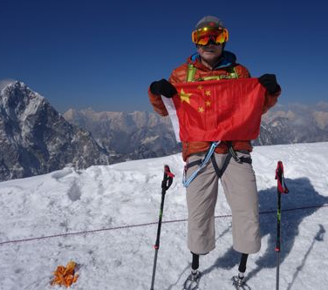
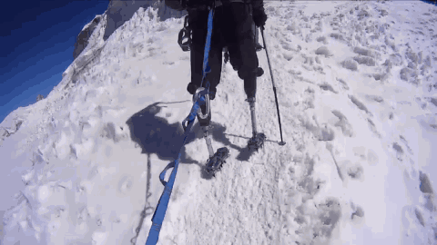
【task 3】Writing
You are supposed to make a brief introduction of Xia Boyu’s life experience to your class. Use at least 4 relative clauses appropriately.

Slide 9
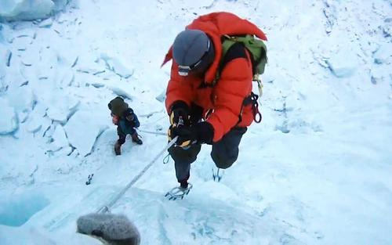
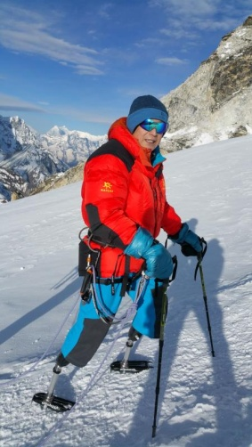
【task 3】Writing
when | where | what
1949 | Chongqing | was born
1975 | at an altitude of 8,600 meters | gave his sleeping bag to a teammate lost both of his lower legs
1975-2018 |  | kept training
May 14th, 2018 | the summit(=top) of Qomolangma | succeeded

Slide 10
【task 3】Writing
His name is Xia Boyu, a Chinese climber who was born in Chongqing 70 years ago.
1975 was the year when he first climbed Mount. Qomolangma. But his journey stopped at an altitude of 8600, where he gave his sleeping bags to his teammate. And he lost both his lower legs forever.
But he kept on training for the following 40 years. The reason why he didn’t give up is that he firmly believed that he could make it to the top one day.
Then came the day, May 14th, 2018. Xia will never forget the moment when he stood on the top of Qomolangma, which is the highest mountain in the world.
I really respect Xia Boyu, whose courage to overcome challenges is an inspiration to me, to you, to every one of us!

Slide 11
【task 4】Complete the Word Builder.
-tion
-ness
-th
-ance
-ful
-less
-ive
-ous
-ly
Word Builder | suffixes
 | prepare
 | situate
 | protect
 | explore
 | die
 | disappear
 | hope
 | harm
 | cheer
 | sad
 | ambition
 | anxious
preparation n.
situation n.
protection n.
exploration n.
n.
death n.
disappearance n.
hopeful a. / hopeless a.
harmful a. / harmless a.
adj.
a.
cheerful a.
sadness n. / sadly ad.
ambitious a.
anxiously ad.
adv.
ad.

Slide 12
【task 5】
Use the correct form of the words to complete the sentences in exercise 7 on page 39.
Scott and Amundsen waited anxiously for spring during the Antarctic winter of 1911.
Amundsen got to the South Pole before Scott because he had done more ___________ before leaving for the Pole.
Scott and his team got into a difficult __________ because their sledges broke down.
Scott’s team tried to stay __________ despite of all the difficulties they faced.
Scott experienced a great sense of _____________ after realizing that all of his efforts to reach the South Pole were for nothing.
Scott wrote about their ____________ situation in his diary.
The bad weather increases the danger of their ___________.
preparation
situation
cheerful
sadness
hopeless
exploration

Slide 13
【task 5】
grammar rules
Amundsen got to the South Pole before Scott because he had done more ___________ before leaving for the Pole.
Scott and his team got into a difficult __________ because their sledges broke down.
Scott experienced a great sense of _____________ after realizing that all of his efforts to reach the South Pole were for nothing.
The bad weather increases the danger of their ___________.
preparation
situation
sadness
exploration
句子的主语或宾语 (动宾/介宾) 一般是名词

Slide 14
【task 5】
grammar rules
Scott’s team tried to stay __________ despite of all the difficulties they faced.
Scott wrote about their ____________ situation in his diary.
Scott and Amundsen waited anxiously for spring during the Antarctic winter of 1911.
cheerful
hopeless
句子的表语或定语 (修饰名词) 一般是形容词;
句子的状语(修饰动词)一般是副词

Slide 15
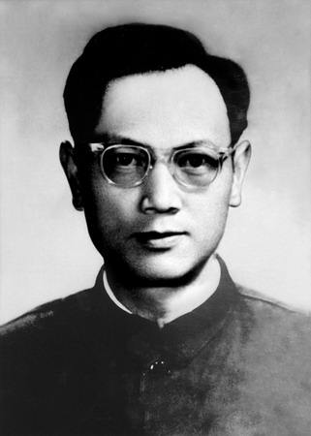
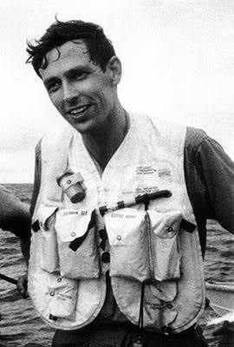
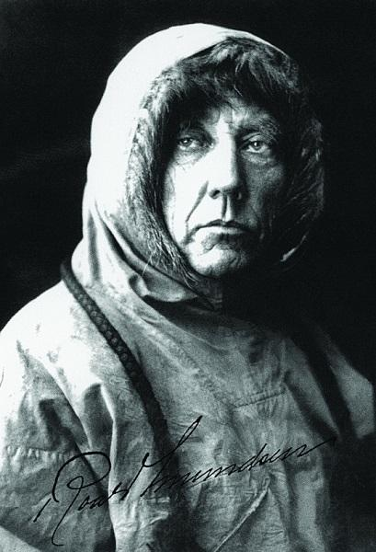
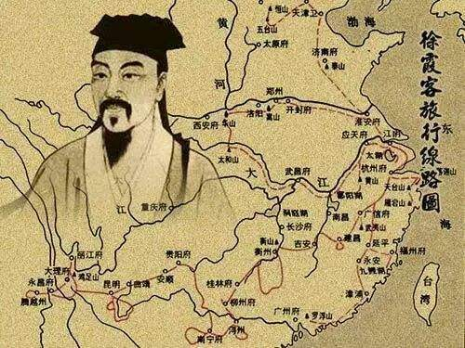
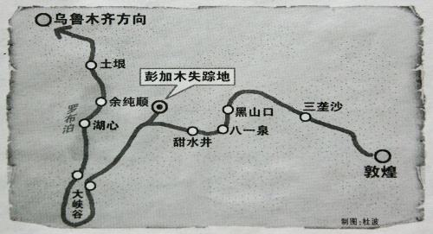
【Homework】 Choose one explorer that you are interested in and introduce his experience of exploration to your class.
Jacques
Piccard
Amundsen

Slide 16
【Homework】 Choose one explorer that you are interested in and introduce his experience of exploration to your class.
Use at least 5 relative clauses (who, which , whose, that, when, where ,why ) appropriately
Include at least 4 words with suffixes (in task 5) in your essay
Requirements:

Slide 17
谢谢您的观看
北京市朝阳区教育研究中心 制作

