Slide 1
必修（二）Unit 5 语法 定语从句(2)
朝阳区线上课堂·高一年级英语
北京市三里屯一中 罗云屏

Slide 2
【 Learning objectives 】 By the end of the class, you will be able to
Identify the sentence patterns with “when, where, why”
Experience and summarize the grammar rules

Slide 3
【 Learning objectives 】 By the end of the class, you will be able to
3. Apply grammar rules through writing sentences concerning place, time and reason
4. Describe the journey to the South Pole using relative clauses with “when, where, why”

Slide 4
【Learning strategy 】
meaning >form

Slide 5
【task 1】 P33 Exercise 9 Read the sentences below. Underline the relative clauses and circle the words that the relative clauses refer to.
1. That was the day when it took only six hours to break my body and soul.

Slide 6
【task 1】 Read the sentences below. Underline the relative clauses and circle the words that the relative clauses refer to.
2. The waves soon carried me to an area where the other fishermen were.

Slide 7
【task 1】 Read the sentences below. Underline the relative clauses and circle the words that the relative clauses refer to.
3. The reason why I’m here to tell the story is that I made the right decision.

Slide 8
【task 1】
That was the day when it took only six hours to break my body and soul.
I’ll never forget the moment when I first met the great explorer to Antarctica.
The waves soon carried me to an area where the other fishermen were.
My brothers and I went back from the islands where we often got more fish than others.
The reason why I’m here to tell the story is that I made the right decision.
The reason why we suffer from the novel coronavirus is that some people killed wild animals and ate them.

Slide 9
【task 2】grammar rules
when
当先行词是时间时, 通常用____________ 引导定语从句。
当先行词是地点时，通常用____________引导定语从句。
当先行词是reason时，通常用__________引导定语从句。
where
why

Slide 10
P83 Exercise 4
Maria: I’m very worried about my aunt and uncle in Indonesia. There have been news reports of a bad landslide near the place _________ they live.
Bi Yu: Oh no! I’m very sorry to hear that. Have you tried to call or email them?
Maria:I couldn’t reach them by phones and they are not online. The place ________ they live is quite remote, which is the reason _______ they have no Internet access. When I tried to call, the phone didn’t seem to connect.
where
where
why

Slide 11
P83 Exercise 4
Bi Yu: Well, I’m sure they will get in touch with you as soon as they can. The bad weather is most likely the reason ___________ the phone lines are down. If I can do anything to help, please let me know. I remember the time __________ my sister was in Japan during an earthquake. I was so anxious until I heard from her. Wait --- is that your phone ringing?
Maria: Oh, yes! It’s my aunt calling. What a relief!
why
when

Slide 12
【task 3】Describe the following time, places and reasons in a sentence using relative clauses with “when,where,why”.
time
the day (Sept. 1st, 2019) the day (Jan.25th, 2020) the days (June 24-26, 2019) the season (spring) the moment / the day (May 24th, 1960)
places
Forbidden City National Museum Beijing Australia Antarctica
reasons
why I like / don’t like English why I respect the explorer why I survived the disaster why I was moved why I love reading the novel

Slide 13
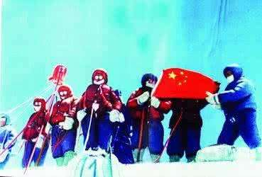
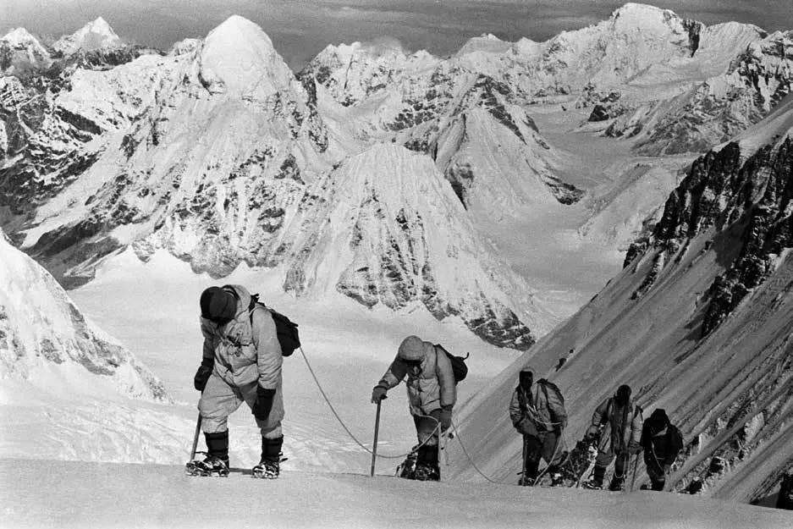
【task 3】
time
the day (Sept. 1st, 2019) the day (Jan.25th, 2020) the days (June 24-26, 2019) the season (spring) the moment / the day (May 24th, 1960)
Example:
May 24th, 1960 is the day when Chinese climbers first reached the top of Qomolangma.
The climbers will never forget the moment when they stood on the top of Qomolangma.

Slide 14
【task 3】
reasons
why I like / don’t like English why I respect the explorer why I survived the disaster why I was moved why I love reading the novel
Example:
The reason why I was moved was that they were cheerful in spite of all the challenges.

Slide 15
【task 3】Describe the following time, places and reasons in a sentence using relative clauses with “when,where,why”.
time (when)
the day (Sept. 1st, 2019) the day (Jan.25th, 2020) the days (June 24-26, 2019) the season (spring) the moment (May 24th, 1960)
places (where)
Forbidden City National Museum Beijing Australia Antarctica
reasons (why)
why I like / don’t like English why I respect the explorer why I survived the disaster why I was moved why I love reading the novel

Slide 16
Last month, I accompanied my foreign friend to the Forbidden City, where she was amazed by the splendid ancient buildings in Ming and Qing Dynasties.
I went to Australia last winter vacation, where I saw the unique and cute animal - koala bear.
In 1911, both Amundsen and Scott reached the Antarctica, where they had a race to the South Pole.
【task 3】
places (where)
Forbidden City Australia Antarctica Beijing National Museum

Slide 17
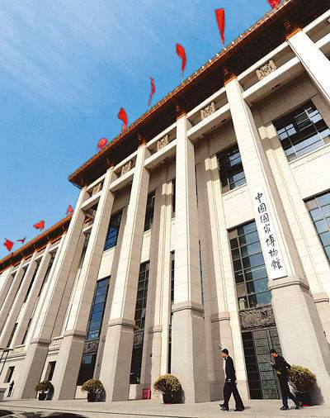
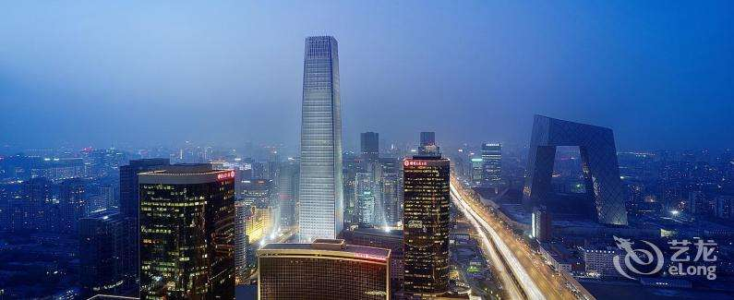
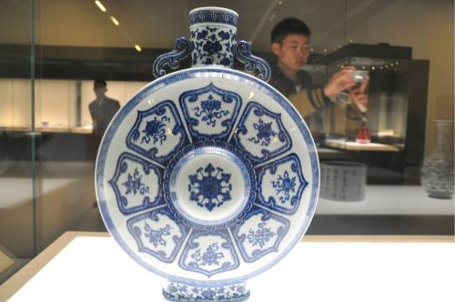
【task 3】
places (where)
Forbidden City Australia Antarctica Beijing National Museum
4. Beijing is the city where I live, I study and I grow up.
5. National Museum is a place where you can admire countless collections of ancient Chinese art.

Slide 18
【task 4】Describe the journey to the South Pole in Amundsen’s and Scott’s tone respectively using “when, where, why” in 3 relative clauses.
the day (14 December, 1911) / the day (17 January, 1912) / the South Pole / Antarctica / Scott / the Norwegian flag

Slide 19
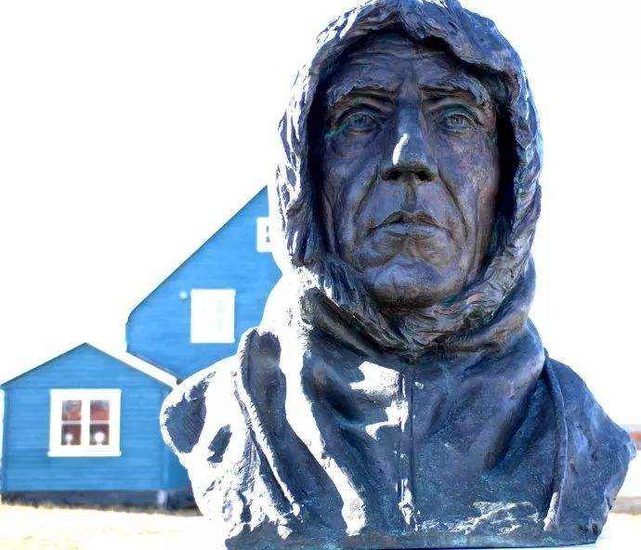
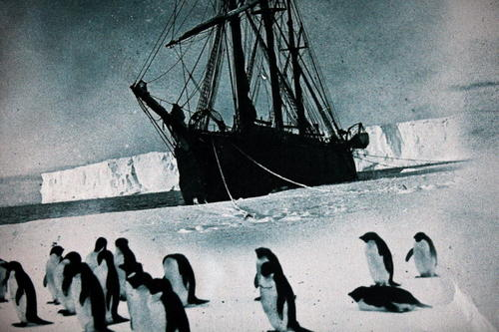
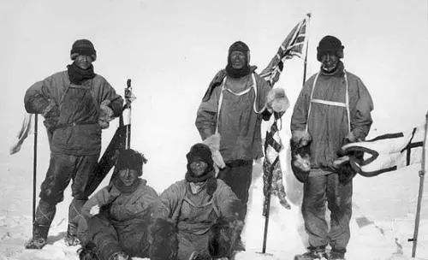
【task 4】
In Amundsen’s tone:
14 December, 1911 is the day when we set foot on the South Pole.
We finally reached the South Pole, where we saw many penguins.
The reason why I respect Scott is that he is brave enough to face all the challenges.

Slide 20
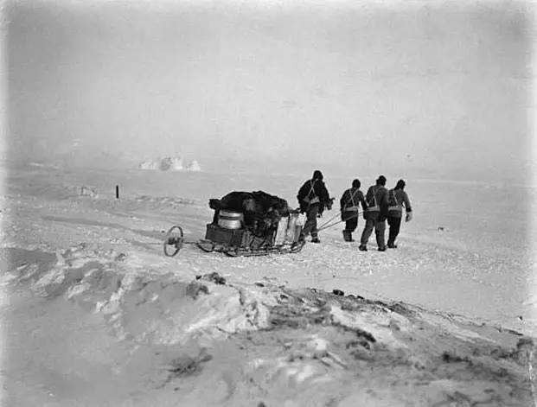
【task 4】
In Scott’s tone:
I will never forget the day -17 January, 1912, when we finally reached the South Pole.
Amundsen also arrives in Antarctica, where we will have a race to the South Pole.
The reason why we feel disappointed is that we see the Norwegian flag.

Slide 21
谢谢您的观看
北京市朝阳区教育研究中心 制作

