Slide 1
高考英语复习备考 情境作文
朝阳区线上课堂·高三英语
北京市和平街第一中学 江珂珂
Notes:
标题改为（分为两行，且加粗）：
高考英语复习备考
情境作文

Slide 2
目 录
教学内容：北京2020年1月，东城区、西城区、海淀区、朝阳区、丰台区以及石景山等六城区高三期末检测情景作文写作。
教学目标：通过对六篇情景作文试题的分析和讲解，掌握情境作文写作实现一档文的方法和技巧。
教学准备：六城区期末考试情境作文试题+答案。
教学过程：1. 情景作文写作实现一档文的技巧点拨；
2. 情境作文写作实现一档文的技巧精讲；
3. 情境作文写作实现一档文的技巧总结及操练。
高三英语复习系列

Slide 3
1. 情景作文写作实现一档文的技巧点拨
一类文的特点：内容的完整性、文章的连贯性、表达的多样性和语言的准确性
1. 要点明确，细节有效
2. 用词准确，句式丰富
3. 内容连贯，结构紧凑
高三英语复习系列
Notes:
格式参考模板：把标题放在第一行，然后再出具体内容

Slide 4
2. 情景作文写作实现一档文的技巧精讲
要点明确 细节有效
有效细节？
充分利用提示性文字，紧扣主题，支撑要点。
高三英语复习系列
Notes:
这个标题跟着谁？要有序号，看着清楚。

Slide 5
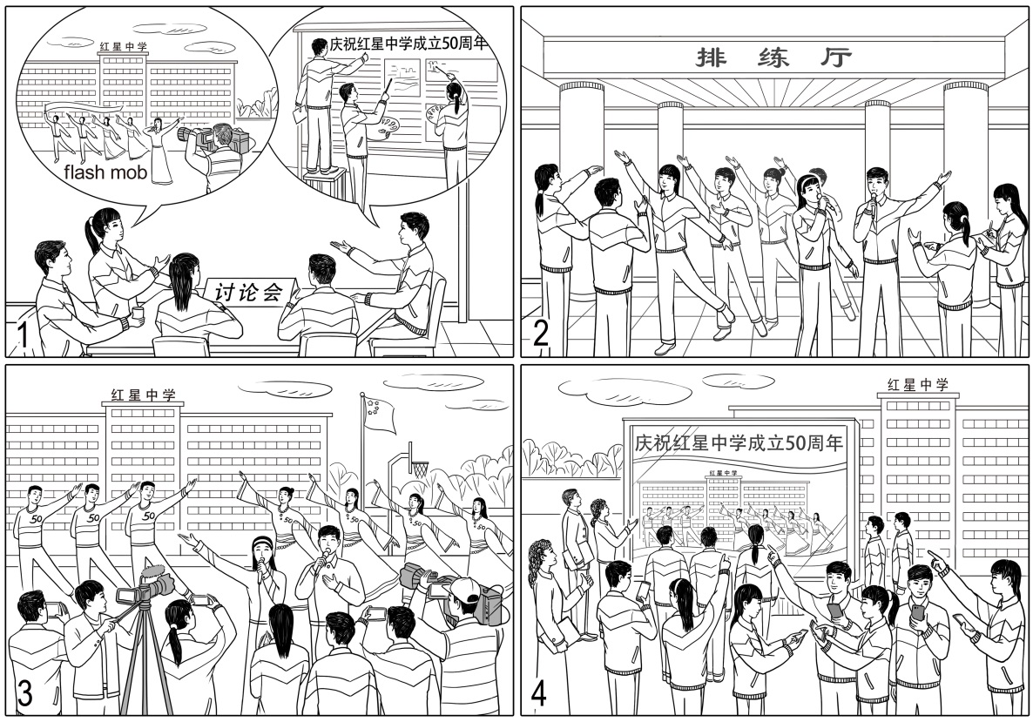
2. 情景作文写作实现一档文的技巧精讲
假设你是红星中学高三学生李华。为庆祝学校建校50周年，上个月你校高三学生录制快闪，表达对母校的祝福。请根据以下四幅图的先后顺序，记述整个过程，并以“A Memorable Activity”为题，给校刊“英语角”写一篇英文稿件。
注意：词数不少于60。
提示词：快闪 flash mob
2020 朝阳期末
高三英语复习系列

Slide 6
2. 情景作文写作实现一档文的技巧精讲
1．讨论 2．排练 3．拍摄 4．观看
 | 无效细节 | 有效细节
图2
图3
During the following days, we spent our spare time practising singing our school song over and over until we were well prepared. Time-consuming as it was, we all thought it worthwhile.
Then we spent several days practicing singing and dancing. We practiced again and again. I could feel sweat dripping down my face.
On that big day, we danced and sang on the playground. Because we were not good at taking photos, we hired some professional ones to take photos for us.
Then came the shooting day. We came to the playground in all directions, singing the school song loudly. Some of us danced with passion. Meanwhile, photographers were shooting the video to record this memorable activity.
高三英语复习系列

Slide 7
2. 情景作文写作实现一档文的技巧精讲
内容连贯 结构紧凑
衔接好图片之间的情景转换，使过渡自然，语意连贯，行文流畅。
高三英语复习系列

Slide 8
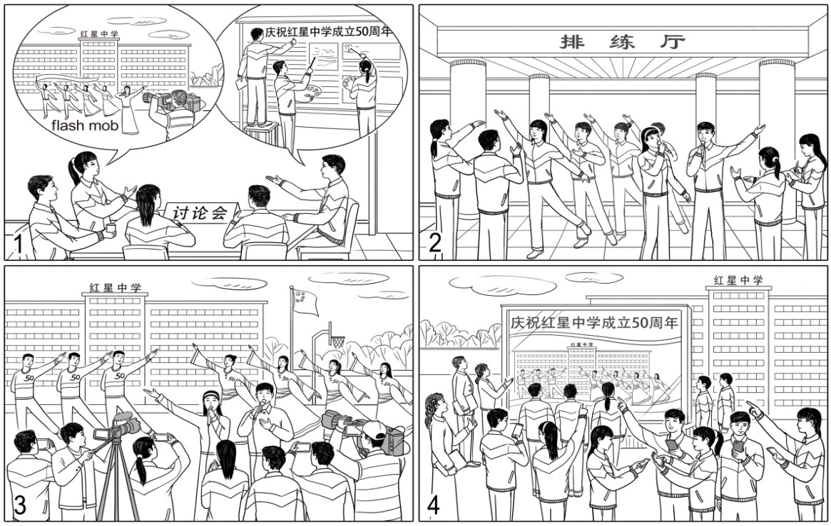
2. 情景作文写作实现一档文的技巧精讲
 | 衔接
图1
图2
图3
图4
before the activity…
during the following days, then…
then came the shooting day…
the next day…
根据情节发展线索，添加时间状语。
2020 朝阳期末
高三英语复习系列

Slide 9
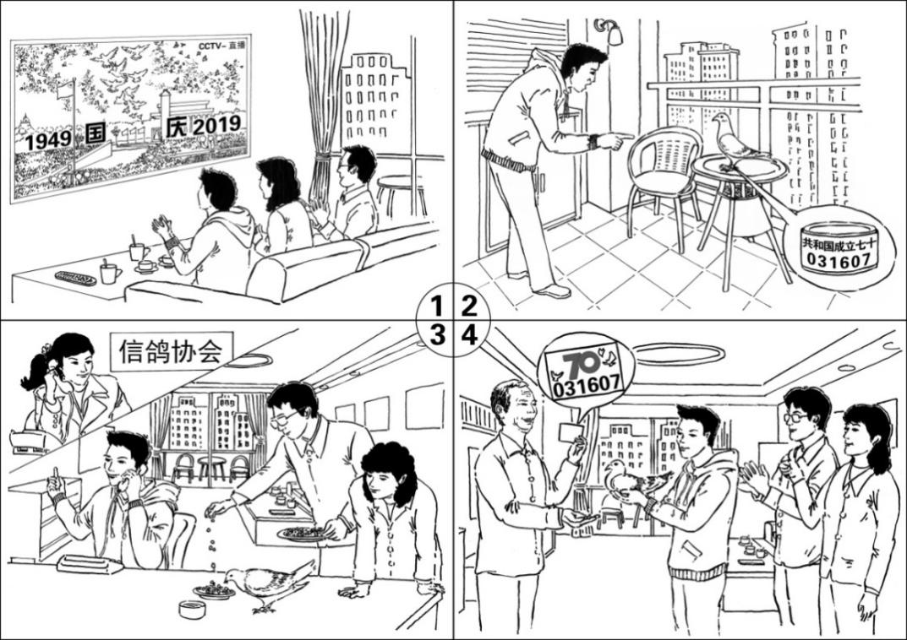
2. 情景作文写作实现一档文的技巧精讲
假设你是红星中学高三学生李华。请根据以下四幅图的先后顺序，写一篇英文周记，记述国庆节当天你和父母帮助迷路的和平鸽找到主人的过程。
注意：词数不少于60。
提示词：周年纪念日anniversary
阳台 balcony
信鸽协会 Pigeon Association
2020 东城期末
高三英语复习系列

Slide 10
2. 情景作文写作实现一档文的技巧精讲
 | 衔接
图1
图2
图3
图4
on that day…
the pictures of the ceremony were flashing through my mind when suddenly…
realizing that it must have lost its way back home, I…
before long…
根据情节发展线索，添加表示因果、递进、解释等逻辑关系的语句，起到承上启下的作用。
2020 东城期末
高三英语复习系列

Slide 11
2. 情景作文写作实现一档文的技巧精讲
用词准确 句式丰富
On that day, like hundreds of millions of families, my parents and I watched the National Day parade on TV with great excitement and pride till the very end of the ceremony, when thousands of pigeons and balloons were released and flew to the sky.
The pictures of the ceremony were flashing through my mind when suddenly I spotted a pigeon on the balcony. It was a beautiful white pigeon, resting on our balcony and refusing to fly away. Around its feet was a ring which read “the 70th anniversary of the founding of the People’s Republic of China”. I couldn’t believe my eyes! This was a National Day pigeon! Realizing that it must have lost its way back home, I managed to find the telephone number of Beijing Pigeon Association and called up for help. In the meanwhile, my parents brought the pigeon inside and fed it some water and bird food.
Before long, the owner got the message and came to take the pigeon back. He thanked us a lot and we all felt honored that we could do something for the unforgettable National Day!
高三英语复习系列

Slide 12
2. 情景作文写作实现一档文的技巧精讲
用词准确 句式丰富
高级词汇
flash, spot…
2. 词组
hundreds of millions of , with great excitement and pride, flash through…
3. 非谓语动词
resting on our balcony and refusing to, realizing that…
4. 并列句和复合句
由when引导的定语从句，be doing… when…
5. 特殊句式
Around its feet was a ring which read “the 70th anniversary of the founding of the People’s Republic of China”.
6. 长短句
I couldn’t believe my eyes! This was a National Day pigeon!
高三英语复习系列

Slide 13
2. 情景作文写作实现一档文的技巧精讲
1. 正确使用高级词汇
2. 大量使用词组、短语和固定搭配
3. 熟练运用非谓语动词
4. 娴熟使用并列句和复合句
5. 准确使用特殊句型（感叹句、倒装句、虚拟语气、强调句等）
6. 交错使用长短句
高三英语复习系列

Slide 14
2. 情景作文写作实现一档文的技巧精讲
听到这个消息，我们感到很兴奋。
When we heard the news, we felt excited.
When we heard the news, we had a sense of excitement/were full of excitement.
Upon hearing the news, we were full of excitement.
It was the news that made us feel extremely excited.
Hardly had we heard the news, when we felt a sense of excitement.
高三英语复习系列

Slide 15
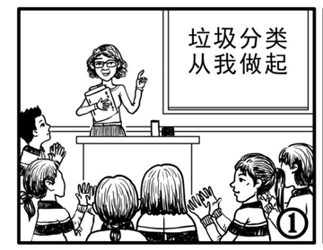
2. 情景作文写作实现一档文的技巧精讲
At the class meeting, our teacher told us the information of the activity.
At the class meeting, our teacher introduced the idea of garbage sorting and called upon us to take action, which was warmly welcomed by all of us.
At the class meeting, our teacher informed us the activity whose theme was “Garbage Sorting, Take Action Now”. Attracted by the news, we couldn’t wait to begin our activity.
2020 丰台期末
高三英语复习系列

Slide 16
3. 情境作文写作实现一档文的技巧总结及操练
实现一档文
1. 要点明确，细节有效
2. 用词准确，句式丰富
3. 内容连贯，结构紧凑
高三英语复习系列

Slide 17
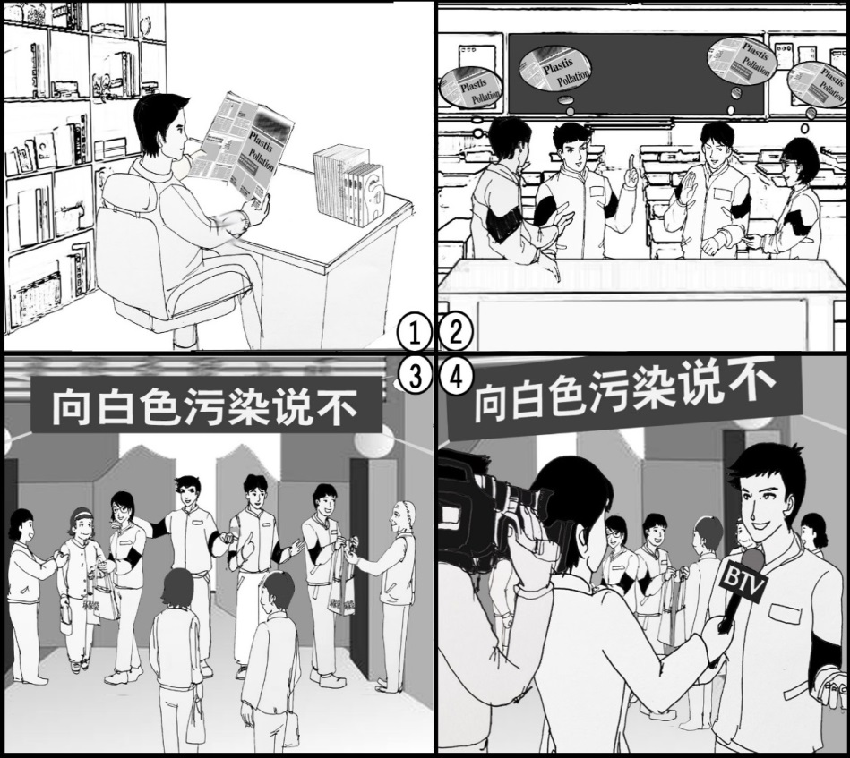
3. 情境作文写作实现一档文的技巧总结及操练
假设你是红星中学高三学生李华，请根据以下四幅图的先后顺序，用英语写一篇短文向校刊“英语园地”投稿，记述你和同学们上周组织“向白色污染说不”主题活动的全过程。
注意：词数不少于60。
2020 海淀期末
高三英语复习系列
Notes:
如果这个放再小结后面，那就是巩固练习？小试牛刀之类的？最好第一行放个标题，这样清楚。

Slide 18
3. 情境作文写作实现一档文的技巧总结及操练
 | 要点 | 衔接 | 细节 | 句式
图1
图2
When reading a newspaper, I noticed some news.
The content or the seriousness of the news..
one evening
One evening, while I was reading a newspaper, a piece of news on white pollution caught my eye. The seriousness
of this issue left me wondering what I should do as a
citizen of the earth.
during the class break the next day
During a class break the next day, I shared the news with some of my classmates. We were all convinced that something must be done to make a change, no matter how trivial it might seem. After a heated discussion, we set our plan for a 2-day campaign and made some necessary preparations.
I shared the news and had a discussion.
Their opinions and their plans…
高三英语复习系列

Slide 19
3. 情境作文写作实现一档文的技巧总结及操练
 | 要点 | 衔接 | 细节 | 句式
图3
图4
Last weekend, our plan became reality. At the front gate of Hongxing Community, we promoted the idea of environmental protection. Meanwhile, we gave out eco-friendly bags to passers-by, hoping that the bags could serve as a daily reminder of the green life we advocated. Impressed by our efforts, they all promised to do as best as they could to avoid white pollution.
We promoted the idea
and gave out the bags.
Eventually, our plan became reality.
Where, when,
purpose, influence
…
Just before the activity came to an end, I was interviewed by BTV, which meant I could make our message heard by a much larger crowd of people. What a pleasant surprise! While introducing what we had done, I couldn’t help but to picture the day when this issue is finally solved with every individual’s effort.
BTV station interviewed me. I introduced what we had done.
In the end of the activity
The feelings, the meaning of the interview…
高三英语复习系列

Slide 20
3. 情境作文写作实现一档文的技巧总结及操练
Last week, together with my classmates, I organized a meaningful activity with the theme “Say No to White Pollution”.
One evening, while I was reading a newspaper, a piece of news on white pollution caught my eye. The seriousness of this issue left me wondering what I should do as a citizen of the earth. During a class break the next day, I shared the news with some of my classmates. We were all convinced that something must be done to make a change, no matter how trivial it might seem. After a heated discussion, we set our plan for a 2-day campaign and made some necessary preparations. Last weekend, our plan became reality. At the front gate of Hongxing Community, we promoted the idea of environmental protection. Meanwhile, we gave out eco-friendly bags to passers-by, hoping that the bags could serve as a daily reminder of the green life we advocated. Impressed by our efforts, they all promised to do as best as they could to avoid white pollution.
Before the activity came to an end, I was interviewed by BTV, which meant I could make our message heard by a much larger crowd of people. What a pleasant surprise! While introducing what we had done, I couldn’t help but to picture the day when this issue is finally solved with every individual’s effort. The earth will surely be a better place then.
高三英语复习系列

Slide 21
谢谢您的观看
北京市朝阳区教育研究中心 制作

