Slide 1
必修（二）Unit 4 词汇&语法 复习（2）
朝阳区线上课堂·高一年级英语
北京中学 李萍

Slide 2
【学习目标】
1. 能够通过语境，学习与app应用相关的词汇。
2. 能够在语境中恰当运用与app相关的词汇。
3. 能够识别合成词的基本构成方式及基本用法。

Slide 3
【学法指导】
在认真学习目标词汇的定义及用法的基础上，务必关注上下文语境，关注一词多义，熟词多义，体会词汇在不同语境中所传递的意思，识别合成词的基本构成方式，并能运用规律，写出基本的合成词。

Slide 4
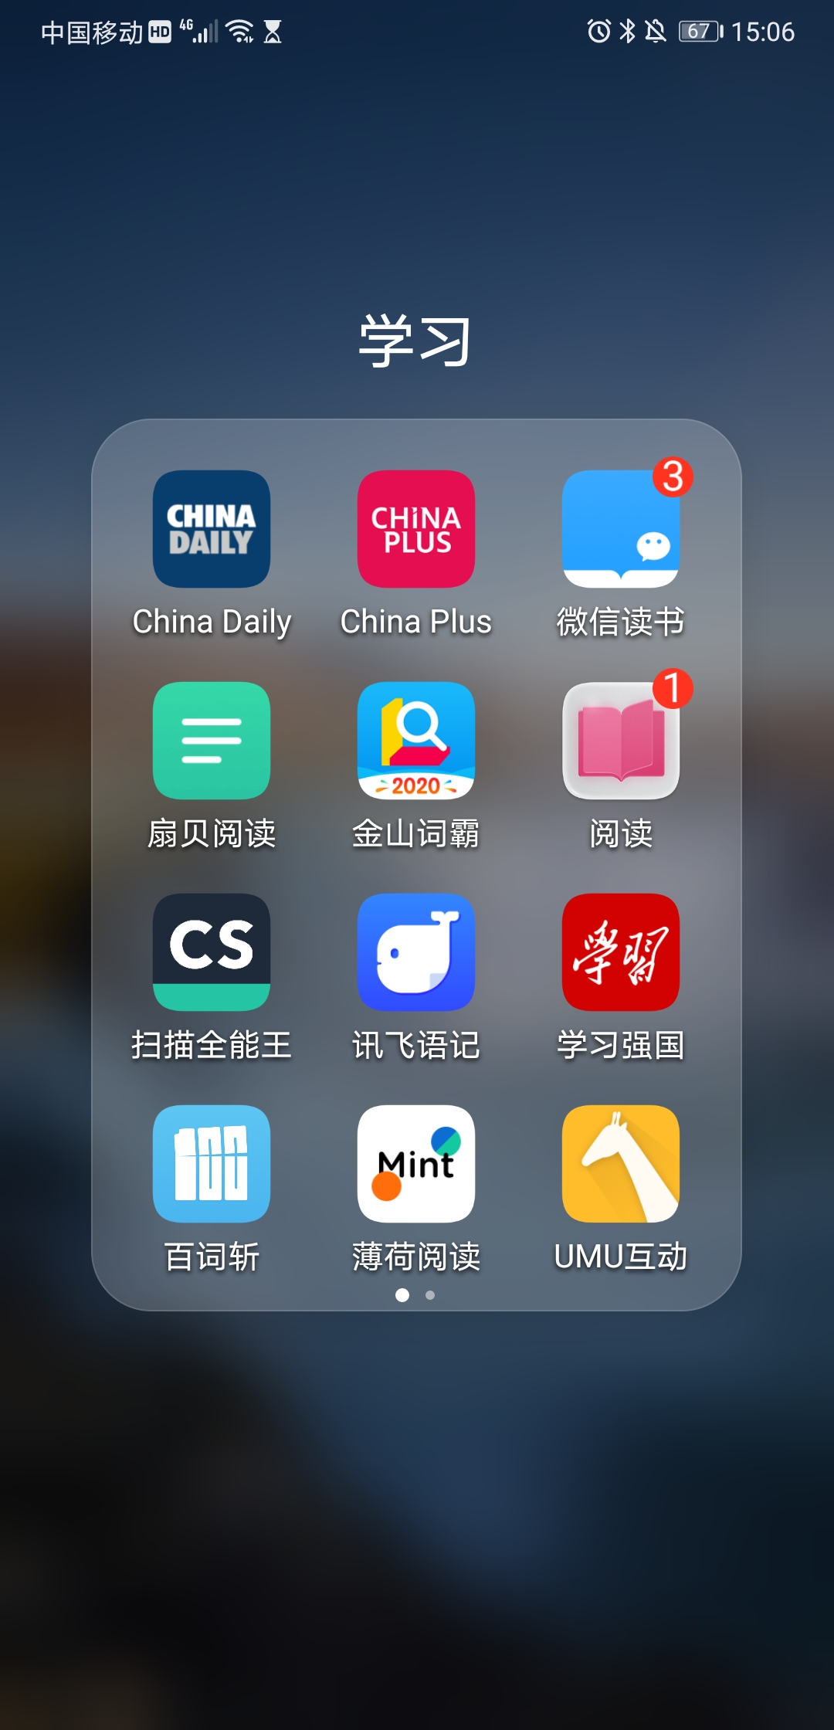
【语境再现】
Most students agree that apps can help them take part in a whole range of activities. Educational apps are the type of apps most frequently used among our classmates because they can do us a favour when we meet difficulties in our study. Besides, we can subscribe to online courses on apps. It saves us quite a lot of time because you just need to input your user name and confirm your password, you will enter your course immediately. Moreover, online courses will be updated in time, so I think they’re quite rewarding.

Slide 5
【探究发现】
1. favour n./v.
Could you do me a favour and pick up Sam from school today?
The suggestion to close the road has found favour with local people.
The warm climate favours many types of tropical plants.
Many countries favour a presidential system of government.

Slide 6
【释义解析】
a thing that you do to help sb. 帮助；好事；恩惠
approval or support for sb/sth 赞同；支持
to prefer one system, plan, way of doing sth, etc. to another 较喜欢；选择
to provide suitable conditions for a particular person, group, etc. 有助于；有利于

Slide 7
【拓展积累】
favourable adj. 有利的，顺利的；赞成的
favourably adv. 赞成地，有利地
favoured adj. 受到宠爱的，得到偏爱的；获得优惠的
do sb. a favour 帮某人一个忙
do someone no favours (非正式)做对某人无用的事；无济于事
in sb’s favour 有利于某人，有助于某人
【活学活用】
(1) She helps me out when I have too much to do, and I ________________________（还人情）when I can.
(2) She made a ________________(好的) impression on his parents.
return the favor
favorable

Slide 8
2. subscribe to vt./vi.
【探究发现】
Which journals does the library subscribe to?
We subscribe to several sports channels (= on TV) .
He subscribes regularly to Amnesty International.
Each employee may subscribe for up to $2,000 worth of shares.
Usenet is a collection of discussion groups, known as newsgroups, to which anybody can subscribe.

Slide 9
【释义解析】
to pay an amount of money regularly in order to receive or use sth. 定期订购（或订阅等）
to pay money regularly to be a member of an organization or to support a charity 定期交纳（会员费）；定期（向慈善机构）捐款；定期捐助
to apply to buy shares in a company 认购（股份）
to apply to take part in an activity, use a service, etc. 申请；预订；报名

Slide 10
【拓展积累】
subscribe to 同意，赞成
subscriber n. 订阅人
【活学活用】
(1) My main reason for _______________(订阅) New Scientist is to keep abreast of advances in science.
(2) The authorities no longer ___________(赞成) the view that disabled people are unsuitable as teachers.
subscribing to
subscribe to

Slide 11
3. confirm. v.
【探究发现】
Please write to confirm your reservation.
The walk in the mountains confirmed his fear of heights.
He was confirmed as captain for the rest of the season.
【释义解析】
(1) to state or show that sth is definitely true or correct, especially by providing evidence （尤指提供证据来）证实，证明，确认
(2) to make sb feel or believe sth even more strongly 使感觉更强烈；使确信
(3) to make a position, an agreement, etc. more definite or official; to establish sb/sth firmly 批准（职位、协议等）；确认；认可

Slide 12
【拓展积累】
adj. confirmed 成习惯的，根深蒂固的
confirmation n. 证实，确认书，证明书
【活学活用】
(1) The expression on his face _______________(证实)my suspicion.
(2) I’m still waiting for _________________(证实)of the test results.
confirmed
confirmation

Slide 13
4. rewarding. adj.
【探究发现】
There is nothing more rewarding than putting smiles on the faces around you.
Teaching is not very financially rewarding.
【释义解析】
worth doing; that makes you happy because you think it is useful or important 值得做的；有益的
producing a lot of money 报酬高的

Slide 14
【拓展积累】
reward n./v. 奖励，回报，报酬；奖金
【活学活用】
Teaching English can sometimes be a very challenging experience but he has always found it to be a ____________
(非常有益的) one.
(2) Winning the match was just the ______________(回报) for the effort the team had made.
rewarding
reward

Slide 15
【语法归纳】
观察下面的词汇，并总结合成词构成方式。
friendship anything
percent website
online self-centered
real-life smartphone

Slide 16
常见合成词构成方式：
合成名词：
(1) n+n
air conditioner 空调
(2) adj + n
central bank 中央银行
(3) v-ing +另一词
washing machine 洗衣机
(4) 其他方式
by-product 副产品

Slide 17
2. 合成形容词
(1) 过去分词或带ed词尾的词构成。
absent-minded 心不在焉的
grey-haired 头发灰白的
(2) 动词的ing 或另一词构成
long-suffering 长期受苦的
far-reaching 深远的(影响)
3. 合成动词及合成副词
water-ski 滑冰

Slide 18
【语法练习】
Make compound words after the example.
part, long, passer, film, short, well, cold, baby, get, low, world
by, known, time, maker, wave, famous, sitter, term, together, lying, blooded
part-time long-term passer-by film-maker short-term
well-known cold-blooded baby-sitter get-together low-wave
world-famous

Slide 19
谢谢您的观看
北京市朝阳区教育研究中心 制作

