Slide 1
必修（二）Unit 4 词汇&语法 复习（1）
朝阳区线上课堂·高一年级英语
北京中学 李萍

Slide 2
【学习目标】
1. 能够通过语境，学习和辨识与虚拟头像的使用相关的词汇。
2. 能够在语境中恰当运用与虚拟头像的使用相关的词汇。
3. 能够辨析并运用过去将来时的基本用法。

Slide 3
【学法指导】
在认真学习目标词汇或语法使用形式的基础上，务必关注上下文语境，关注一词多义，熟词多义，体会词汇在不同语境中所传递的意思，并运用目标词汇和语法，准确表达自己的思想。

Slide 4
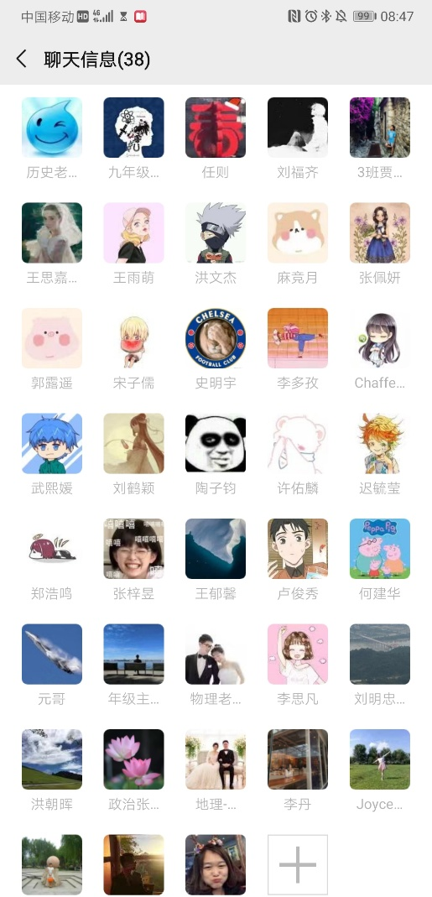
【语境再现】
Read the following passage and recall the meanings of the underlined words.
Many teenagers love exploring new technologies, because they are so convenient. In our class, almost every student has more than two avatars—images used as their digital identity. There are a wide variety of forms and uses of avatars among our classmates, usually a sensible avatar for school and a silly one for fun. Although some classmates expressed their concerns about avatars, I think we should view them in a more positive light.

Slide 5
【探究发现】
1. convenient. adj.
A bicycle is often more convenient than a car in towns.
The house is very convenient for several schools.
useful, easy or quick to do; not causing problems 实用的；便利的；方便的；省事的
near to a particular place; easy to get to 附近的；近便的；容易到达的

Slide 6
【拓展积累】
convenience n. 方便；便利
conveniently adv. 方便地，便利地
for the convenience of…为了…的方便
at sb’s convenience 在方便时；在适宜的地点
【活学活用】
(1) It is very _________________ to pay by credit card.
(2) Can you call me at your _________________ to arrange a meeting?
(3) The hotel is ___________ situated close to the beach.
convenient
convenience
conveniently

Slide 7
【探究发现】
2. variety n
This tool can be used in a variety of ways.
Apples come in a great many varieties.
He can perform an astonishing variety of acts, including mime and juggling.
【释义解析】
several different sorts of the same thing （同一事物的）不同种类，多种式样
[不可数名词] the quality of not being the same or not doing the same thing all the time 变化；多样化；多变性
a type of entertainment which includes many different kinds of acts in the same show. 综艺表演，综艺节目

Slide 8
【拓展积累】
a wide variety of 各种各样的
various adj. 多样的
variously adv. 以各种方式，不同地
【活学活用】
(1) She took the job for ____________ reasons.
(2) You will find a wide _____________ of choices available in school cafeterias.
various
variety

Slide 9
3. sensible adj.
【探究发现】
I think the sensible thing would be to take a taxi home.
An old woman is wearing sensible shoes and a neat skirt.
reasonable, practical, and showing good judgment 明智的，合理的，实际的，有判断力的
suitable for a particular purpose, and practical rather than fashionable 适当的，合理的；朴素实用的

Slide 10
【拓展积累】
sensibly adv. 举止得体
sensitive adj. 敏感的，善解人意的
【活学活用】
(1) The ______________ way is to leave them alone.
(2) She is always very _______________ dressed.
sensible
sensibly

Slide 11
4. concern n/v.
【探究发现】
There is growing concern about violence on television.
This study concerns couples’ expectation of marriage.
What concerns me is our lack of preparation for the change.
【释义解析】
a feeling of worry 忧虑，担心，关切
to be about sth. 与…有关；涉及
to worry sb. 让某人担忧

Slide 12
【拓展积累】
concerned adj. 担心的，关心的
be concerned with sth. 与…有关，涉及
concern yourself with/about sth. 对…感兴趣
be concerned to do sth. 认为（做某事）重要
be concerned about/for/over sth./sb. 对…感到担心，忧虑
【活学活用】
(1) Politicians should not _____________________(更关注)power and control than with the good of the people.
(2) She __________________(担心)that she might miss the turning and get lost.
be more concerned with
was concerned

Slide 13
5. view n./v.
【探究发现】
The law should be viewed as a way of meeting certain social goals.
In my view, the country needs of change of government.
The sun disappeared from the view.
There were magnificent views of the surrounding countryside.

Slide 14
【释义解析】
to think about something or someone in a particular way (以某种方式)看，把…视为
what you think or believe about something 观点，意见，看法，想法
what you are able to see or whether you can see it 视力；视野；视线
what you can see from a particular place or position, especially beautiful countryside （从某处看到的）景色，风景；（尤指）乡间美景

Slide 15
【拓展积累】
view sb./sth. as 把…看做
from one’s point of view/ in one’s view就某人的观点来看
come into view 进入视线
out of view 看不见
have sth. in view 心中有…的目的
in view of sth. 鉴于，考虑到，由于
on view 陈列着；展览着
viewer n. 观察者

Slide 16
【活学活用】
(1) First-generation Americans ___________ the United States ________（把…看成）a land of golden opportunity.
(2) Teachers and parents have _________________(相似的观点)on students’ health.
(3) The lake soon _________________________(映入眼帘).
viewed
as
similar views
came into view

Slide 17
【语法观察】
仔细阅读下面的句子，请画出句子中的过去将来时。
1. Yet, very few people knew that future avatars would have such a wide variety of forms and uses.
2. When people started creating their own avatars, they discovered that they were going to have the power to create new identities that did not look or act like their real selves at all.

Slide 18
【语法归纳】
1. 过去将来时表示从过去某时看将来要发生的事情。will和be going to 用于一般将来时。在过去将来时中，will要变成____________, be going to 要变为 _____________________。
would
was/were going to

Slide 19
2. 请以及物动词do为例，写出一般将来时和过去将来时的基本形式。
 | 主动 | 被动
一般将来时
过去将来时
will be done
was/were going to
be done
will do
am/is/are going to do
would do
was/were going to do
would be done
was/were going to be done

Slide 20
3. would do除了表示过去将来时，还可以表示过去重复的动作。试比较：
He said he would raise the question at the meeting. 画线部分表示 ________________
When I was small, my mum would read me stories at night. 画线部分表示 _____________
4. was/were going to do除了表示根据计划或安排即将发生的事，还可以表示根据当时情况判断有可能但不一定发生某事。
如：It seemed as if it was going to rain. 看来好像要下雨。
过去将来时
过去重复的动作

Slide 21
【语法练习】请根据中文提示完成句子。
She said ____________________________________
(她将立即出发).
2. I was told that __________________________________
(她将按时到这儿).
3. They made up their mind that ____________________________________________________________________
(一旦汤姆换工作，他们就买个新房子).
she would/was going to start at once
she would/was going to be there on time
They would/were going to buy a new house once Tom
changed jobs

Slide 22
谢谢您的观看
北京市朝阳区教育研究中心 制作

