Slide 1
必修（一）Unit 3 词汇&语法 复习（2）
朝阳区线上课堂·高一年级英语
北京市第八十中学 刘博文

Slide 2
represent
effort
calm down
patience
event
custom

Slide 3
Effort: the physical or mental energy that you need to do sth; sth that takes a lot of energy.
You should put more efforts into your work.

Slide 4
Effort: an attempt to do sth especially when it is difficult to do（艰难的尝试；试图；尽力）
The local clubs are making every effort to interest more young people.

Slide 5
Represent: to be a member of a group of people and act or speak on their behalf at an event, a meeting, etc.
The competition attracted over 500 contestants representing 8 different countries.

Slide 6
Represent: to act or speak officially for sb and defend their interests（作为。。。的代言人；维护。。。的利益）
The union represents over 200 000 teachers.

Slide 7
Patience: Patience with sb or sth: the ability to stay calm and accept a delay or sth annoying without complaining（耐心；忍耐力）
Teaching children with special needs requires patience and understanding.

Slide 8
Patience: the ability to spend a lot of time doing sth difficult that needs a lot of attention and effort.（毅力；坚忍；恒心）
It takes time and patience to finish a marathon.

Slide 9
Calm down: phrasal verb, if you calm down, or if someone calms you down, you become less angry, upset, or excited.
Calm down for a minute and listen to me.

Slide 10
Calm down: if things calm down, or someone or something calms things down, the amount of activity, trouble, or panic is reduced.（使平息下来）
We will go back to normal when things calm down.

Slide 11
Custom: custom of doing sth: an accepted way of behaving or of doing things in a society or a community.
They have the custom of giving presents at Christmas.

Slide 12
Event: a thing that happens, especially sth important.
The election was the main event of 2016.

Slide 13
Event: a planned public or social occasion（公开活动；社交场合）
She is the leader of this fund-raising event.

Slide 14
How to use passive voice
一般现在时被动语态 am/is /are+ done
一般过去时被动语态 was/were+ done
现在进行时被动语态 am/is /are+ being done
过去进行时被动语态 was/were+ being done
现在完成时被动语态 have/ has+ been done
一般将来时被动语态 am/is/are gong to/ will+ be done

Slide 15
Practice
Use the Passive to describe the following pictures properly.

Slide 16
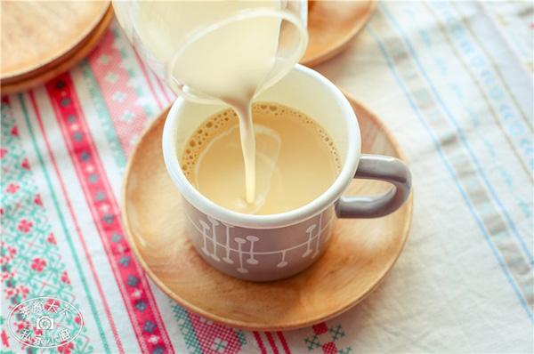
In England, tea is usually served with milk and sugar.
England/ serve / milk and sugar

Slide 17
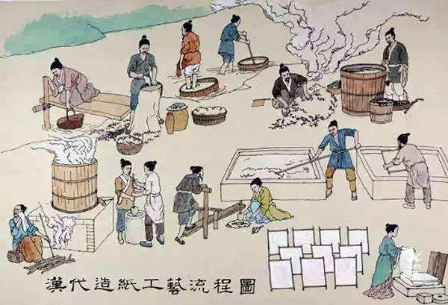
Papermaking technology was first invented by Cai Lun in AD105.
Papermaking technology / invent / Cai Lun / AD105

Slide 18
2022 Winter Olympics / hold / Beijing
The 2022 Winter Olympics will be held in Beijing.

Slide 19
a bridge/ build
Sorry, I didn’t arrive on time, because ______________
a bridge is being built now.

Slide 20
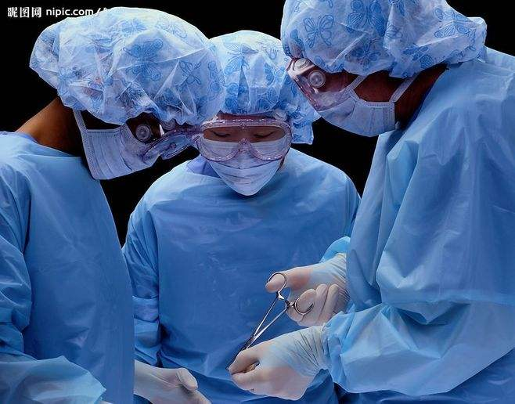
the man/
operate
At ten o’clock yesterday,
_________________________
the man was being operated on .

Slide 21
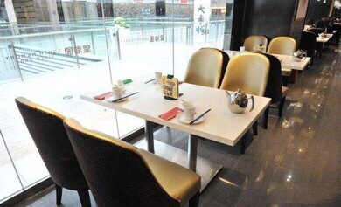
take
I want to sit at the table near the window.
Sorry, __________________
It has been taken.

Slide 22
An important meeting _______________ (hold) in our school now.
On each Spring Festival, each house _____________(decorate) with upside-down Fu.
When we arrived at the garage, our car __________________(repair).
My car _________________ (destroy) in the accident yesterday.
The child ________________________(take care of) by grandma all these years.
Those books ___________________ (publish) next month.
is being held
is decorated
was being repaired
was destroyed
has been taken care of
will be published

Slide 23
谢谢您的观看
北京市朝阳区教育研究中心 制作

