Slide 1
必修（一）Unit 3 词汇&语法 复习（1）
朝阳区线上课堂·高一年级英语
北京市第八十中学 刘博文

Slide 2
graduation
decorate
immediately
put up
host
tradition

Slide 3
Decorate: ~sth with sth, to make sth look more attractive by putting things on it.
They decorate the room with flowers and balloons.

Slide 4
Graduation: the act of successfully completing a university degree, or studies at an American high school
Martha graduated from high school two years ago.

Slide 5
Put up: to suggest an idea, etc. for other people to discuss.
She put up an argument in the meeting.

Slide 6
Put up: ~to raise sth or put it in a higher position.
She has put her hair up

Slide 7
Put up: to build sth or place sth somewhere
They would like to put up a tent in this area.

Slide 8
Put up: to fix sth in a place where it will be seen
He put up a notice/a poster on the bulletin board.

Slide 9
Put up: to raise or increase sth
They’ve put up the rent by $20 a month.

Slide 10
Put sb up: to let sb stay at your home
We can put you up for the night.

Slide 11
Immediately: without delay
He answered almost immediately.

Slide 12
Immediately: (usually used with prepositions) next to or very close to a particular place or time.
Turn right immediately after the church.

Slide 13
Tradition: A belief, custom or way of doing sth that has existed for a long time among a particular group of people; a set of these beliefs or customs.
By tradition, children play trick or treat on the Halloween.

Slide 14
Host: to organize an event to which others are invited and make all the arrangements for them.
This year’s World Cup finals will be hosted in Germany.

Slide 15
When to use passive voice
We don’t know or don’t need to know the “doer”.
The “doer” is obvious
The action is more important than “doer”
In scientific reports or in newspaper articles, the passive is more formal than the active.

Slide 16
How to use passive voice
一般现在时被动语态 am/is /are+ done
一般过去时被动语态 was/were+ done
现在进行时被动语态 am/is /are+ being done
过去进行时被动语态 was/were+ being done
现在完成时被动语态 have/ has+ been done
一般将来时被动语态 am/is/are gong to/ will+ be done

Slide 17
Practice
Use the Passive to describe the following pictures properly.

Slide 18
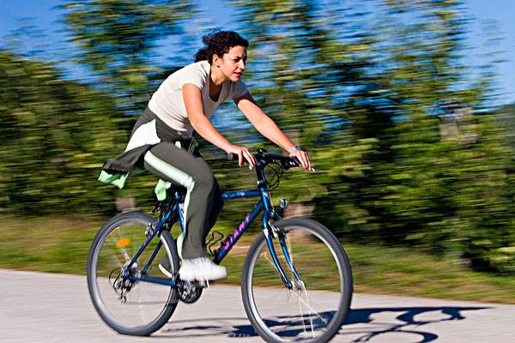
Nowadays, cycling _____________ （regard）as one of the best all-round forms of exercise.
is regarded

Slide 19
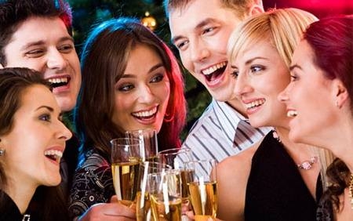
Did you enjoy the party?
---Yes. We ___________ (treat) well by our host.
were treated

Slide 20
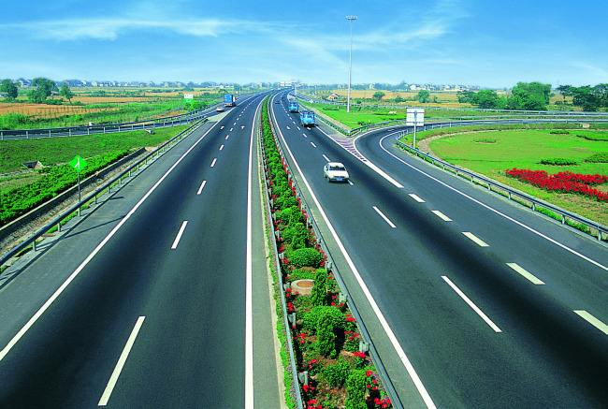
More expressways ________________ (build) in Sichuan soon to promote the local economy.
will be built

Slide 21
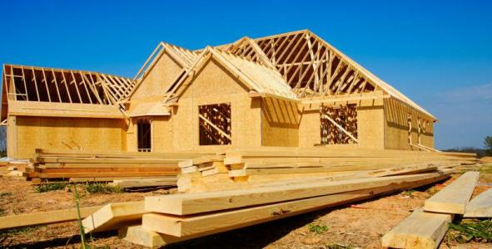
They are living with their parents for the moment because their own house ________________ (rebuild).
is being rebuilt

Slide 22
We won’t start the work until all the preparations ________________ (make).
have been made

Slide 23
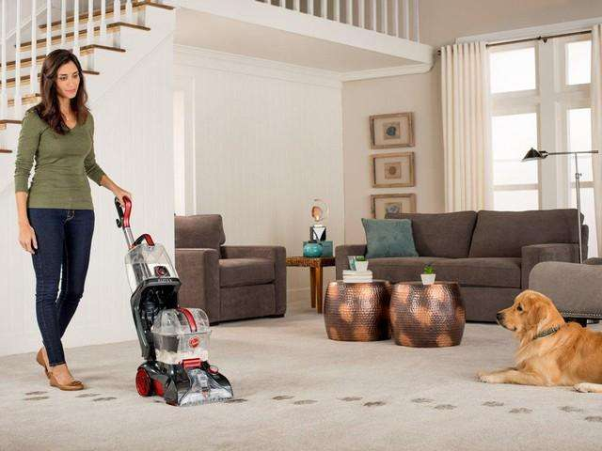
The room ________________ (clean) by her at eight yesterday.
was being cleaned

Slide 24
The bedroom____________(decorate) in yellow when I lived there last summer.
If nothing __________(do), the Oceans will turn into fish deserts.
Shakespeare’s play Hamlet _______________(make) into at least ten different films over the past years.
A famous actress _________________(invite) to give us a lecture about Beijing Opera next week.
She wanted to borrow my computer because hers __________________(repair).
A bridge _______________ (build), and I can’t stand the noise.
was decorated
is done
has been made
will be invited
was being repaired
is being built

Slide 25
谢谢您的观看
北京市朝阳区教育研究中心 制作

