Slide 1
语法填空
朝阳区线上课堂·高三英语
北京市陈经纶中学 宁 昕

Slide 2
教学内容
0 1
TEACHING CONTENT
语法填空三大考点突破---时态语态、非谓语、三大从句
高三英语复习系列

Slide 3
教学目标
0 2
TEACHING GOAL
1. 明确语法填空的考点
2. 掌握解题方法
3. 突破易错点
高三英语复习系列

Slide 4
教学准备
0 3
TEACHING PREPARATION
1. 总结城6区期末语法填空的考点，明确重点语法项。
2.总结学生易错点
3.总结解题方法
高三英语复习系列

Slide 5
教学过程
TEACHING PROCEDURE
0 4
1. 语法填空的考点归纳
2. 时态语态、非谓语、三大从句基础知识回顾
3. 突破易错点
4.巩固练习、小结解题方法
高三英语复习系列

Slide 6
期末6城区考点归纳
 | 时态语态 | 非谓语 | 从句 | 形容词 | 副词 | 名词 | 介词 | 代词 | 冠词
朝阳 | 3过，现被，现 | 2to do，doing | 2定，名 | 1 | 1 |  | 1 on/ over/ about
海淀 | 3过进，现在，现完 | 2doing，to do | 2状，定 | 1 natural |  | 1复数troubles | 1 with
东城 | 3过完，过被，现 | 2to do，done | 2定，名 | 1cultural |  | 1复数animals | 1behind/after
西城 | 3现，现完，过被 | 2to do，doing | 1定 |  | 1-ly | 1复数ways | 1 for |  | 1 the
丰台 | 3过，过被，现在 | 2done，doing | 2名，定 |  | 1 well/ better | 1 honesty |  | 1反身
石景山 | 3过进，过被，现在/现完 | 1 doing | 2+1：状，定。并列连词but/while |  |  | 1 dollars | 1 in | 1 Its
高三英语复习系列
高三英语复习系列

Slide 7
必考点1
时态语态
高三英语复习系列

Slide 8
易错点1
一般将来时的其它表达：
①go，come， start，move， leave，arrive，fly等表示位移的动词可用进行时表示按计划即将发生的动作。
②时刻表、航班表、火车列车表上或日程安排上早就定好的事情，可用一般现在时表示将来(常与时间状语连用)。
③“be about to+动词原形”表示安排或计划中的马上就要发生的动作，一般不与时间状语连用。
④“be to+动词原形”表示按计划进行或征求对方意见；表示吩咐、命令、禁止，可能性等；表示“注定会成为”；可用于条件、时间状语从句中表示“想要”。
高三英语复习系列

Slide 9
易错点2
固定句型中的时态：
①“祈使句+and/or/ otherwise+陈述句”，陈述句用一般将来时。
②“This/It/ That is+the+序数词+time+(that)从句”，从句用现在完成时。
③“This/It/ That was+the+序数词+time+(that)从句”，从句用过去完成时。
④“It is/ has been+时间段+ since +从句”，since从句中用一般过去时。
⑤“it is (high) time (that) sb. /sth. did”that从句中用一般过去时。
⑥“was/were doing sth. when sb /sth did”，
（过去）正在做某事突然（发生了另一件事）。
⑦“Hardly had sb. done sth when…”与“No sooner had sb. done sth. than…”
意为“一……就……”，主句中用过去完成时，从句中用一般过去时。
⑧ “by the time+sb./sth.did”作状语时，主句用 had done。
⑨在时间、条件状语从句中，主句用一般（过去）将来时，从句用一般现在时
或一般过去时。
⑩在宾语从句中，如主句用一般过去时，从句应用过去的某种时态；从句表客观
事实或真理，用一般现在时。
高三英语复习系列

Slide 10
易错点3
不用于进行时态的动词：
①感官类：look，feel，smell，sound，taste，see，hear等。
②情感类：like，love，prefer，admire，hate，fear等。
③心理状态类：wish，hope，want，need，believe，
understand，agree，know，remember，forget等。
④存在状态类：appear，lie in，remain，belong，have等。
⑤行为结果类：allow，accept，permit，promise，admit等。
高三英语复习系列

Slide 11
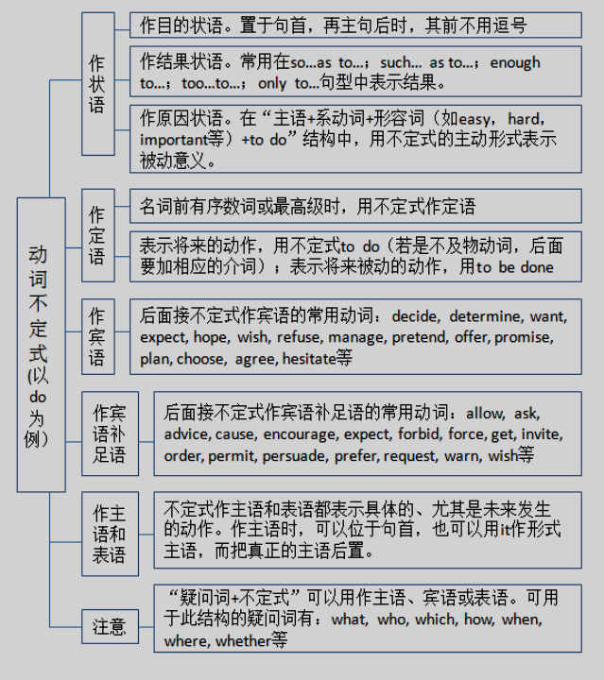
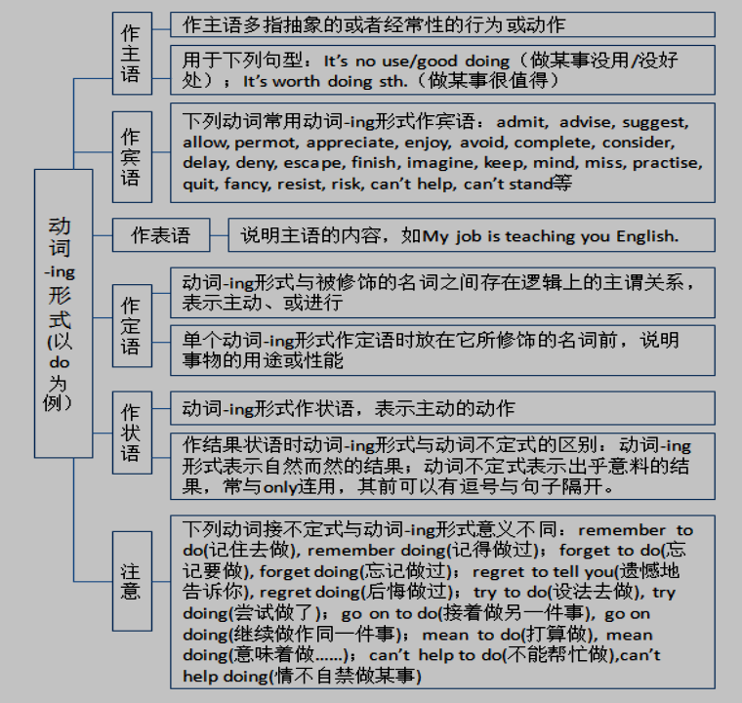
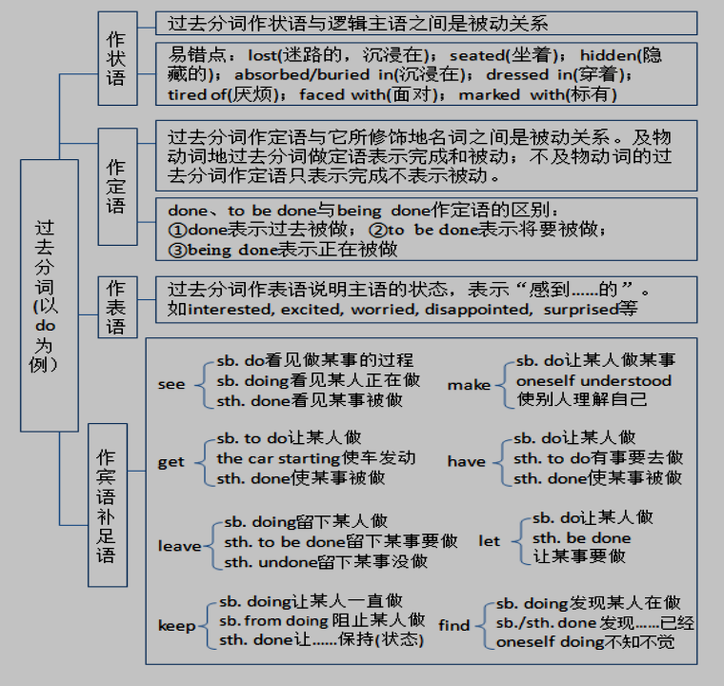
必考点2
非谓语
高三英语复习系列

Slide 12
规律方法
1. 非谓语动词主要考查的是最基本用法，但是题目的设置注重情景化和结构复杂化。
2. 考查的角度呈现出多样化趋势，不仅仅是非谓语动词间的互相干扰。
高三英语复习系列

Slide 13
易错点
1. 表面上考查分词，实际上考查形容词的情况：
The man won a big prize, surprised and happy.
2. 在“被动形式表主动”情况中出题：
Dressed in a white skirt, the girl looks like an angel.
3.在“主动形式表被动”情况中出题：
With many problems remaining unsettled, the newly selected president will have a hard time.
高三英语复习系列

Slide 14
易错点
4. 从“主语一致或不一致”角度出题：
Seen from this angle, the mountain looks like a face of a man.
Seeing from this angle, I can see the mountain looks like a face of a man.
高三英语复习系列

Slide 15
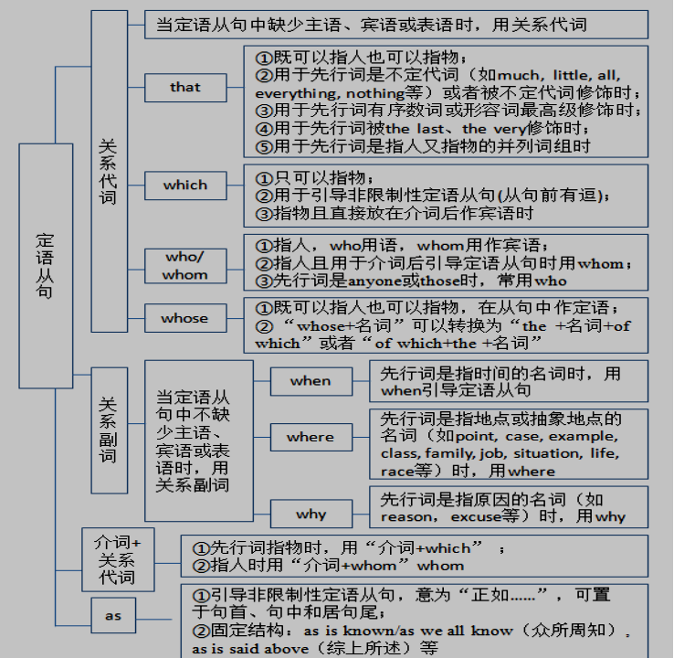
必考点3
三大从句
高三英语复习系列

Slide 16
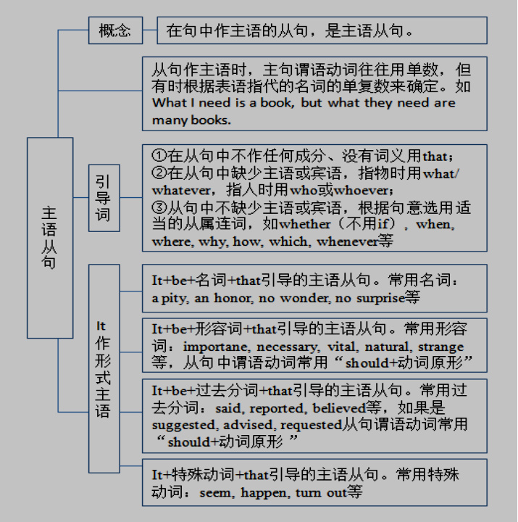
必考点3三大从句
高三英语复习系列

Slide 17
必考点3
三大从句
高三英语复习系列

Slide 18
易错点1
名从中的what与定从中的which
She did not know what had happened.
She did not know the accident which had happened.
高三英语复习系列

Slide 19
易错点2
状从中的before的用法
1. 表示“在...之后..., 才”
The American Civil War lasted four years before the North won in the end.
2. 表示“还没来得及...就...”
He rushed out of the room before I could say a word.
高三英语复习系列

Slide 20
易错点2
3. 表示“在...之前...就”
It was evening before we reached the little town of Winchester.
4. 表示“趁...”，“等到...”，或 “没等...就... ”等。
He made a mistake, but then he corrected the situation before it got worse.
高三英语复习系列

Slide 21
易错点2
5. 用于句型“It + will/would be + 时间段 + before...”中，表示“要过多久才...”也可用于“It + may be + 时间段 + before...”，表示“也许要过多久才”。其否定形式“It will/would not be +时间段+ before...”表示“不久就…，过不了多久就…”。
The field research will take John and Paul about five months; it will be a long time before we meet them again.
It will not be long before we know the result of the experiment.
高三英语复习系列

Slide 22
易错点2
6. 用于句型“It was+ 时间段 + before...”句型中，表示“过了（多长时间）才”，其否定形式“It was not+ 时间段 + before...”表示“不久就…，没过（多长时间）就…”。
It wasn’t two years before he left the country.
高三英语复习系列

Slide 23
易错点3
1. 常见句型“It be +时间段 + since引导的时间状语从句”,表示“自从...已经有多长时间了”。
It is almost five years since we saw each other last time.
2. 常见句型“It be +时间段 + when引导的时间状语从句”,表示“某个动作发生时，是某个时间”。
It was not yet 8 o'clock when Jack arrived home.
高三英语复习系列

Slide 24
Practice A
My trip to Paris was so memorable. First of all, the hotel was fantastic. It overlooked the Seine, the famous river I __1____________ (read) about in so many poems. We listened to the laughter of the children and watched the river run by __2___________ (slow) below. Next, Montmartre was a wonderful place for painters. The air was filled with the sounds of happy people and the smell of paint. __3___________I enjoyed most were the cafes. There I had a cup of coffee and watched people on the street. Everyone had a sense of style.
had read
slowly
What
高三英语复习系列

Slide 25
Practice B
Football is a popular sport with fans all over the world. There is, however, an indoor version of the game _4__ (know) as “table football”. It was invented in 1921 and people __5__________ (get) great pleasure from it since then. The game is played on a special table. Players control their “team” by turning sticks, to which the “players” are attached. As in real football, __6_______ (point) will be awarded when putting the ball in the other players’ goal. Table football requires using hands and eyes together excellently, which is really exciting.
known
have got
points
高三英语复习系列

Slide 26
Practice C
Shark attacks can be deadly, but they are not common. Each year, sharks usually kill fewer than 10 people worldwide, and about 100 people _7____________ (injure). You are more likely to be attacked in parts of the sea __8__ ____________tourists throw in food to bring in sharks. However, people are dangerous to sharks, too. 60 million sharks are killed ___9__________ food and medicine every year. As a result, some kinds of sharks may die out completely. __10_____________ (protect) these wonderful animals, some countries have made programs to help them survive.
are injured
where
for
To protect
高三英语复习系列

Slide 27
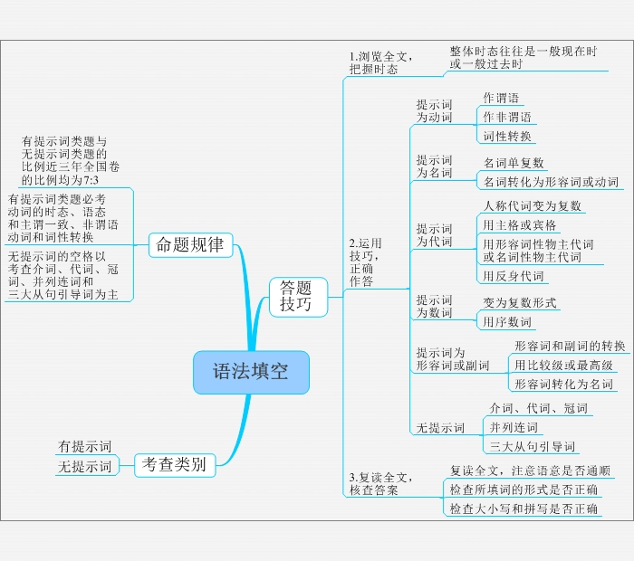
小结
高三英语复习系列

Slide 28
谢谢您的观看
北京市朝阳区教育研究中心 制作

