Slide 1
人教版必修4 Unit3 词汇 （复习）
朝阳区线上课堂·高二英语
东北师大附中朝阳学校 李秋爽

Slide 2
Learning Objectives
At the end of the class you will be able to
Further understand (理解) the meanings and different forms of the target language in different contexts.
Apply(运用) the target language in proper forms in different contexts.
Make up(创造) a short writing by using the target language.

Slide 3
Text Summary
请按下暂停键；思考并补全故事。
Chaplin was an extraordinary performer who _____________________(be one of the main characters and director of ) many outstanding comedies. Few were bored watching his moustache, his gestures or his _____________(interesting; amusing) __________(response) when chased by detectives. Being drunk, sliding on a banana skin or ____________(to speak or say something very quietly) his own failures to nobody, he made us feel more __________ (satisfied; pleased; happy) with our life without any verbal explanation. In a film, he played a person who is homeless and __________ (poor). Though he_________(come over)many difficulties, he wasn’t fortunate enough. With all the porridge eaten up, he boiled his shoe, ___________(select; choose) the shoe lace, _________the leather bottom and chewed it like a pancake. His acting was so____________(making you believe that sth. is true)and amusing that everybody couldn’t help bursting into laughter. His sense of humor has astonished everybody throughout the world __________(so far; till now).

Slide 4
Text Summary
请按下暂停键；核对你的答案。
starred in and directed
Chaplin was an extraordinary performer who _____________________(be one of the main characters and director of ) many outstanding comedies. Few were bored watching his moustache, his gestures or his _____________(interesting; amusing) __________(response) when chased by detectives. Being drunk, sliding on a banana skin or ____________(to speak or say something very quietly) his own failures to nobody, he made us feel more __________ (satisfied; pleased; happy) with our life without any verbal explanation. In a film, he played a person who is homeless and __________ (poor). Though he_________(come over)many difficulties, he wasn’t fortunate enough. With all the porridge eaten up, he boiled his shoe, ___________(select; choose) the shoe lace, _________the leather bottom and chewed it like a pancake. His acting was so____________(making you believe that sth. is true)and amusing that everybody couldn’t help bursting into laughter. His sense of humor has astonished everybody throughout the world __________(so far; till now).
entertaining
reactions
whispering
content
badly off
overcame
picked out
cut off
convincing
up to now

Slide 5
Match and Read
请按下暂停键；完成匹配。
star in and direct
entertaining reactions
be/feel content with
pick out
cut off
up to now
badly off
convincing adj.
overcome v.
whisper v.
耳语
到目前为止
对…满意
切断
克服
挑出
令人信服的
有趣的反应
穷的
主演并导演

Slide 6
Match and Read
star in and direct 主演并导演
entertaining reactions 有趣的反应
be/feel content with 对…满意
pick out 挑出
cut off 切断
up to now 迄今为止
badly off 穷的
convincing adj. 令人信服的
overcome v. 克服
whisper v. 耳语

Slide 7
star in and direct; entertaining reactions
Practise and explore
请按下暂停键；思考一下。
Yesterday, I watched a film which Xu Zheng, the famous ____________ (direct)and _____(star), directed and starred in, and was greatly impressed by his entertaining reactions ____ his mother in the film.
director
star
to

Slide 8
star in and direct; entertaining reactions
Practise and explore
Yesterday, I watched a film which Xu Zheng, the famous ____________ (direct)and _____(star), directed and starred in, and was greatly impressed by his entertaining reactions ____ his mother in the film.
director
n. 导演
star
n. 明星
to
n. ~ to sth. 对…的反应

Slide 9
star in and direct; entertaining reactions
Practise and explore
请按下暂停键；思考一下。
Yesterday, I watched a film which Xu Zheng, the famous ____________ (direct)and _____(star), directed and starred in, and was greatly impressed by his entertaining reactions ____ his mother in the film.
His performance never fails _________ (entertain) the audience and they often _______(reaction) violently to his outstanding talent. No wonder he is so successful in the ___________ (entertain) industry.
director
n. 导演
star
n. 明星
to
n. ~ to sth. 对…的反应
to entertain
v. 娱乐；招待
react
v. (对)…作出反应 （to）
entertainment
n.娱乐 ~industry 娱乐圈

Slide 10
be/feel content with ; badly off; overcome; up to now
Practise and explore
请按下暂停键；思考一下。
Though the tramp is pretty _________than ever, so far, he ______________ fear and others’ judgements and has led his life in his own way by reading books and picking rubbish. Up to now, he _________ (read) hundreds of books and ________________ with his peaceful life.

Slide 11
be/feel content with ; badly off; overcome; up to now
Practise and explore
badly off 比较级：worse off 最高级：worst off
仅作表语，不做定语
Though the tramp is pretty _________than ever, so far, he ______________ fear and others’ judgements and has led his life in his own way by reading books and picking rubbish. Up to now, he _________ (read) hundreds of books and ________________ with his peaceful life.
worse off
has overcome
原形：overcome p.t. overcame p.p. overcome
~difficulties/fear/embarrassment/sorrow
has read
has been content
up to now; so far; till now; until now
到目前为止（现完标志词）
be pleased/satisfied/content with对…满意

Slide 12
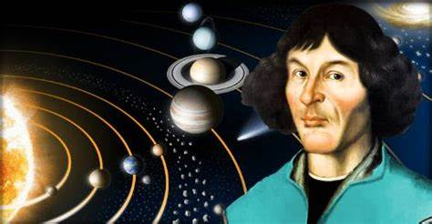
whisper v. n. convince v.
请按下暂停键；思考一下。
When Copernicus first found that the earth is not the center of the universe, he only __________ (whisper)it to some of his friends. Later with enough evidence he __________(convince) people _______ his theory. His evidence was so ___________ (convince) that everyone ______________(convince) to believe in him and stopped talking about him _____________(低语).

Slide 13
whisper v. n. convincing adj.
When Copernicus first found that the earth is not the center of the universe, he only __________ (whisper)it to some of his friends. Later with enough evidence he __________(convince) people _______ his theory. His evidence was so ___________ (convince) that everyone ______________(convince) to believe in him and stopped talking about him _____________(低语).
whispered
convince sb. of sth.使某人相信某事
convince sb. to do sth.说服某人去做某事
convincing adj.令人信服的
convinced adj. 感到信服的
convinced
of
convincing
was convinced
in a whisper
in a whisper/whispers 低声说

Slide 14
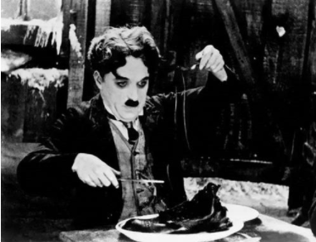
请按下暂停键；思考一下。
With all the porridge eaten up, he boiled his shoe, picked out the shoe lace, cut off the leather bottom and chewed it like a pancake.
A. His story was picked out as the best by the judges.
B. I picked out Valerie's voice from among the general conversation.
C. I could just pick out some letters carved into the stone.
D. I bet you can pick him out of a crowd of people.
choose\select
recognize\spot\make out

Slide 15
Compare and explore
请按下暂停键；思考一下。
With all the porridge eaten up, he boiled his shoe, picked out the shoe lace, cut off the leather bottom and chewed it like a pancake.
A. One of his fingers was cut off in the accident.
B. The US has threatened to cut off economic and military aid.
C. In winter, the town is often cut off by snow.
separate
stop the supply of

Slide 16
请按下暂停键；思考一下。
pick out; cut off
The talented little boy is good at ___________ a particular voice from a noisy background.
We forgot to pay the bill. As a result, our electricity _____________.
As usual, the director ___________ some entertaining scenes to make sure the amusing effect of the film.
Due to the severe cancer, part of his lung had to ___________.
picking out
was cut off
picked out
be cut off

Slide 17
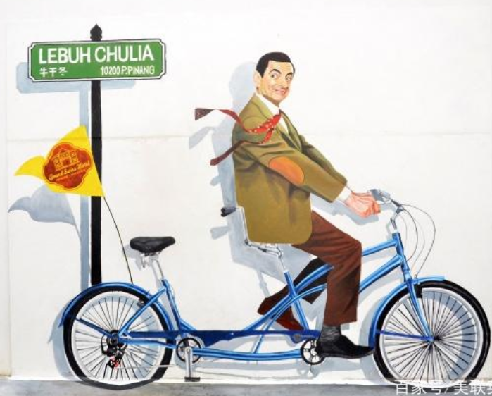
Language in use
请按下暂停键；思考一下。
star in and direct; entertaining; reaction; be content with; pick out; cut off; up to now; badly off; convince; overcome; slide; whisper
在童年时期，憨豆先生就梦想着主演并导演一些喜剧。然而他们没有搞笑的外貌并且口吃（suffer from stutter）。他甚至可以听到人们低声谈论他。即便如此，他克服了自己的尴尬并且没有让别人的品头论足（judgements）切断了他实现梦想的道路。在牛津大学（Oxford University）学习时，他因滑稽的表演被一名导演选中。在20世纪90年代，贫困潦倒并总是发现自己处于诸如切断手指等尴尬境地的憨豆先生在娱乐圈广受欢迎。至今为止，他从没有失败过说服观众自己相信非凡的表演才华，并且一直对自己坚持梦想的决定感到很满意。

Slide 18
Language in use
star in and direct; entertaining; reaction; be content with; pick out; cut off; up to now; badly off; convince; overcome; slide; whisper
In his childhood, Mr. Bean dreamed of starring in and directing some comedies. However, he didn’t have an entertaining appearance and suffered from stutter. He could even hear people talking about him in a whisper. Even so, he overcame his embarrassment and did not let others’ judgements cut off his way to realize his dream. When he was studying at Oxford University, he was picked out by a director because of his entertaining performance. In the 1990s, Mr. Bean who was badly off and always found himself under embarrassing situations such cutting off his finger became a sudden hit in the entertainment industry. Up to now, he has never failed to convince the audience of his extraordinary talent in acting and he has been content with his decision to stick to his dream.

Slide 19
badly off （只做表语不做定语）
贫困的,拮据的,不幸的(poor)
—(反义词) be well off富有
content
adj.满足的,满意的
be content/pleased/satisfied with
overcome
v. 克服 (overcame; overcome)
~difficulty/embarrassment/fear/sorrow 克服恐惧/困难/悲恸/尴尬
come over 克服
up to now 直到现在
现在完成时态标志词
whisper v. n.
低声地,耳语; （风）飒飒作响
私下里说,暗中传播;
in whispers/in a whisper(低声地).
convincing adj. 令人信服的;
convinced adj.被说服的
convince vt.使某人相信/信服;说服
~ sb. of sth./that+句子/to do sth.
pick out
①挑选出;
②认出;
(=recognize\spot\make out)
cut off
①切断
②中断 (水、电、食物等资源供给)
Sum up
star
①n.明星a football/pop/rock star
②v. (pt. p.p. starred) 主演 star in…
direct
v.导演,指导;
n. director 导演
adj.直接的
n. direction 方向
entertain
vt.逗…乐,使…有兴趣; 招待, 款待;
adj. entertaining 有趣的,娱乐的
n.entertainment 娱乐;招待,款待
react
vi.作出反应,回应;起作用 （to）
n. reaction 反应 （to）

Slide 20
Homework
Make up a story with the expressions we reviewed today.

Slide 22
谢谢您的观看
北京市朝阳区教育研究中心 制作

